Slide 1
Generating Images with Diffusion Model from Scratch using MNIST
Leveraging the MNIST Dataset
Name: Akshit Hasmukh Kumar Jain
NUID: 002876444

Slide 2
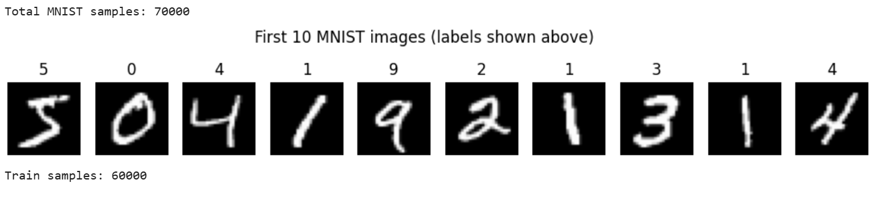
Dataset: MNIST
Consists of 70,000 grayscale images of handwritten digits (0–9)
Image size: 28x28 pixels
60,000 training samples and 10,000 test samples
Normalized to [-1, 1] for stable training
Used for both unconditional and class-conditional generation

Slide 3
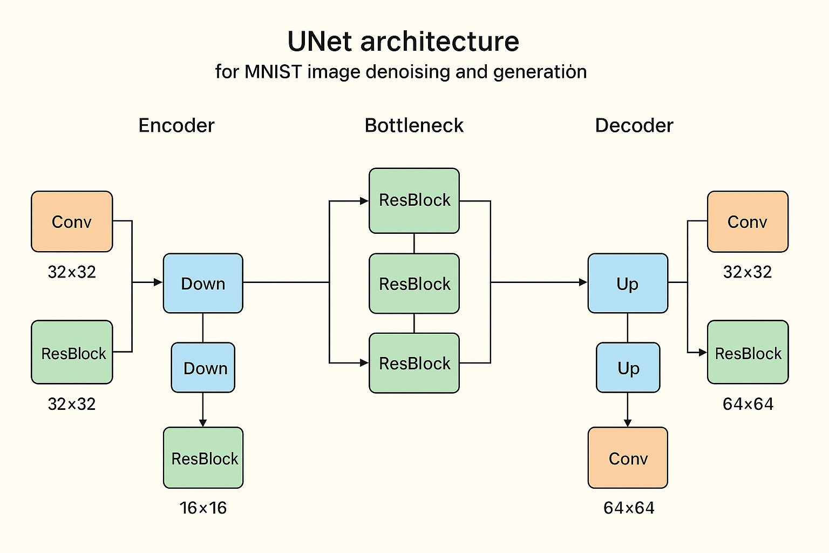
U-Net Architecture
Encoder–Bottleneck–Decoder structure
Residual blocks with GroupNorm and SiLU activation
Downsampling via strided convolutions, upsampling via nearest-neighbor + conv
Skip connections between encoder and decoder to preserve details
Conditioned on timestep embeddings and optional digit class embeddings

Slide 4
Diffusion Scheduler
Implements forward process (adding noise) and parameters for reverse denoising
Linear beta schedule from β_start=1e-4 to β_end=0.02
Stores α_t, ᾱ_t (cumulative product), and related constants
q_sample(x₀, t): Adds noise to original image x₀ at timestep t
Posterior variance used for reverse step sampling

Slide 5
Sampling Methods
DDPM Sampler: Iterative denoising from Gaussian noise → image
DDIM Sampler: Deterministic variant for faster generation
Both support class-conditional generation by specifying digit label
Reverse process runs from T timesteps down to 0
Generates realistic MNIST digits from pure noise

Slide 6
Training Info
Trained for 25 epochs on MNIST dataset
Generated digits match conditioning labels accurately
DDIM produces similar quality in fewer steps
Noise-to-image transformation visualized successfully
Supports both unconditional and digit-specific generation

Slide 7
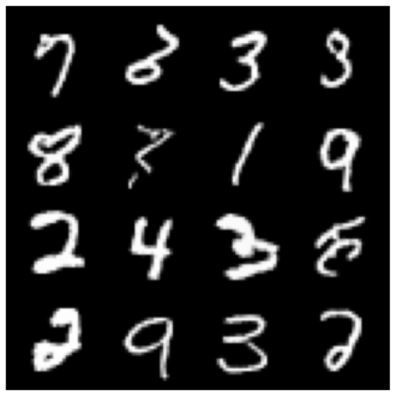
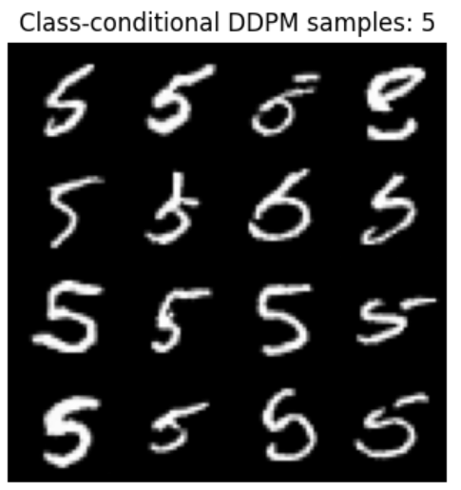
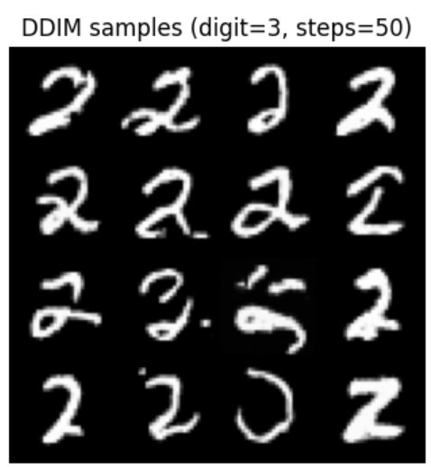
Image Generation Results

Slide 8
Conclusion & Key Takeaways
We successfully implemented a diffusion model from scratch, training it on the MNIST dataset to generate realistic handwritten digits.
By combining a U-Net architecture with a custom DDPM scheduler and both DDPM and DDIM samplers, we achieved high-quality digit generation with support for class-conditional outputs.
This approach demonstrates how diffusion models can be adapted to simple datasets, providing a solid foundation for scaling to more complex image generation tasks.

Slide 9
Thank you

