Slide 1
Class X Holiday home work Group-7, Computer Science.

Slide 2
Index
Abstract
Introduction
New Green ICT Concept
• Eco ICT For Inducing Behavioral Change
Conclusion

Slide 3
Abstract
The worldwide growth in the use of Information and Communications Technology ICT products has had both positive and negative effects. Electronics enable us to make information exchange quicker and easier; reduce our need to physically move people, products, information, and allow us to cut traffic, but increase pollution and increase the negative ecological impact. Recently, an argumentative issue refers indirectly to the benefit of ICT to go green and decrease the negative ecological impact. In the near future, ICT will also play a critical role in supporting the necessary paradigm shifts within the green sector towards more sustainable generation.

Slide 4

Introduction
Green computing and communication, refers to environmentally sustainable computing or IT. It is “the study and practice of designing, manufacturing, using, and disposing of computers, servers, and associated subsystems – such as monitors, printers, storage devices, and networking and communications systems – efficiently and effectively with minimal or no impact on Built environment. Green IT also strives to achieve economic viability and improved system performance and use, while abiding by our social and ethical responsibilities in buildings. Thus, green IT includes the dimensions of environmental sustainability, the economics of energy efficiency, and the total cost of ownership, which includes the cost of disposal and recycling within usable built environment. It is the study and practice of using computing resources efficiently in buildings to reduce the cost and environmental effects.

Slide 5
With increasing recognition that man-made greenhouse gas emissions are a major contributing factor to global warming, enterprises, governments, and society at large now have an important new agenda: tackling environmental issues and adopting environmentally sound practices. Greening our IT products, applications, services, and practices in buildings are both economic and environmental imperative, as well as our social responsibility. Therefore, a growing number of IT vendors and users are moving towards green IT and thereby assisting in building a green society and economy.
The goals of green computing are, among others:
1. Reducing the use of hazardous materials,
2. Maximizing energy efficiency during the product's lifetime, and
3. Promoting recyclability or biodegradability of defunct products and factory waste.

Slide 6

New green ict concept
Green ICT is drawing a lot of attention and it originates from its source “Green Computing”. However, “Green Computing” in the earlier stage was based on the idea that ICT is deeply related to high energy consumption as well as production of harmful materials and non-recyclable waste that do not decompose, and aimed at production of energy efficient, eco-friendly and recyclable ICT goods. Meanwhile, as environmental problems aggravate recently, ICT is being expanded beyond the mere production of eco-friendly products, to becoming actively applied in dealing with environmental problems. Green ICT is also concerned now with developing and applying production processes or sharing in them with adequate attention being given to the environmental impacts.

Slide 7
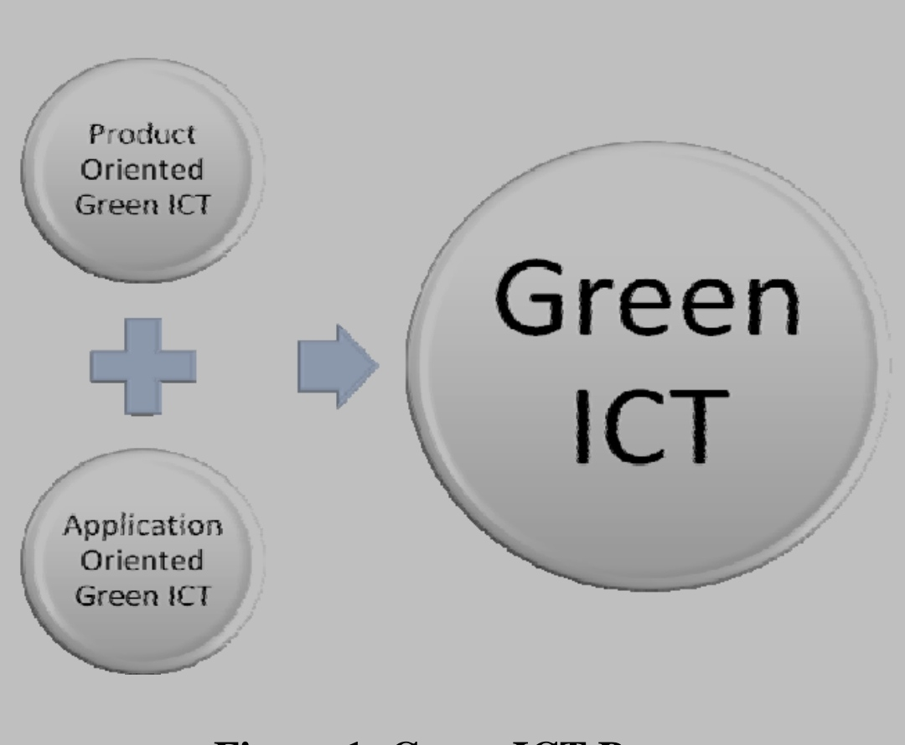
Green ICT can be divided to mainly two orientations of attention, namely Product Orient Green ICT (i.e. hardware, materials, etc.) and Application Oriented Green ICT (i.e. Software automation, workflows, integrated systems, etc.). As the earlier stage of Green Computing, the Product Oriented Green ICT was the main objective of the Green Computing and there was no attention directed to the Application Oriented Green ICT. Recently, the Application Oriented Green ICT is new concept raising and converging with the Product Oriented Green ICT for complete Green ICT.

Slide 8
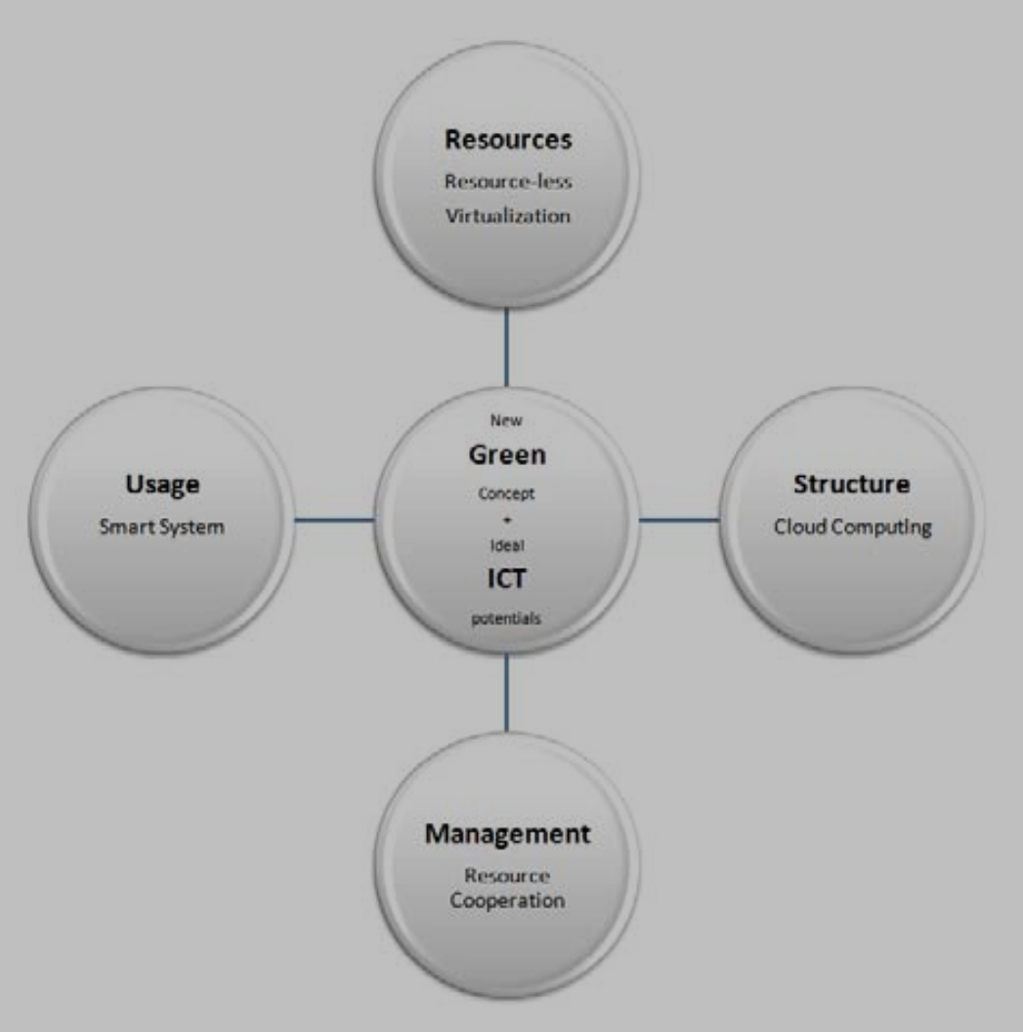
Eco ICT For Inducing Behavioral Change
Application Oriented ICT can play an important rolehere because it can assist individuals and enterprises in making more informed decisions and reward socially desirable behavior in daily life. There are many situations in which users – despite their general intention to protect the environment – do not take even the simplest measures to reduce their impact. The Application Oriented ICT would support improvement in the previous four areas and would support the upgrading from their present situation to the new required behavior.

Slide 9
Application Oriented ICT and Resources
Application Oriented ICT and Structure
The Application Oriented ICT or ICT automation enables the end users to reduce the resources by full automation. Even, the argument of the needed resources for ICT automation will replace the traditional resources leading to increasing the resources is false argument, because the ICT raises the virtualization concept to reduce its resources.
Even with the full automation using ICT and with the aid of Application Oriented ICT, the benefits of many systems can be enjoyed by the sharing resources and reducing impact on environment. The Application Oriented ICT introduced dominating cloud computing to centralize the resources and its usage.

Slide 10
Application Oriented ICT and Management
Application Oriented ICT and Usage
Many of ICT automation systems provide well resources cooperation on the domains that are applied. ControllApplication Oriented ICT and Managementing process would emerge and occur as a default result of the automation. Moreover, the Application Oriented ICT enables more cooperation and interaction among the resources andconsequently more influential impact on the environment.
Application Oriented ICT, after imposing the smart systems, would result in the emergence of a new generation of the Smart ICT. Those smart Application Oriented ICT systems dramatically affected the usage of the environment resources and turn them to more smart usage.

Slide 11

CONCLUSION
While Application Oriented ICT and green model will, with no doubt, be essential for achieving savings, the adoption of these systems and user behavior in general will have a major influence on the demand for greening. Application Oriented ICT and its automation can play an important role here because it can assist in making more informed decisions and reward desirable behavior in greening. According to the arguments presented here, the ICT can be executed to reach greening or going green. But clearly, if we are to achieve an optimized solution based on sustainable green;“Green ICT” still need further refinement and application work to enable sizable gain of all anticipated benefits of the Application Oriented ICT concept.

