Slide 1
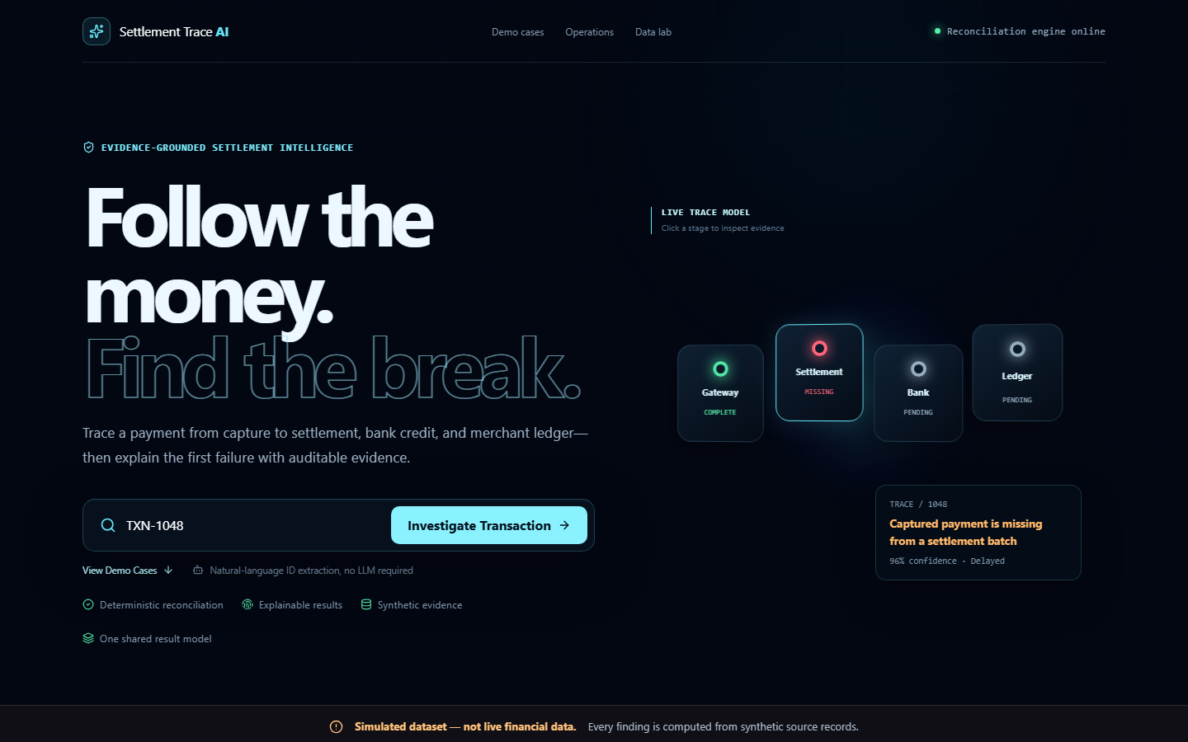
Settlement
Trace AI
Evidence-based answers for settlement failures
Trace a payment across the gateway, settlement batch, bank record and merchant ledger.
SIMULATED DATA ONLY
Origin Hackathon / Product Demo
Notes:
Opening: merchant support teams need a fast, defensible answer to a simple question: where did the money stop? All records in this demonstration are synthetic.

Slide 2
The settlement investigation problem
02
A captured payment can pass through four systems before a merchant sees it.
Support teams compare timestamps, amounts, references and statuses across disconnected records. Missing or conflicting evidence turns a routine ticket into a manual audit.
Gateway
Settlement
Bank
Ledger
Payment captured
Batch and processing
Credit and UTR
Merchant posting
The operational question
Where is the first broken link, and what evidence proves it?
Notes:
The investigation spans four record systems. The application follows the same sequence and identifies the first stage that is missing, delayed, failed or inconsistent.

Slide 3
Deterministic reconciliation
03
The engine produces the same answer from the same records. It does not ask a language model to invent transaction facts.
01
Extract the ID
Normalize a TXN reference from any question
TXN-1048
96% confidence
02
Join evidence
Captured payment is missing
from a settlement batch
Match gateway, settlement, bank and ledger records
03
Test consistency
Compare status, amount, UTR, timing and duplicate records
First break
Next action
Locate the break
Settlement
Escalate to settlement operations
04
Return the earliest confirmed failure or missing stage
05
Explain the action
Calculate confidence, SLA impact and next support step
Notes:
Example TXN-1048: the gateway captured the payment, but no matching settlement exists after the expected cutoff. The engine returns a delayed status at the settlement stage with 96 percent confidence.

Slide 4
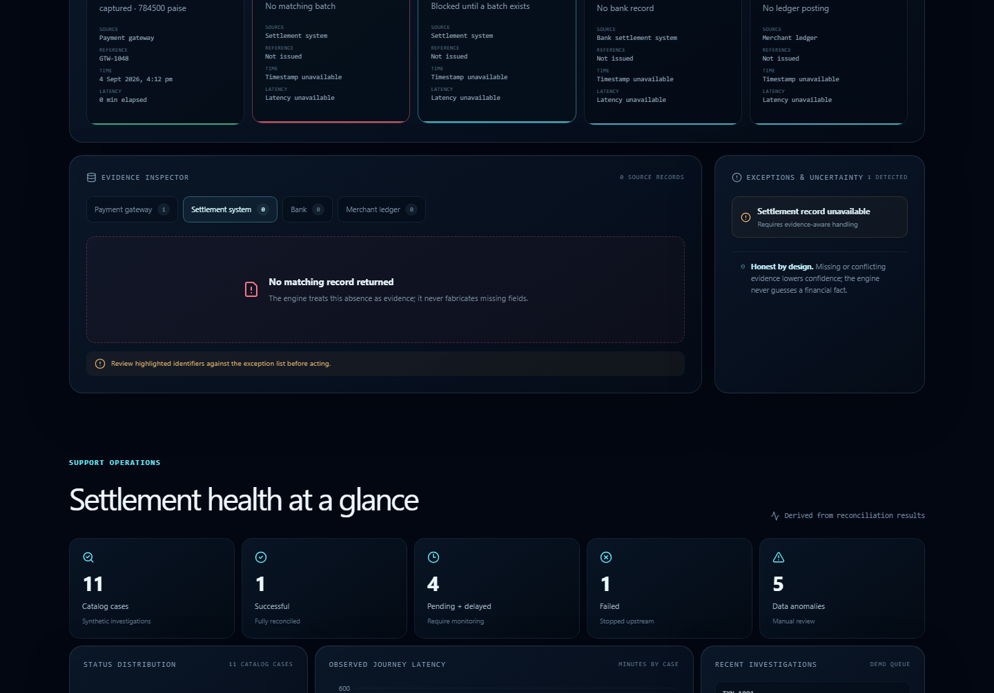
Investigation workspace
04
One result model powers every view
3D trace
Completed, pending and broken stages share the engine result
Five-event timeline
Every timestamp and latency comes from source records
Evidence inspector
Missing and conflicting fields stay visible
Uncertainty handling
Low confidence triggers an explicit exception
Investigation report
Print or download the structured result
Notes:
Walk through the current transaction, the timeline and the evidence tabs. Clicking a 3D stage opens the same underlying evidence. The product keeps missing data visible and supports a downloadable structured report.

Slide 5
Scenario coverage and release quality
05
Eleven synthetic cases cover clean settlement, delays, failures, mismatches and incomplete evidence.
15
tests passed
TypeScript
No type errors
Production build
Cloudflare-compatible release validated
All records and amounts are simulated.
Notes:
Chart values are derived from the eleven bundled demo cases: one successful, two pending, two delayed, one failed, three mismatches and two uncertain. The release passed 15 unit tests, TypeScript checking, linting and the production build.

Slide 6
Judge demo in 90 seconds
06
00:00
Healthy reference
Open TXN-1001 and show the complete four-stage path
00:20
First broken link
Ask why TXN-1048 is pending and show the missing settlement plus SLA
00:50
Honest uncertainty
Open TXN-1097 and show the bank-versus-ledger conflict
01:10
Operational scale
Finish on the Operations view and download the report
Live demo
Evidence shows where the payment stopped and what support should do next.
settlement-trace-ai.nikhilgurnani0524.chatgpt.site
Notes:
Close on the product's core value: a support agent can locate the settlement break, explain it from auditable evidence and avoid false certainty when records conflict.

