Slide 1
Leave Management System
System Design Presentation
Angular | ASP.NET Core | SQL Server
Prepared by: Akshit Arora

Slide 2
Project Overview
Web-based Leave Management System
Automates leave application and approval
Enterprise-ready and secure

Slide 3
Technology Stack
Frontend: Angular
Backend: ASP.NET Core Web API
Database: Microsoft SQL Server
Security: JWT Authentication

Slide 4
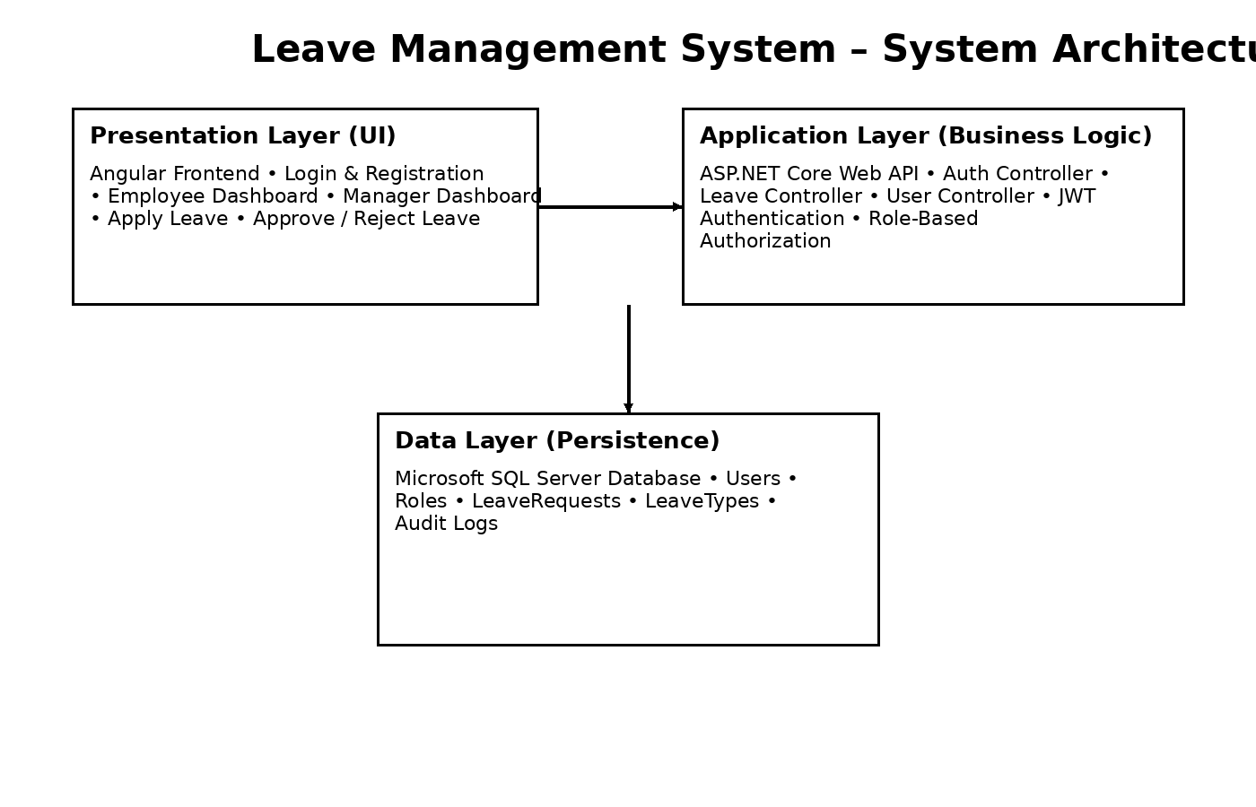
System Architecture

Slide 5
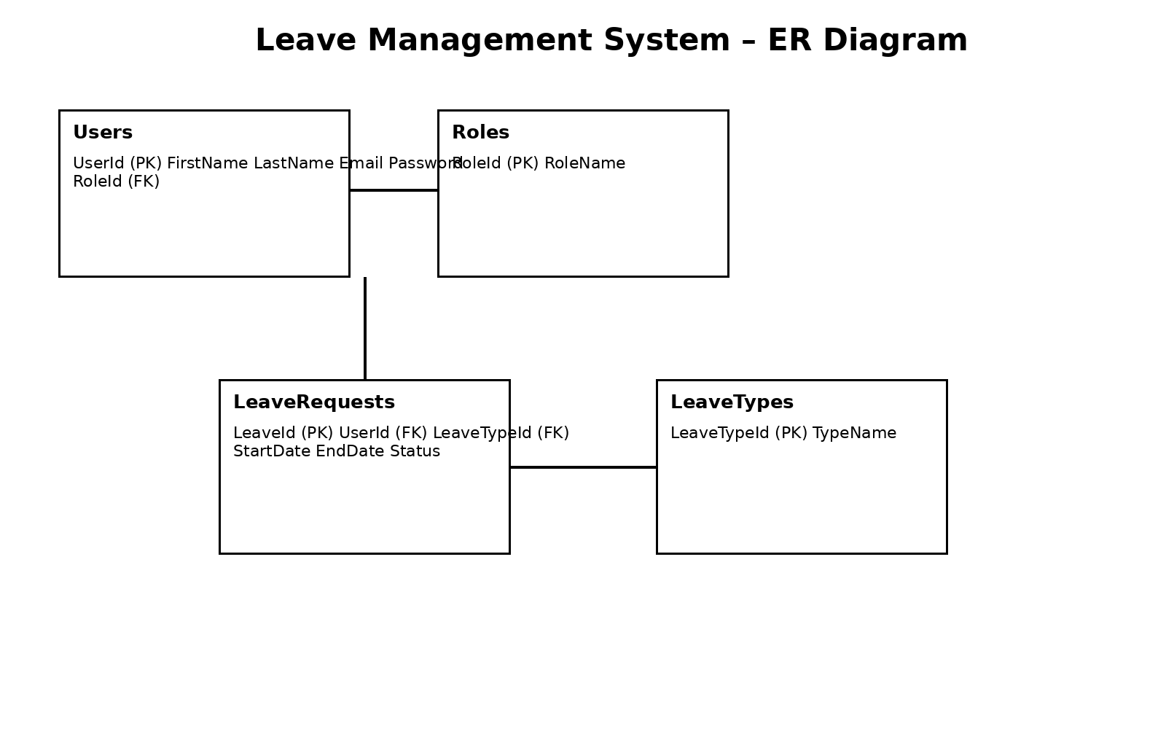
ER Diagram

Slide 6
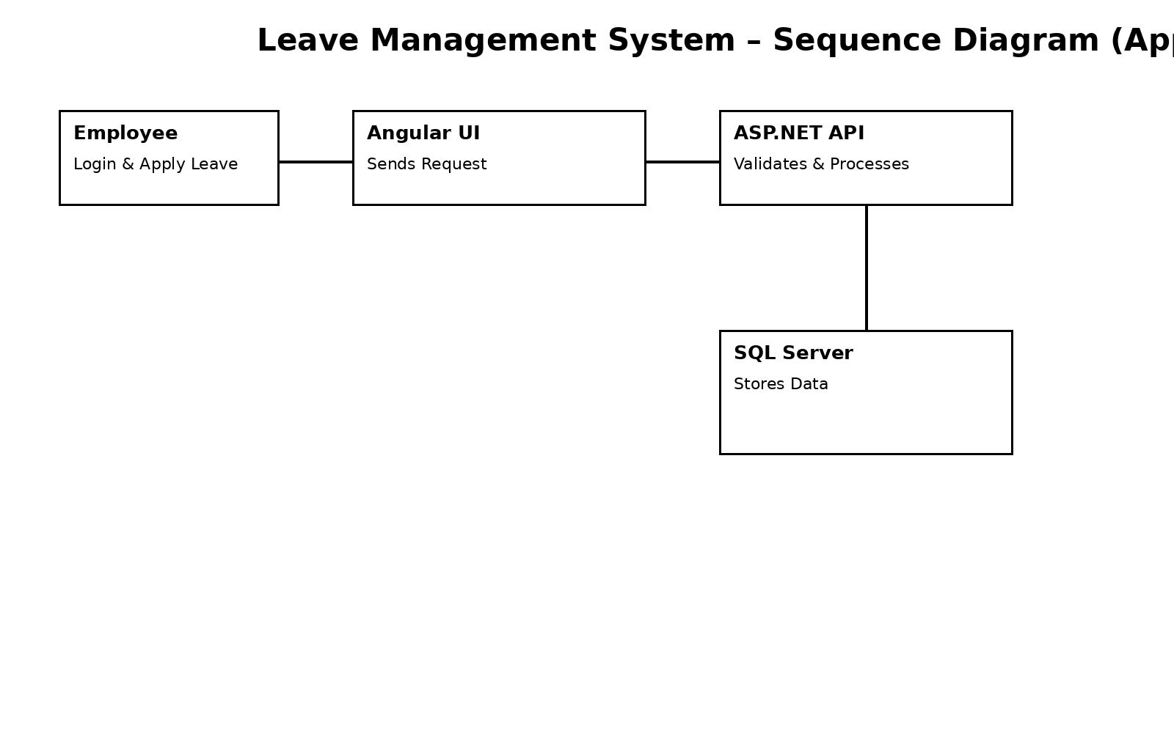
Sequence Diagram – Apply Leave

Slide 7
Functional Modules
Employee Module – Apply & Track Leave
Manager Module – Approve / Reject Leave
Authentication & Authorization

Slide 8
API Design
/api/auth/login
/api/auth/register
/api/leave/apply
/api/leave/approve

Slide 9
Security & Non-Functional Requirements
JWT-based Authentication
Role-based Access Control
Scalable & Reliable Architecture

Slide 10
Conclusion
Enterprise-grade system design
Scalable, secure, and maintainable
Suitable for real-world deployment

