Slide 1
Command line editors
working with text files in the terminal

Slide 2
ed
Line Editors
ex
pico
nano
Terminal Editors
vi
emacs
KDE
kate
Editors
GUI Editors
kwrite
Gnome
sublime
gedit
eclipse
atom
IDE
Bluefish
brackets
NetBeans

Slide 3
Features
Scrolling, view modes, current position in file
Navigation (char, word, line, pattern)
Insert, Replace, Delete
Cut-Copy-Paste
Search-Replace
Language-aware syntax highlighting
Key-maps, init scripts, macros
Plugins

Slide 4
ed
Show the Prompt | P
Command Format | [addr[,addr]]cmd[params]
commands for location | 2 . $ % + - , ; /RE/
commands for editing | f p a c d i j s m u
execute a shell command | !command
edit a file | e filename
read file contents into buffer | r filename
read command output into buffer | r !command
write buffer to filename | w filename
quit | q

Slide 5
ed / ex commands
f | show name of file being edited
p | print the current line
a | append at the current line
c | change the line
d | delete the current line
i | insert line at the current position
j | join lines
s | search for regex pattern
m | move current line to position
u | undo latest change

Slide 6
nano
Search and replace
Ctrl+Q Start backward search
Ctrl+W Start forward search
Alt+Q Find next occurrence backward
Alt+W Find next occurrence forward
Alt+R Start a replacing session
File handling
Ctrl+S Save current file
Ctrl+O Offer to write file ("Save as")
Ctrl+R Insert a file into current one
Ctrl+X Close buffer, exit from nano
Deletion
Ctrl+H Delete character before cursor
Ctrl+D Delete character under cursor
Alt+Bsp Delete word to the left
Ctrl+Del Delete word to the right
Alt+Del Delete current line
Editing
Ctrl+K Cut current line into cutbuffer
Alt+6 Copy current line into cutbuffer
Ctrl+U Paste contents of cutbuffer
Alt+T Cut until end of buffer
Ctrl+] Complete current word
Alt+3 Comment/uncomment line/region
Alt+U Undo last action
Alt+E Redo last undone action
Information
Ctrl+C Report cursor position
Alt+D Report line/word/character count
Ctrl+G Display help text
https://www.nano-editor.org/dist/latest/cheatsheet.html

Slide 7
nano
Moving around
Ctrl+B One character backward
Ctrl+F One character forward
Ctrl+← One word backward
Ctrl+→ One word forward
Ctrl+A To start of line
Ctrl+E To end of line
Ctrl+P One line up
Ctrl+N One line down
Ctrl+↑ To previous block
Ctrl+↓ To next block
Ctrl+Y One page up
Ctrl+V One page down
Alt+\ To top of buffer
Alt+/ To end of buffer
Special movement
Alt+G Go to specified line
Alt+] Go to complementary bracket
Alt+↑ Scroll viewport up
Alt+↓ Scroll viewport down
Alt+< Switch to preceding buffer
Alt+> Switch to succeeding buffer
Various
Alt+A Turn the mark on/off
Tab Indent marked region
Shift+Tab Unindent marked region
Alt+V Enter next keystroke verbatim
Alt+N Turn line numbers on/off
Alt+P Turn visible whitespace on/off
Alt+X Hide or unhide the help lines
Ctrl+L Refresh the screen
https://www.nano-editor.org/dist/latest/cheatsheet.html

Slide 8
Modes in vi
command mode
Esc
vi
i
o
a
insert mode
I
O
A
ex mode
:

Slide 9
vi help
command mode
(press Esc to enter it)
k
up-arrow
Exiting vi
:w write out
:x write out and quit
:wq write out and quit
:q quit (if write out is over)
:q! ignore changes and quit
h backspace
left-arrow
l space
right-arrow
Moving around in vi
j return
down-arrow
https://vimhelp.org/

Slide 10
vi command mode
Screen manipulation
Moving around
cntrl+f | Scroll forward one screen
cntrl+b | Scroll backward one screen
cntrl+d | Scroll down half screen
cntrl+u | Scroll up half screen
cntrl+l | Redraw screen
cntrl+r | Redraw screen removing deleted stuff
0 | start of the current line
$ | end of the current line
w | beginning of next word
b | beginning of preceding word
:0 | first line in the file
1G | first line in the file
:n | nth line in the file
nG | nth line in the file
:$ | last line in the file
G | last line in the file

Slide 11
vi command mode
changing text
deleting text
r | replace single char under cursor
R | replace chars from cursor till Esc
cw | change word under cursor, from current char till Esc
cNw | change N words, from current char till Esc
C | change chars in current line till Esc
cc | change current line till Esc
Ncc | change next N lines, starting from current, till Esc
x | delete single char under cursor
Nx | delete N chars from cursor
dw | delete one word, from the char under cursor
dNw | delete N words, from the char under cursor
D | Delete rest of the line, from the char under cursor
dd | delete current line
Ndd | delete next N lines, starting from current

Slide 12
vi command mode
copy-paste text
yy | copy current line to buffer
Nyy | copy next N lines, including current, into buffer
p | Paste buffer into text after current line
u | undo previous action
searching text
/string | search forward for string
?string | Search backward for string
n | move cursor to next occurance of string
N | move to previous occurance of string
:se nu set line numbers
:se nonu unset line numbers

Slide 13
emacs
C-x means contrl+x
M-x means alt+x
Moving around
C-p | Move up one line
C-b | Move left one char
C-f | Move right one char
C-n | Move down one line
C-a | Goto beginning of current line
C-e | Goto end of current line
C-v | Move forward one screen
M-< | Move to first line of the file
M-b | Move left to previous word
M-f | Move right to next word
M-> | Move to last line of the file
M-a | Move to beginning of current sentence
M-e | Move to end of current sentence
M-v | Move back one screen
https://www.gnu.org/software/emacs/refcards/pdf/refcard.pdf

Slide 14
emacs commands
Exiting emacs
C-x C-s | Save buffer to file
C-z | Exit emacs but keep it running
C-x C-c | Exit emacs and stop it
copy-paste
M-backspace | Cut the word before cursor
M-d | Cut the word after cursor
C-k | Cut from cursor to end of line
M-k | Cut from cursor to end of the sentence
C-y | Paste the content at the cursor
searching text
C-s | Search forward
C-r | Search backward
M-x | Replace string

Slide 15

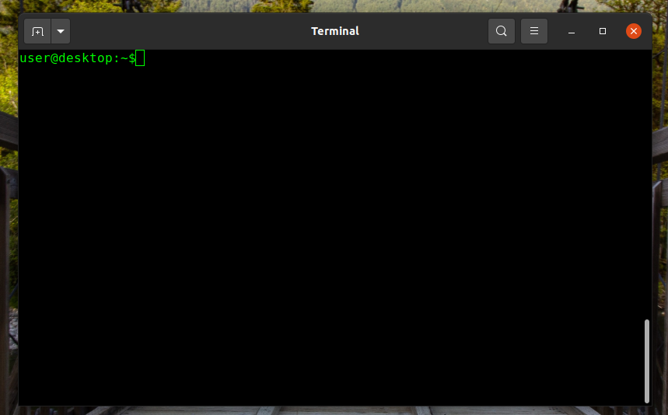
Life has started ...
Ref: wikipedia, may be copyrighted

