Slide 1
Network & ssh
Accessing remote machines on command line

Slide 2
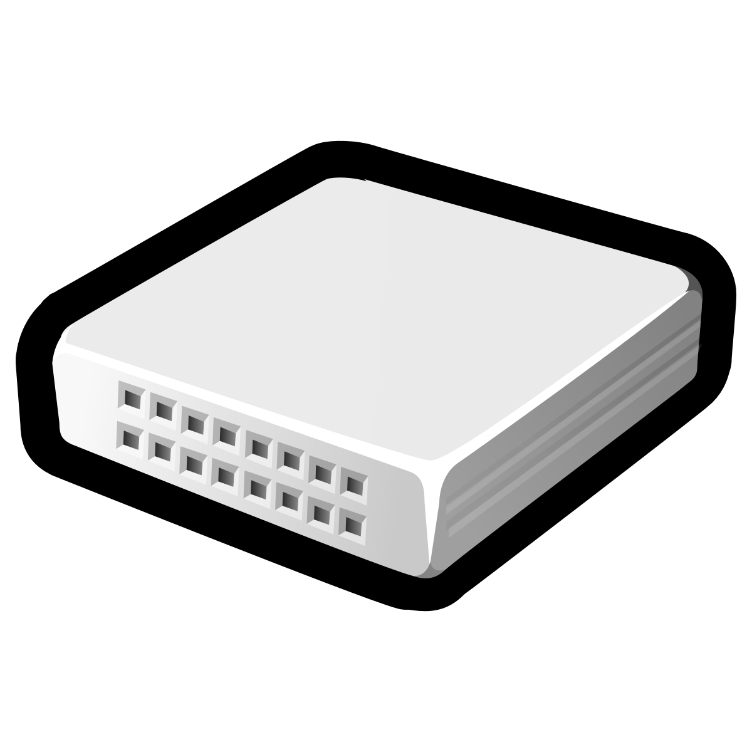

gateway
gateway
Public Network
Private Network
Private Network

Slide 3

127.0.0.0/8
Localhost
Class A: 10.0.0.0/8
16,777,216
IPv4
address range
Class B: 172.16.0.0/12
Private network
1,048,576
Class C: 192.168.0.0/16
65,536
Public network

Slide 4
Gateway 1-2
Private Network#3
Gateway 2-3
Private Network#1
Private Network#2

Slide 5
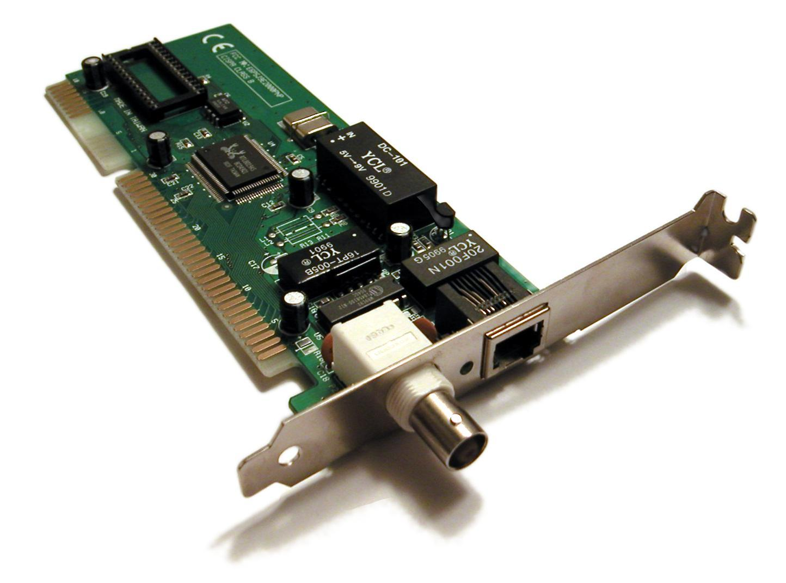

Ports
IP address
tcp port 22
tcp port 25
tcp port 80
connection
tcp port 443
routing

Slide 6
Ways to gain remote access
VPN access
ssh tunneling
Remote desktop : x2go, rdp, pcoip,
Desktop over browser: Apache Guacomole
Commercial, over internet : Teamviewer, AnyDesk, Zoho assist, ...

Slide 7
Some important ports
21 | ftp | File transfer
22 | ssh | Secure Shell
25 | smtp | Simple Mail Transfer Protocol
80 | http | Hypertext Tranfer Protocol
443 | https | Secure Hypertext Tranfer Protocol
631 | cups | Common Unix Printing System
3306 | mysql | MySQL database

Slide 8
Firewall
Ports open on my machine
Ports needed to be accessed on remote machine
Network routing over the port
Firewall controls at each hop

Slide 9
Protecting a server
Web Application Filter
Network
Firewall
Anonymous Users
Server with a public service

Slide 10
SELinux
Security Enhanced Linux mode available on Ubuntu too, apart from server grade flavors like CentOS, Fedora, RHEL, SuSE Linux etc.,
Additional layer of access control on files to services
Role Based Access Control
Process sandboxing, least privilege access for subjects
Check using ls -lZ and ps -eZ

Slide 11
SELinux
RBAC items: user (unconfined_u), role (object_r), type (user_home_t), level (s0)
Modes: disabled, enforcing, permissive
Tools: semanage, restorecon
SELinux is recommended for all publicly visible servers

Slide 12
Network tools
ping | To see if the remote machine is up
traceroute | Diagnostics the hop timings to the remote machine
nslookup | Ask for conversion of IP address to name
dig | DNS lookup utility
netstat | Print network connections
mxtoolbox.com | For help with accessibility from public network
whois lookup | Who owns which domain name
nmap | (careful !) Network port scanner
wireshark | (careful !) Network protocol analyzer

Slide 13
High Performance Computing
Look at www.top500.org for statistics
Accessing a remote HPC machine is usually over SSH
Long duration jobs are submitted to a job scheduler for execution
Raw data if large needs to be processed remotely before being transferred to your machine (network charges? bandwidth?)
Comfort with command line is a must

