Slide 1
Managing Storage
LVM & RAID

Slide 2
LVM
Logical Volume Management
Pooling multiple storage devices as a single logical volume
lvm2 tools : create and manage virtual block devices from physical devices

Slide 3
RAID
Redundant Arrays of Independent Disks
Distributing data over multiple discs for redundancy / speed / increased capacity
Raid Controller : software or hardware

Slide 4
RAID modes
Description
RAID Mode
Comments
Min Drives
RAID 0 | 2 | Striping | Speed up
RAID 1 | 2 | Mirroring | Read is n times faster, n-1 drive failures tolerated
RAID 5 | 3 | Block-level striping with distributed parity | 1 drive failure tolerated, Read is n times faster, write is n-1 times faster
RAID 6 | 4 | Block-level striping with dual distributed parity | 2 drive failures tolerated, read is n times faster, write is n-2 times faster
usable capacity < actual capacity

Slide 5
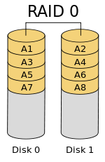
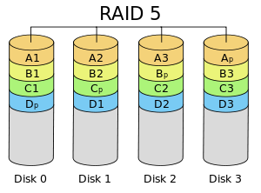

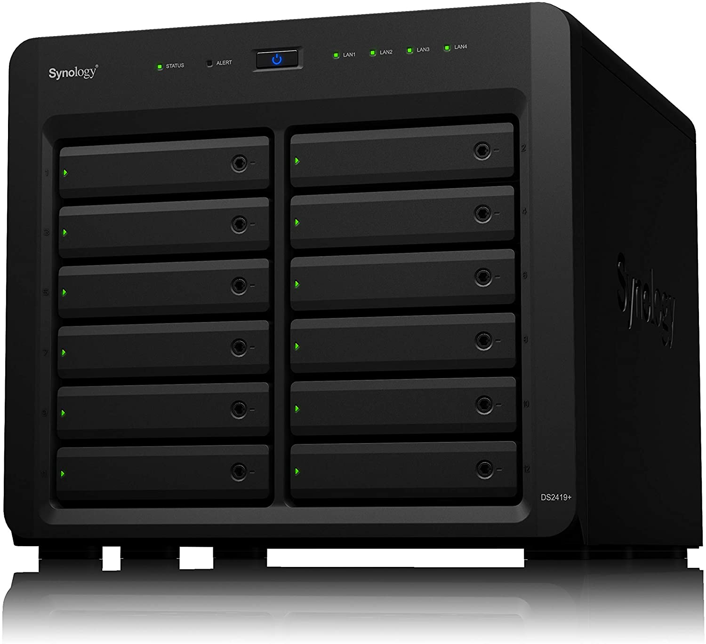
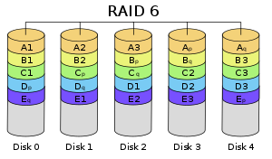
Ref: amazon.com
Images courtesy: Wikipedia

