Slide 1
TVS DocBuddy
Simplifying Documentation, One Document at a Time
TVS DocBuddy saves you from the hassle of:
Visiting offices to get forms
Filling the form manually every single time.
Then printing it and going to offices to submit them.
Now easily fill forms like Loan Agreement, Sanction Letter, Welcome Letter, and many more by just entering the required information once via a plethora of digital templates provide on the app.
TVS Docbuddy will itself generate the form in the required forma(pdf) which can directly be submitted.
Flutter
Firebase
Used for the front-end where the user will interact with the mobile app.
Used as a database at the backend which will store basic data like name, address, DOB, etc to autofill it in future. Thus, saving time.

Slide 2
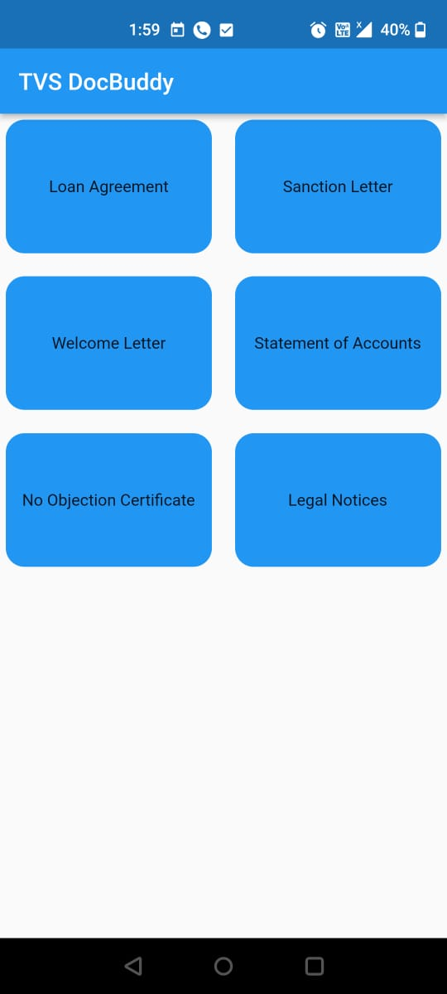
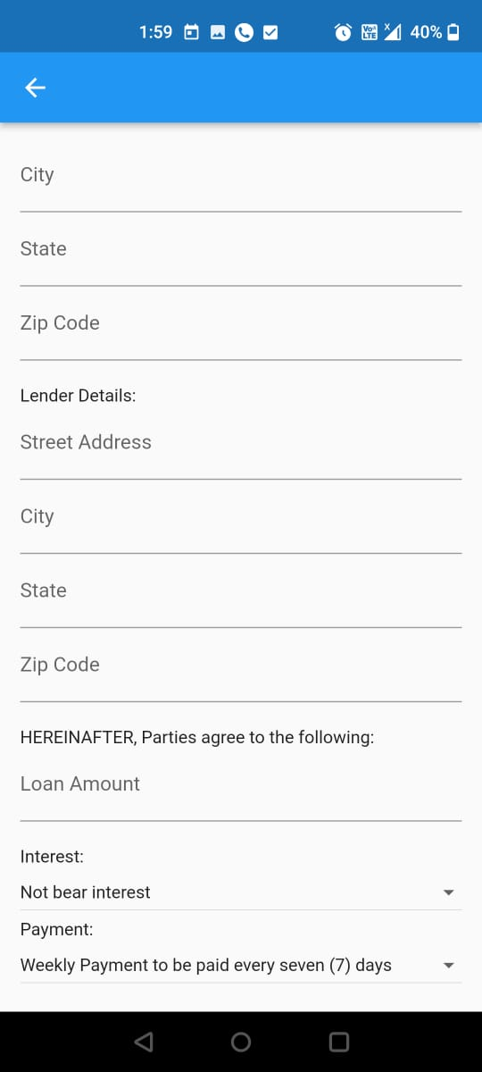
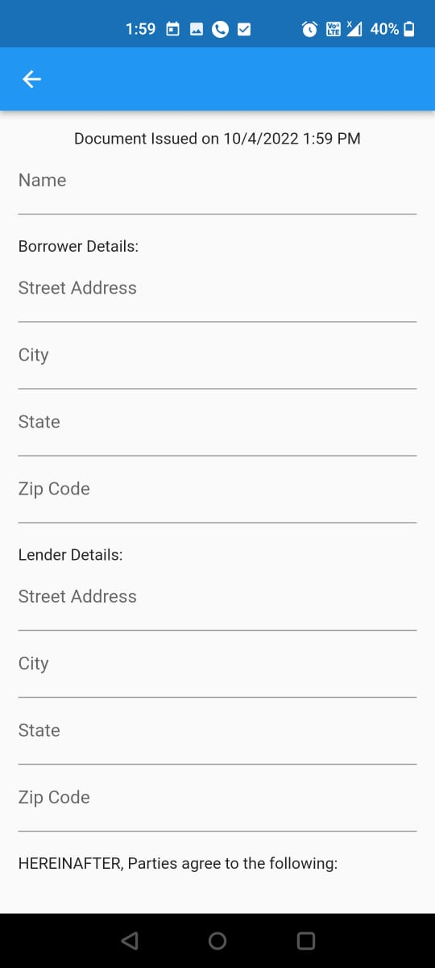
Screenshots from the working prototype
Select the form template
Fill in the required information.
Done!
Basic data can be stored to autofill in the future, saving a lot of time.
You can also convert the form into a pdf to print it, with the press of a button!

