Slide 1



ET WEALTH EXPO 2026 — DAY 2
Day 2 Social Media Coverage & Speaker Showcase Deck
Event Date: 31st October 2026 | Source: The Economic Times (@EconomicTimes) | Total Posts: 25 Highlights
Interactive Deck: All X, LinkedIn, and Instagram links are live and clickable.

Slide 2

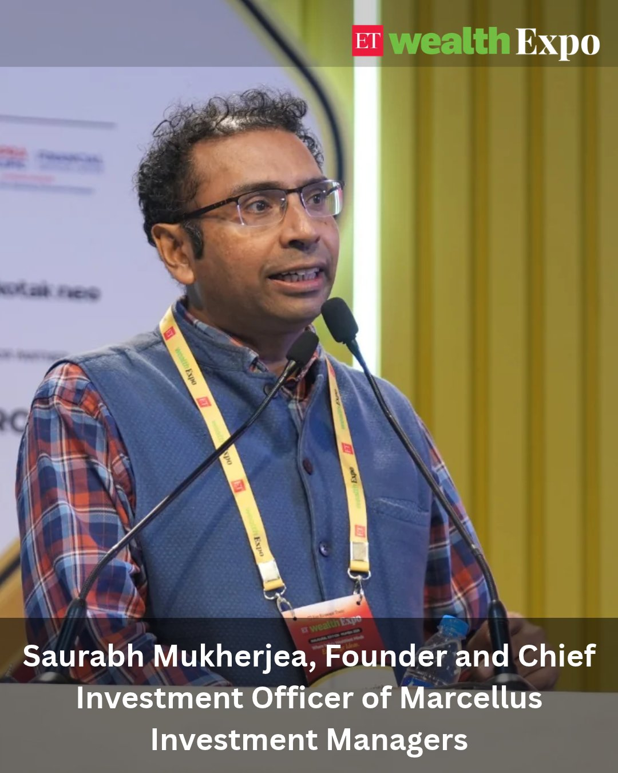
Posted on 31st October
Speaker / Session: Saurabh Mukherjea
The Economic Times ●
···
2d
Your expenses are global. Is your portfolio?
At #ETWealthExpo, Saurabh Mukherjea, Founder & Chief Investment Officer, @MarcellusInvest , makes a compelling case for global investing, highlighting why Indian investors need to look beyond domestic markets.
From overseas education and imported consumption to currency depreciation and global market opportunities, he explains why geographical diversification matters for long-term wealth creation.
Is your portfolio keeping pace with your global aspirations?
https://x.com/EconomicTimes/status/2116407465675993107?a=ZCsP96BcxiAXiSduMSc&s=20
https://www.linkedin.com/feed/update/urn:li:activity:7522173173631528960

Slide 3
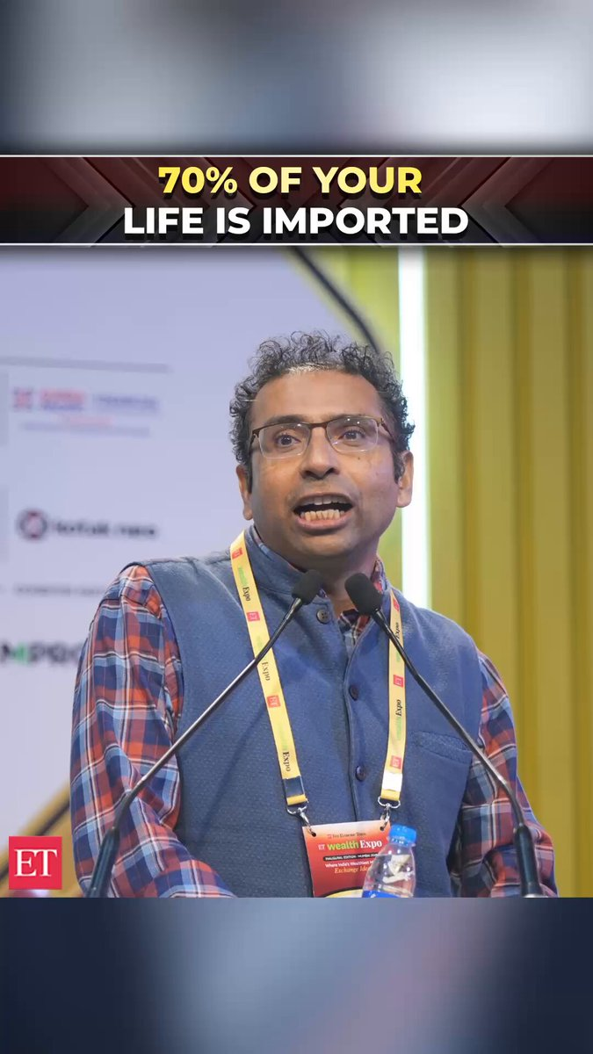
Posted on 31st October
The Economic Times ●
···
2d
From your phone to aviation fuel to the raw material in your medicines, about 70% of daily spending is effectively in dollars, says Saurabh Mukherjea, Founder & CIO, @MarcellusInvest , at the ET Wealth Expo in Mumbai. Yet few Indians hold much of their portfolio in dollars. When the rupee falls, that gap costs you.
#saurabhmukherjea #marcellus #globalinvesting #rupee #dollar #imports #portfoliodiversification #investing #etwealthexpo #shorts
https://x.com/EconomicTimes/status/2116457608152584305?s=20
https://www.linkedin.com/feed/update/urn:li:activity:7522222744445386752
https://www.instagram.com/reel/DfJzWRuSFOP/?utm_source=ig_web_copy_link&psln=MzRlODBiNWFlZA==&srtk=MzRlODBiNWFlZA==

Slide 4
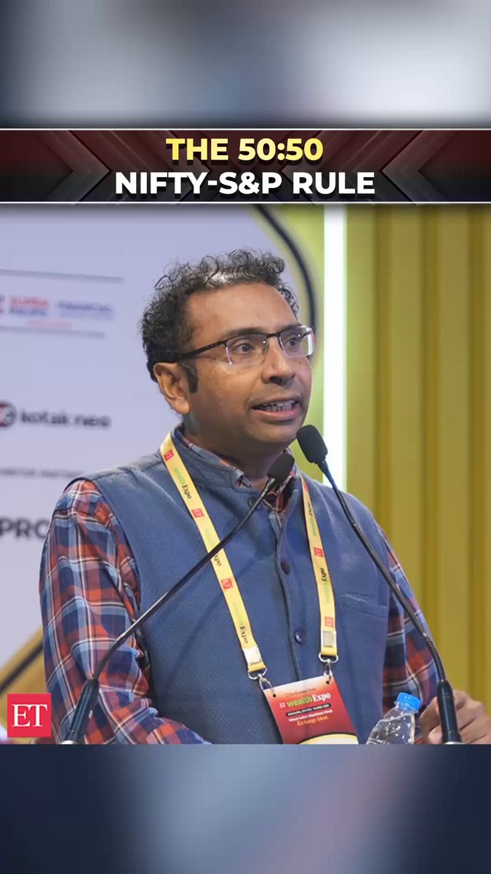
Posted on 31st October
The Economic Times ●
···
2d
The simplest low-cost diversified portfolio is 50% in the Nifty and 50% in the S&P 500, says Saurabh Mukherjea, Founder & CIO,@MarcellusInvest , at the ET Wealth Expo in Mumbai. Pick a date, such as your birthday or Budget Day, and rebalance back to 50:50 every year. Over time, returns tend to favour the better-performing market while volatility falls.
#saurabhmukherjea #nifty #sp500 #assetallocation #rebalancing #markowitz #indexfunds #investing #etwealthexpo #shorts
https://x.com/EconomicTimes/status/2116542702678585469?a=A7oX-N587NSjwohFDNM&s=20
https://www.linkedin.com/feed/update/urn:li:activity:7522307851889901568
https://www.instagram.com/reel/DfKaC68SBGs/?utm_source=ig_web_copy_link&dlrf=MzRlODBiNWFlZA==&srtk=MzRlODBiNWFlZA==

Slide 5
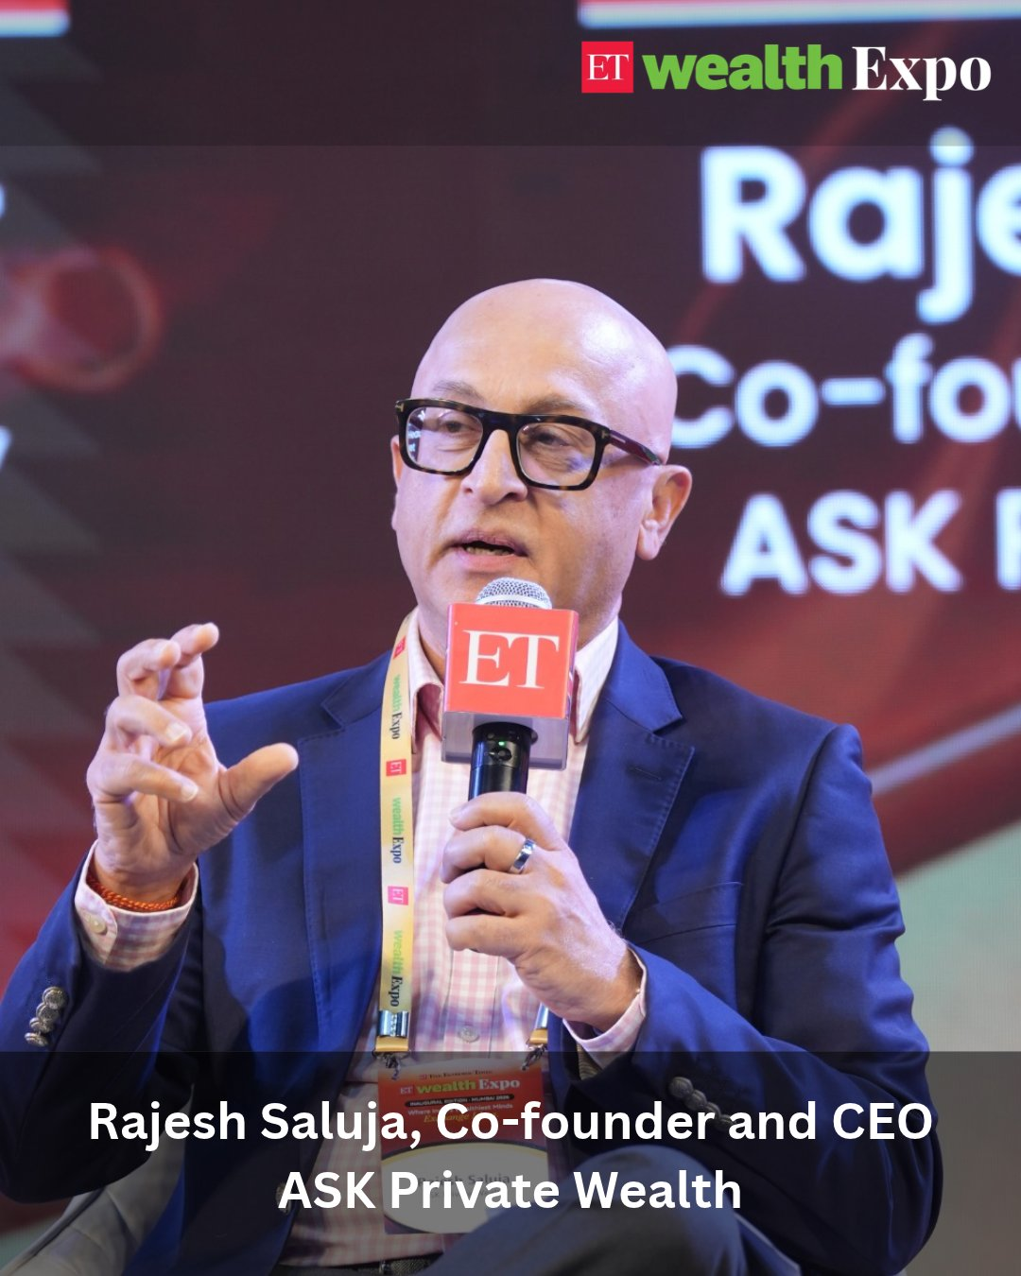
Posted on 31st October
Speaker / Session: Rajesh Saluja
The Economic Times ●
···
2d
Is the next generation inheriting wealth, or the wisdom to manage it?
As investment choices expand beyond traditional assets such as real estate and gold, wealth management calls for a sharper focus on capital preservation, long-term compounding and portfolio resilience.
At #ETWealthExpo, Rajesh Saluja, Co-founder & CEO, @ASK_WM , shares why families need a clear investment framework, balancing a safety pot, a compounding pot and an opportunistic pot to guide wealth decisions across generations.
Because lasting wealth is not just about maximising returns. It is about preserving capital and passing on the discipline to manage it.
#WealthManagement #FamilyWealth #Investing #PortfolioManagement
https://x.com/EconomicTimes/status/2116423190197256215?a=HUU_Q486uJN93ishvus&s=20
https://www.linkedin.com/feed/update/urn:li:activity:7522188655227088896

Slide 6
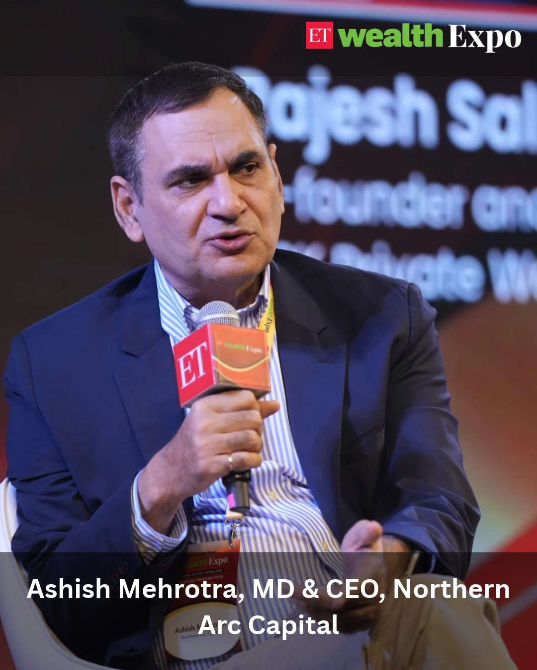
Posted on 31st October
Speaker / Session: Ashish Mehrotra
The Economic Times ●
···
2d
Private credit: An emerging opportunity in India’s fixed-income landscape?
As India’s credit market expands, private credit is opening up new avenues for investors, offering companies access to structured financing beyond conventional bank lending.
At #ETWealthExpo, @AshishMehrotra_, MD & CEO, @_NorthernArc, explains how private credit works, the opportunities it presents and why investors must look beyond promised returns to assess credit quality, liquidity and recovery structures.
His perspective: In private credit, understanding the risks and the fund manager’s ability to manage them is just as important as the returns.
#PrivateCredit #FixedIncome #WealthManagement #AlternativeInvestments
https://x.com/EconomicTimes/status/2116421178504224821?a=clJl3sZ0jxQ2rwFaqNY&s=20
https://www.linkedin.com/feed/update/urn:li:activity:7522186372045115392

Slide 7
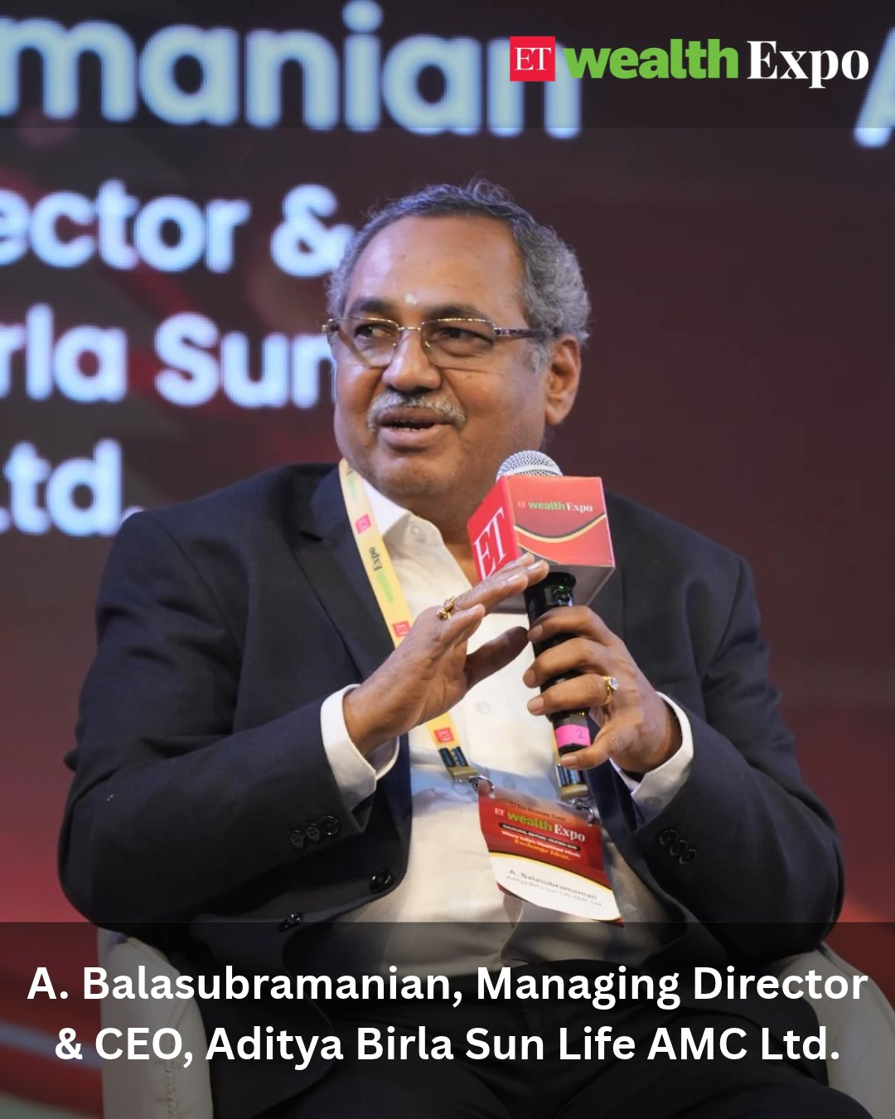
Posted on 31st October
Speaker / Session: A. Balasubramanian
The Economic Times ●
···
2d
Are alternative investments becoming the next big growth engine for India's wealth management industry?
At #ETWealthExpo, A. Balasubramanian (@MFBALA), Managing Director & CEO, Aditya Birla Sun Life AMC Ltd., shares his perspective on the growing demand for alternative assets, the evolving investment landscape and the role of mutual funds as the core of an investor's portfolio.
His outlook: Alternatives could grow at 20–25% as investors explore new opportunities.
#ETWealthExpo #ABalasubramanian #AdityaBirlaSunLifeAMC #AlternativeInvestments #WealthManagement
https://x.com/EconomicTimes/status/2116414514384212412?a=hVIzEujz-C70s62MKK8&s=20
https://www.linkedin.com/feed/update/urn:li:activity:7522179595912216576

Slide 8
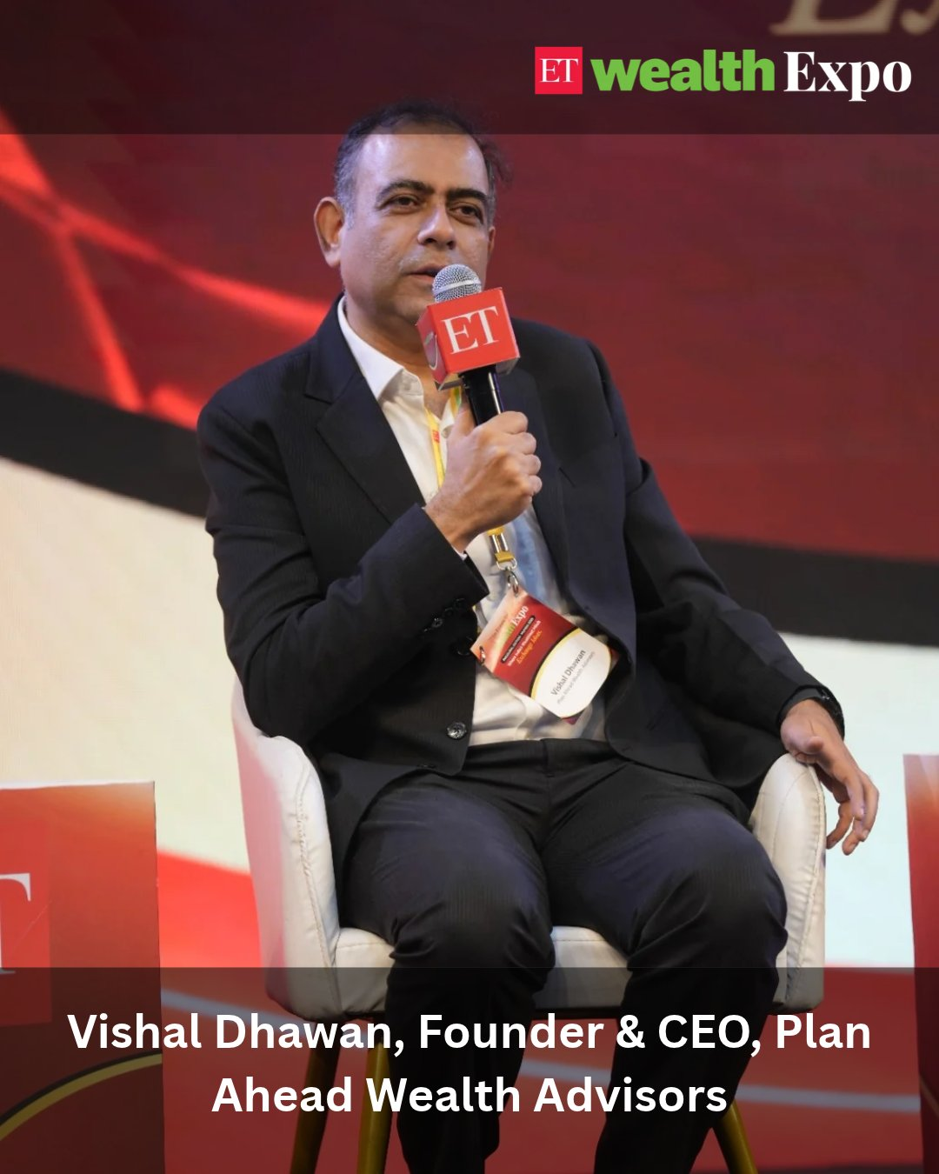
Posted on 31st October
Speaker / Session: Vishal Dhawan
The Economic Times ●
···
2d
Real estate or equities: Which creates more wealth over the long term?
A property’s purchase price is only part of the equation. Stamp duty, registration, loan interest, maintenance and other costs can significantly affect actual returns.
At #ETWealthExpo, @vishdhawan , Founder & CEO, @Planaheadwealth , compares the long-term performance of real estate and equities, highlighting why total cost of ownership and the power of compounding matter when evaluating investment choices.
His key takeaway: Even a few percentage points of difference in annual returns can translate into a significant gap in wealth over 20 years.
#WealthCreation #RealEstate #EquityInvesting #PersonalFinance
https://x.com/EconomicTimes/status/2116427937000104263?a=5WJgLKWEB1w3iX0JhBA&s=20
https://www.linkedin.com/feed/update/urn:li:activity:7522193261986230273

Slide 9
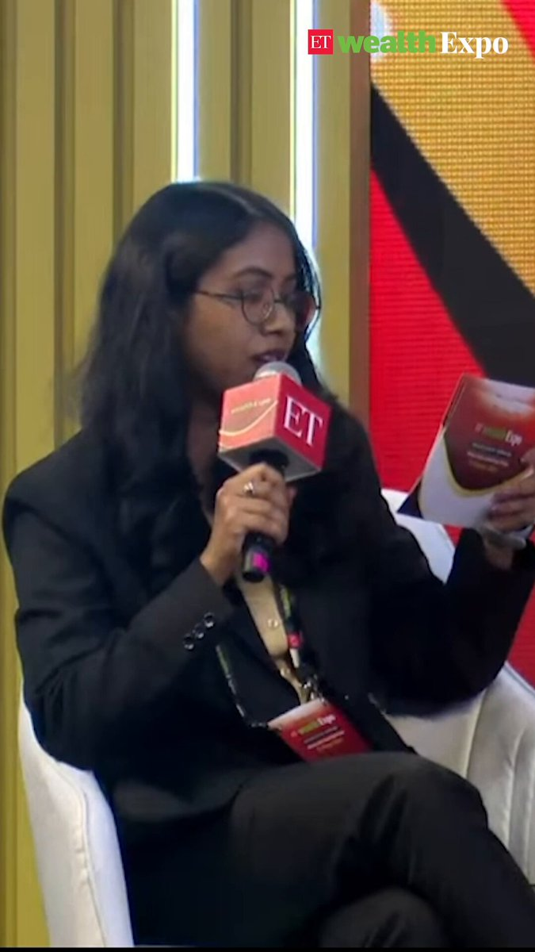
Posted on 31st October
Speaker / Session: Ajay Sharma
The Economic Times ●
···
2d
Ajay Sharma, MD of Valuation & Advisory Services at @colliers_ind , at #ETWealthExpo, talks about how many people inheriting real estate assets are putting them back to the market, which means there will be a lot more properties in the secondary housing market.
https://x.com/EconomicTimes/status/2116523876738023847?a=QCuo2pRt0X8Z5KjpbD4&s=20
https://www.linkedin.com/feed/update/urn:li:activity:7522289198196940800

Slide 10
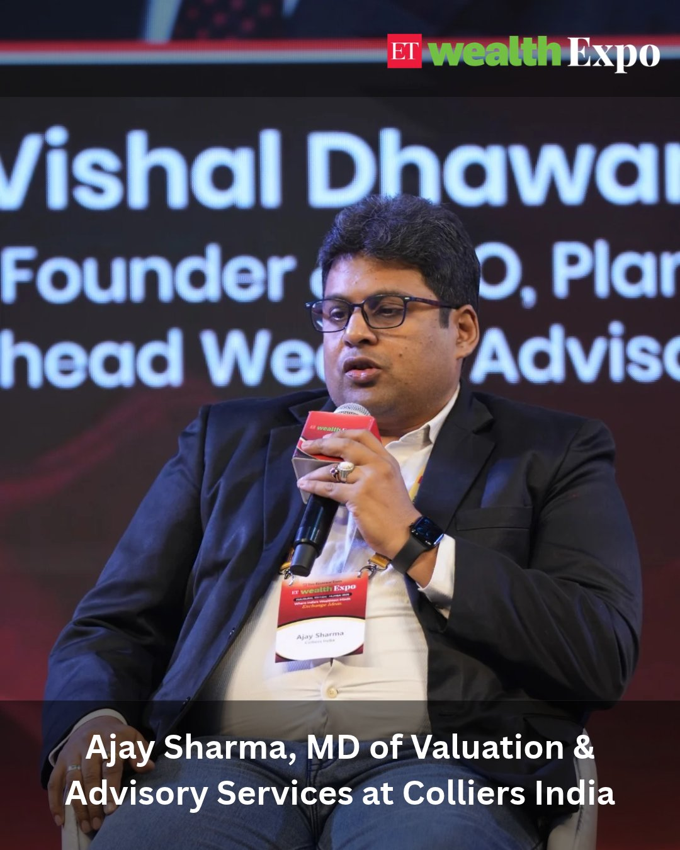
Posted on 31st October
The Economic Times ●
···
2d
Is homeownership still a financial necessity, or is renting becoming the smarter choice for the next generation?
As lifestyles, career choices and economic realities evolve, younger generations are rethinking the idea of owning property and staying tied to one location.
At #ETWealthExpo, Ajay Sharma, MD, Valuation & Advisory Services, @colliers_ind , explores this generational shift and its implications for India's residential real estate market, from a stronger secondary market to the growing potential of rental housing.
The big shift: Real estate decisions are increasingly being shaped by changing lifestyles, not just the aspiration to own a home.
#RealEstate #HousingMarket #RentalHousing #WealthManagement
https://x.com/EconomicTimes/status/2116432536381304871?s=20
https://www.linkedin.com/feed/update/urn:li:activity:7522198013801594881

Slide 11
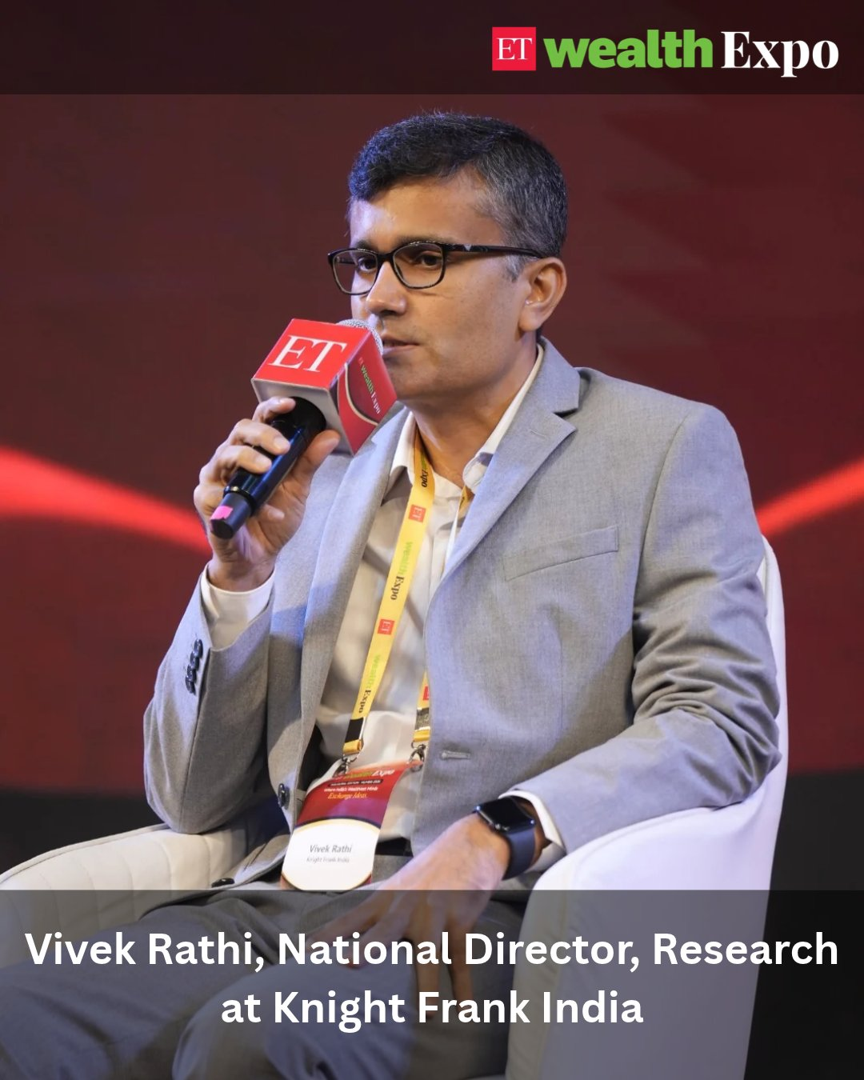
Posted on 31st October
Speaker / Session: Vivek Rathi
The Economic Times ●
···
2d
Does the comfort of owning real estate hide the risks of overconcentration?
Unlike listed assets, property prices do not fluctuate visibly every day. But lower visible volatility does not necessarily mean lower risk. Illiquidity, limited price discovery and difficulty exiting can make real estate a concentrated bet.
At #ETWealthExpo, Vivek Rathi, National Director – Research, @KnightFrank_IN , highlights why investors must look beyond the comfort of physical assets and assess the liquidity, diversification and exit options within their portfolios.
The key takeaway: Real estate should be a conscious portfolio choice, not an overwhelming concentration of family wealth.
#RealEstate #PortfolioDiversification #WealthManagement #InvestmentStrategy
https://x.com/EconomicTimes/status/2116435703940907268?a=CtnWKuopTRSM7Z2Eos4&s=20
https://www.linkedin.com/feed/update/urn:li:activity:7522201205415288832

Slide 12
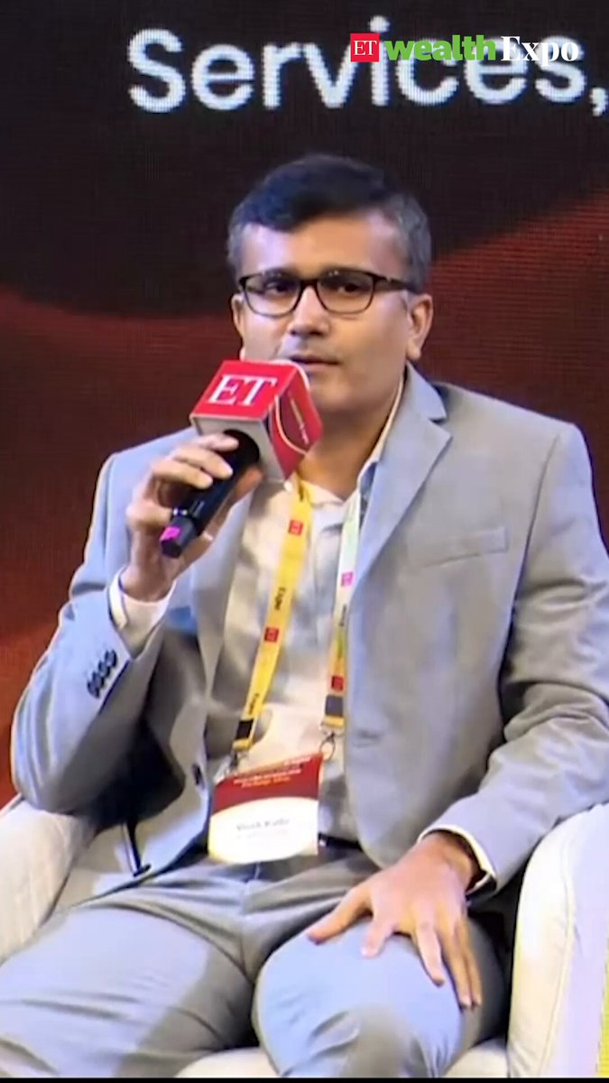
Posted on 31st October
The Economic Times ●
···
2d
Vivek Rathi, National Director – Research at @KnightFrank_IN , at the #ETWealthExpo talk, said that real estate investment lacks the excitement of other assets like equities since traditional real estate takes time to liquidate.
https://x.com/EconomicTimes/status/2116526765938225349?s=20
https://www.linkedin.com/feed/update/urn:li:activity:7522291964130787329

Slide 13
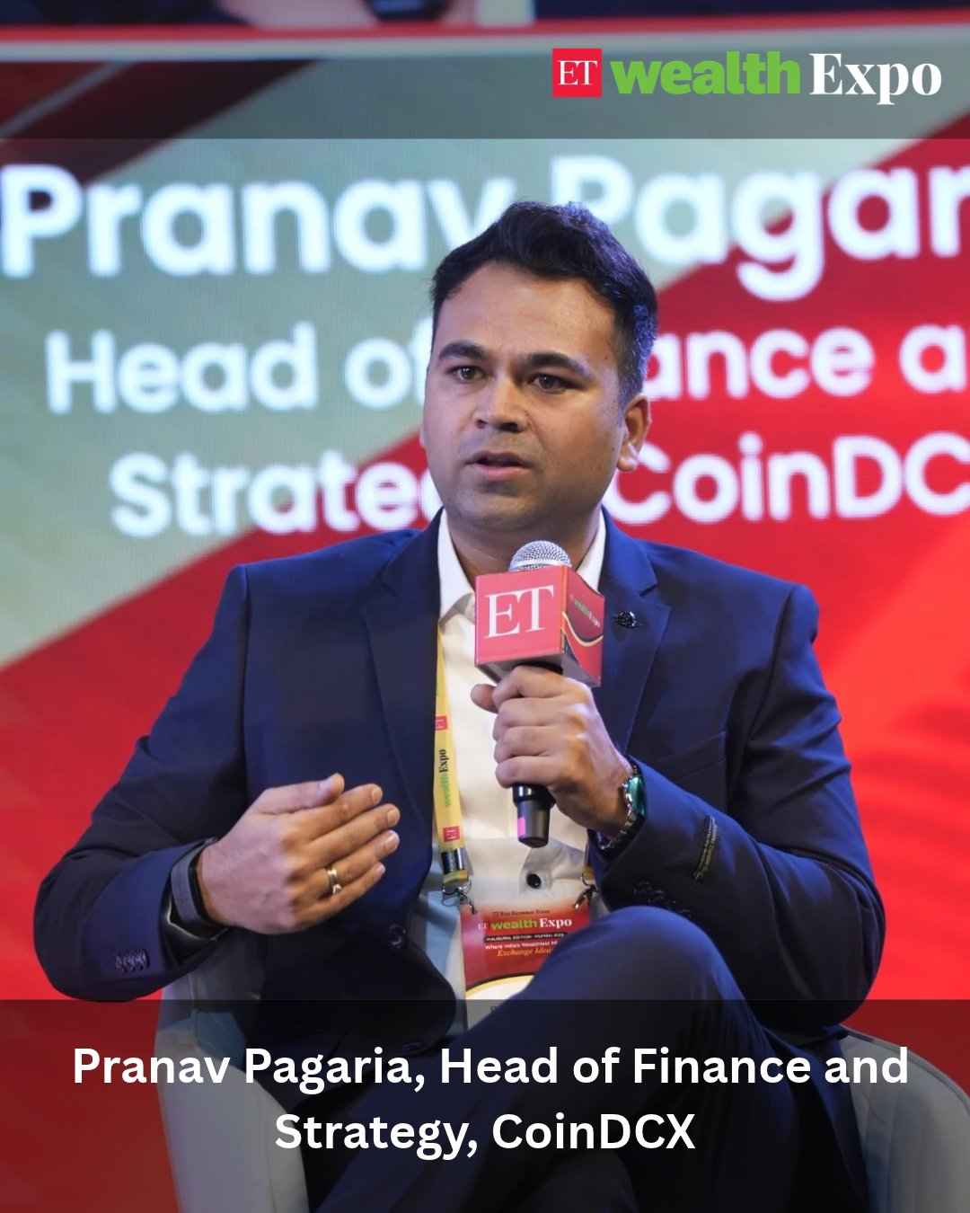
Posted on 31st October
Speaker / Session: Pranav Pagaria
The Economic Times ●
···
2d
Is crypto moving from speculation to mainstream investment?
Once viewed with scepticism, crypto is increasingly drawing interest from institutional investors, family offices and a younger generation of investors.
At #ETWealthExpo, @pranavpagaria , Head of Finance and Strategy, @CoinDCX , shares how the crypto investment landscape is evolving, the growing role of Bitcoin and Ethereum ETFs, and why blockchain could reshape the future of financial markets.
As interest grows, the key question for investors remains: how should they approach this emerging asset class?
#Crypto #DigitalAssets #Bitcoin #Blockchain #WealthManagement
https://x.com/EconomicTimes/status/2116425199759335815?a=5lwn2RHR3Q17FJa15qU&s=20
https://www.linkedin.com/feed/update/urn:li:activity:7522190888685445120

Slide 14
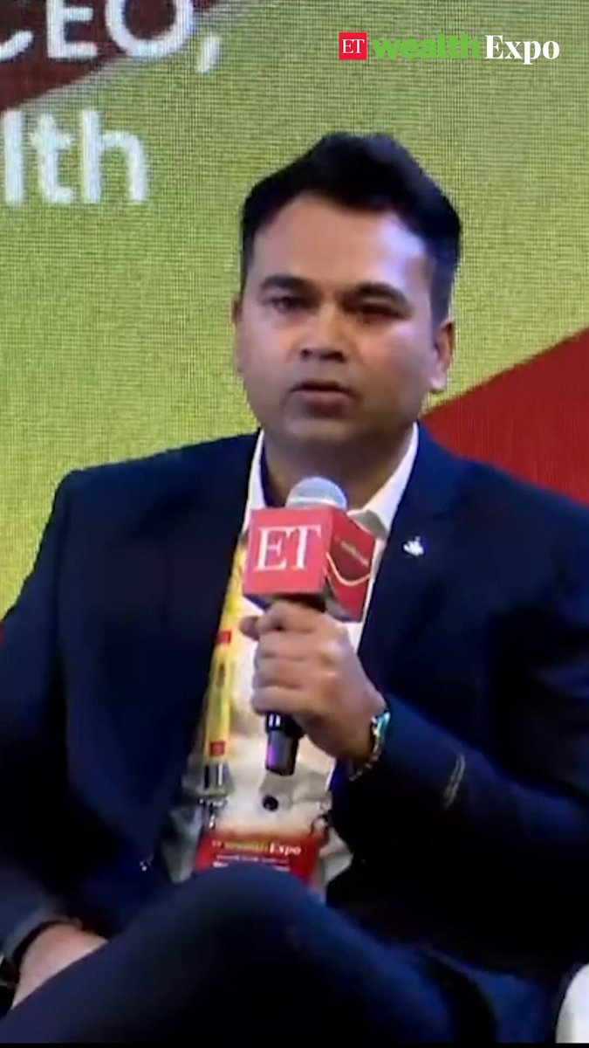
Posted on 31st October
The Economic Times ●
···
2d
Crypto is now a $2.6 trillion market! Pranav Pagaria, Head of Finance & Strategy, @CoinDCX , discusses the role of crypto ETFs and why blockchain and AI could shape the future of institutional markets at ET Wealth Expo.
#ETWealthExpo #wealthmanagement #personalfinance #PMS #AIF #privatecredit #privateequity
https://x.com/EconomicTimes/status/2116528923593122052?s=20
https://www.linkedin.com/feed/update/urn:li:activity:7522294209874284546

Slide 15
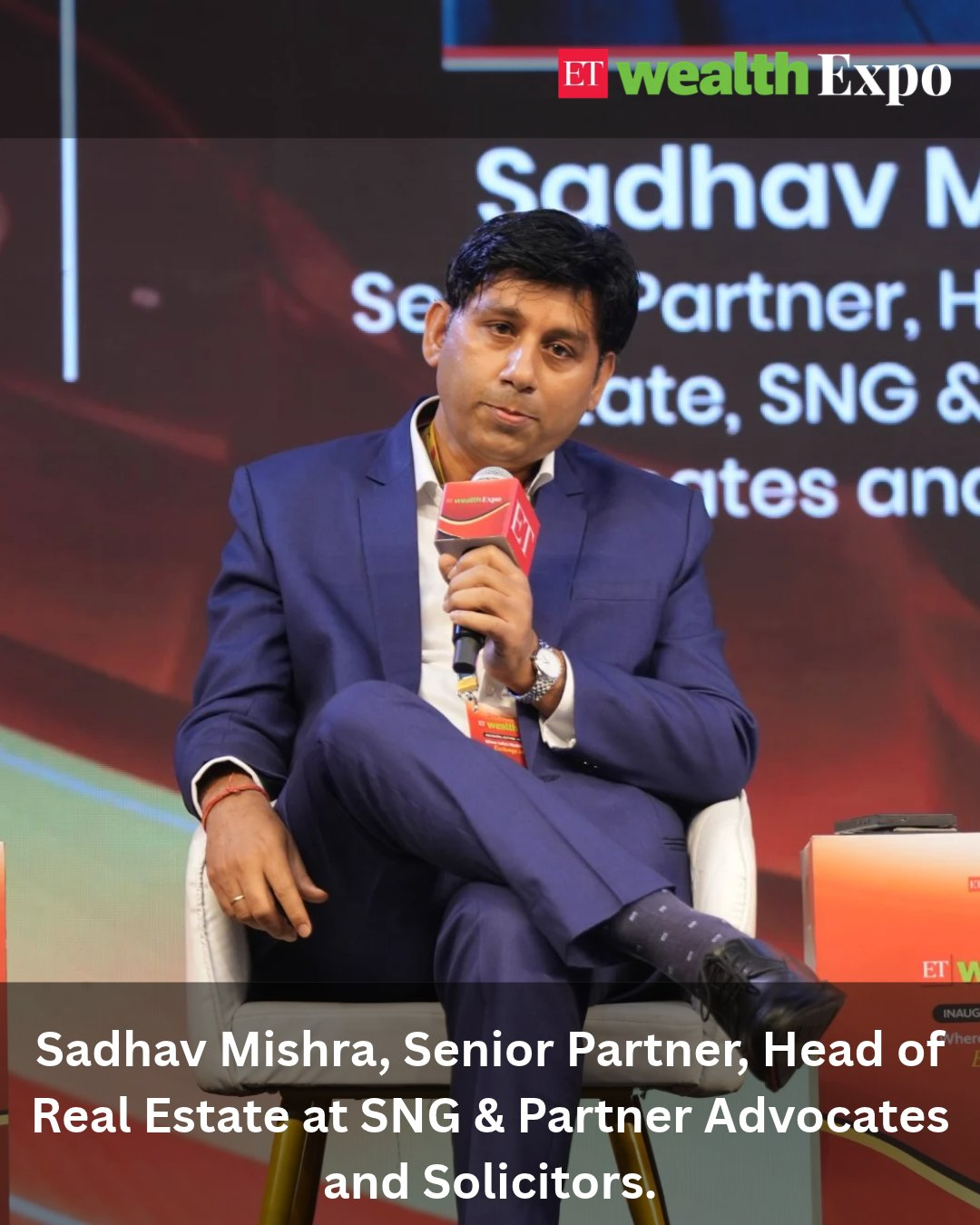
Posted on 31st October
Speaker / Session: Sadhav Mishra
The Economic Times ●
···
2d
Buying a property? A home loan approval does not guarantee a clear title.
Delayed possession and incomplete legal due diligence remain key concerns for homebuyers. While RERA provides remedies under Section 18 for delays, buyers must also look beyond routine title checks before committing to a property.
At #ETWealthExpo, Sadhav Mishra, Senior Partner and Head of Real Estate, SNG & Partners, Advocates & Solicitors, explains the protections available to homebuyers under RERA and why thorough checks of land title, statutory dues and project approvals are essential.
The takeaway: Protecting your property investment starts well before possession.
#RealEstate #RERA #PropertyInvestment #Homebuyers
https://x.com/EconomicTimes/status/2116458694162731159?a=Qdc8fliIOEptVOYESlg&s=20
https://www.linkedin.com/feed/update/urn:li:activity:7522224197687738369

Slide 16
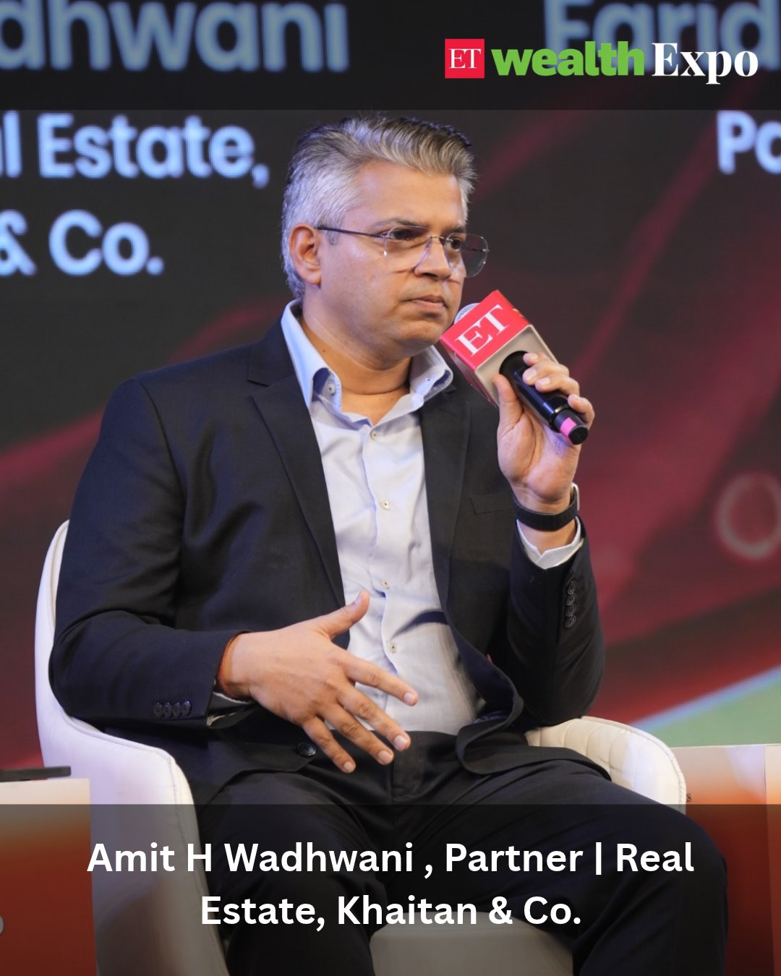
Posted on 31st October
Speaker / Session: Amit H Wadhwani
The Economic Times ●
···
2d
When property ownership meets family relationships, clarity matters.
Co-owned property, inheritance and marital ownership can become complex when legal rights, financial contributions and family expectations do not align.
At #ETWealthExpo, Amit H Wadhwani, Partner, Real Estate,@KhaitanCo , explains why documented family arrangements, clearly defined ownership shares and legally valid wills or gift deeds are essential to preventing disputes and protecting property rights.
The takeaway: Don't leave major property decisions to assumptions. Put ownership, succession and rights on record.
#RealEstate #PropertyOwnership #InheritancePlanning #LegalDueDiligence
https://x.com/EconomicTimes/status/2116469388408930719?s=20
https://www.linkedin.com/feed/update/urn:li:activity:7522235105374040064

Slide 17
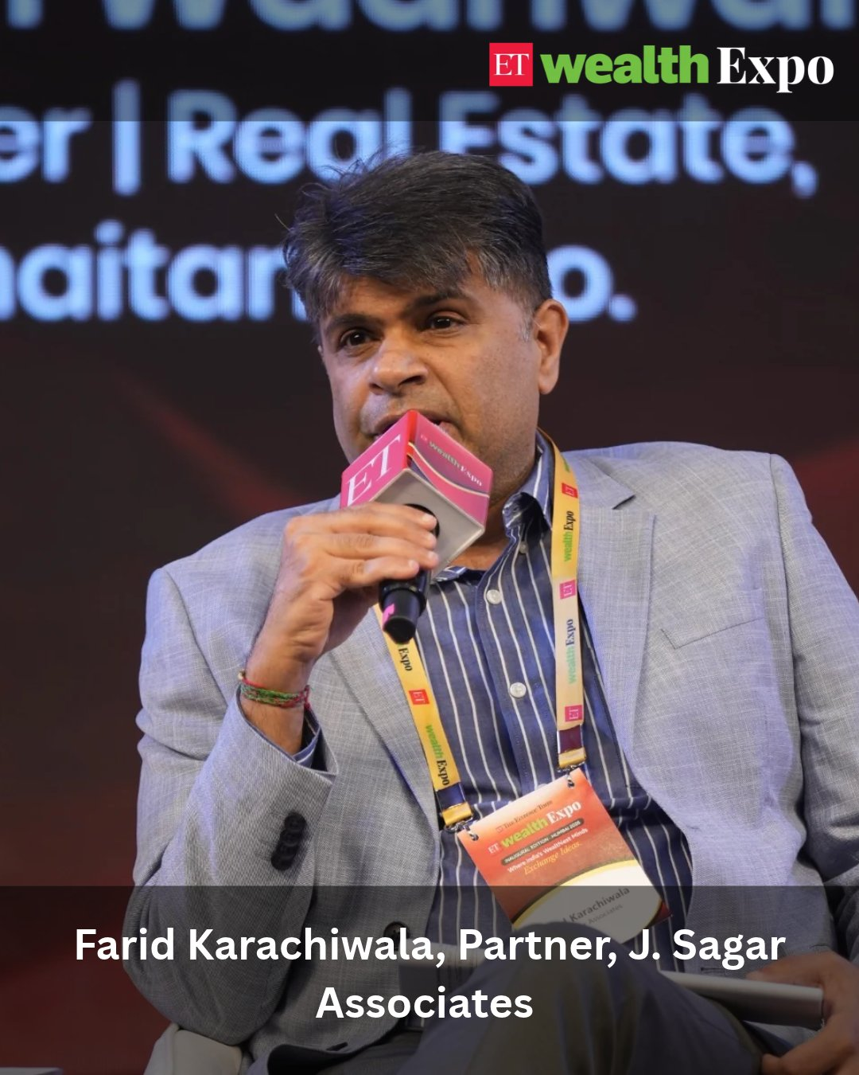
Posted on 31st October
Speaker / Session: Farid Karachiwala
The Economic Times ●
···
2d
Buying property with others? Make sure you know your rights before you invest.
From delayed possession and unclear property titles to co-ownership disputes and exit challenges, real estate investments come with legal considerations that go beyond the purchase price.
At #ETWealthExpo, Farid Karachiwala, Partner, J. Sagar Associates, highlights the legal remedies available to homebuyers, why a bank's home loan approval does not guarantee a clear property title, and the importance of clear agreements when investing in jointly owned property.
His advice: Strong legal safeguards and clearly defined exit mechanisms are essential to protecting your property investment.
#RealEstate #PropertyInvestment #LegalDueDiligence #WealthManagement
https://x.com/EconomicTimes/status/2116466931918328174?a=rgKTDenVPgncyMOvtBw&s=20
https://www.linkedin.com/feed/update/urn:li:activity:7522232235324911616

Slide 18
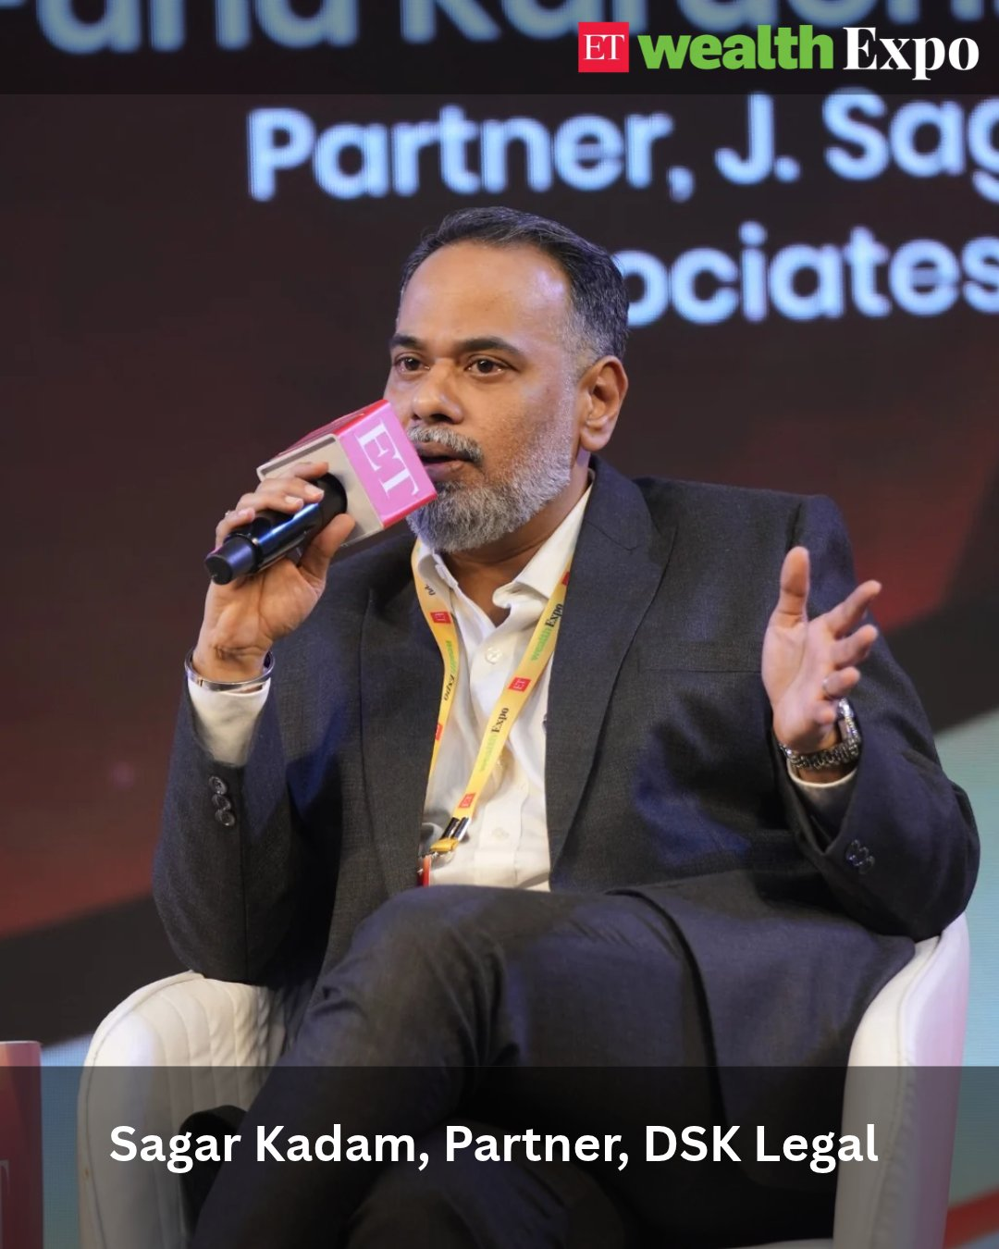
Posted on 31st October
Speaker / Session: Sagar Kadam
The Economic Times ●
···
2d
Property disputes often begin long before a sale or inheritance. The right legal planning can prevent them.
When multiple people co-own a property, clearly defining ownership shares and exit terms at the time of purchase can help avoid future disagreements. Similarly, a valid will and a trusted executor can make property succession more orderly and reduce the risk of disputes among legal heirs.
At #ETWealthExpo, Sagar Kadam, Partner, DSK Legal, highlights why proactive legal arrangements, documented ownership and proper estate planning are essential to protecting family assets.
The takeaway: Plan for ownership, exit and succession before disputes arise.
#RealEstate #EstatePlanning #PropertyOwnership #InheritancePlanning
https://x.com/EconomicTimes/status/2116478517034762445?a=aJVL3UppFBqyHqAIzO8&s=20
https://www.linkedin.com/feed/update/urn:li:activity:7522244300647071745

Slide 19
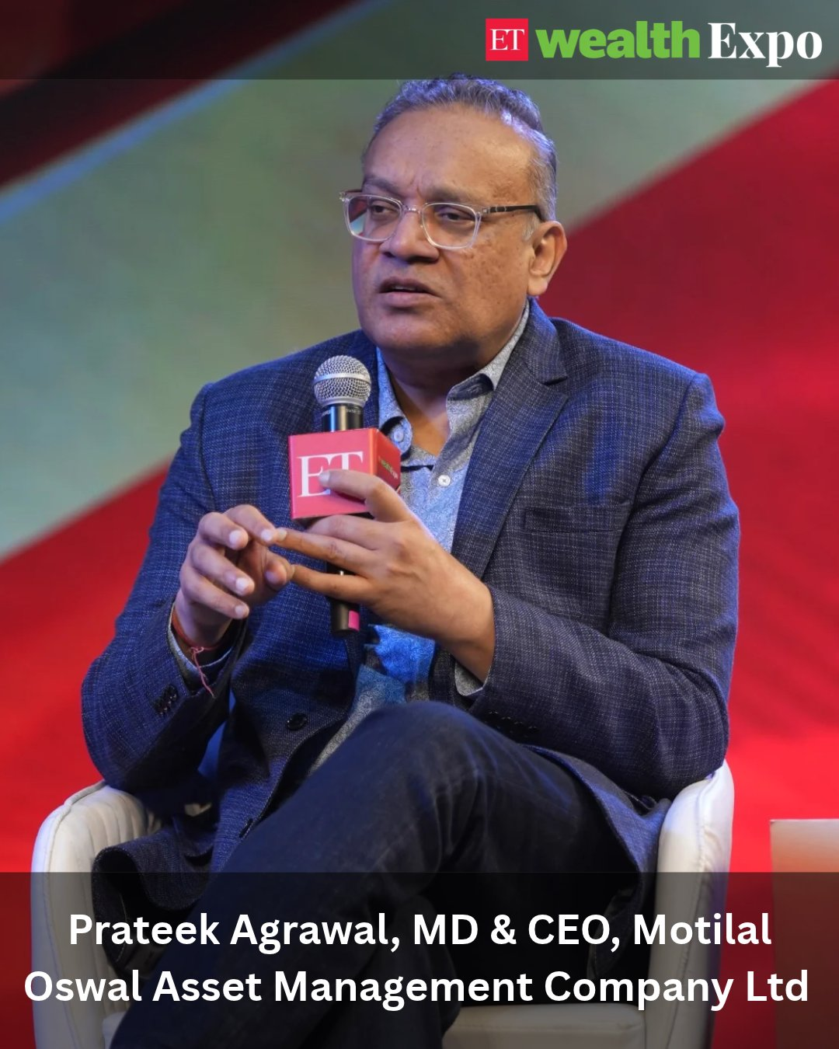
Posted on 31st October
Speaker / Session: Prateek Agrawal
The Economic Times ●
···
2d
Where will India's next generation of wealth creators emerge?
Long-term wealth creation often comes from identifying emerging sectors early, backing businesses with strong earnings potential and recognising market leaders before they become mainstream.
At #ETWealthExpo, Prateek Agrawal, MD & CEO, @MotilalOswalAMC , shares his perspective on the sectors shaping India's next growth cycle, from digital and electronics to electric vehicles, defence and AI enablers.
His investment philosophy: Look for young, high-growth sectors, identify the leaders and stay invested in businesses that can compound earnings over the long term.
#EquityInvesting #WealthCreation #IndianMarkets #LongTermInvesting
https://x.com/EconomicTimes/status/2116474186998682061?a=1xI94bnfaLTXWUK11Wk&s=20
https://www.linkedin.com/feed/update/urn:li:activity:7522239555329015809

Slide 20
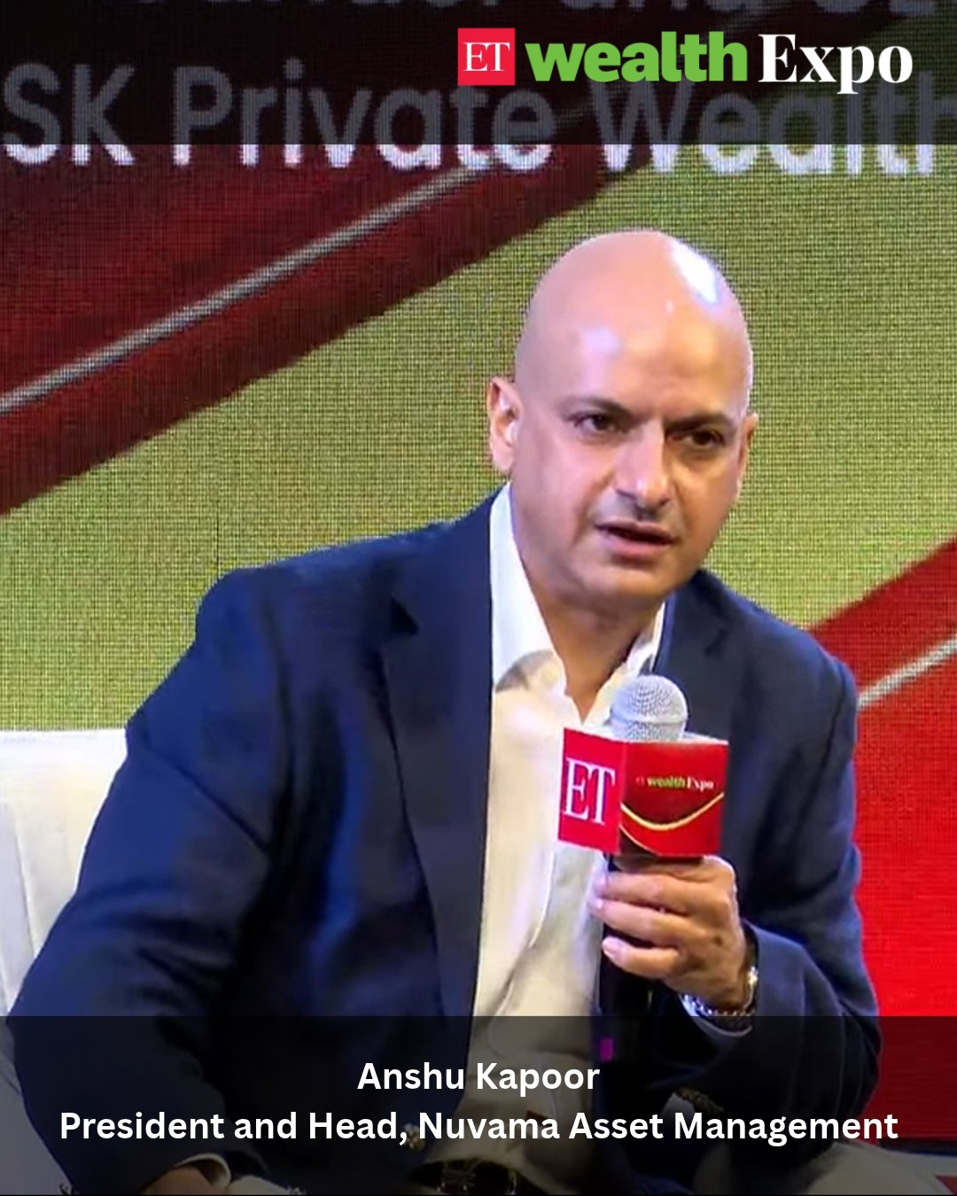
Posted on 31st October
Speaker / Session: Anshu Kapoor
The Economic Times ●
···
2d
India's alternative investment landscape is growing. But entering these markets requires the right approach.
At #ETWealthExpo, Anshu Kapoor of Nuvama Asset Management urged investors to explore AIFs, SIFs and REITs through professional fund managers rather than jumping into direct investments.
Expertise matters when navigating complex asset classes.
https://x.com/EconomicTimes/status/2116413565104165295
https://www.linkedin.com/feed/update/urn:li:share:7522179267770843136/

Slide 21
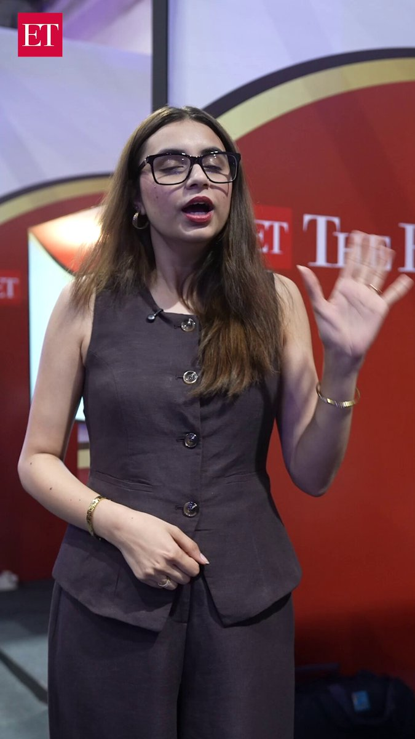
Posted on 31st October
Speaker / Session: Day 2: Shagun
The Economic Times ●
···
2d
Could one conversation change the way you manage your wealth?
At #ETWealthExpo 2026, investors are getting the opportunity to sit down with financial planners and personal finance experts, assess their portfolios, address real financial challenges and discover what they can do better.
From understanding what's working to identifying the next steps, expert guidance can make all the difference.
Join us at NESCO, Mumbai, and make your next wealth decision count!
@bajajfinservmf | @MProfit | @FederalBankLtd | @suprapacific | Choice Wealth | @WhiteOakCap | @IRA_REITs | @Nuvama_Wealth | @PhonePe | @kotakneo | @smcglobal
#ETWealthExpo #WealthCreation #FinancialPlanning #PersonalFinance
https://x.com/EconomicTimes/status/2116463054942552068?a=GTcJd7VEdRJCONT4kA8&s=20
https://www.linkedin.com/feed/update/urn:li:activity:7522227895491305472
https://www.instagram.com/reel/DfJ1fUfyDBP/?utm_source=ig_web_copy_link&rpxt=MzRlODBiNWFlZA==&srtk=MzRlODBiNWFlZA==

Slide 22
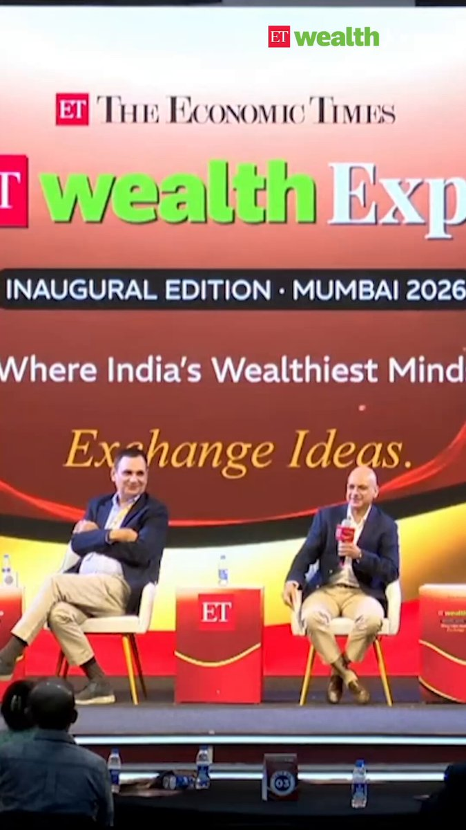
Posted on 31st October
Speaker / Session: Anshu Kapoor
The Economic Times ●
···
2d
Anshu Kapoor, President & Head, Nuvama Asset Management, picks commercial real estate as his standout asset class, citing Bengaluru's strong demand, while also highlighting opportunities in private equity. Watch his insights from the ET Wealth Expo in Mumbai.
#ETWealthExpo #wealthmanagement #personalfinance #PMS #AIF #privatecredit #privateequity
https://x.com/EconomicTimes/status/2116485994648387849?a=huUQpwca4BrJiAl-eck&s=20
https://www.linkedin.com/feed/update/urn:li:activity:7522253040742129664

Slide 23
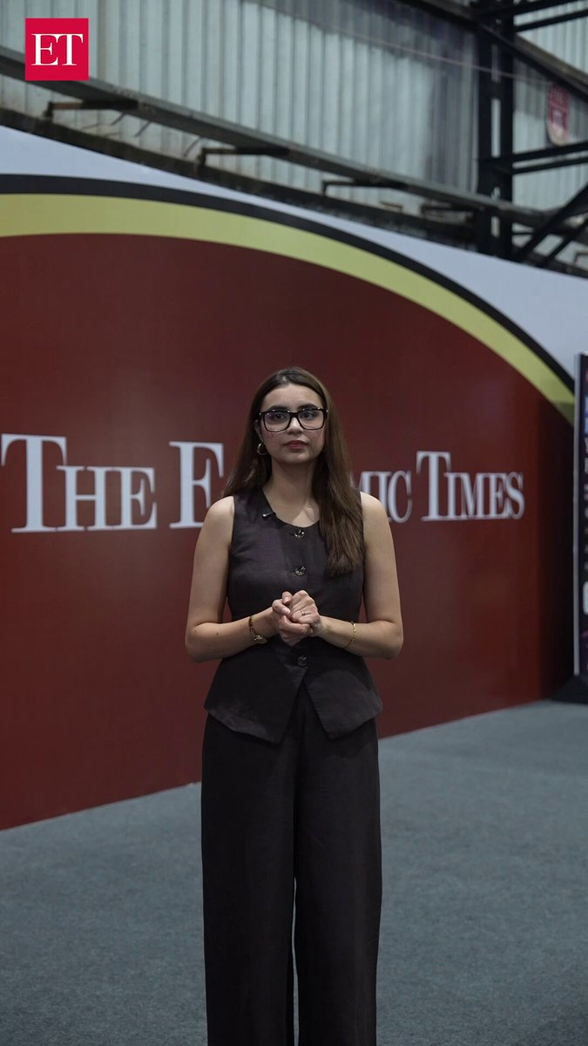
Posted on 31st October
Speaker / Session: Day 2: Shagun (2)
The Economic Times ●
···
2d
Want exposure to commercial real estate without buying an entire property? REITs could be worth exploring.
But how do you identify the right REIT to invest in?
At #ETWealthExpo 2026, Ramesh Nair, MD & CEO, Mindspace Business Parks REIT and Board Member, Indian REITs Association, shares five key factors investors should evaluate before investing in REITs:
Net operating income and its growth
Consistency of investor distributions
Portfolio occupancy levels
The sponsor's ability to add quality assets
The experience and track record of the management team
A useful starting point for anyone looking to understand listed real estate investments.
What would you like to know about REITs? Share your questions in the comments.
#REITs #CommercialRealEstate #RealEstateInvesting #WealthCreation
https://x.com/EconomicTimes/status/2116472993928941873?a=GQ9gxr-twjF7ed4RK9I&s=20
https://www.linkedin.com/feed/update/urn:li:activity:7522238356043370496

Slide 24
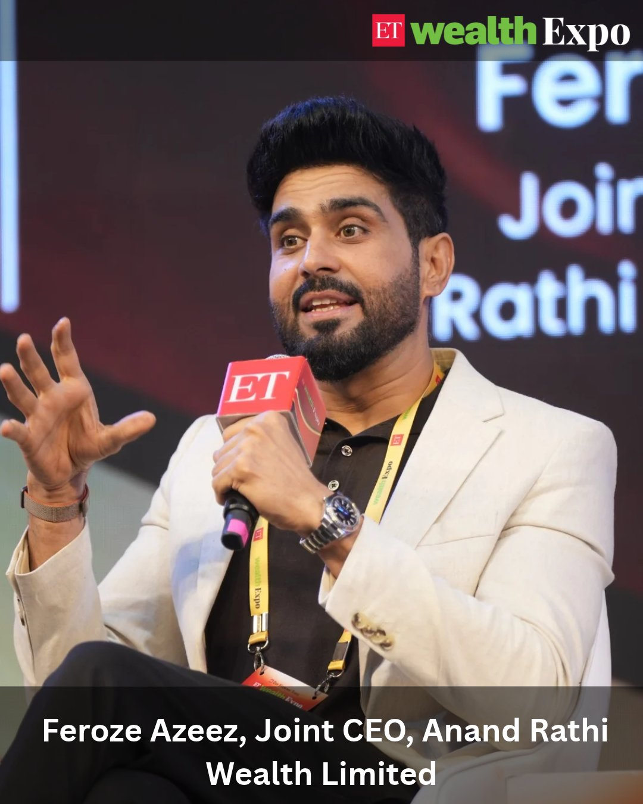
Posted on 31st October
Speaker / Session: Feroze Azeez
The Economic Times ●
···
2d
How much money do you really need to retire early?
Is there a thumb rule that can help you decide when you have enough to stop working? At #ETWealthExpo 2026,@feroze_azeez , Joint CEO, @ARWealth, shares a simple framework: your retirement corpus should be linked to your monthly expenses, inflation and a sound investment strategy.
His thumb rule: A monthly expense of ₹50,000 calls for a corpus of ₹1 crore, while ₹1 lakh in monthly expenses calls for ₹2 crore. He argues that this approach can apply across age groups, provided the money is managed with the right strategy.
But retirement is not just about having enough money. It is also about having a reason to stay mentally and physically engaged.
#EarlyRetirement #RetirementPlanning #WealthCreation #PersonalFinance #ETWealthExpo
https://x.com/EconomicTimes/status/2116537306412908595?s=20
https://www.linkedin.com/feed/update/urn:li:activity:7522251536773722112

Slide 25
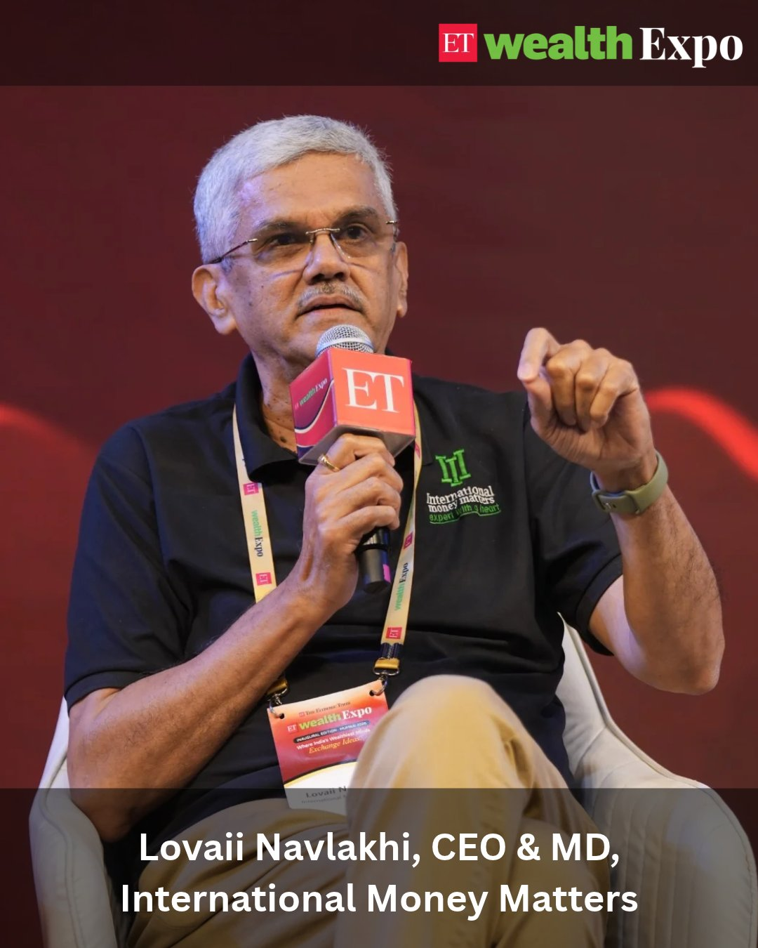
Posted on 31st October
Speaker / Session: Lovaii Navlakhi
The Economic Times ●
···
2d
Retirement planning is about more than reaching a financial target. It's about making sure your money outlasts you.
How long will you live? What will inflation look like? What returns can your investments realistically generate? These are the questions that determine how much you need for a financially secure retirement.
At #ETWealthExpo, @LovaiiNavlakhi , CEO & MD, International Money Matters Pvt Ltd (@IMMPL), highlights why retirement calculations must account for a longer life expectancy, rising healthcare costs and the possibility of lower future returns. He shares a striking example: someone aged 50, spending ₹5 lakh a month at today's value, may need a retirement corpus of around ₹19 crore to fund expenses until age 100, assuming a 2% annual return above inflation.
He also points to a less discussed challenge: the loss of identity after retirement. Staying mentally engaged and finding meaningful pursuits can be just as important as financial preparedness.
#RetirementPlanning #FinancialIndependence #WealthManagement #PersonalFinance
https://x.com/EconomicTimes/status/2116491261159092663?a=N54wfFm3itHR1ODRMyY&s=20
https://www.linkedin.com/feed/update/urn:li:activity:7522256659730268160

Slide 26
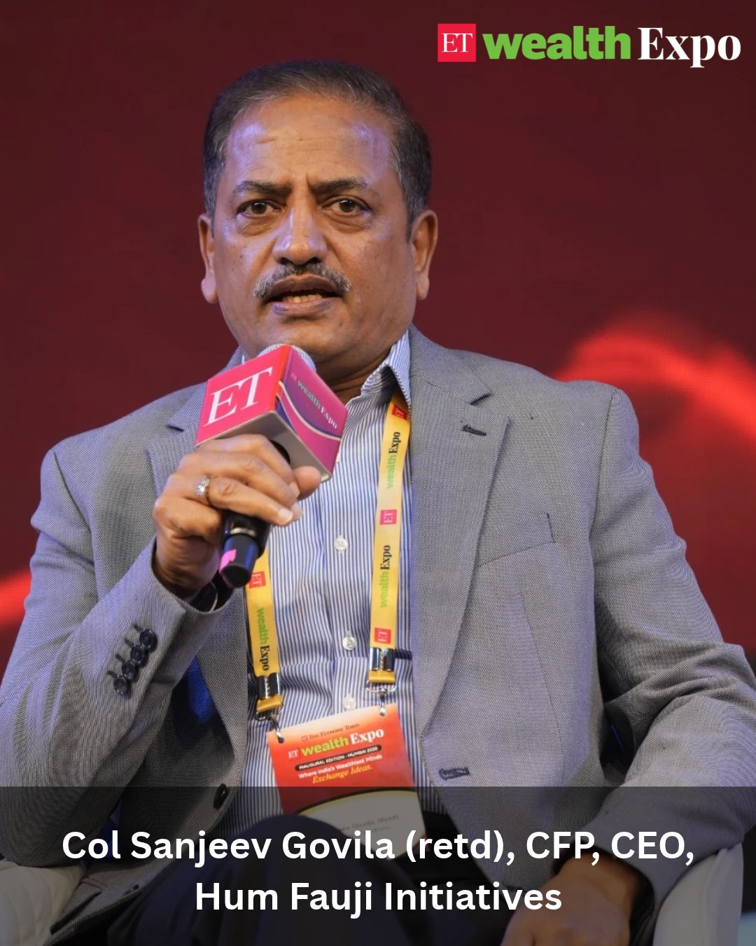
Posted on 31st October
Speaker / Session: Col Sanjeev Govila (retd)
The Economic Times ●
···
2d
Retirement is not the end of your working life. It can be the beginning of a new purpose.
From consulting and entrepreneurship to teaching, tutoring and philanthropy, there are several ways to stay active and find meaning after stepping away from a full-time career. But the transition needs planning, not just financial preparation.
At #ETWealthExpo 2026, Col Sanjeev Govila (Retd) (@SanjeevGovila), CFP, CEO, @humfauji , highlights why having a clear plan for life after retirement is just as important as having the right corpus. He shares how two people with similar finances can experience retirement very differently, depending on whether they have a purpose and goals to pursue.
His message: Don't just plan when to retire. Plan what you will do next.
#RetirementPlanning #FinancialFreedom #SecondCareer #WealthManagement #ETWealthExpo
https://x.com/EconomicTimes/status/2116494641407435132?s=20
https://www.linkedin.com/feed/update/urn:li:activity:7522260021783617536

