Slide 1
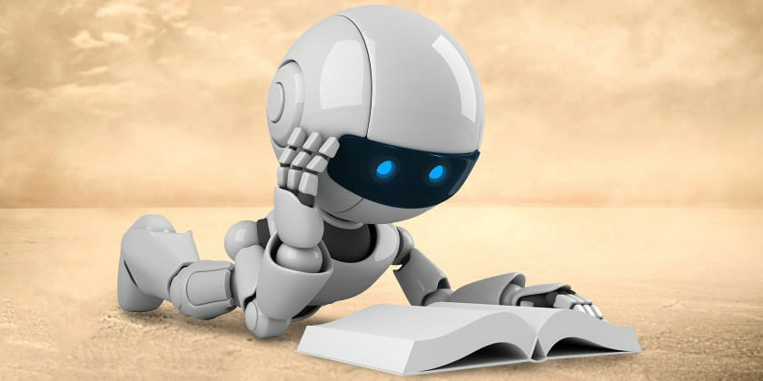
PRESENTATION ON A “Chatbot”
BY: AKSHIT
SHIMT GORAYA, PUNJAB

Slide 2
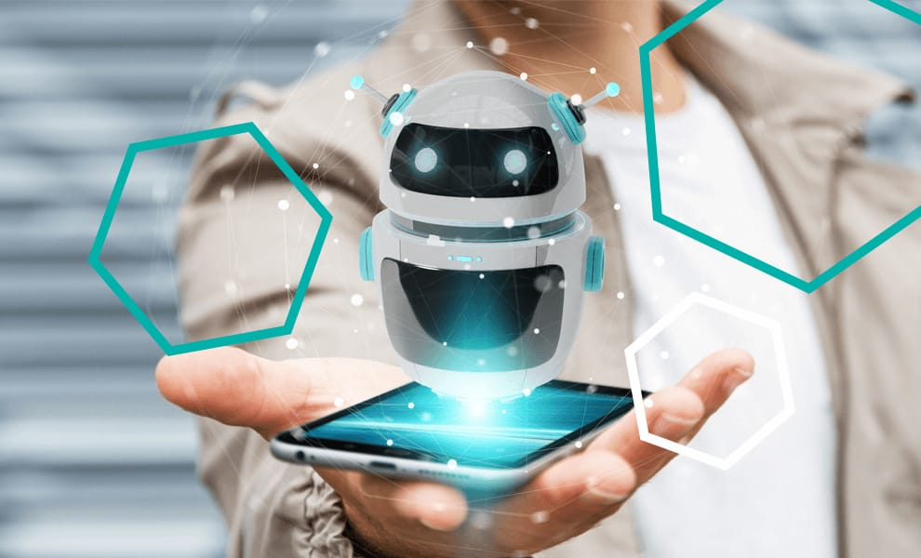
INDEX
What is Chatbot?
Introduction
History of Chatbot
Problem with current scenario
Educational requirement
System requirement
How does it work?
Types of Chatbot
We need a bot that can

Slide 3
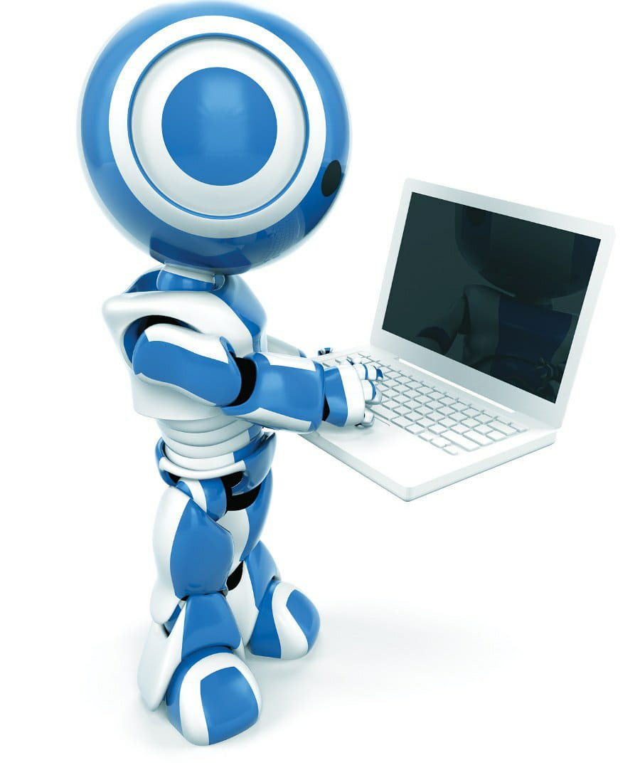
Principle of Chatbot
Data flow diagram(DFD)
ER diagram
Architecture Chatbot
Do Chatbot have inherent advantage over humans
List of best AI Chatbot
Application
Limitation
Advantage
Disadvantage
Successful example of Chatbot
Conclusion
Reference

Slide 4
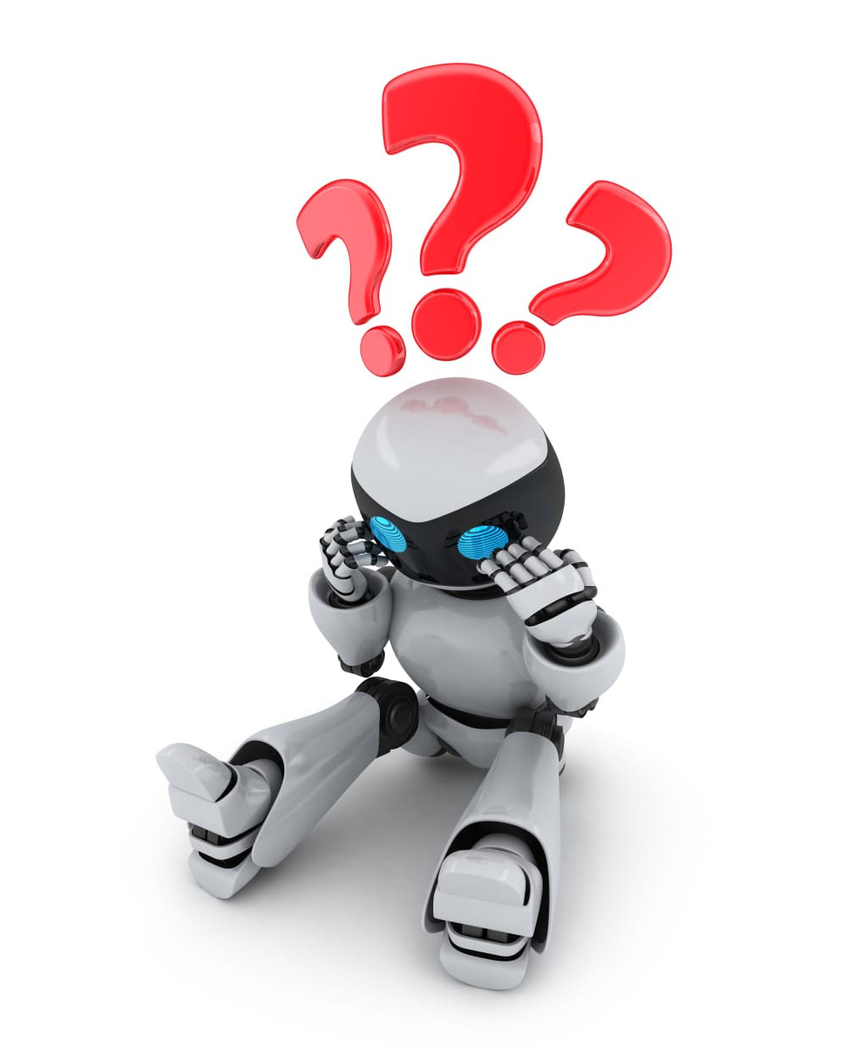
WHAT IS A Chatbot ?
A chat robot, a computer program that simulates human conversation, or chat, through artificial intelligence.
It is a service, powered by rules and artificial intelligence, that you interact with via a chat interface.
The service could be any number of things, ranging from functional to fun, and it could live in any major chat product (Facebook Messenger, Slack, Telegram, Text Messages, etc).

Slide 5
INTRODUCTION
A Chatbot is an artificial person, animal or other creature which holds conversations with humans. This could be a text based (typed) conversation, a spoken conversation or even a non-verbal conversation. Chat bot can run on local computers and phones, though most of the time it is accessed through the internet. Chat bot is typically perceived as engaging software entity which humans can talk to. It can be interesting, inspiring and intriguing. It appears everywhere, from old ancient HTML pages to modern advanced social networkingwebsites, and from standard computers to fashionable smart mobile devices. Chat bots talk in almost every major language. Their language (Natural Language Processing, NLP) skills vary from extremely poor tovery clever intelligent, helpful and funny. The same counts for their graphic design, sometimes it feels like a cartoonish character drawn by a child, and on the other hand there are photo-realistic 3D animated characters available, which are hard to distinguish from humans. And they are all referred to as “chat bots”.

Slide 6
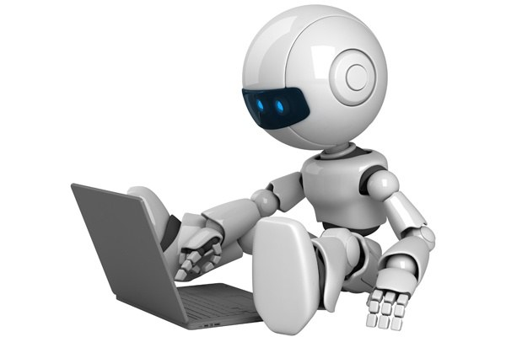
HISTORY OF Chatbot
The first Chatbot ever was developed by MIT professor Joseph Weizenbaum in the 1960s. It was called ELIZA. You’ll read more about ELIZA and other popular Chatbots that were developed in the second half of the 20th century later on.
In the year 2009, a company called WeChat in China created a more advanced Chatbot. Since its launch, WeChat has conquered the hearts of many users who demonstrate an unwavering loyalty to it. It is a highly thriving social media platform.

Slide 7
Through its platform, it has made it easy to create very simple Chatbots. It has grown to be an example of the most favored ways for marketers and employers to reduce the work they do as they interact with customers online.
Though it has implications and is less performant than today’s messaging apps such as Facebook Messenger, Slack, and Telegram, it doesn’t mean that you cannot construct a very smart bot on WeChat. Chumen Wenwen Company, founded in 2012 by a former Google employee, has built a very sophisticated bot running on WeChat.
Early in 2016, we saw the intro of the first wave of artificial data technology in the design of Chatbots. Social media platforms like Facebook enabled developers to build a Chatbot for their trademark or service so that customers could carry out some of their daily actions from inside their messaging platform.

Slide 8
Problem with current scenario
Traditionally, the chat bot system is not known to people who are not more into the technology.
Even if there exist a chat bot system, it is not much accurate in proving the answer or solutions..
This process consumes lot of time as well as money as the customer needed to visit college if its miles away from home.
Also, this process may lead to communication gap between student and college.

Slide 9
Educational Requirements
The Project is developed using Php as a language. We used Notepad++ for Design and coding of project. Created and maintained all databases into My SQL 5.6, in that we create tables, write query for store data or record of project. Managed database using WAMP server.

Slide 10
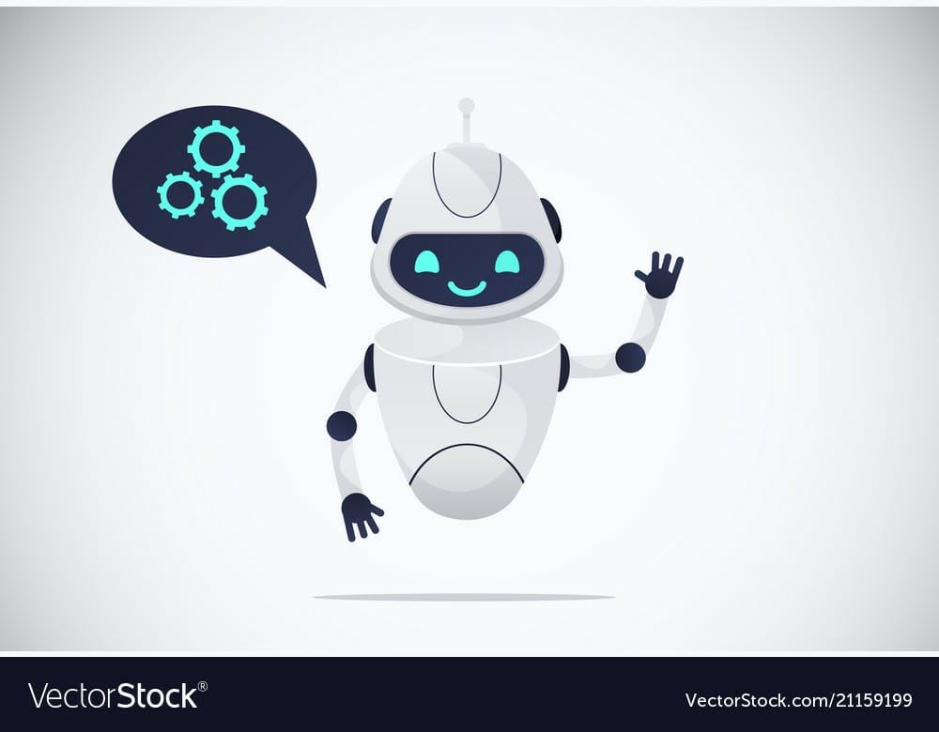
SYSTEM REQUIRMENTS
1. Hardware requirements
Processor-Intel Pentium or higher
RAM-minimum->4GB maximum->6GB
2. Software requirements
Front End- OS-Windows 7,8,10
Back End- Python must be installed
3. Python IDE (jetBrains Pychram)

Slide 11
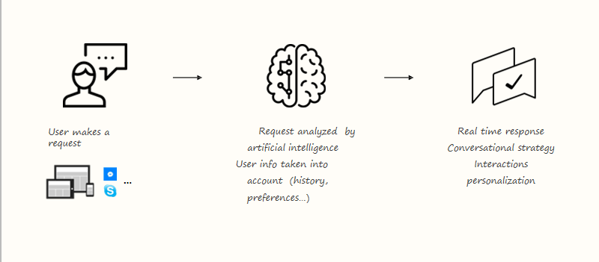
How does it work ?

Slide 12
Types of Chatbots
1. Flow-oriented Chatbot
2. Artificially Intelligent Chatbot:
3. Hybrid Chatbot:
4. Human supported bots

Slide 13
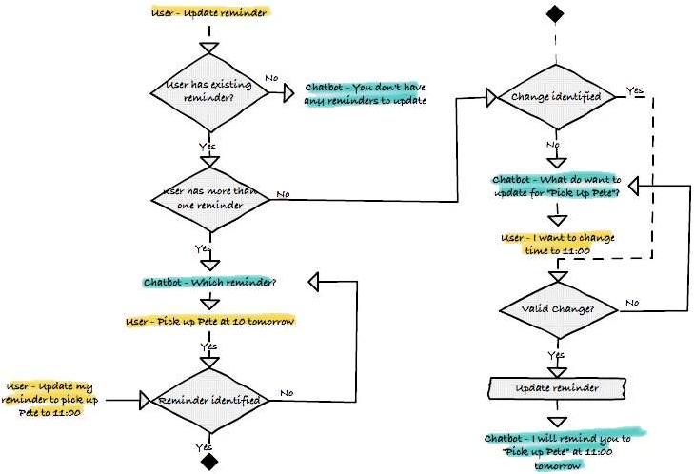
1. Flow-oriented Chatbot:

Slide 14
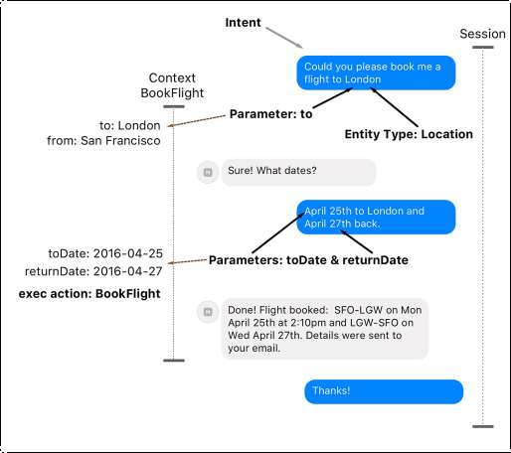
2. Artificially Intelligent Chatbot:

Slide 15
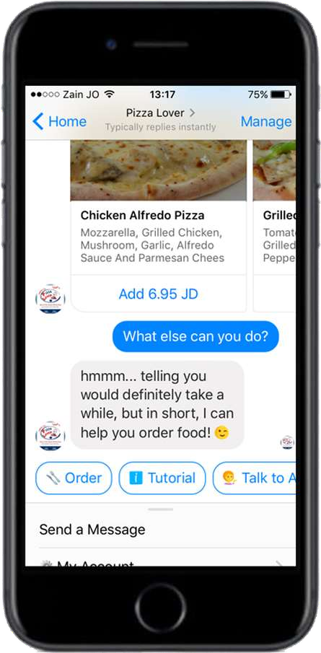
3. Hybrid Chatbot:

Slide 16
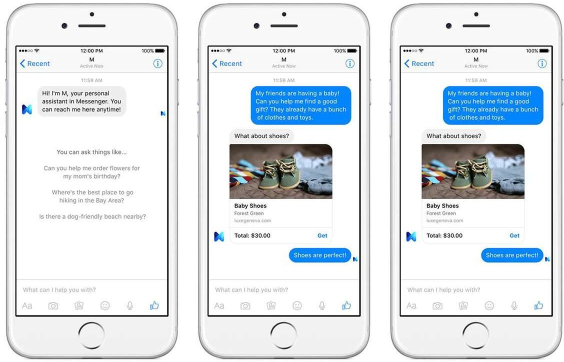
4. Human supported bots:

Slide 17
WE NEED A BOT THAT CAN:
Provide seamless self service support within it help desk
Make a city for intelligent
Change the way we do HR

Slide 18
PRINICIPLES OF Chatbot
Don‟t pretend to be a human-
Playing bait-and-switch with a user can make them feel that they have been duped, or that they don‟t understand how a system works; both are bad user experiences. Don‟t pull the rug out from under your users. This means not using “is-typing” indicators or artificial delays to make it seem more human. On the contrary, bot messages should be styled differently and be clearly labeled in a way that communicates they are not human. This doesn‟t preclude us from giving the bot personality.
Keep it incredibly simple-
Bot conversations should be bounded to very particular subjects and follow linear conversation routes; we avoid complicated branching paths. We‟re not trying to create a general, self-aware A.I. here. It‟s okay to expose and explain limitations. BASAAP. Individual bot designers shouldn‟t have to account for tricky failure cases. Users will tire of complicated passages of dialogue.

Slide 19
Respect the chat medium-
One advantage of smart messaging apps is that we can strip away a lot of apps and interface and reduce the interaction to a simple chat UI.It would therefore be pointless to turn around and drop an entire app directly into a conversation. Keep everything native to theconversational back-and-forth. Every bot interaction is about call and response, with the bot publishing comments into the chat thread and the end user responding in the reply area. Bots can‟t modify conversations in ways that humans can. At the same time, make use of conventions: rather than printing out an ungainly URL in a bot response, show a nicely-formatted card previewing the linked page.
Optimise for the end user-
Bots should be used to improve the end user experience, not just to make life easier for customer support teams. A designer should ask themselves: would a human be better for the end user? If the answer is yes, you shouldn‟t be using a bot. Bots should not attempt to replace what humans are good at; rather they should attempt to improve what humans are slow at. Machines should work; people should think.
Use sparingly-
Bot interactions should be short and precise. It should be impossible to get into a protracted back and forth conversation with a bot; anything above two inputs feels laborious

Slide 20
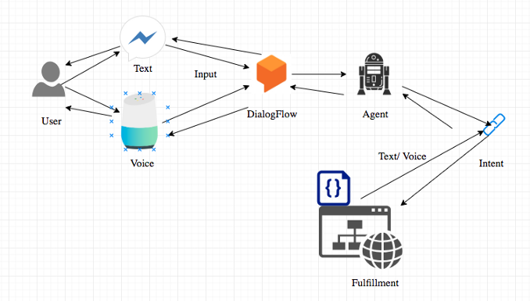
DATA FLOW DIAGRAM (DFD)

Slide 21
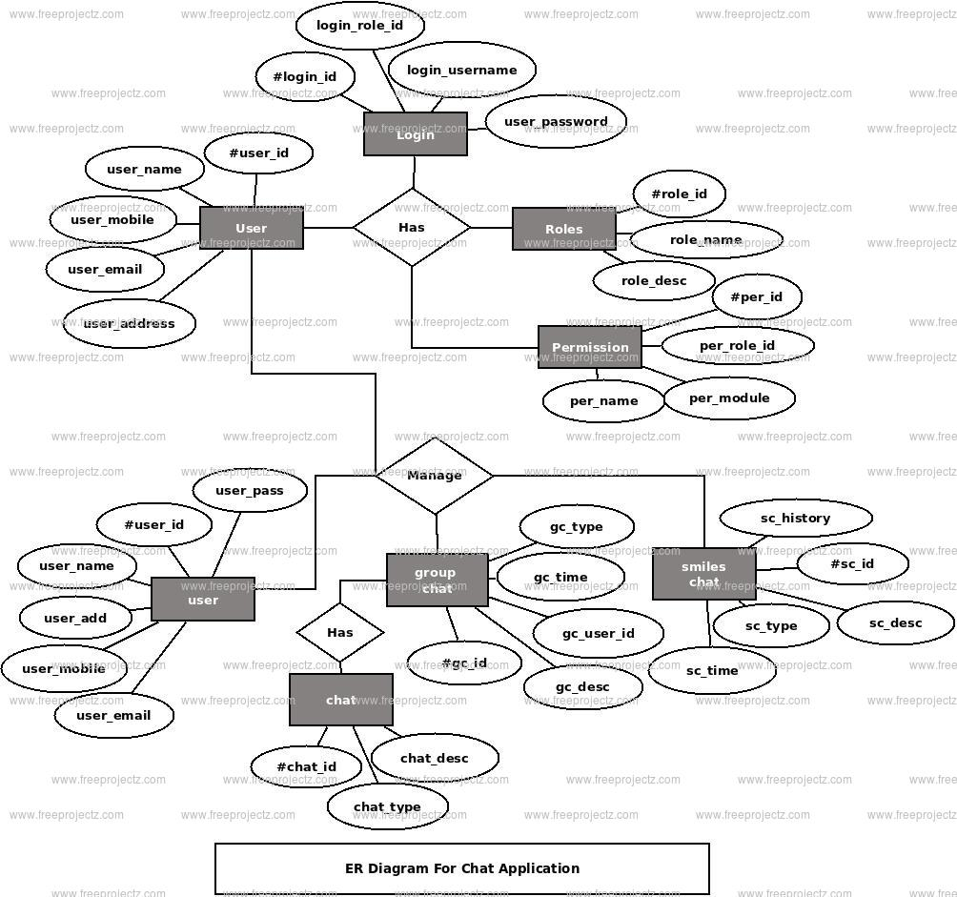
ER DIAGRAM

Slide 22
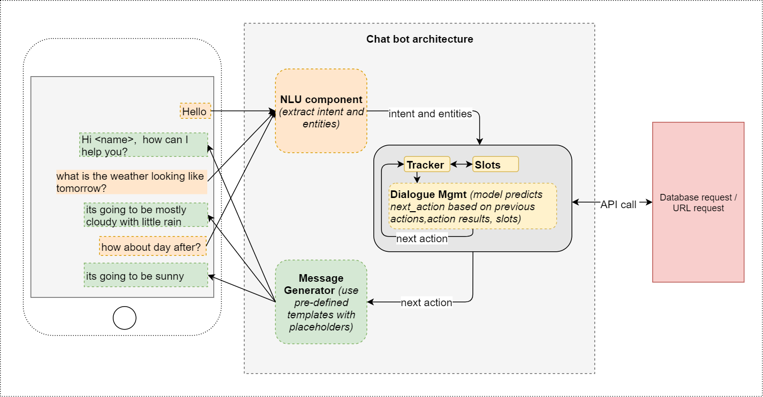
Chatbot ARCHITECTURE

Slide 23
Do Chatbot have inherent advantage over humans
Chatbots help enterprises in various ways as mentioned below:
Chatbots have a number of potential benefits over traditional GUIs. First, they can simplify applications for users. For example, rather than navigating through an interface or website to find information, users can just say or type what they want. Users can also compress multistep tasks into a single command, such as, “Get my list of open opportunities this quarter, and send it to Janet.
Second, the conversational UIs that Chatbots offer may require little to no training, given that they understand and can interpret natural language and translate it into actions.
Third, users can leverage Chatbots to operate several business applications at once. For example, users can invoke multiple Chatbot actions in conversation with team members at the same time.

Slide 24
List of best AI Chatbots:
Mitsuku (Leobner Prize Winner) - Prize in AI for Chatbots in 2013
Jabberwacky
PersonalityForge
Botser
Cleverbot

Slide 25
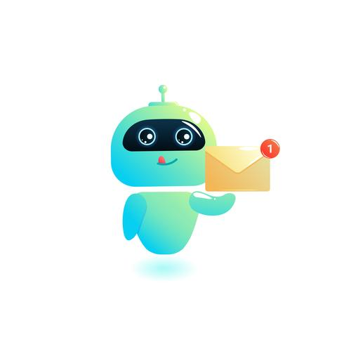
APPLICATION OF A Chatbot
1. Accessible any time.
2. Handling capacity.
3. Flexible attribute.
4. Customer satisfaction.
5. Cost effective.
5. Faster on boarding.
6. Work automation.
7. Personal assistant.

Slide 26
LIMITATION-
As the database, used for output generation, is fixed and limited, Chatbots can fail while dealing with an unsaved query.
A Chatbot's efficiency highly depends on language processing and is limited because of irregularities, such as accents and mistakes that can create an important barrier for international and multi-cultural organizations
Chatbots are unable to deal with multiple questions at the same time and so conversation opportunities are limited.
Chatbots require a large amount of conversational data to train.
As it happens usually with technology-led changes in existing services, some consumers, more often than not from the old generation, are uncomfortable with Chatbots due to their limited understanding, making it obvious that their requests are being dealt with by machines.

Slide 27
ADVANTAGES:
User does not have to go personally to college office for the enquiry.
This application enables the students to be updated with college cultural activities.
This application saves time for the student as well as teaching and non-teaching staffs.

Slide 28
DISADVANTAGES:
Lack emotion.
Difficult to create.
Require maintain.
It require active internet connection as error may occur.

Slide 29
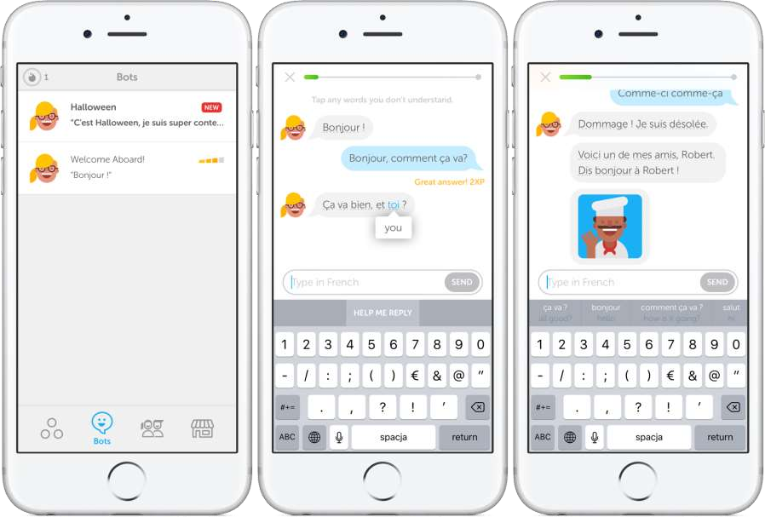

Successful example of Chatbots:

Slide 30
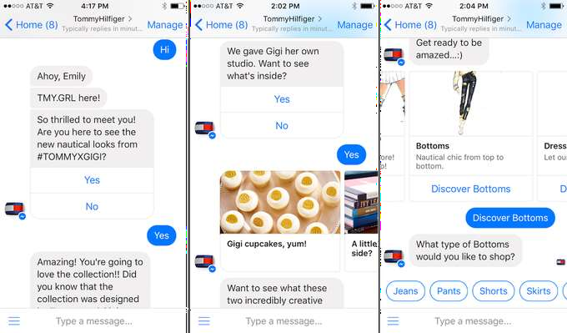
HOW FASHION BRANDS USE ChatbotS TO SHINE

Slide 31
CONCLUSION:
The main objectives of the project were to develop an algorithm that will be used to identify answers related to user submitted questions. To develop a database were all the related data will be stored and to develop a web interface. The web interface developed had two parts, one for simple users and one for the administrator.
A background research took place, which included an overview of the conversation procedure and any relevant chat bots available. A database was developed, which stores information about questions, answers, keywords, logs and feedback messages. A usable system was designed, developed and deployed to the web server on two occasions. An evaluation took place from data collected by potential students of the University. Also after received feedback from the first deployment, extra requirements were introduced and implemented

Slide 32
REFERENCE:
Emanuela Haller and Traian Rebedea, “Designing a Chat-bot that Simulates an Historical Figure”, IEEE Conference Publications, July 2013.
Maja Pantic, Reinier Zwitserloot, and Robbert Jan Grootjans, “Teaching Introductory Artificial Intelligence Using Asimple Agent Framework” , IEEE Transactions On Education, Vol. 48, No. 3, August 2005.

Slide 33
THANK YOU

