Slide 1
Nuvama Wealth Management Limited - Video Analytics Report
Objective
- Capture and log authorized and unauthorized entries into the dealing rooms of Nuvama Wealth Management Limited.
- Maintain a verifiable audit trail of all personnel movement (entries and exits) inside the dealing rooms.
- Detect and log instances of mobile phone usage inside the dealing rooms (restricted activity).
Branches Covered
- Bangalore Branch - Dealing Room
- Ahmedabad Branch - Dealing Room
Approach
- Each authorized dealer is registered into the system with their reference photographs to build an identity database.
- Existing CCTV feeds from the dealing rooms are continuously processed by the analytics engine - no new hardware is required.
- The system identifies every person entering the dealing room: known dealers are logged as authorized entries/exits, unknown faces are logged as unauthorized entries with snapshots saved as evidence.
- Mobile phone usage is detected and logged separately as a compliance event.
- All events are time-stamped, stored in a central log, and exportable as a spreadsheet for compliance review and audit purposes.
- Scope explicitly includes monitoring of mobile phone usage in addition to entry/exit tracking.

Slide 2
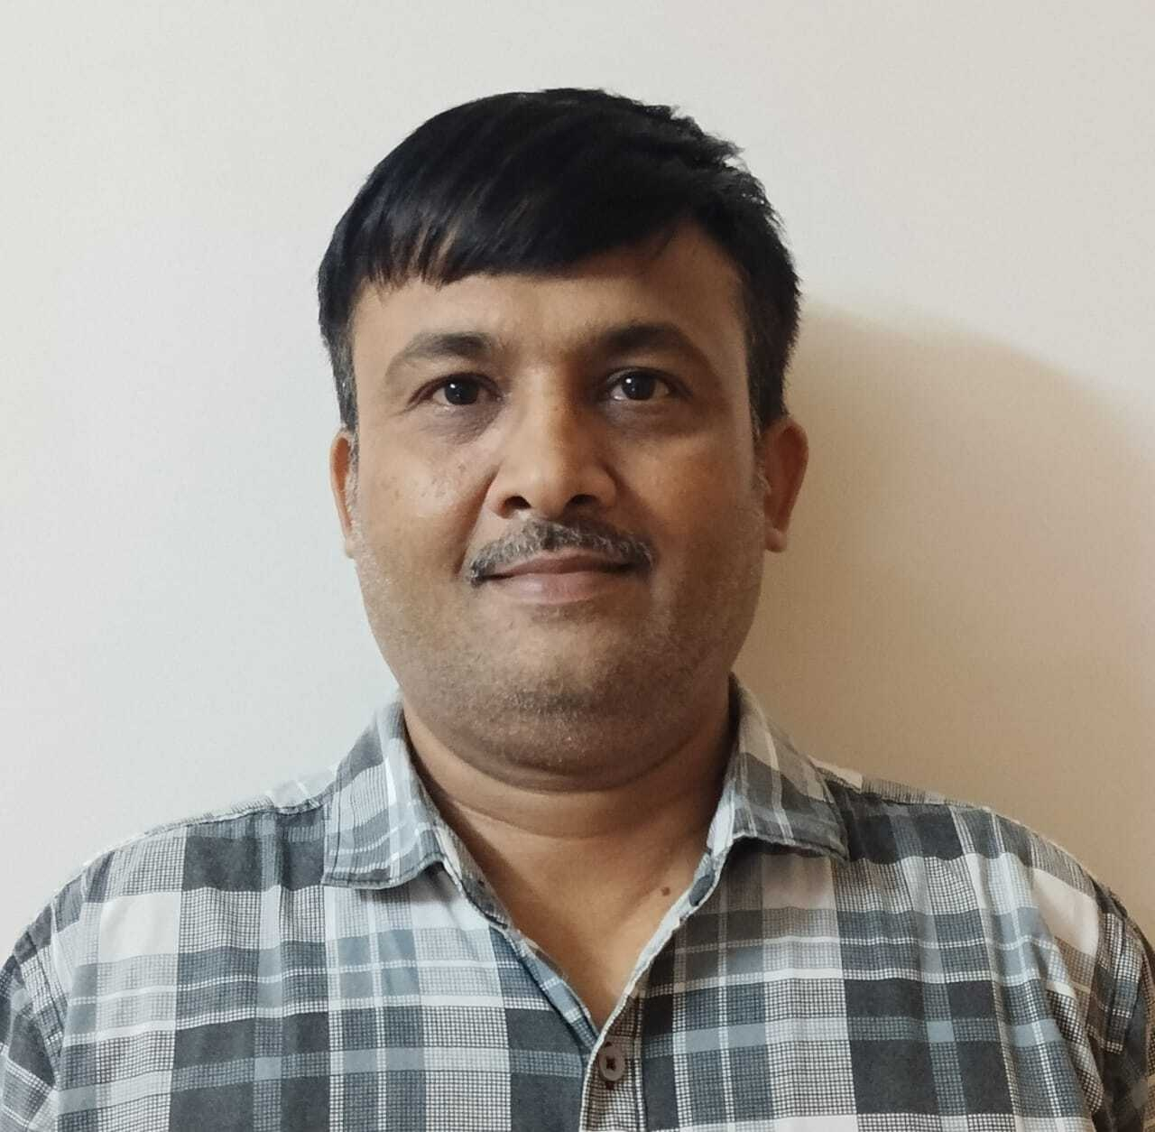
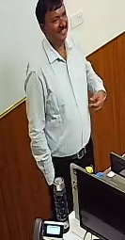
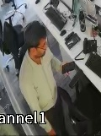
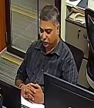
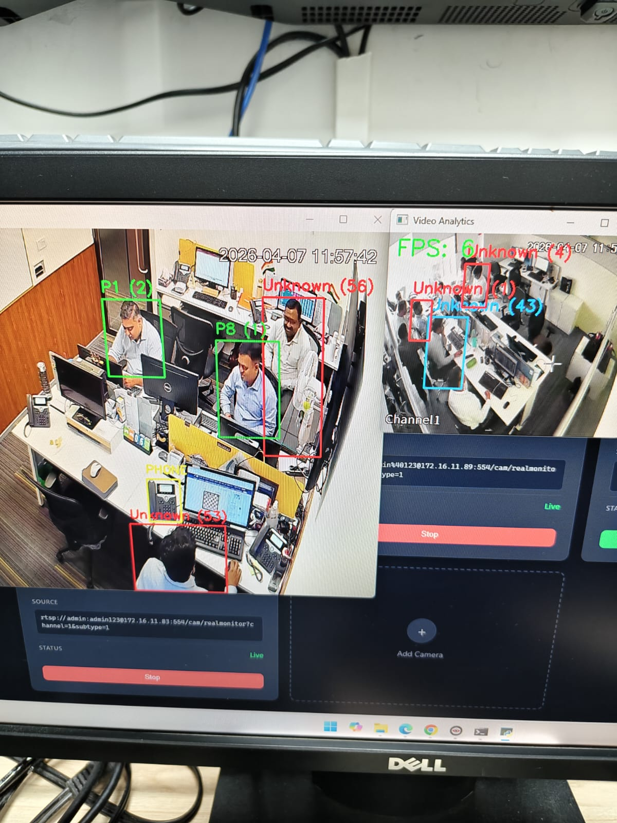
Logged Events - Spreadsheet Summary & Statistics
Reporting Window: 24-Mar-2026 to 05-May-2026 (22 active days)
Total Events Logged: 28,269
Snapshots Captured (unauthorized): 5,971
Bangalore Branch (Dahua Ch8):
- Authorized Entries: 221
- Authorized Exits: 212
- Unauthorized Entries: 3,737
- Mobile Phone Usage: 11
Ahmedabad Branch:
- Unauthorized Entries: 11,282
- Mobile Phone Usage: 24
- (Authorized entries/exits not reliably captured - see Limitations)
Top Identified Dealers (by entry count):
- Dealer B3: 352 entries
- Dealer B2: 19 entries
- Other registered dealers: 1-4 entries each
Sample Captures
Registration Photo of personnel
Unauthorized entry (2026-04-16 11:11:22
Mobile Phone Usage
Authorized entry (2026-04-27 10:42:29
Glance of the system
Spreadsheet Fields: Timestamp | Source/Camera | Event Type (entry/exit/unauthorized/phone_detected) | User Name | Snapshot Path

Slide 3
Limitations Observed
1. Reference Image Quality and Coverage
- Reference images of dealers provided for registration were not up to the mark - several were outdated, low-resolution, or captured at unfavourable angles.
- This directly reduced the system's ability to recognise registered dealers, causing genuine dealers to be mis-classified as unauthorized.
- Refreshing the reference image set with recent/live, front-facing, well-lit photographs would materially improve recognition accuracy.
2. Camera Quality (notably Ahmedabad branch)
- The CCTV feed quality at the Ahmedabad branch was visibly inferior to the Bangalore branch - lower resolution, weaker lighting and motion blur.
- Poor image quality reduces the model's ability to extract reliable facial features, which is the dominant cause of the inflated unauthorized count (11,282) recorded at Ahmedabad.
3. Camera Positioning and Angle
- The cameras were positioned such that several dealers sat far from the lens, producing very small face crops that the model could not match to references.
- Many dealers also sat with their backs or sides facing the camera for long periods, so no usable face was visible at the moment of detection.
- Both factors caused legitimate dealers to repeatedly trigger unauthorized-entry events. This is the primary explanation for the high unauthorized counts, especially at the Ahmedabad branch where poor positioning compounded with poor camera quality.
- Recommendation: re-position cameras to capture a clearer frontal view of the dealing-room entrance and seating area, and upgrade Ahmedabad camera hardware in line with Bangalore.

