Slide 1
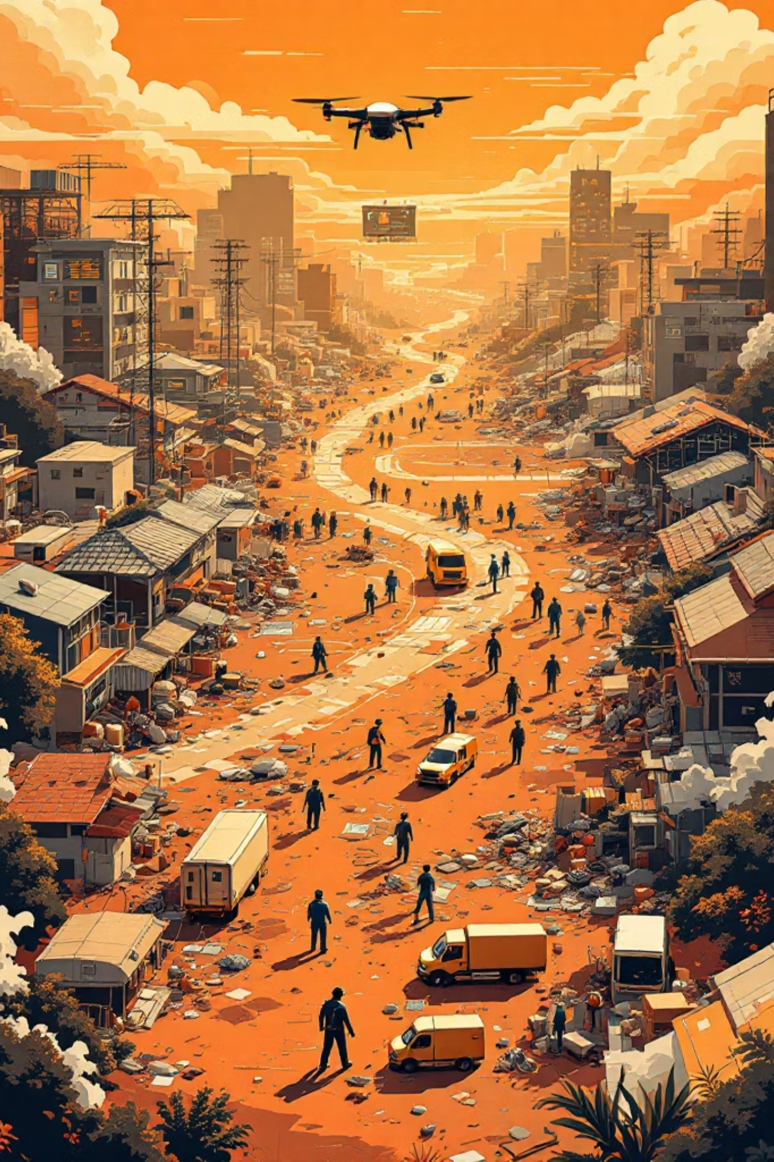
AI Rescue Drone Agent
21CSC206T - Artificial Intelligence Project Review
Bhoomika Poddar | RA2411026010571
Farzan Alam | RA2411026010573
Akshit Gaurana | RA2411026010576

Slide 2
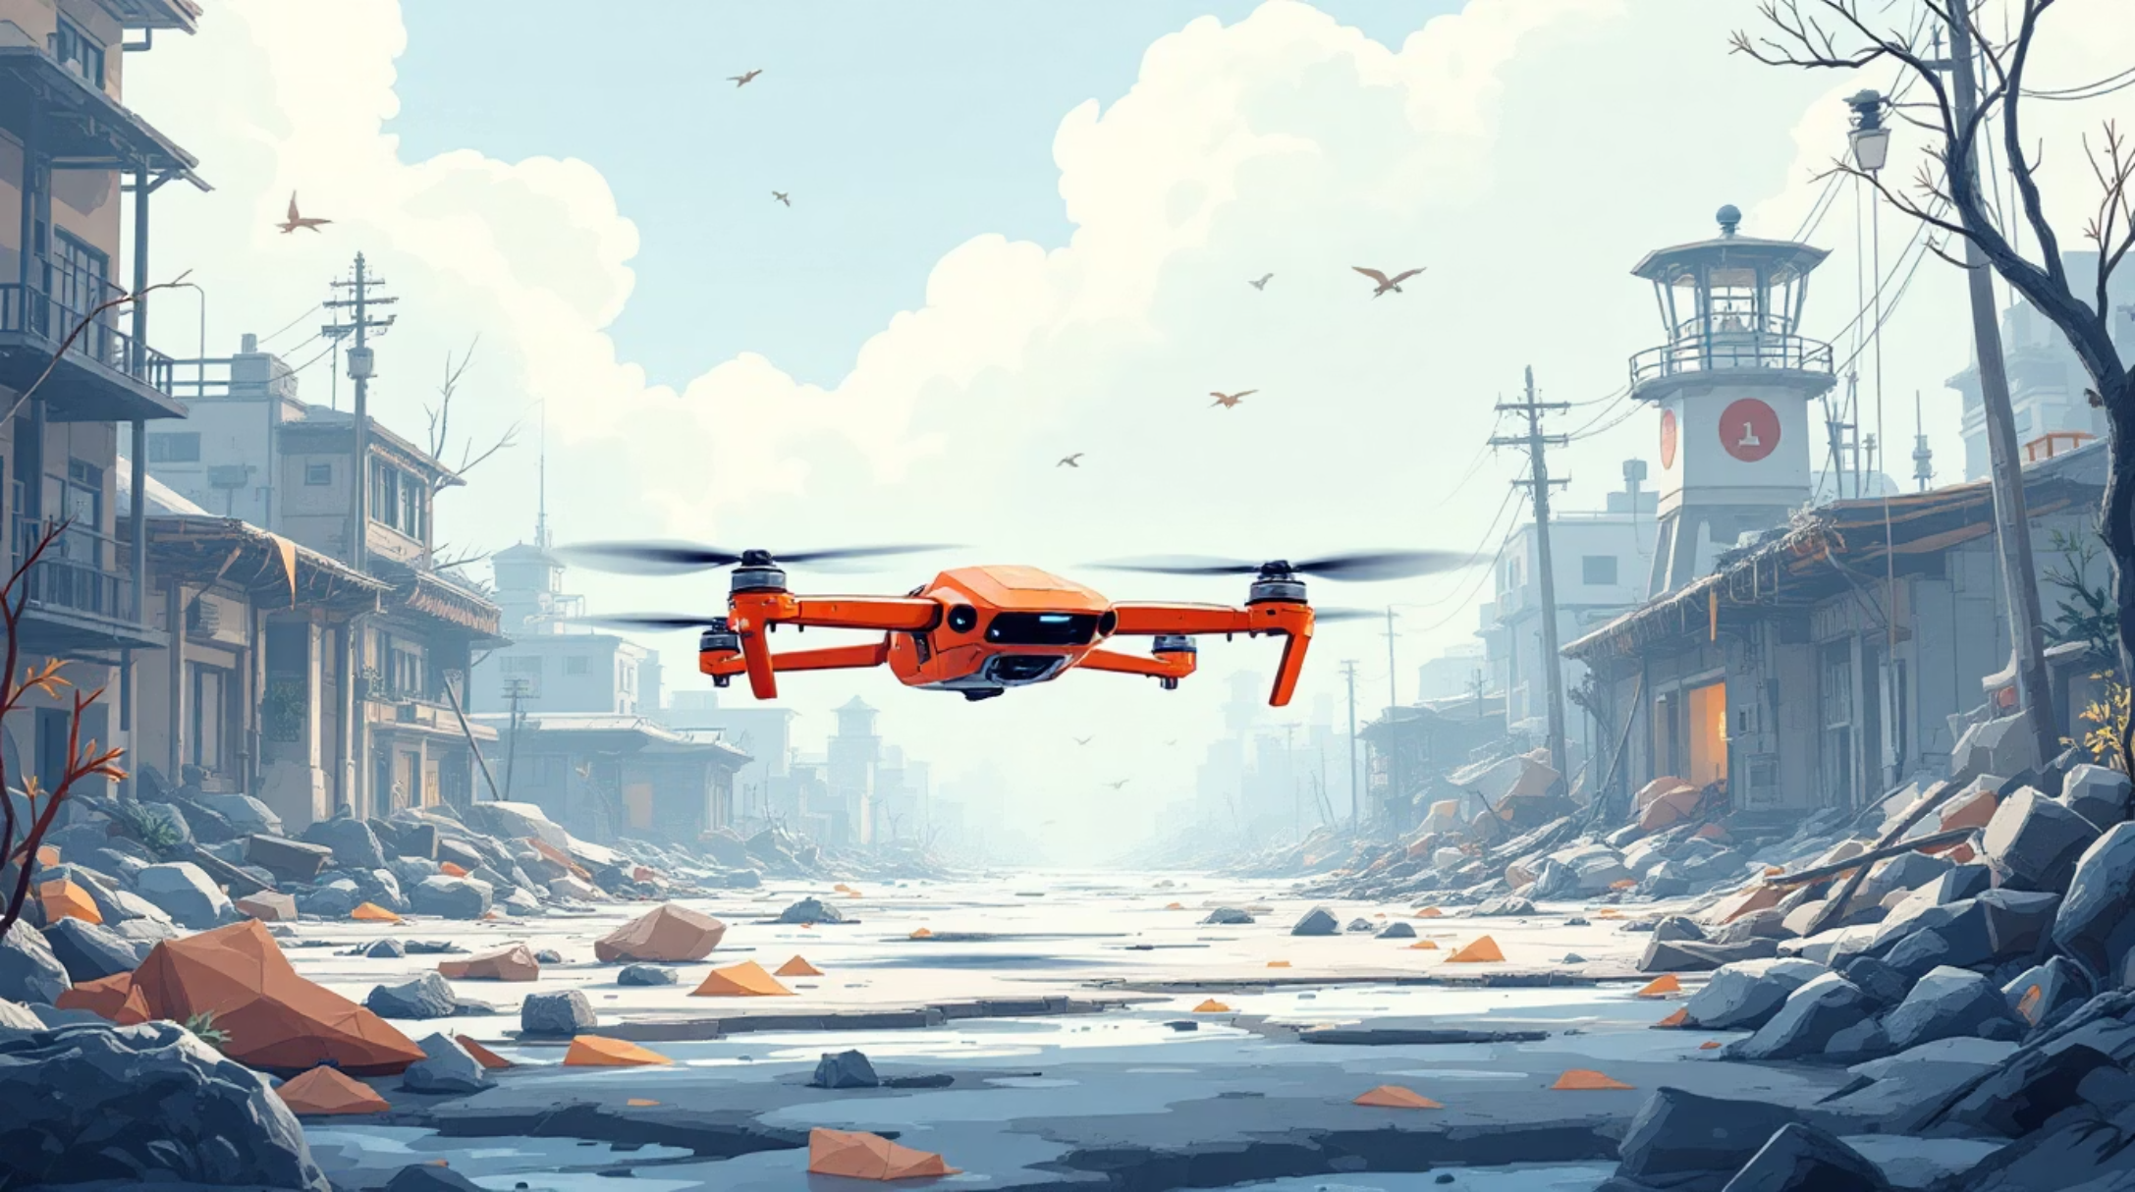
Introduction
An autonomous AI-powered drone system designed to revolutionize disaster rescue operations. This intelligent agent utilizes advanced search algorithms and sensor technology to efficiently locate victims in hazardous environments where human responders face significant risks.
The system combines pathfinding algorithms with real-time environmental awareness to navigate complex disaster zones, identify survivors, and optimize rescue routes.

Slide 3
Problem Statement
Time-Critical Response
Human Safety Risk
Disaster zones require immediate victim location, but manual searches are slow and inefficient in large affected areas.
Rescue personnel face life-threatening dangers from structural collapse, hazardous materials, and unstable terrain during search operations.
Complex Navigation
Resource Optimization
Destroyed infrastructure creates unpredictable obstacles requiring adaptive pathfinding and real-time decision-making capabilities.
Limited rescue resources must be deployed strategically across vast disaster areas to maximize victim recovery probability.

Slide 4


Problem Formulation
The rescue mission is modeled as a search problem with defined states, actions, and goals within a grid-based representation of the disaster environment.
Initial State
Obstacle Blocks
Goal State
State Expansion
State Space
Actions
Goal Test
Grid cells representing drone positions with obstacle markings and victim locations as target states.
Move in four directions (up, down, left, right) with path cost based on terrain difficulty and distance.
Victim detected at current position with confirmed vital signs through sensor verification.

Slide 5

Intelligent Agent Model
Sensors
Environment
Processing
Actuators
Visual Sensors
Positioning Systems
Goal Recognition
Camera and thermal imaging detect heat signatures and visual markers to identify survivors in rubble and debris.
GPS and obstacle detection sensors provide real-time location tracking and collision avoidance capabilities.
Image processing algorithms analyze sensor data to distinguish victims from environmental objects and debris.

Slide 6

Search Algorithms
Three pathfinding approaches enable efficient navigation through disaster environments, with A* selected as the optimal solution.
Breadth-First Search (BFS)
Depth-First Search (DFS)
Explores all neighboring positions at current depth before proceeding deeper. Guarantees shortest path but requires significant memory for large search spaces.
Explores as far as possible along each branch before backtracking. Memory-efficient but may find suboptimal paths and miss victims in other branches.
A* Search Algorithm
Combines path cost with heuristic estimation to prioritize promising routes. Optimally balances efficiency and accuracy, finding shortest paths while minimizing exploration.

Slide 7
Constraints
01
02
Obstacle Avoidance
Battery Limitations
Collapsing structures and debris require dynamic path recalculation and obstacle detection through sensor fusion.
Limited flight time constrains search area coverage, necessitating efficient routing and optimal charging station placement.
03
04
Environmental Factors
Safety Protocols
Weather conditions, visibility, and structural instability impact sensor reliability and navigation safety protocols.
Collision avoidance systems and emergency landing procedures ensure autonomous operation without human intervention.

Slide 8
Technology Stack
AI & Algorithms
Simulation Backend
Frontend Interface
Python programming language
A* search implementation
BFS and DFS algorithms
Heuristic functions
Python with NumPy
OpenCV for image processing
Flask or FastAPI framework
Grid-based environment model
Streamlit for simple UI
React for advanced interface
Real-time visualization
Control dashboard
Data Management
Drone Integration
SQLite for local storage
Firebase for cloud sync
Victim location records
Path history tracking
Raspberry Pi controller
Sensor array modules
GPS positioning system
Wireless communication

Slide 9
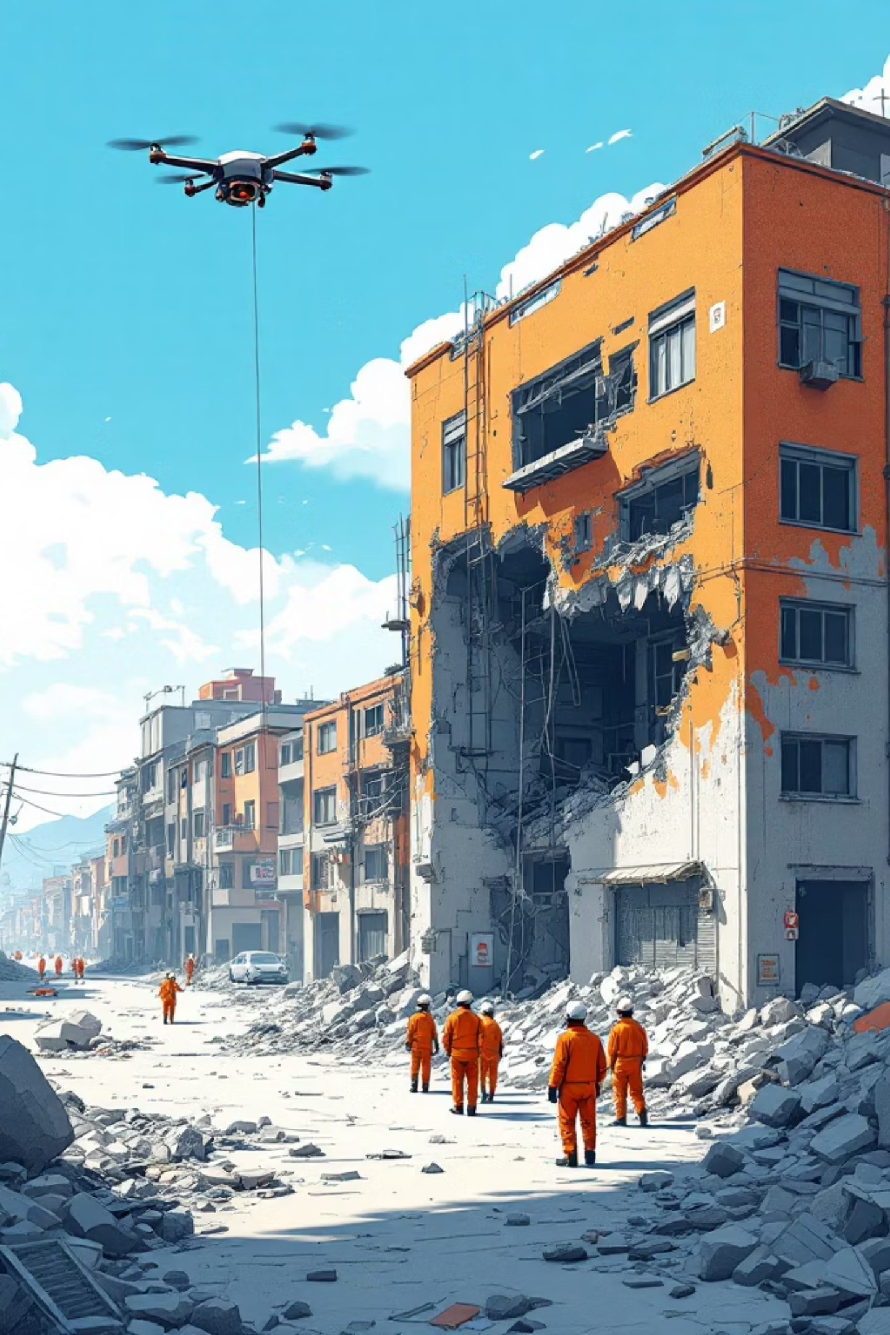
Applications
Earthquake Rescue
Flood Operations
Locates survivors trapped under collapsed buildings and infrastructure, navigating through unstable rubble using thermal imaging.
Searches flooded areas where ground access is impossible, identifying people stranded on rooftops or isolated locations.
Forest Search
Covers vast wilderness areas to find missing persons, using pattern recognition to distinguish humans from natural objects.

Slide 10
Advantages
Rapid Response Time
Enhanced Safety
Automated deployment and continuous operation reduce victim location time from hours to minutes, significantly improving survival rates.
Removes human rescuers from dangerous environments, eliminating risks from structural collapse, hazardous materials, and secondary disasters.
Systematic Coverage
Extended Operation
Algorithmic search patterns ensure complete area coverage without overlap, maximizing efficiency and minimizing missed victims.
Multiple drones operating in shifts with autonomous recharging enable 24/7 search operations until all victims are located.

Slide 11
Thank You
Bhoomika Poddar
Farzan Alam
Akshit Gaurana
Questions?

