Slide 1


Topic - Push & Pull
Presented By: Akshit Kumar
Notes:
Note: First “Right Click” on the Gradient background, go to “Order” option and “Send it to Back”, then insert your picture into “Image Placeholder”, “Right Click” on the picture and again go to “Order” option and “Send it to Back” to get the “Gradient” effect.
<number>

Slide 2

Our Agenda
01
Introduction of Git
02
Work-Flow of Git
03
Git Commands & Snapshots
04
Push & Pull
05
References

Slide 3
Introduction of Git
What is Git ?
Functions of a VCS
Advantage of Git
Git is a free and open source distributed version control system (VCS) designed to handle everything from small to large with speed and efficiency.
Version control system VCS is a software that helps software developers to work together and maintain a complete history of their work.
VCS allows developers to work simultaneously .
Does not allow overwriting each-others changes.
Maintain a history of every version
Free and open source
Fast and small
Implicit backup
Security
No need of power hardwares
Easier branching

Slide 4
DVCS (Distributed Version Control System) Terminology
Working Directory and Staging Area or Index
Repository
Local Repository - Every VCS tool provides a private workplace as a working copy. Developers make changes in their private workplace and after commit, these changes become a part of the
The working directory is the place where files are checked out.
In other CVCS, developers generally make modifications and commit their changes directly to the repository. But
A software repository, or “repo” for short, is a storage location for software packages. Often a table of contents is also stored, along with metadata.
A software repository is typically managed by source control or repository managers.

Slide 5
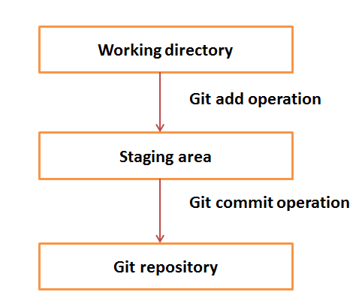
Work-Flow of Git
Steps to Follow
Step 1 − You modify a file from the working directory.
Step 2 − You add these files to the staging area.
Step 3 − You perform commit operation that moves the files from the staging area. After push operation, it stores the changes permanently to the Git repository.

Slide 6
Git Commands
git init - The git init command creates a new Git repository. It can be used to convert an existing, unversioned project to a Git repository or initialize a new, empty repository.
git add - git add is the first command in a chain of operations that directs Git to "save" a snapshot of the current project state, into the commit history.
git status - The git status command displays the state of the working directory and the staging area.
git commit - The git commit command captures a snapshot of the project’s currently staged changes.
git branch - Branches are used to create another line of development. By default, Git has a master branch, which is same as trunk in Subversion. Usually, a branch is created to work on a new feature. Once the feature is completed, it is merged back with the master branch and we delete the branch.
git push - git push is a command used to add all committed files in the local repository to the remote repository. So in the remote repository, all files and changes will be visible to anyone with access to the remote repository.
git fetch - fetch command used to get files from the remote repository to the local repository but not into the working directory.
git merge - merge command used to get the files from the local repository into the working directory.
git pull - pull command used to get files from the remote repository directly into the working directory. It is equivalent to a git fetch and a git merge .
Notes:
<number>

Slide 7
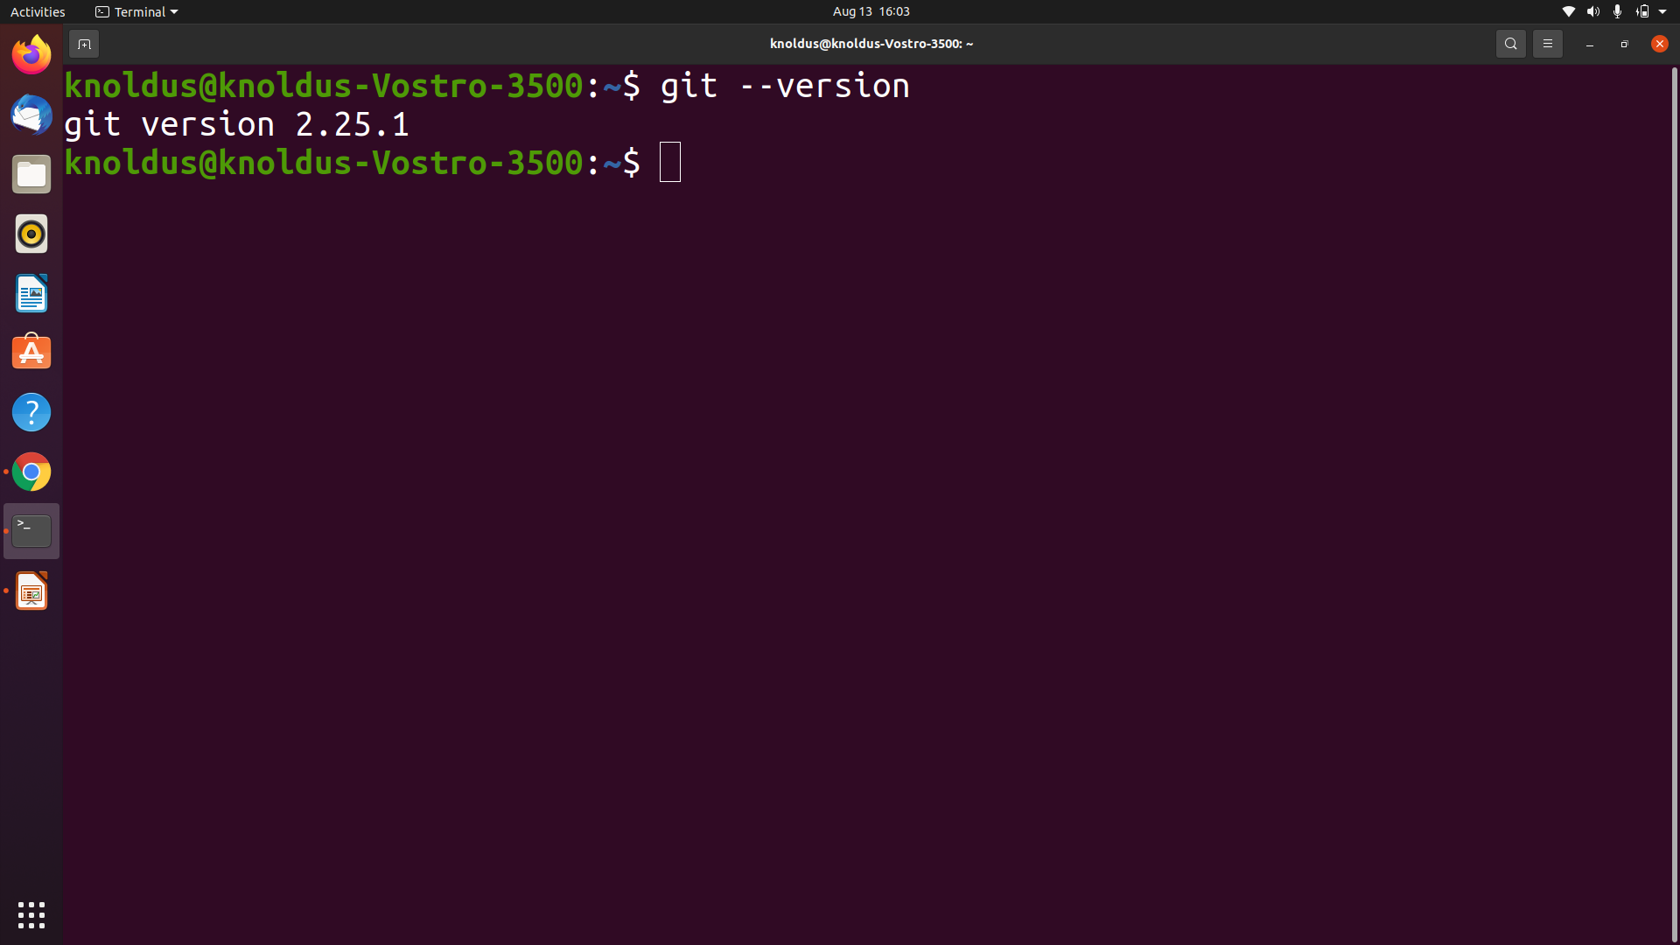
Working with GIT Commands
Firstly Make a GitHub Account
Make sure you have Git installed on you machine.
Check the version
git --version
Notes:
<number>

Slide 8
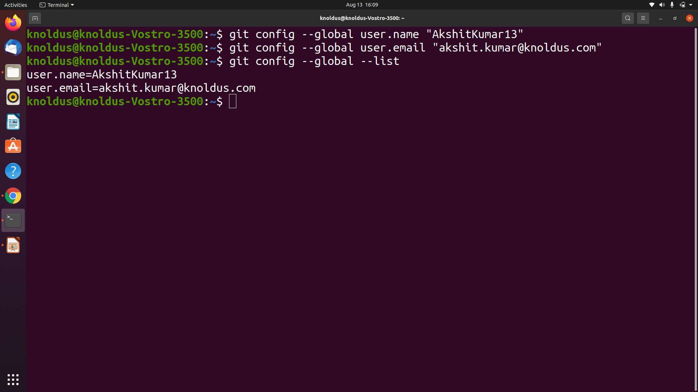
Git Commands
$ git config --global user.name "YOUR_USERNAME"
$ git config --global user.email "your email"
$ git config --global --list # To check the info you just provided
Notes:
<number>

Slide 9
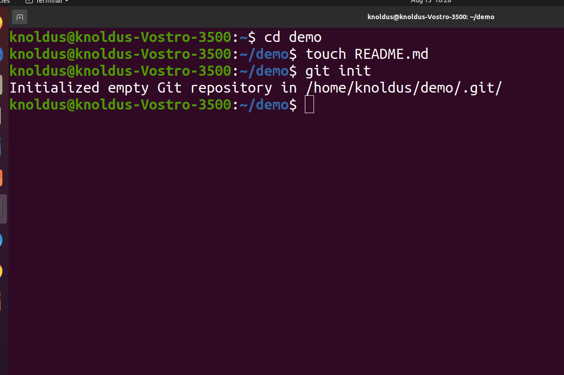
Git Commands
Let’s start with Git-
Create a new repository on GitHub
Now, locate to the folder you want to place under git in your terminal.
$ cd demo
Initialize Git:
And to place it under git, enter:
- $git init
-$ touch README.md # To create a README file for the repository $ git init
Notes:
<number>

Slide 10
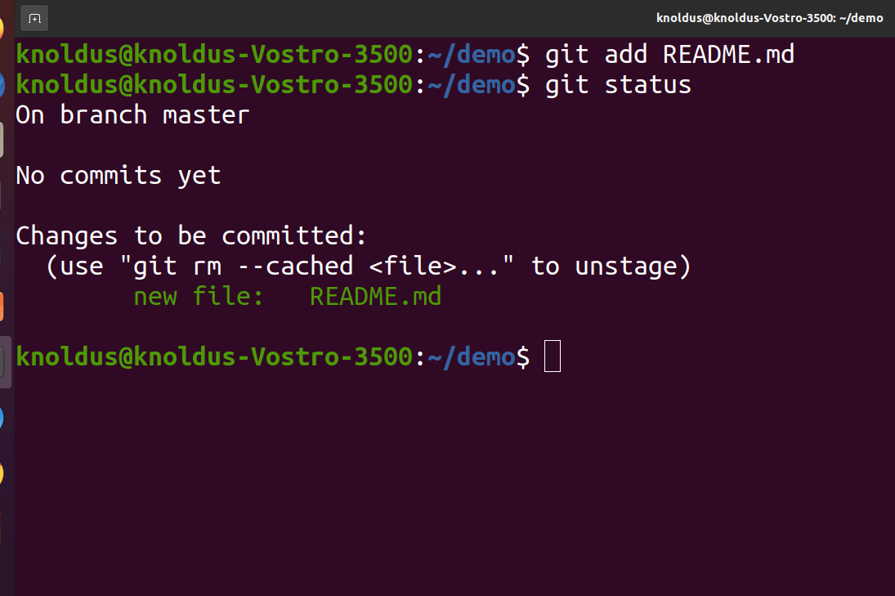
Git Commands
Add files to the Staging Area for commit:
Now to add the files to the git repository for commit:
$ git add . # Adds all the files in the local repository and stages them for commit
if you want to add a specific file
$ git add filename# To add a specific file
Before we commit let’s see what files are staged:
$ git status # Lists all new or modified files to be committed
Notes:
<number>

Slide 11
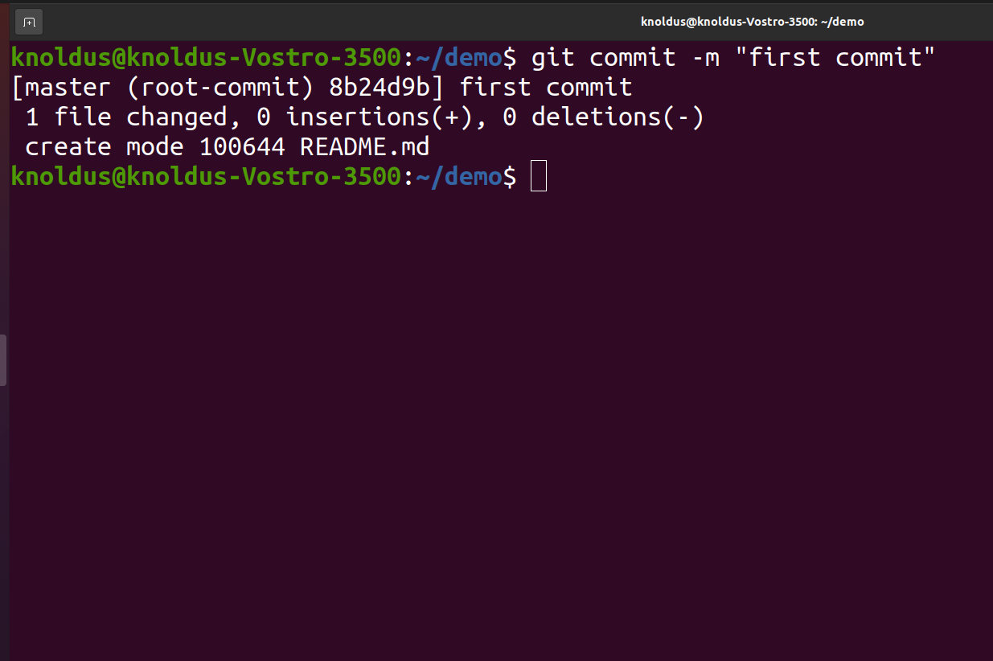
Git commands
Commit - Changes you made to your Git Repo:
$ git commit -m "First commit" # The message in the " " is given so that the other users can read the message and see what changes you made
Notes:
<number>

Slide 12
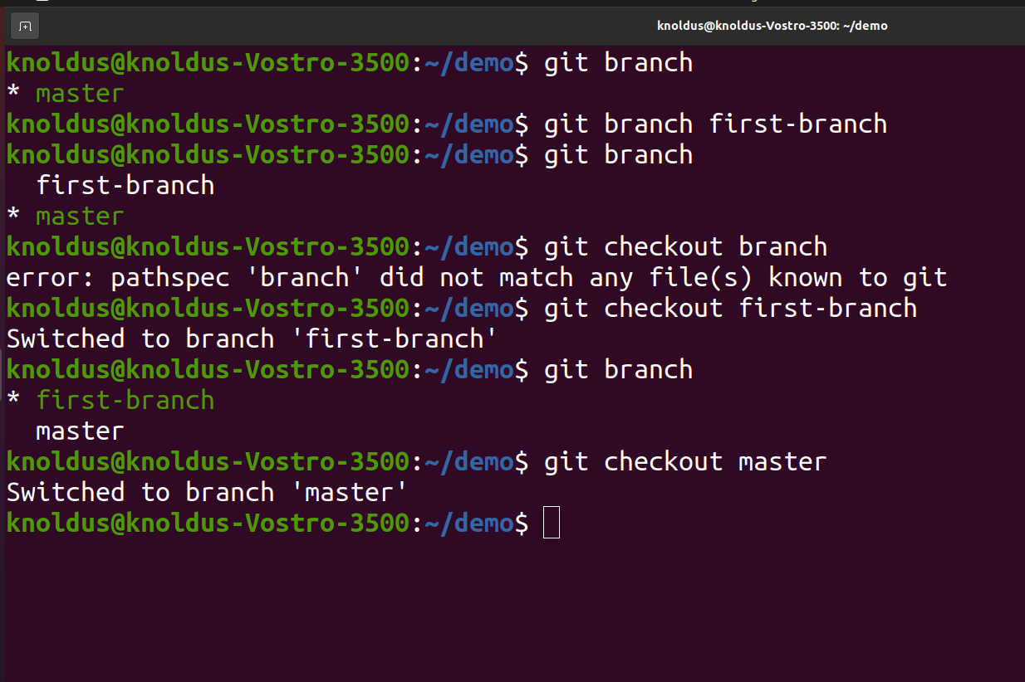
Git Commands
branch - Branches are used to create another line of development.
$ git branch # use to check the branch
$ git branch new-branch-name #uses to create a new branch
$ git checkout branchname #uses to jump the branch
Notes:
<number>

Slide 13
Push & Pull
Push - Push operation copies changes from a local repository instance to a remote one. This is used to store the changes permanently into the Git repository. This is same as the commit operation in Subversion.
Add a remote origin and Push:
$ git remote add origin remote_repository_URL # sets the new remote
The git remote command lets you create, view, and delete connections to other repositories.
$ git remote -v # List the remote connections you have to other repositories.
The git remote -v command lists the URLs of the remote connections you have to other repositories.
$ git push -u origin master # pushes changes to origin
Notes:
<number>

Slide 14
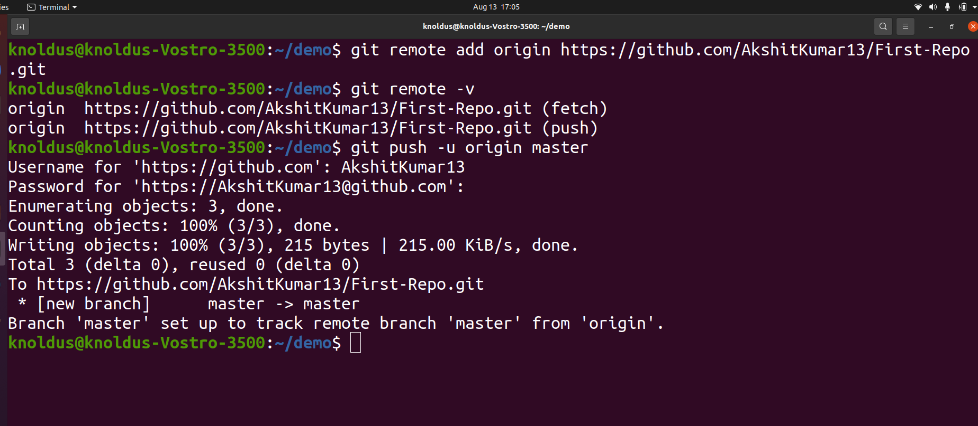
Push Snapshots
Notes:
<number>

Slide 15
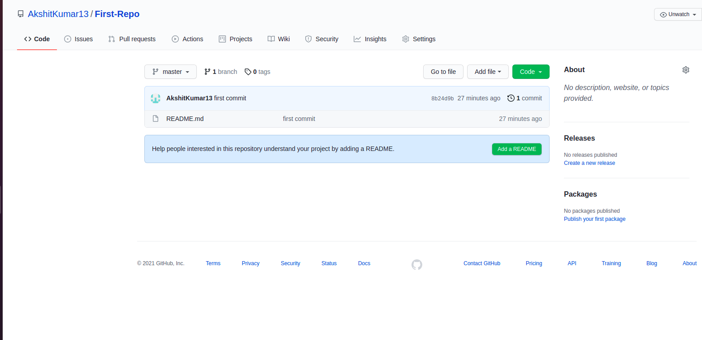
Github repository
After push the file from local repo to remote repo :-
Notes:
<number>

Slide 16
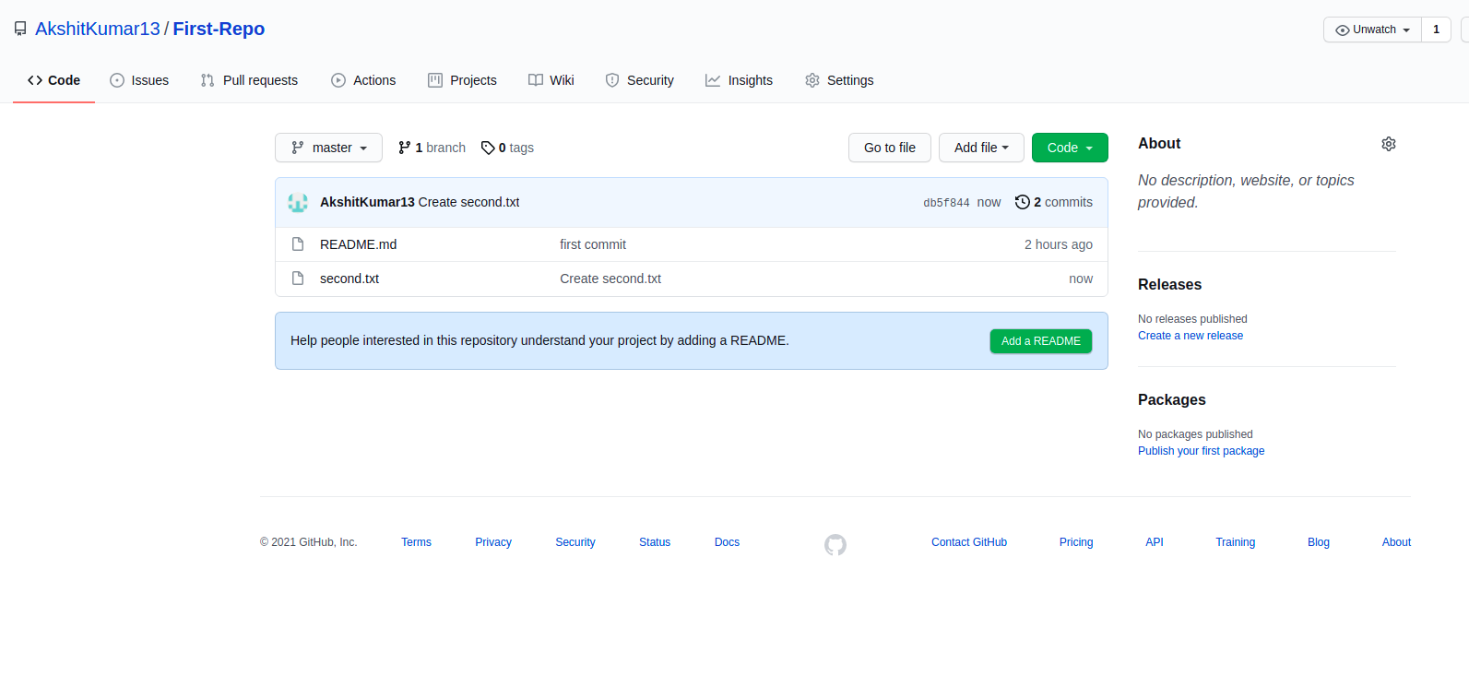
Push & Pull
Pull - The term pull is used to receive data from GitHub. It fetches and merges changes from the remote server to your working directory. The git pull command is used to pull a repository.
$ git pull <option> [<repository URL><refspec>...]
<option>: Options are the commands; these commands are used as an additional option in a particular command. Options can be -q (quiet), -v (verbose), -e(edit) and more.
First we create a file on github - second.txt and commit it .
Notes:
<number>

Slide 17
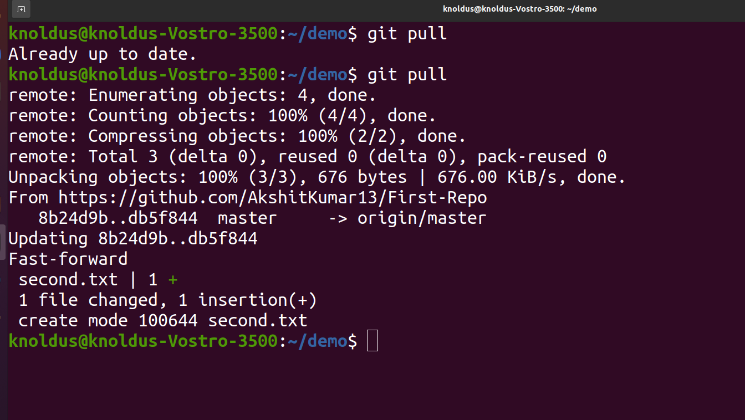
Push & Pull
Default git pull:
We can pull a remote repository by just using the git pull command. It's a default option.
$ git pull # now we pull the second.txt file using this pull command in over local repo.
Notes:
<number>

Slide 18
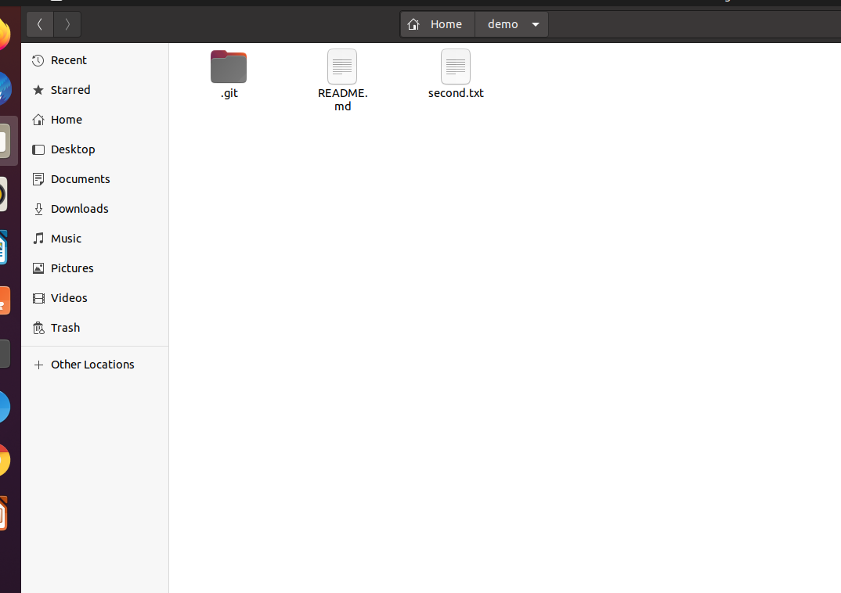
Push & Pull
In this snapshot we can see the second .txt file which is pulled from remote repository

Slide 19
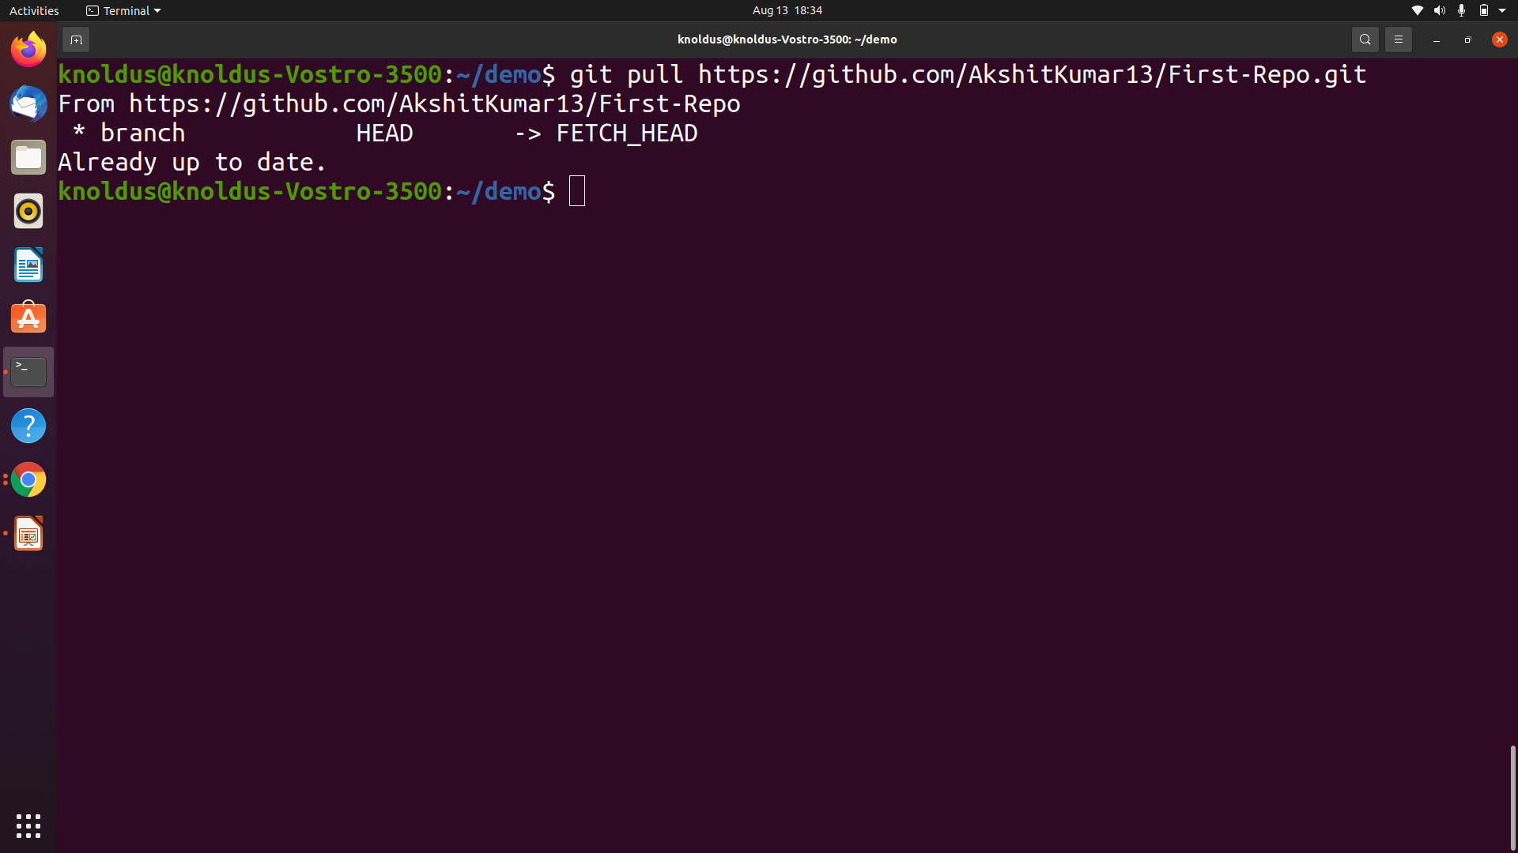
Push & Pull
$ git pull <remote branch URL>
this command is used to pull a remote branch:
Notes:
<number>

Slide 20
References
https://www.javatpoint.com/git-pull
https://www.tutorialspoint.com/git/git_basic_concepts.htm
https://git-scm.com/
Notes:
<number>

Slide 21
Thank You !
Notes:
<number>

