Slide 1


Slide 2
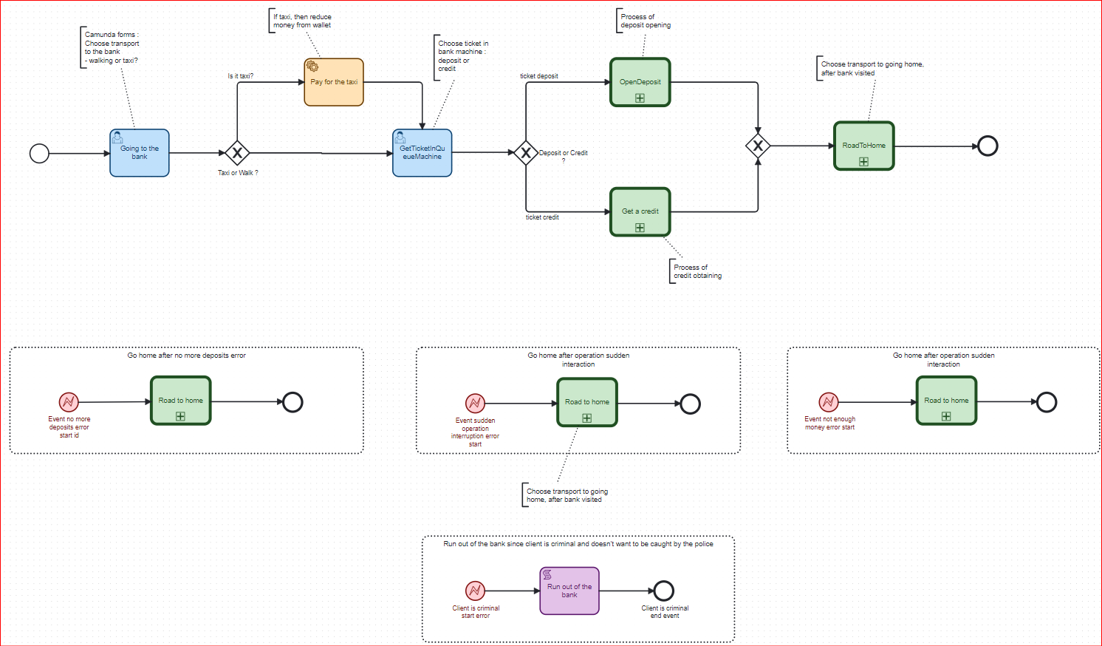
The main process

Slide 3
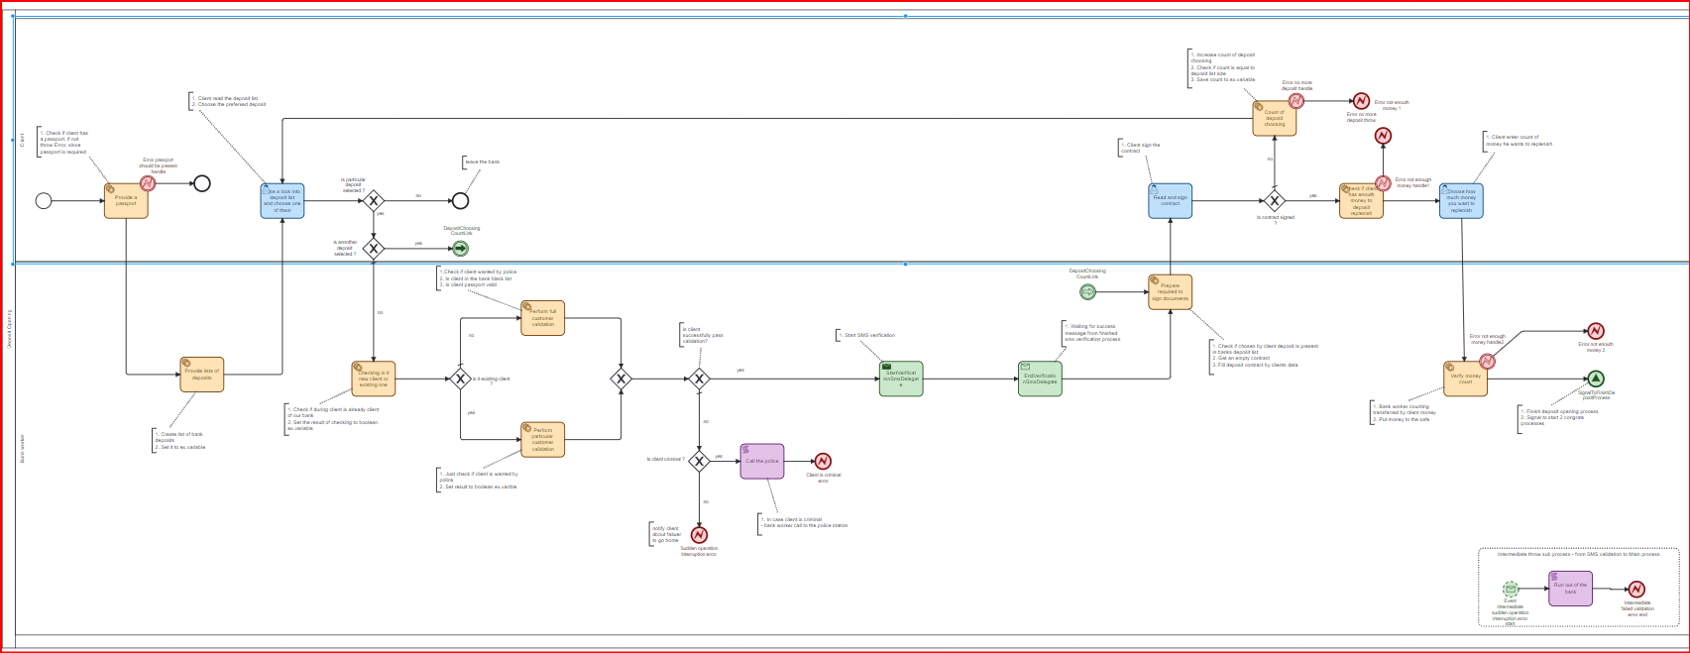
The Deposit obtaining process

Slide 4
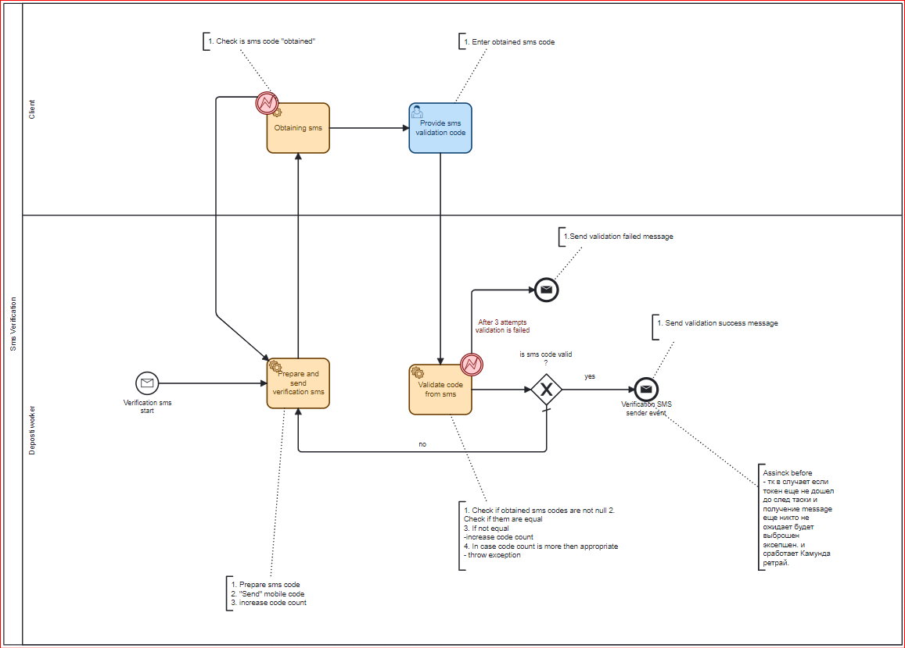
SMS verification process

Slide 5
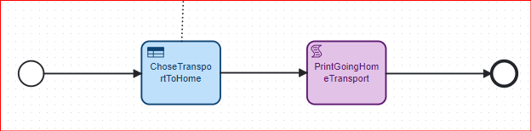
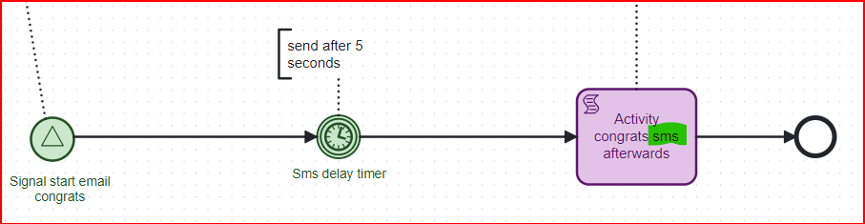
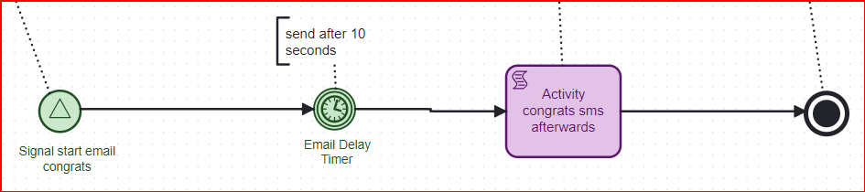
Additional processes

Slide 6
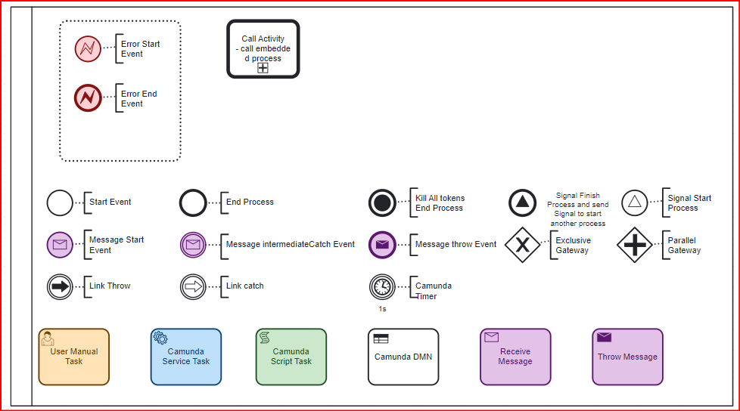
The part of the Camunda signs we are going to use in project

Slide 7
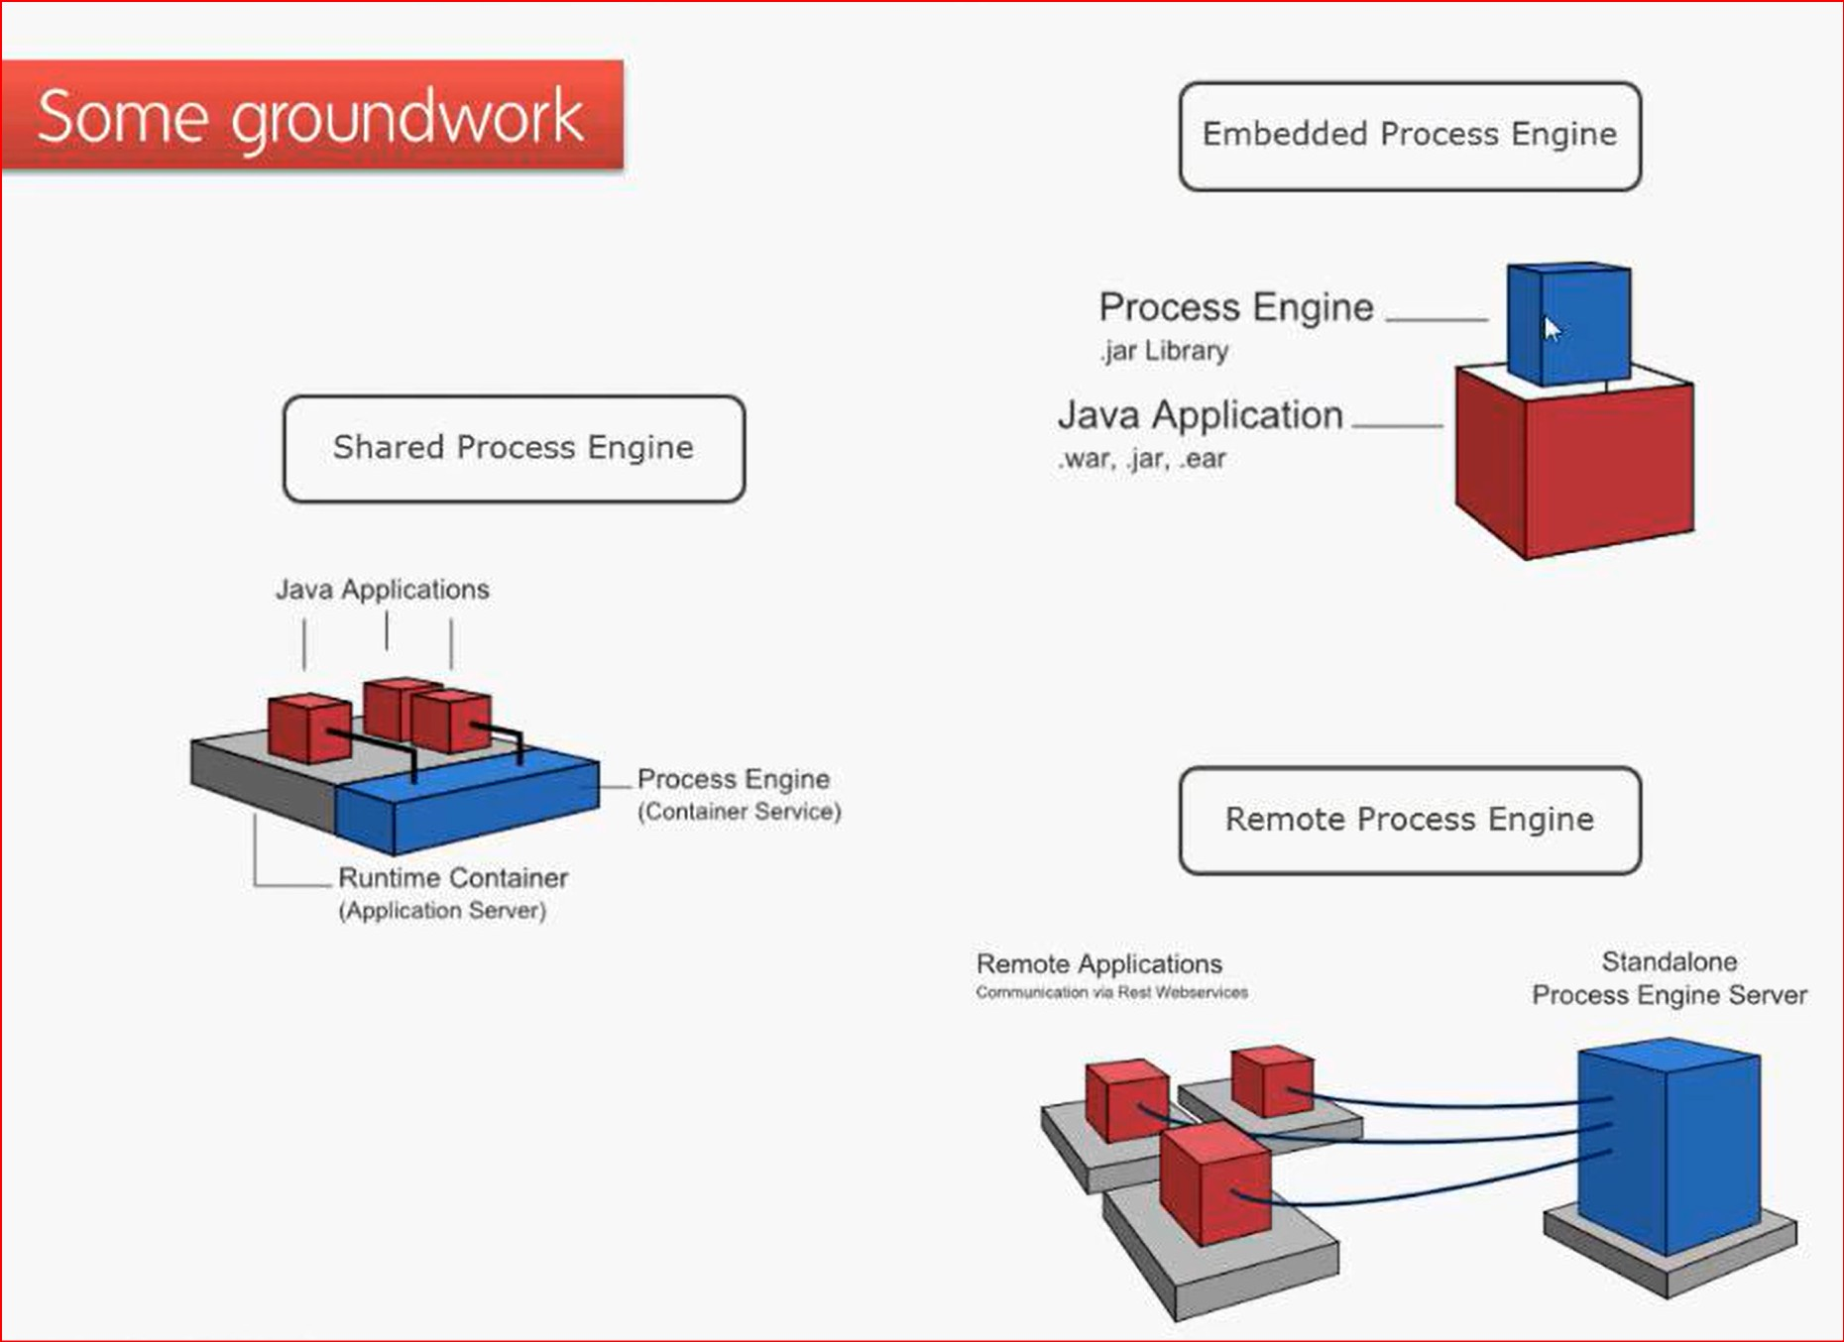

Slide 8
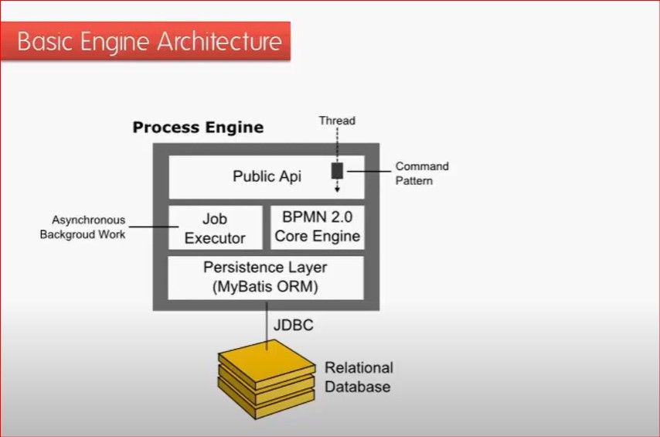

Slide 9
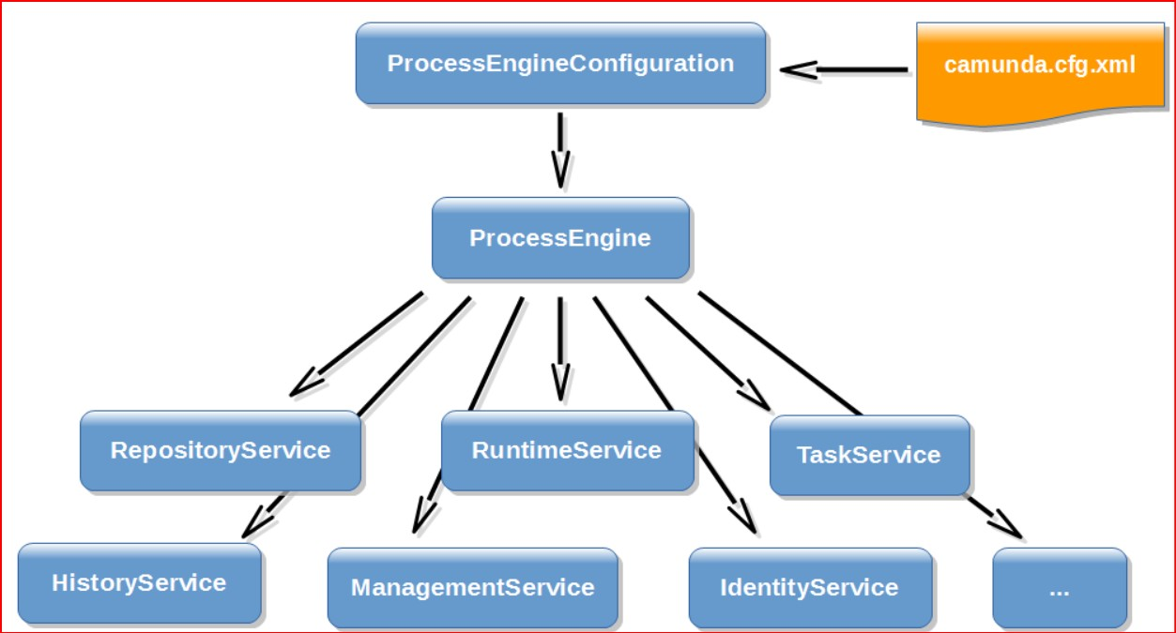

Slide 10
ProcessEngine processEngine = ProcessEngines.getDefaultProcessEngine();
TaskService taskService = processEngine.getTaskService();
FormService formService = processEngine.getFormService();
IdentityService identityService = processEngine.getIdentityService();
RuntimeService runtimeService = processEngine.getRuntimeService();
RepositoryService repositoryService = processEngine.getRepositoryService();

Slide 11
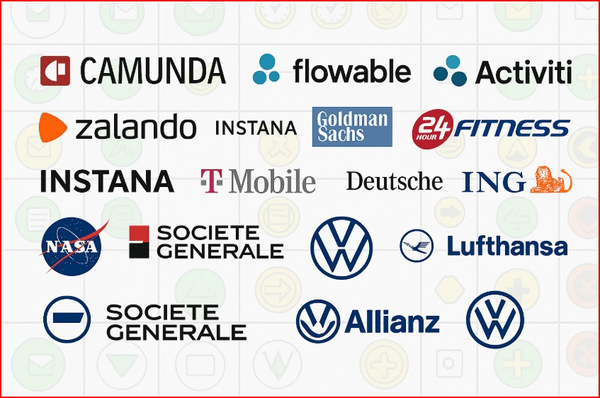

Slide 12
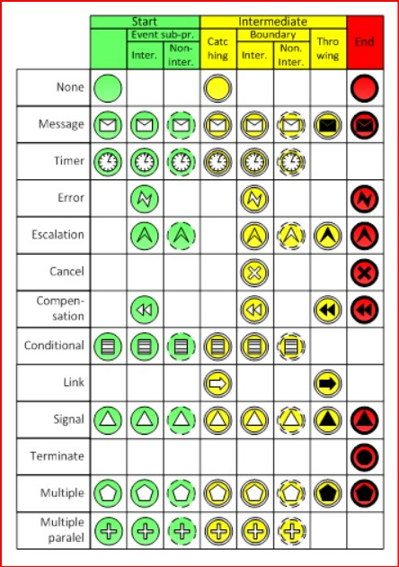
The list of often used BPMN events

Slide 13
Camunda Forum : https://forum.camunda.io/ Camunda DOCUMENTATION : https://camunda.com/ Camunda examples : https://github.com/camunda/camunda-bpm-examples Camunda events https://camunda.com/events/ linkedin : https://www.linkedin.com/company/camunda/ youtube : https://www.youtube.com/user/camundavideo
Useful links

Slide 14
Java 17 https://www.oracle.com/java/technologies/downloads/#java17 installation instruction : https://docs.oracle.com/en/java/javase/17/install/overview-jdk-installation.html#GUID-A0EAF7DB-67EB-4218-AD54-3E54CDD8D89E Maven https://maven.apache.org/download.cgi installation instruction : https://maven.apache.org/install.html Camunda modeler version 5.22.0 https://downloads.camunda.cloud/release/camunda-modeler/5.22.0/ installation instruction (only first page) : https://docs.camunda.org/get-started/quick-start/install/ Intellij Idea Community Edition version 2023.3.5 https://www.jetbrains.com/idea/download/other.html installation instruction (standalone installation) : https://www.jetbrains.com/help/idea/installation-guide.html#standalone Please don’t forger about the “path” variables on your computer
Installation links

Slide 15

Signal
A Signal Event is a powerful way to broadcast messages in BPMN
It can be interrupting or non-interrupting, catch or throw
It is great when you need to notify many processes at once
It’s easy to send using REST API (for example, from Postman)
Perfect for notifications, escalations, timers, and parallel logic

Slide 16

Conditional Event
Conditional Event is a powerful way to wait for logical conditions
It can be used to start a process or pause it inside
Helps to build dynamic and flexible process flows that react to variable values
The process can pause and wait, which is great for automation and control
Supports JUEL and FEEL expressions

Slide 17
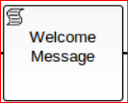
Script Task
What is it?
An automated activity in the process
Runs a script without user interaction
Use cases:
Logging
Simple calculations
Updating variables
Conditional logic
Script Types: Inline – Write directly in the task External – Reference a file
Supported languages:
Groovy
JavaScript
JRuby
Jython

Slide 18
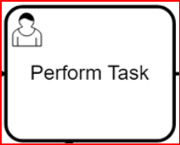
User Task
User Task is done by a human, not by the system
Set the task type to "User Task" and add an assignee (e.g. demo)
Tasks appear in Camunda Tasklist for the assigned user
The process waits until the user completes the task
Supports Camunda Forms, custom forms (Angular/React), or external interfaces
Works great for human decisions, approvals, and manual checks

Slide 19

Service Task
Used for: Executing system logic automatically
Common uses:
Has call REST API
Run Java code (JavaDelegate)
Work with databases or external systems
Java Class Setup:
Implement JavaDelegate interface
Override execute(DelegateExecution execution)
Add full class name in Modeler (e.g. com.example.MyService)

Slide 20
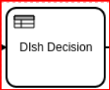
DMN
What is DMN ?
A table-based way to define business rules (by OMG), used instead of complex if-else logic in BPMN.
Why use it? ✅ Easy to read and maintain ✅ Business-friendly (supports FEEL language) ✅ Rules can be changed without touching the process model
Hit Policy Types:
FIRST: First match is taken
ANY: All matches must return the same result
COLLECT: Gather multiple results (use SUM, MAX, etc.)
RULE ORDER: Return all matches in order
UNIQUE: Only one rule matches

Slide 21
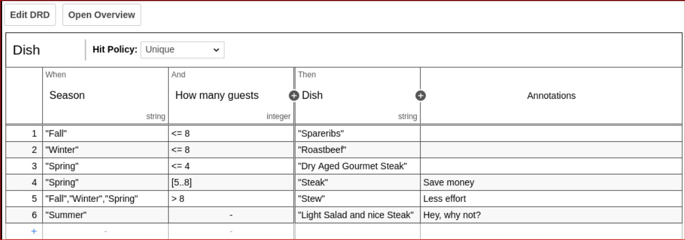
DMN

Slide 22
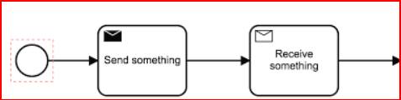
Message task
Key Points:
Send Task: Sends a message to another process or service
Receive Task: Waits for a message to continue the process
Message Start Event: Starts a process when a message is received
Intermediate Message Event: Waits for a message during the process
Why Use Message Task?
Connect different pools (departments, services)
Support async communication (no need to wait)
Useful for microservices and event-driven flows
Can also send messages using REST API

Slide 23
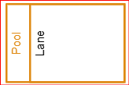
Lane & pool
Pool - Represents a participant
Lane - Sub-part of a Pool for roles or teams
Why Use Them?
Features:
Clear separation of responsibilities
Useful for collaboration and multi-role processes
Use Link Events to connect lanes
Use Message Flows between Pools

Slide 24
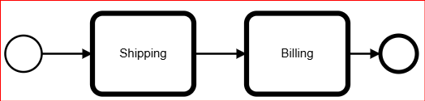
Call activity
Call Activity
Calls another BPMN process
Used for reusing existing logic
Starts a separate process instance
Set “Called Element” in Modeler
📦 Embedded Subprocess
Built into the same diagram
Has own start/end, tasks, gateways
Great for grouping logic locally
No separate process instance
⚡ Event-based Subprocess
Triggers on event: message, timer, signal, etc.
Can run any time during the main process
Used for errors, interruptions, or messages

Slide 25



Error
Error Handling
Managing what happens when something goes wrong
Boundary Error Event
Catches error from a task
Error End Event
Sends an error
Event Subprocess
Reacts to error from anywhere in the process
Error Code
Links the error and the handler

Slide 26
Transactions & Asynchronous Flags in Camunda BPM
Retry Behavior
Default: 3 automatic retries
You can configure retry policy in BPMN or Java
What is a Transaction? A part of the process between two wait states (User Task, Timer). If something fails inside – everything is rolled back.
Asynchronous Before
Adds a transaction boundary before a task
Saves all previous data before entering the task
Useful when the next task might fail (e.g., external API call)
Why Use Asynchronous Flags?
Prevent full rollback of process
Enable retry if task fails
Required for parallel or non-blocking executions
Asynchronous After
Adds a boundary after the task
The task completes, but next steps run in a new transaction

Slide 27
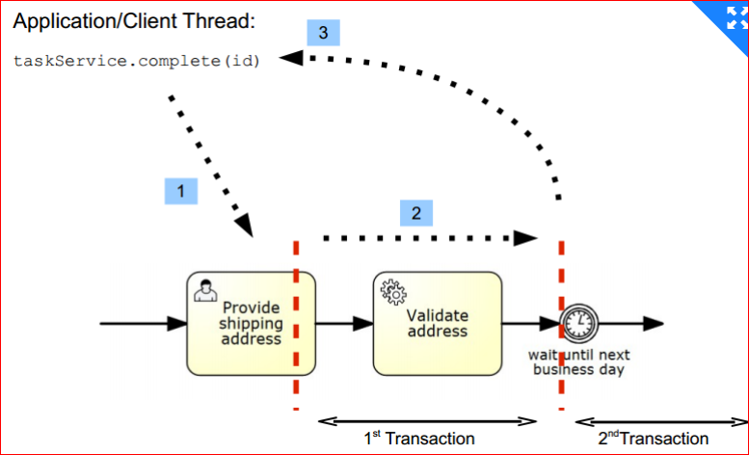
Transactions & Asynchronous Flags in Camunda BPM

