Slide 1

Problem
Team Name
Code For Vision
Team Members
Design a low cost, sustainable, and energy-efficient solution to help prevent water crisis in the near future, making use of existing and emerging technologies.
Akshit Ostwal
Jayesh Joshi
Aditya Surana
Manish Garg
Problem Name
Water Crisis

Slide 2
Water Crisis
Some of the Causes:-
Increase in Population
Climate Change
Improper agriculture techniques
Competition of water resources
Increases Pollution
India's water crisis is often attributed to lack of government planning, increased corporate privatization, industrial and human waste and government corruption.

Slide 3
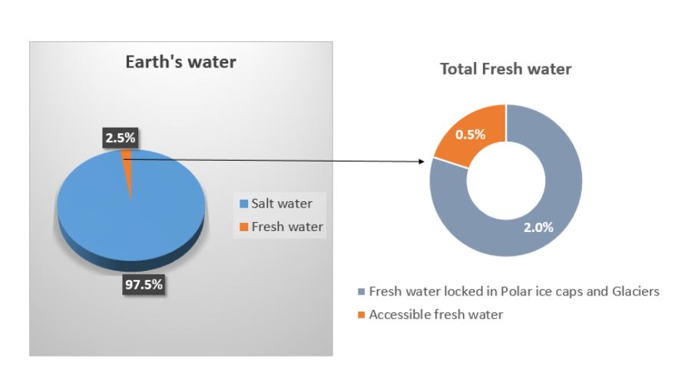
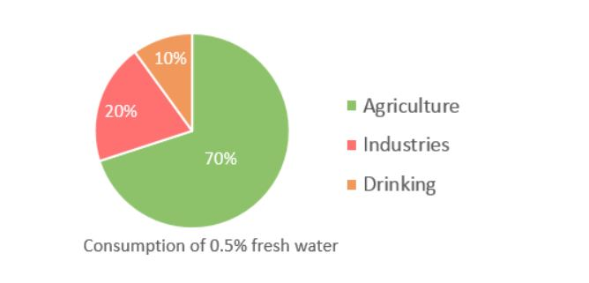
Improper Agriculture Techniques
Total Earth’s water is salt water – 97.5%
Only 2.5% is fresh water.
Out of that 2.5% fresh water, 2% is locked in polar ice caps and glaciers and only 0.5% fresh water is left which is used for drinking, agriculture, industries etc.
Alone in agriculture sector 60% water is wastage out of 70% used.

Slide 4
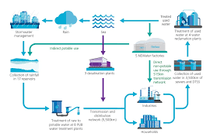
Non technical solution to overcome water crisis
Rainwater harvesting
Restoring and maintaining our water bodies.
Growing trees.
Mandatory water recycling in all apartments and textiles.
Reusing the waste water from RO. During purification process nearly 70% water gets wasted. We can store and re-use it.
Creating social awareness among the people about effective usage of water.
Revolutionize the agriculture practice.

Slide 5






Dependencies
Technical Solution
Lot of data is needed.
All Information about these 7 inputs.
Smartphone (Android) phone is required to use the app.
Internet is required to sync the data on server.
In order to decreases the wastage of water in agriculture, will develop web/mobile app which takes 7 inputs namely.
Crop Name
State Name
Temperature
Humidity
Air Pressure
Soil Fertility
Light Intensity
Using Machine Learning it will give the output, what amount of water(litre) per acre required.
Technologies Stack

Slide 6



Dependencies
Technical Solution
WHAT DO WE NEED
It will take 7 inputs (Crop Name, State Name, Temperature, Humidity, Air Pressure, Soil Fertility, Light Intensity)
Mobile/Web App
Can add different intents for perfect experiences
Can define actions that can be embed into machine at the run time.
Can train it accordingly for better accuracy.
Admin
Interact by giving the inputs information.
Can save the required information in his/her profile.
Can review his/her prediction of quantity of water required per acre.
Users

Slide 7
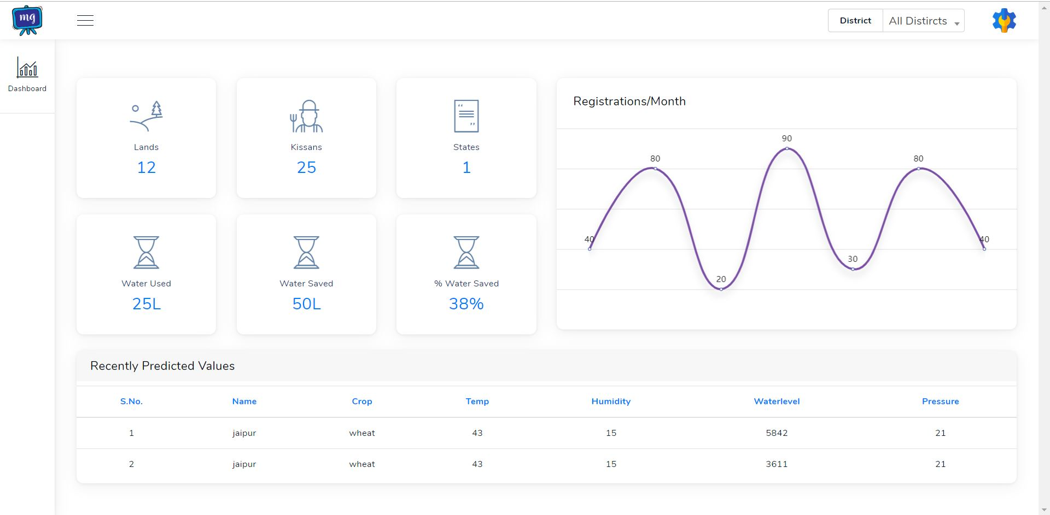
Snap of Website Admin Portal

Slide 8
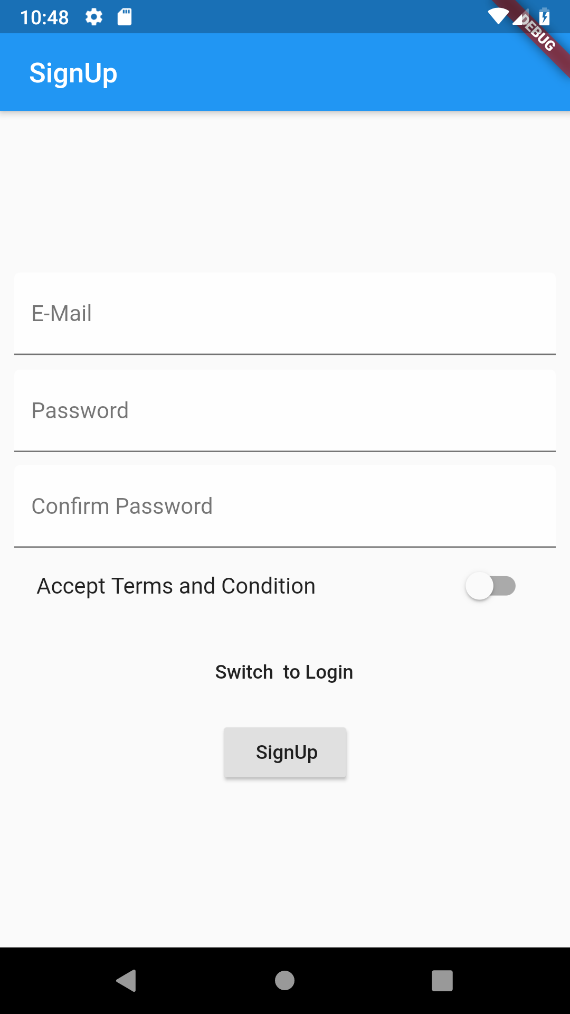
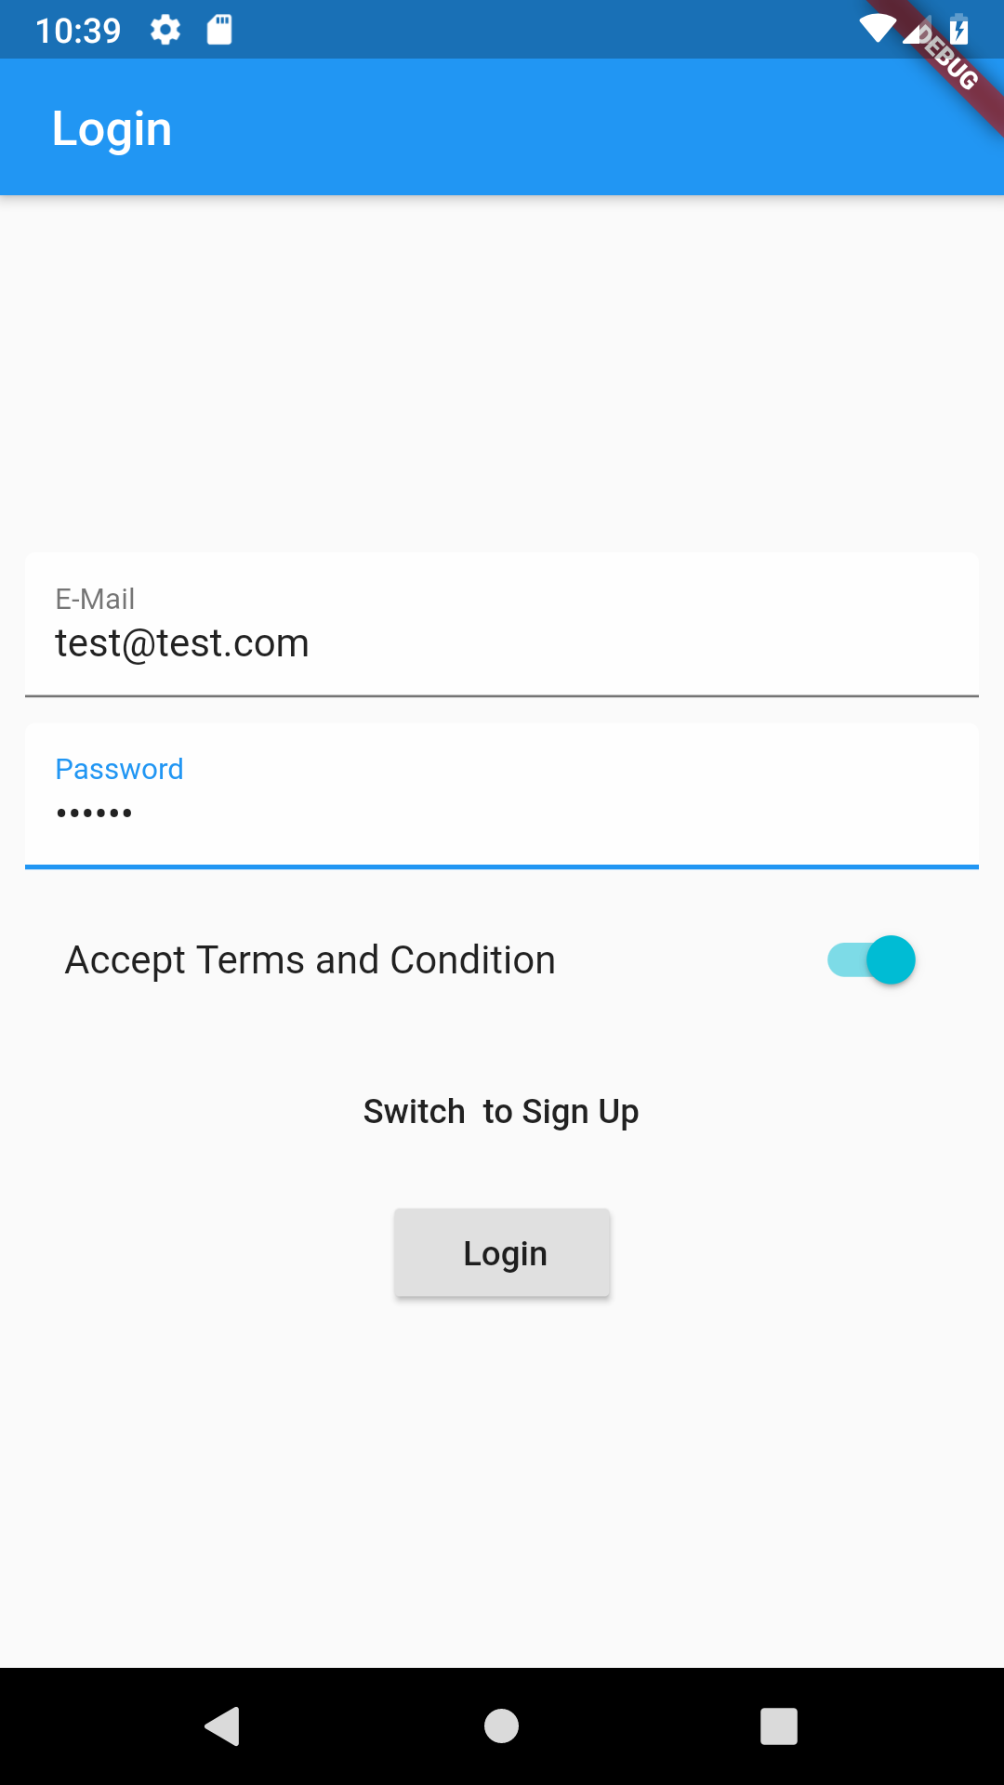
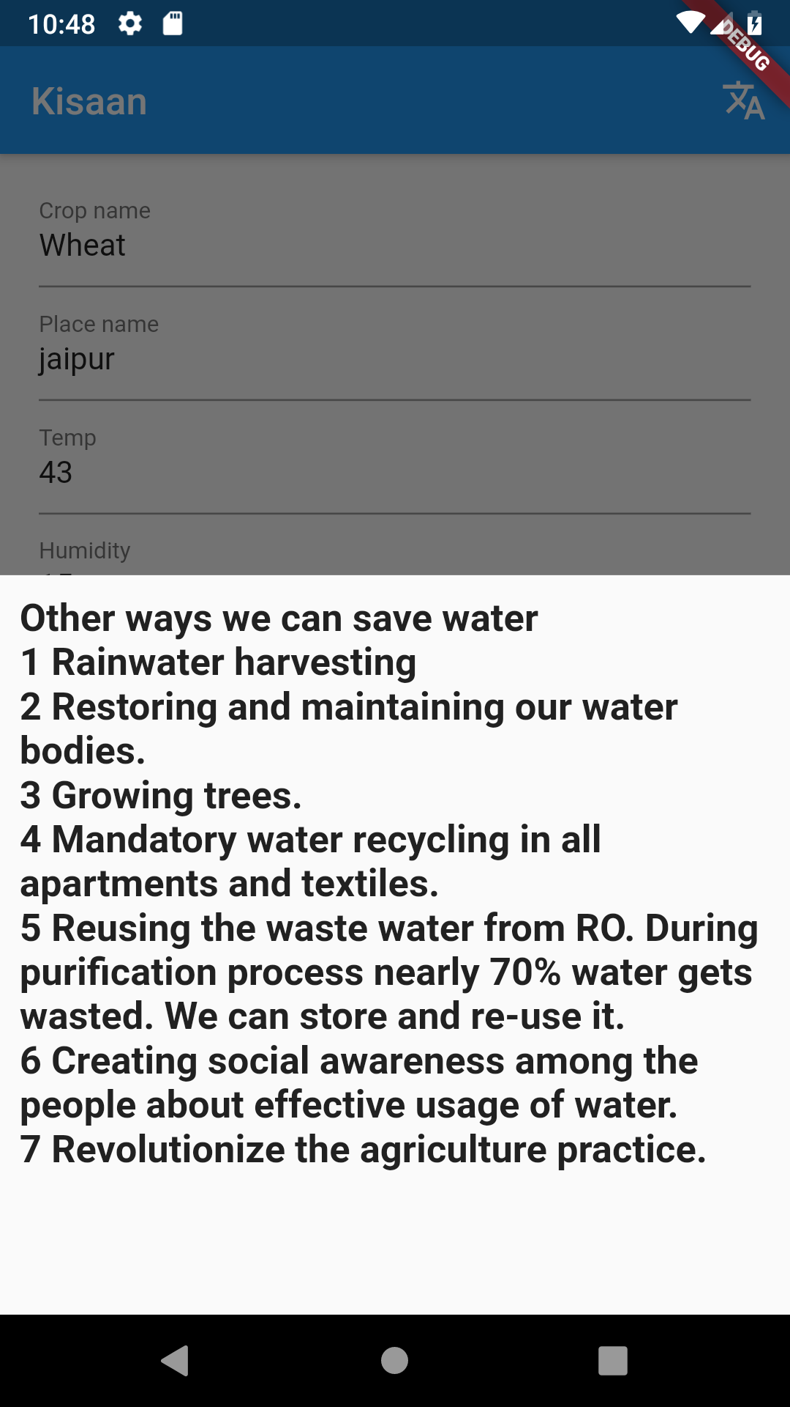

Slide 9
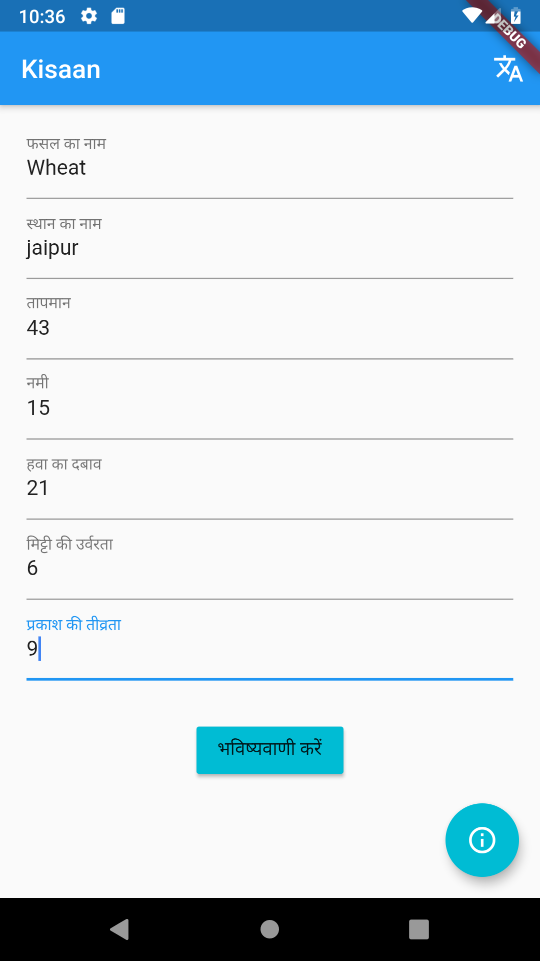
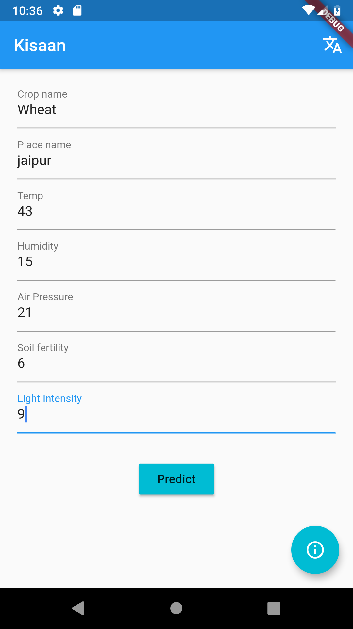
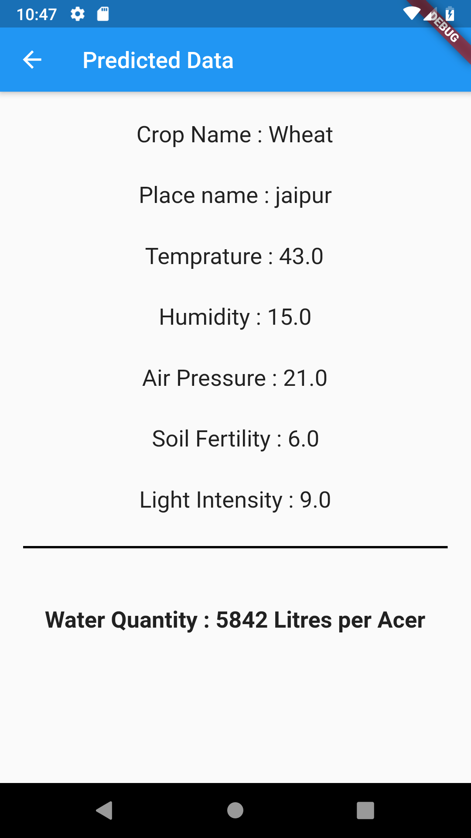

Slide 10
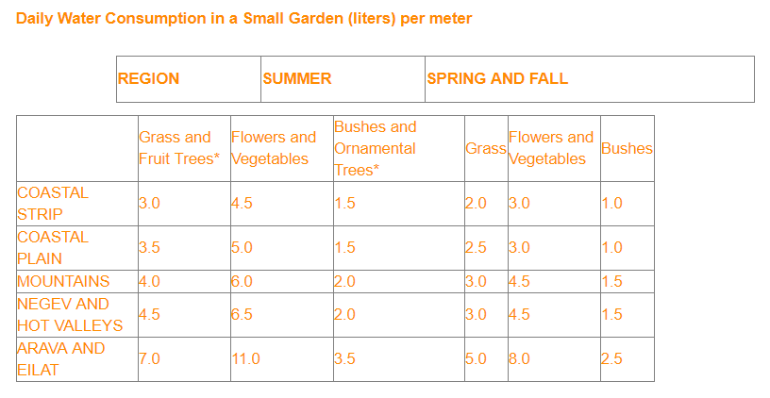
According to Ministry of India:

Slide 11
Revenue Model
Lets Do Some Maths!!
Total Population of India – 1.2 billion.
Estimates for total number of farmers in India for 2011 - 450 million (38% of total population).
We will not take any cost from farmers until 2 years, then will take 1 rupee per prediction or monthly plan(15 Rs per month)or yearly plan(120 per year).
If half of the farmers will take help from this farmer then 225million*1 = 225 million rupees.

