Slide 1



SMART Question
How household incomes are related with the number of maternal deaths and drug overdose deaths?

Slide 2
Variables
Median Household Income
Total Number of Maternal Death
Total Number of Drug Overdose Death

Slide 3
EDA
Histogram
QQ Plot
Boxplot

Slide 4
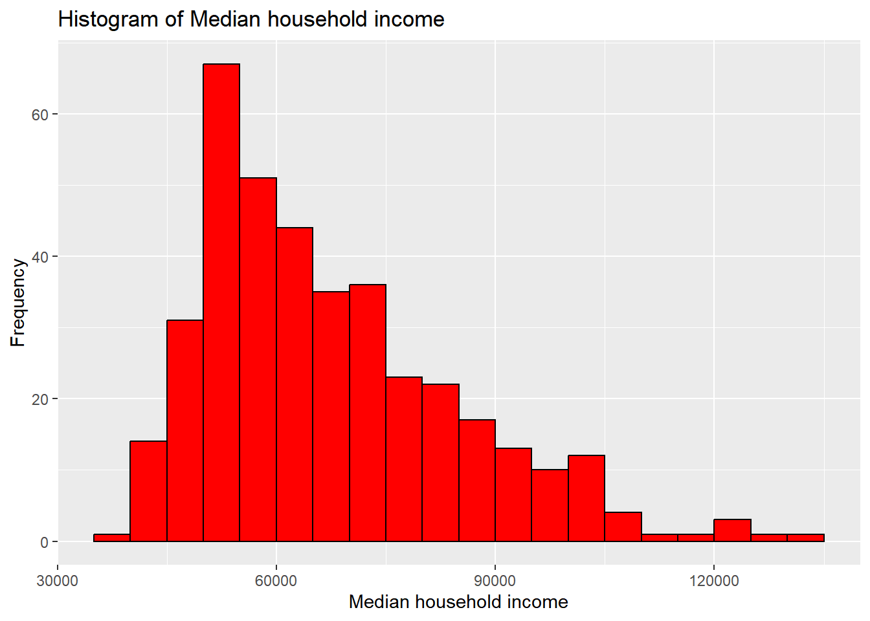

Slide 5
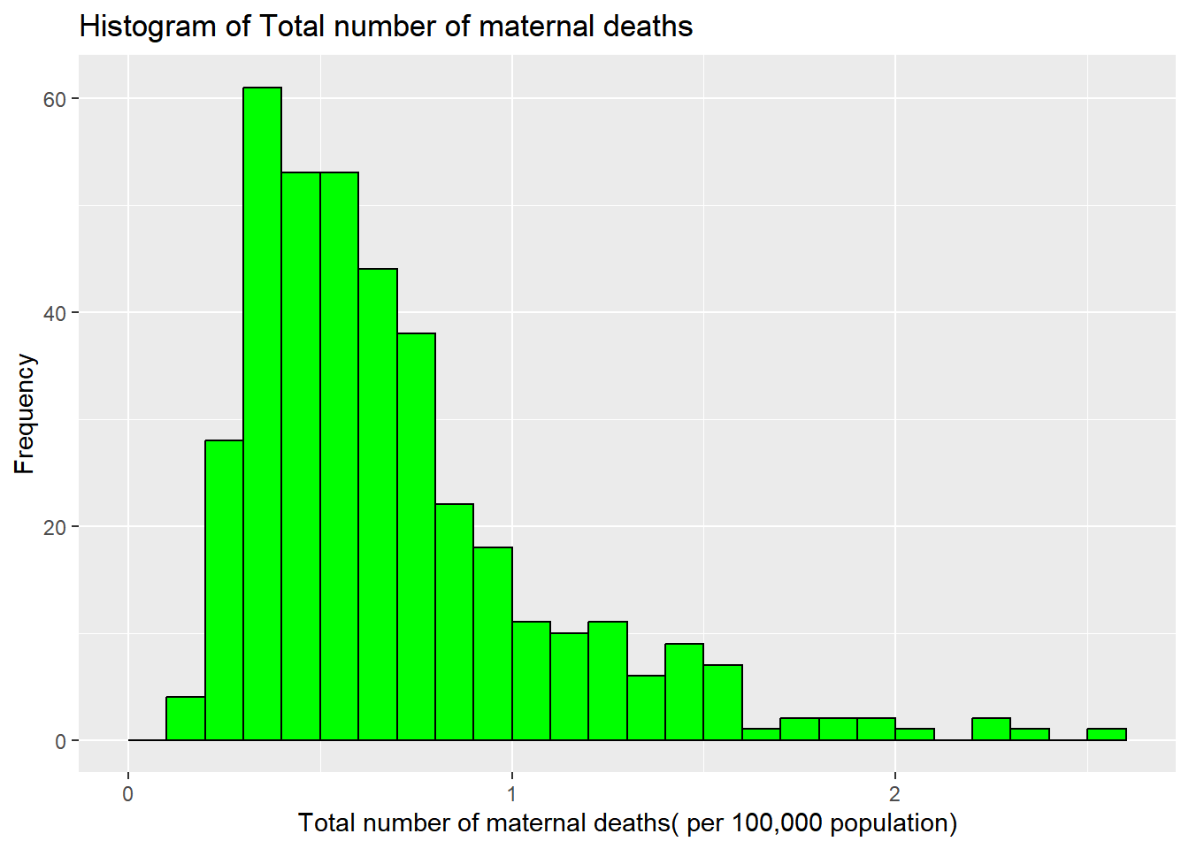

Slide 6
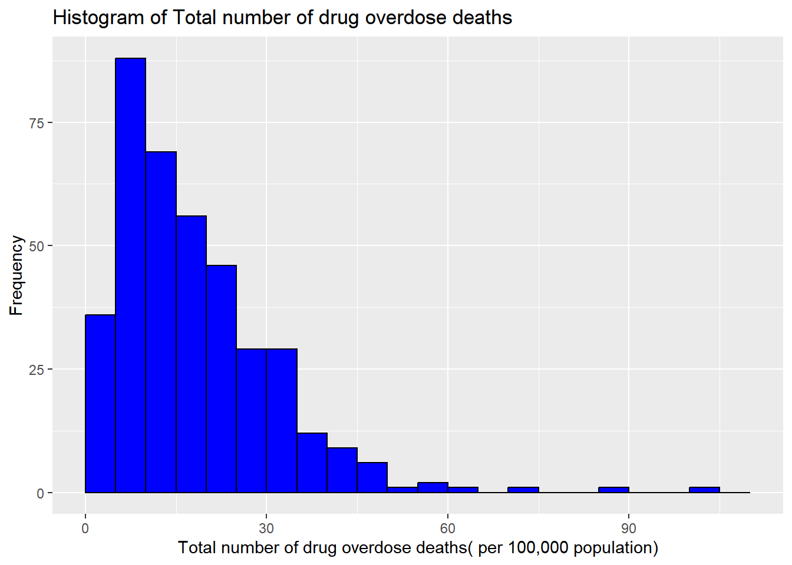

Slide 7
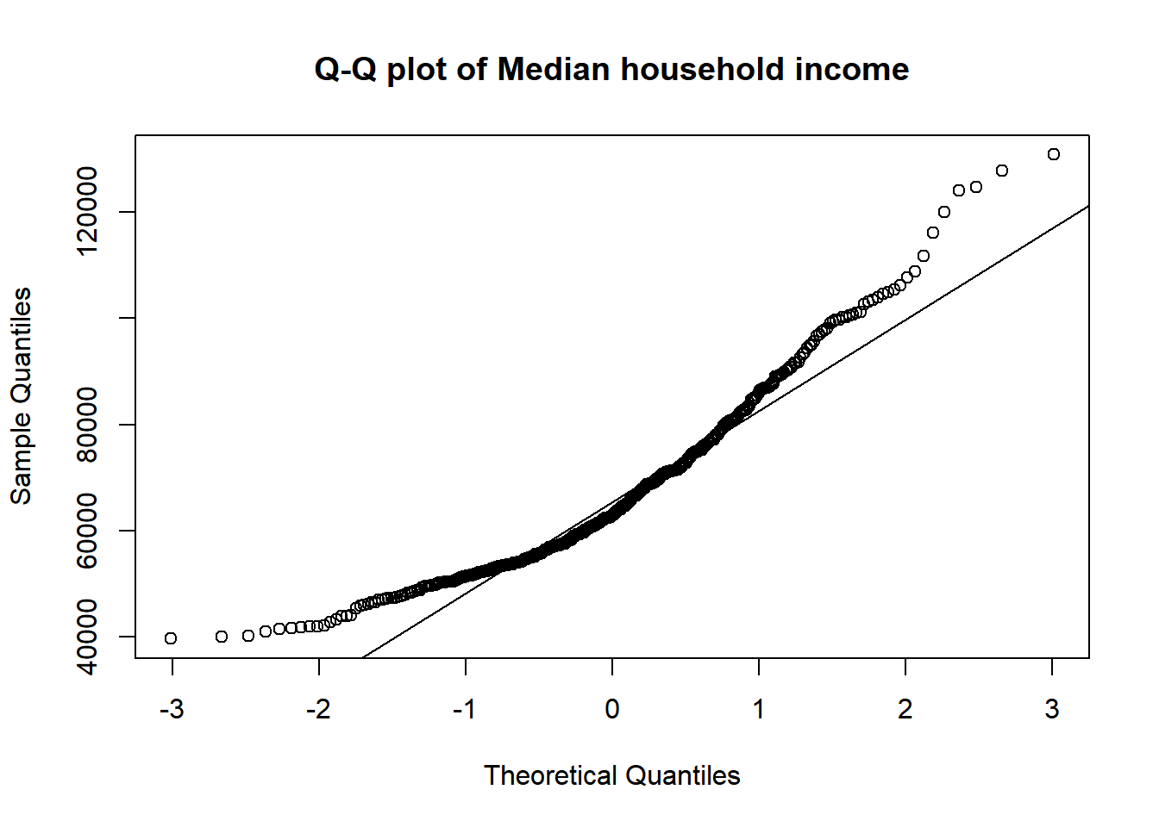

Slide 8
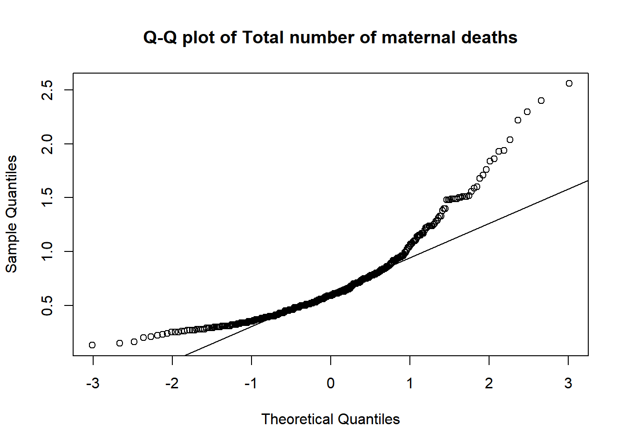

Slide 9
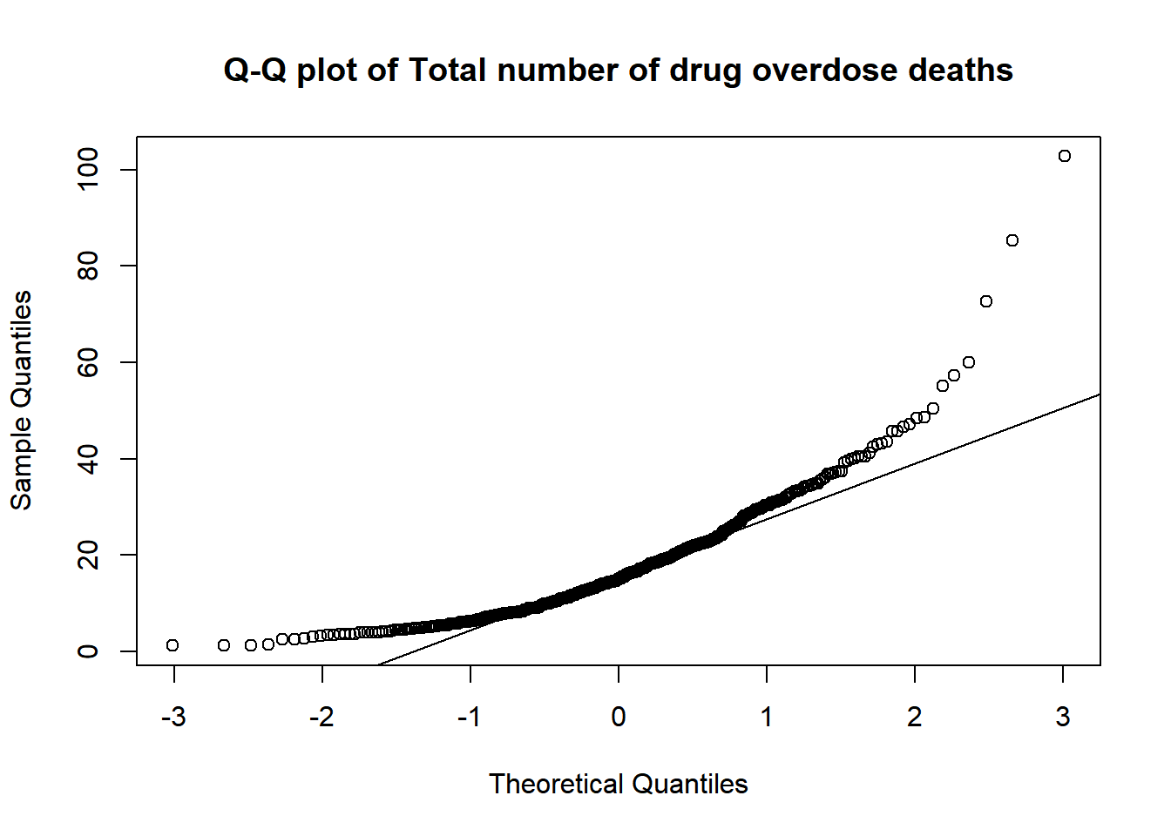

Slide 10
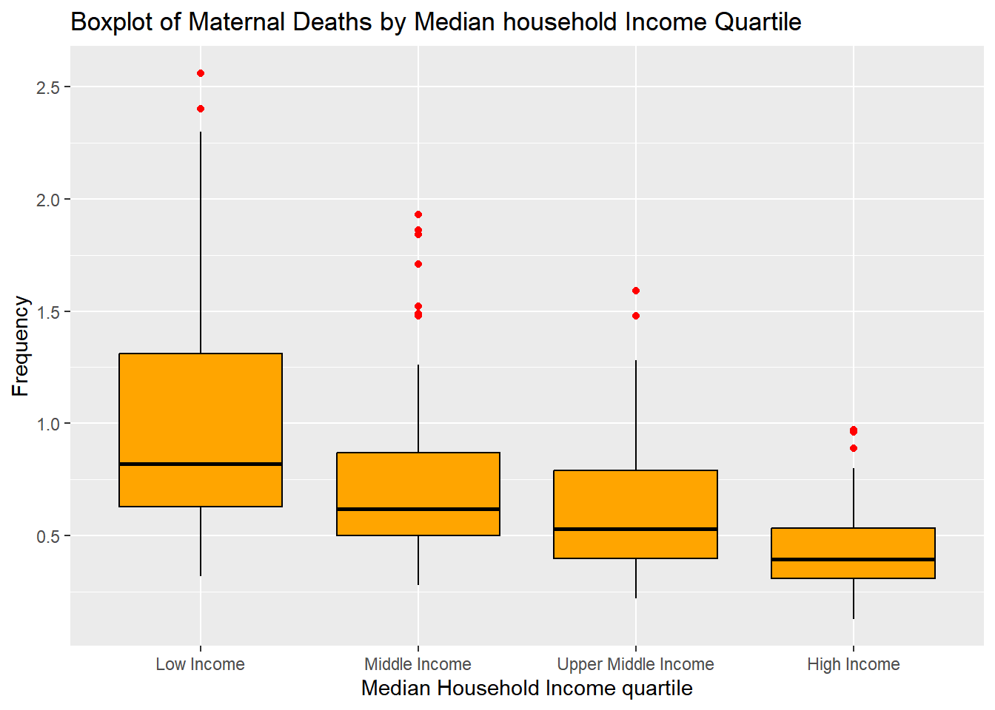

Slide 11
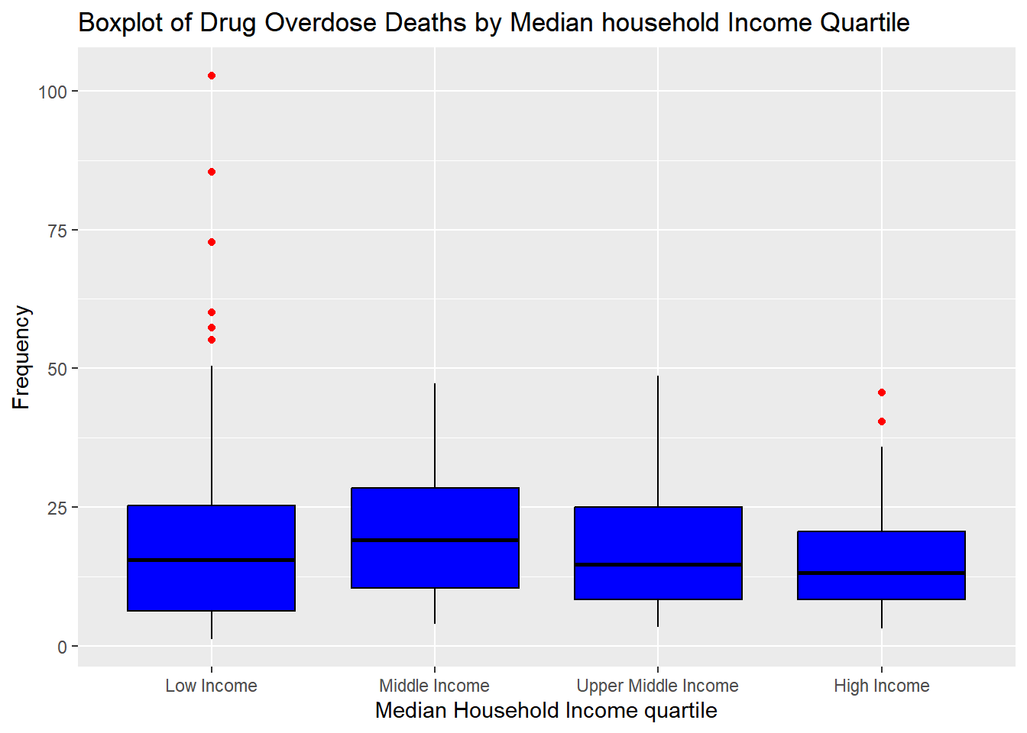

Slide 12
ANOVA Test
Whether the means are the same among different income groups.

Slide 13
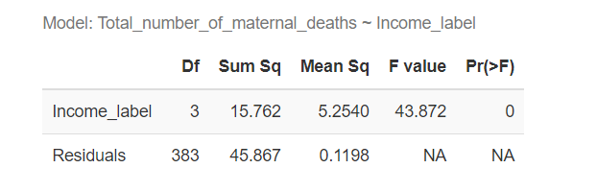
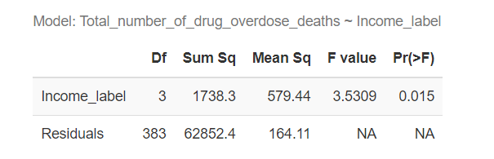
ANOVA Test Results
The means are not all the same among different income groups for two dependent variables.

Slide 14
Post-hoc Tukey HSD Test
All pairs of sample means are to be tested

Slide 15
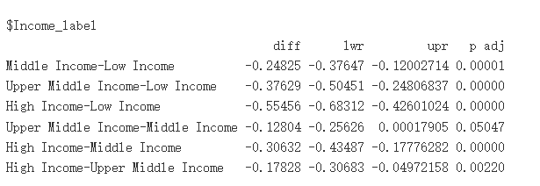
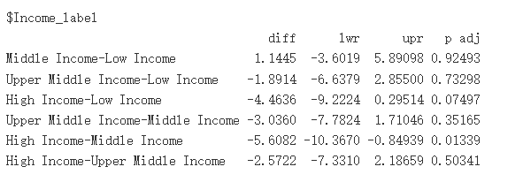
Post-hoc Tukey HSD Test Results

Slide 16
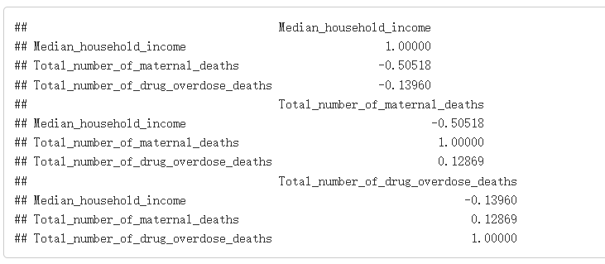
Correlation Matrix

Slide 17
Possible explainations
Cities with higher median household incomes tend to have better access to healthcare, education, nutrition, and social support, which can all contribute to lower maternal mortality.
Lower-income populations are generally more vulnerable to drug overdoses due to factors like reduced access to treatment, higher stress levels, but on the other hand, higher-income populations may have more access to prescription medications or more expensive illicit drugs which can also lead to overdose.

