Slide 1
Vroomcheck
Data warehouse design
Kimball data model · Snowflake implementation
Notes:
Two diagrams: the Kimball data model of the gold layer, then the Snowflake implementation that shows every layer in the warehouse.

Slide 2
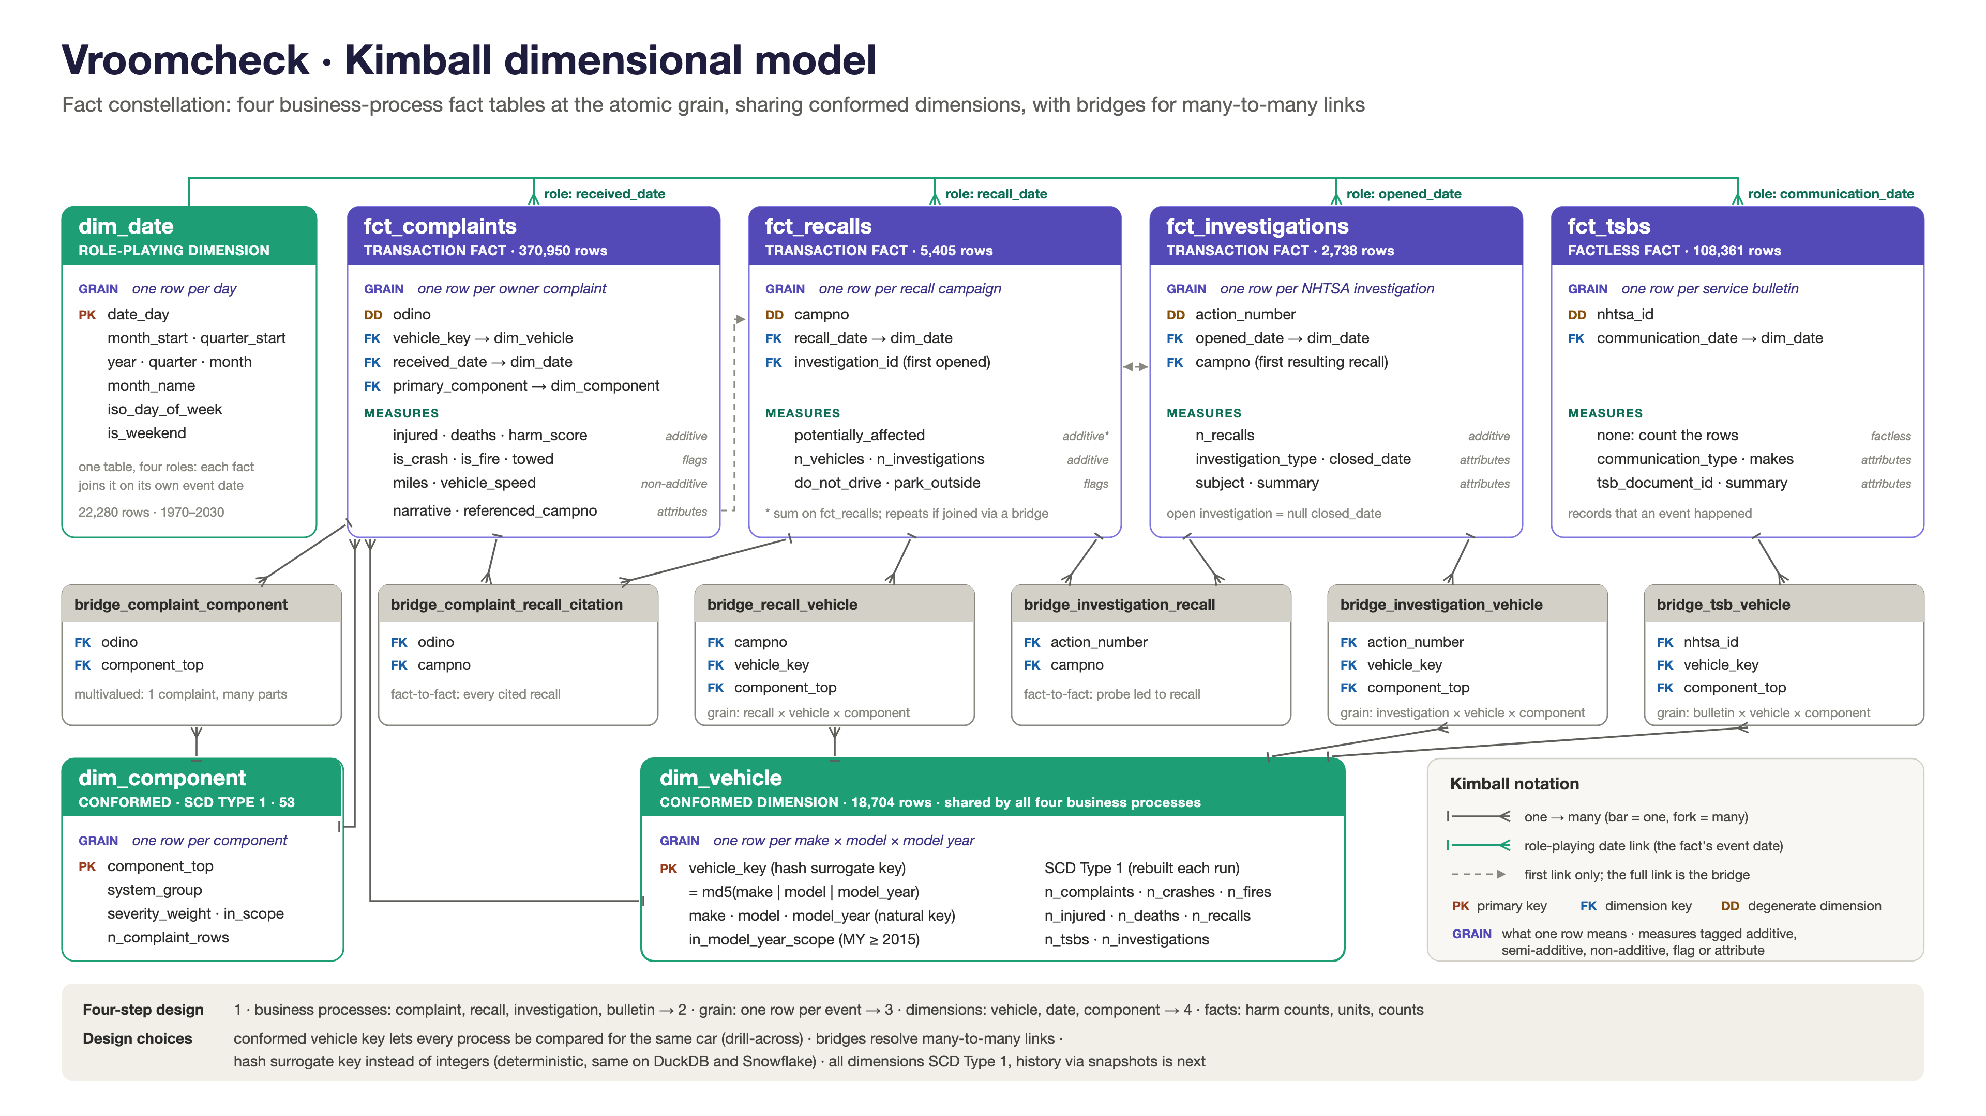
Notes:
Kimball designs around business events: each event is a fact table, its context goes into dimensions. Four events sharing dimensions = a fact constellation.
Four steps: business processes (complaint, recall, investigation, bulletin) -> grain (one row per event) -> dimensions (vehicle, date, component) -> facts (harm counts, affected units, counts).
Facts: complaints, recalls, investigations are transaction facts; service bulletins are a factless fact (count the rows).
Measures: injuries, deaths, harm score are additive; crash/fire are flags; miles and speed are non-additive.
dim_vehicle is conformed: one md5(make|model|year) key shared by all four processes, so we can drill across (2019 Honda Civic: 426 complaints, 4 recalls).
dim_date is role-playing (received, recall, opened, communication date). dim_component holds 53 components with severity weights.
Six bridges handle many-to-many links. Each fact keeps its NHTSA ID as a degenerate dimension. All dimensions are SCD Type 1.

Slide 3
Kimball bus matrix
Business process | Fact table | Grain (one row per) | Vehicle | Date (role) | Component
Complaint filed | fct_complaints transaction · 371 K rows | complaint | Direct | received | Direct
Recall issued | fct_recalls transaction · 5.4 K rows | recall campaign | Bridge | recall | Bridge
Investigation opened | fct_investigations transaction · 2.7 K rows | investigation | Bridge | opened | Bridge
Bulletin issued | fct_tsbs factless · 108 K rows | service bulletin | Bridge | communication | Bridge
Dimension type |  |  | conformed | role-playing | conformed
Direct the fact table holds the dimension key Bridge linked through a bridge table (many-to-many)
Notes:
The bus matrix is Kimball's planning table: business processes down the side, shared dimensions across the top.
Each process is one fact table at the atomic grain: one row per complaint, recall, investigation or bulletin.
All four processes share the same three dimensions, which is what makes them conformed: we can compare every process for the same vehicle, date and component.
Complaints hold the vehicle and component keys directly. Recalls, investigations and bulletins cover many vehicles each, so they reach those dimensions through bridge tables.
Date is one table playing four roles: received, recall, opened and communication date.

Slide 4
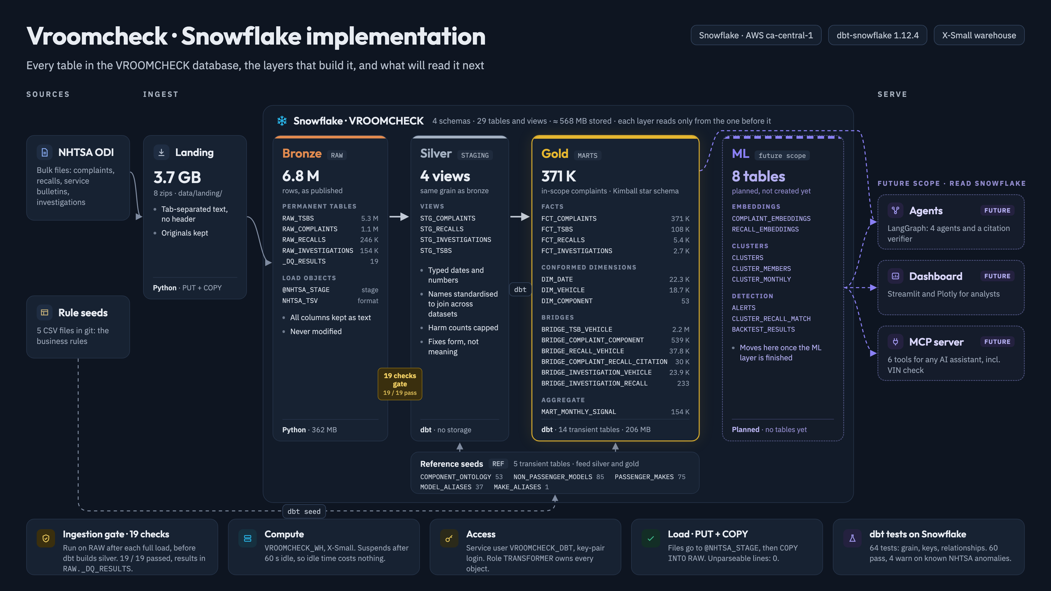
Notes:
One Snowflake database, VROOMCHECK: 4 schemas, 29 tables and views, medallion layers. Each layer reads only from the one before it.
Ingest: 8 NHTSA zip files (3.7 GB) uploaded with PUT to an internal stage, loaded with COPY INTO.
Bronze (RAW): 6.8 M rows exactly as published, all text, never modified, permanent tables.
19-check gate between bronze and silver: 12 critical checks stop the run before dbt. 19 / 19 pass; results in RAW._DQ_RESULTS.
Silver (STAGING): 4 dbt views. Fix form, not meaning: typed dates, standardised names, capped harm counts. No storage.
Gold (MARTS): Kimball star schema, 14 transient tables, 371 K in-scope complaints. Reference seeds hold the business rules.
Future scope (dashed): 8 ML tables, then agents, dashboard and MCP server read from Snowflake.
Platform: X-Small warehouse, auto-suspend 60 s; key-pair service user; 64 dbt tests.

