Slide 1
UNIVERSITÀ DEGLI STUDI DI GENOVA
◉ 01 / 31
M.Sc. Robotics Engineering · Master's Thesis · A.Y. 2025/26
EMBODIED LLM ARENA
OmniLLM
Comparing, routing and orchestrating multiple Large Language Models through a social robot
CANDIDATE
SUPERVISOR
CO-SUPERVISOR
[ Your Name ]
Prof. Antonio Sgorbissa
Dr. Lucrezia Grassi
M.Sc. Robotics Engineering
DIBRIS · UniGe
DIBRIS · UniGe

Slide 2
02
CONTEXT
§ 01 — RESEARCH CONTEXT
2022
ChatGPT ships. Dialogue agents become plausible.
Large Language Models are moving out of the chatbox.
2023
First Pepper / NAO demos with GPT-3.5 wrappers.
2024
Anthropic, Google, DeepSeek close the gap. Open-weights on laptops.
In the last three years LLMs have become the de-facto reasoning engine for dialogue systems. Social robots, which have historically relied on hand-authored finite-state machines, are now being plugged into a single cloud LLM to handle open-ended conversation.
2025
19+ frontier models. No consensus on which is "best".
2026
This thesis — an arena to find out, via real embodied interaction.
But every new robot project commits to one model — and nobody knows whether that is the right choice.
OMNILLM · EMBODIED LLM ARENA
I. Motivation
02 / 31

Slide 3
03
PROBLEM
§ 02 — THE PROBLEM
Static, text-only benchmarks no longer measure what matters.
0 1 · CONTAMINATION
0 2 · SATURATION
0 3 · MODALITY MISMATCH
Benchmarks leak
Everyone scores 90%+
Text ≠ Embodiment
MMLU, HumanEval, GSM8K appear verbatim in training corpora. A model may have seen the test.
The top five frontier models sit within 2 points of each other. The ladder has collapsed.
A model that types brilliantly may still feel cold, slow or unsafe when it has a face and a body.
arXiv:2502.17521 · arXiv:2506.23864 · LiveBench (ICLR 2025)
→ We need a new axis of evaluation.
OMNILLM · EMBODIED LLM ARENA
I. Motivation
03 / 31

Slide 4
04
GAP
§ 03 — THE GAP
No prior study has benchmarked multiple LLMs through a social robot.
STATE OF THE ART · WHAT EXISTS
Study
Multi-LLM
Robot
Routing
THE UNANSWERED QUESTION
"Does an LLM ranking derived from embodied interaction agree with the ranking we get from text?"
MMLU / LiveBench
✓
✗
✗
Chatbot Arena
✓
✗
✗
Pepper + ChatGPT demos
✗
✓
✗
If it doesn't, every robot deployment currently picking a model on the basis of MMLU or Chatbot Arena is picking blindly.
NAO conversational agents
✗
✓
✗
This thesis — OmniLLM
✓
✓
✓
OMNILLM · EMBODIED LLM ARENA
I. Motivation
04 / 31

Slide 5
05
OBJECTIVE
§ 04 — THESIS OBJECTIVE
Build the first arena that evaluates LLMs through a social robot.
01
02
03
Platform
Protocol
Proof
A modular, plug-in architecture where any LLM is a 5-line YAML entry — not a rewrite.
Four task types × five routing conditions, counterbalanced across human participants.
Automatic metrics + Likert + Godspeed + pairwise ELO — converging on a single verdict.
OMNILLM · EMBODIED LLM ARENA
I. Motivation
05 / 31

Slide 6
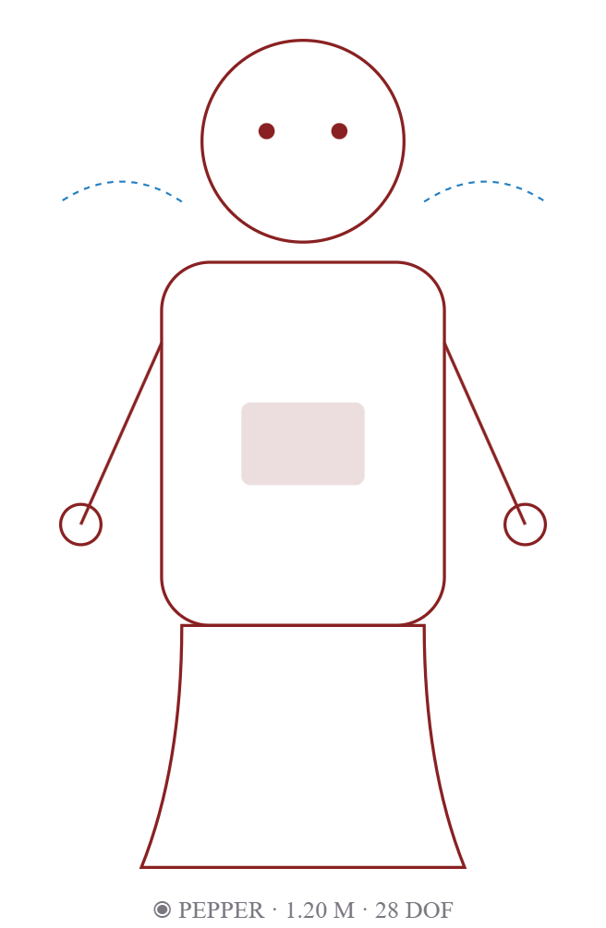
06
WHY A ROBOT
§ 05 — THE MOTIVATION FOR EMBODIMENT
Text benchmarks miss what a body adds to — and demands from — an LLM.
01
Latency becomes visceral.
A 3-second text pause is tolerable. A 3-second silence while a robot stares at you is awkward — and the LLM is blamed.
02
Grounding is required.
A robot must answer "where is Room 305?" with a real pointing gesture. Vague text is useless.
03
Social pressure changes judgment.
Physical presence, eye contact and gestures shift perceived competence and trust — effects text-only evaluation cannot capture.
04
Multilingualism is immersive.
When Pepper answers you in your own tongue, fluency quality matters far more than a BLEU score on paper.
OMNILLM · EMBODIED LLM ARENA
II. Approach
06 / 31

Slide 7
07
THE PLATFORM
§ 06 — WHY PEPPER
Pepper is the canonical HRI platform — and its age is an asset.
"Pepper's NAOqi 2.x runtime is locked to Python 2.7. This forces a clean separation of robot control and AI inference — which is exactly what a multi-LLM arena needs."
1.20 m
28
HEIGHT
DEGREES OF FREEDOM
4
2 + 1
WHY THIS ROBOT FOR THIS STUDY
◆
Richest expressive channel: speech, gaze, arm gestures, eye LEDs, tablet.
DIRECTIONAL MICROPHONES
RGB CAMERAS + TABLET
◆
Already available in the IRAI Lab — no hardware risk.
◆
SDK forces a clean HTTP boundary, ideal for swapping LLM backends live.
NAOqi 2.5
> 20 000
RUNTIME (PYTHON 2.7)
UNITS DEPLOYED WORLDWIDE
◆
Widely studied → our results stay comparable with prior Pepper HRI literature.
OMNILLM · EMBODIED LLM ARENA
II. Approach
07 / 31

Slide 8
08
TASKS
§ 07 — FOUR TASK TYPES
Every interaction is exactly one of four canonical HRI tasks.
T1
◉
T2
→
T3
♡
T4
‡
Information Retrieval
Navigation & Guidance
Social Conversation
Multilingual
"What time does the lab open?"
"Where is Room 305?"
"How are you today?"
"¿Dónde está la cafetería?"
Requires RAG over lab documents. Tests factual grounding.
Robot must point physically; text alone is useless. Tests embodiment.
Empathy, naturalness, timing. Tests social competence.
Any of the above, in another language. Tests linguistic breadth.
◼ classifier · rule-based primary + LLM fallback · confidence ∈ [0, 1] · routed downstream to task-specific pipeline
OMNILLM · EMBODIED LLM ARENA
II. Approach
08 / 31

Slide 9
09
HYPOTHESES
§ 08 — RESEARCH HYPOTHESES
Three falsifiable claims the experiment will test.
H₁
Embodied ranking ≠ text-only ranking.
LLM quality orderings produced from HRI sessions will differ significantly from those produced by MMLU / Chatbot Arena — measured via Spearman rank correlation.
H₂
Dynamic routing > any fixed model.
A task-typed router that chooses a different LLM for T1 / T2 / T3 / T4 will outperform the best single model on aggregate user satisfaction.
H₃
RAG raises accuracy uniformly.
Across every LLM backend, RAG-augmented answers will score higher on accuracy and trust than the same backend without RAG.
OMNILLM · EMBODIED LLM ARENA
II. Approach
09 / 31

Slide 10
10
ARCHITECTURE
§ 09 — SYSTEM ARCHITECTURE
Three layers: body, brain, providers.
LAYER 1 · PHYSICAL
LAYER 1 · BRIDGE (PY 2.7)
Human participant ⇄ Pepper robot ALAudioDevice → WAV 16 kHz ALAnimatedSpeech · ALMotion · ALLeds · Tablet
naoqi_client.py — captures audio, base64-encodes, HTTP POST /interact, executes RobotAction on return
↓ HTTP/JSON · :5000 ↓
LAYER 2 · AI SERVER · PYTHON 3.11+ · FLASK
omnillm.server.app
LANGGRAPH AGENT
RAG PIPELINE
OMNILLM CORE
LOGGER
Transcribe → Detect lang → Classify task → conditional RAG / direct LLM → Smart Router / Council → Build RobotAction → Log
ChromaDB vectors + keyword fallback 6 KB documents
LiteLLM gateway 6 routing strategies 5 consensus modes ELO scorer
Latency · tokens · cost RAG faithfulness Questionnaires CSV / JSON export
↓ HTTPS ↓
OpenAI
Anthropic
Google
DeepSeek · Qwen
Ollama — local
GPT-5.4 / 4o / o1
Opus · Sonnet · Haiku
Gemini 2.5 / Flash
V3 · R1 · 72B
Llama3 · Qwen · Mistral
OMNILLM · EMBODIED LLM ARENA
III. System
10 / 31

Slide 11
11
TOPOLOGY
§ 10 — CLIENT–SERVER TOPOLOGY
A two-process design, bridged by one HTTP endpoint.
CLIENT · ON PEPPER
SERVER · LAPTOP / CLOUD
NAOqi · Python 2.7
Flask · Python 3.11+
• ALAudioDevice → WAV
• POST /interact
• base64 encode
HTTP JSON :5000
• POST /transcribe
• requests.post(/interact)
• POST /evaluate
• ALAnimatedSpeech.say()
• GET /health
• ALBehaviorManager
• GET /status
• ALLeds.fadeRGB()
• GET /export
• ALTabletService.show()
• LangGraph ⇄ LiteLLM
WHY THIS SHAPE MATTERS
The Flask server never assumes Pepper exists . Remove the NAOqi client and the same server still answers text queries — which means the full LLM pipeline is testable without the robot, and other robots (NAO, Buddy) can drop in with a different bridge.
OMNILLM · EMBODIED LLM ARENA
III. System
11 / 31

Slide 12
12
DATA FLOW
§ 11 — VOICE-TO-SPEECH LIFECYCLE
21 steps from human voice to Pepper's reply.
01
Human speaks
sound waves
TIMING BUDGET · END-TO-END TARGET < 3 S
02
Pepper mic → WAV 16 kHz
bytes
Whisper STT
350 ms · 550 ms
03
HTTP POST /interact
base64 JSON
Language detect
8 ms · 8 ms
04
Whisper transcription
"Where is Room 305?"
Task classify
15 ms · 500 ms
05
Language detection
"en"
RAG retrieval
120 ms · 120 ms
06
Task classification
T2 · navigation
LLM generation
2000 ms · 1200 ms
07
RAG retrieval
top-k chunks + scores
Gesture plan
8 ms · 8 ms
08
LLM generation
via LiteLLM gateway
Network RTT
25 ms · 25 ms
09
Gesture planner
point_left · LED #00AAFF
▮ local Ollama · ▮ cloud API typical total: 800 – 2 500 ms
10
Log interaction
latency · cost · model
11
HTTP response
RobotAction JSON
12
Pepper executes action
speech + motion + LED
OMNILLM · EMBODIED LLM ARENA
III. System
12 / 31

Slide 13
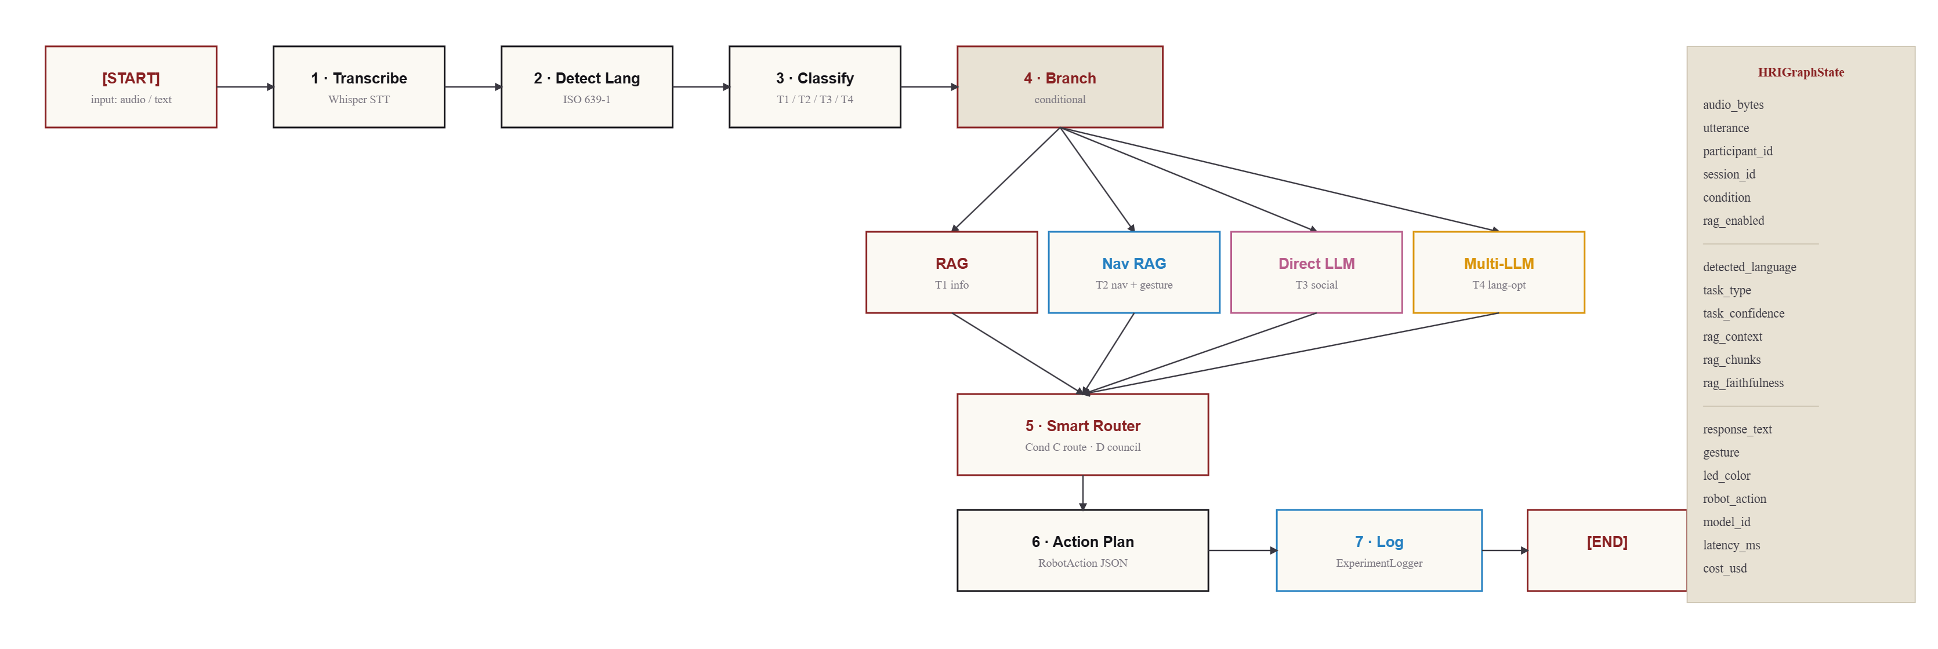
13
LANGGRAPH
§ 12 — LANGGRAPH AGENT PIPELINE
Seven nodes. One shared state. Conditional routing by task type.
OMNILLM · EMBODIED LLM ARENA
III. System
13 / 31

Slide 14
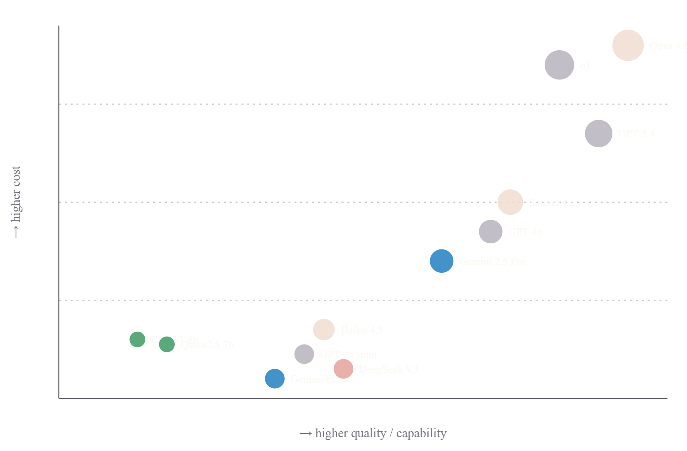
14
PROVIDERS
§ 13 — LLM PROVIDER LANDSCAPE
Nineteen models. Four families. One YAML entry each.
OpenAI
COST · OUTPUT $ / 1 M TOKENS
GPT-5.4 · 4o · o1 · o3-mini · 4o-mini
Anthropic
Claude Opus · Sonnet · Haiku 4.6
Google
Gemini 2.5 Pro · 2.5 Flash · 2.0 Flash
DeepSeek · Qwen
DeepSeek V3 · R1 · Qwen 2.5 72B
Ollama — FREE local
Llama3:8b · Qwen2.5:7b · Mistral · DS-R1:14b
ADDING A NEW MODEL
my-model:
provider: openai
model: my-v2
cost_per_1m_input: 1.00
cost_per_1m_output: 3.00
OMNILLM · EMBODIED LLM ARENA
III. System
14 / 31

Slide 15
15
ROUTER
§ 14 — SMART ROUTER
Six strategies. The router learns from past evaluations.
BEST_QUALITY
LOWEST_COST
LOWEST_LATENCY
Pick the model with the highest historical judge score.
Cheapest model that clears a quality floor.
Historically fastest model.
↪ Bulk demos.
↪ Live robot feel.
↪ Research tasks.
BEST_VALUE
LOCAL_PREFERRED
TASK_TYPE
0.5·Q + 0.3/latency + 0.2/cost — composite.
Ollama first, cloud as fallback.
T1→GPT-4o-mini · T2→Gemini · T3→Haiku · T4→Gemini
↪ General.
↪ Privacy, offline.
↪ HRI condition C.
SCORING FORMULA · BEST_VALUE
value = quality × 0.5 + (1 / latency_ms) × 0.3 + (1 / cost_usd) × 0.2
Weights are configurable per deployment. History is re-read from results/ on every run — so the router improves as more sessions are logged.
OMNILLM · EMBODIED LLM ARENA
III. System
15 / 31

Slide 16
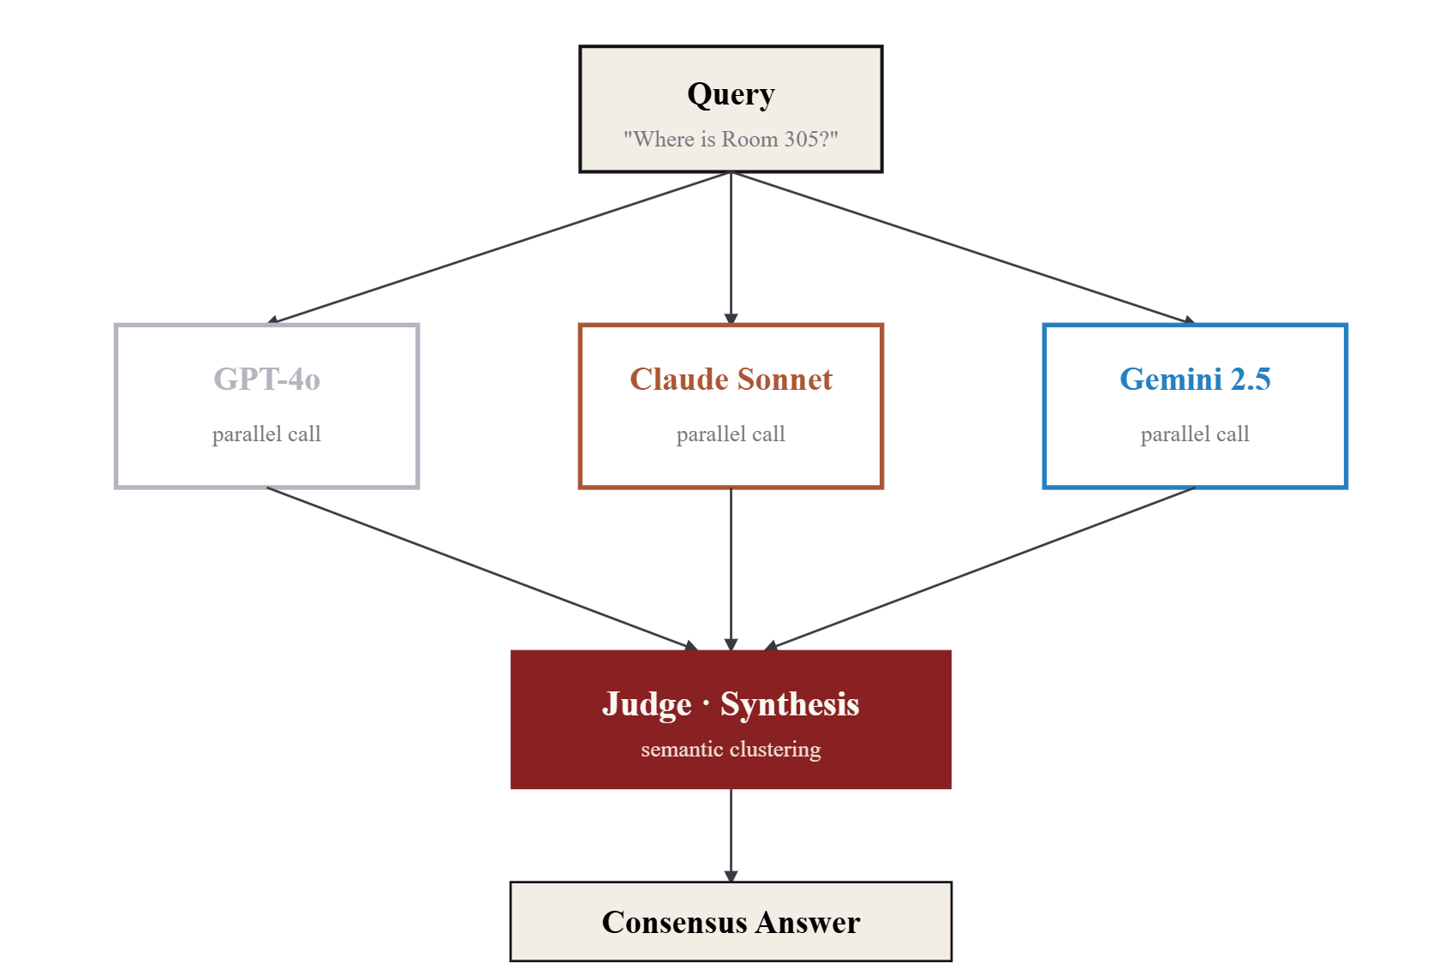
16
COUNCIL
§ 15 — THE LLM COUNCIL
Three independent models. One synthesised answer.
FIVE SYNTHESIS STRATEGIES
majority_vote
pick the cluster with the most agreements
judge_synth
LLM judge writes a combined best answer
weighted_elo
weight each model by current ELO
longest_agree
longest span shared by ≥ 2 models
safety_veto
any refusal veto blocks synthesis
A robot should rarely trust a single model for a potentially unsafe action. The council is the safety net.
OMNILLM · EMBODIED LLM ARENA
III. System
16 / 31

Slide 17
17
RAG
§ 16 — RAG KNOWLEDGE BASE
Grounding answers in six lab documents — not model memory.
INDEXED CORPUS
PIPELINE
lab_info.txt
Rooms · hours · WiFi · safety
T1
◦
Chunk documents · 512 chars · 64 overlap
university_map.txt
Floor plans · directions
T2
◦
Embed with sentence-transformers
research_projects.txt
Active lab projects
T1
◦
Store in ChromaDB (persistent)
event_schedule.csv
Seminars · open days
T1
→
Query → embed → top-k cosine similarity
→
Augment prompt with retrieved chunks
visitor_profiles.csv
Names · roles · slots
T1
→
LLM answers, grounded in context
faq.txt
Frequently asked Q&A
T1 baseline
✓
LLM-as-Judge scores faithfulness ∈ [0,1]
!
Hallucination flag if claim not supported
Fallback:
If ChromaDB fails to initialise, the pipeline degrades gracefully to keyword search — the server never crashes on a vector DB issue.
OMNILLM · EMBODIED LLM ARENA
III. System
17 / 31

Slide 18
18
SPEECH · LANG
§ 17 — SPEECH & LANGUAGE PROCESSING
Whisper transcribes. A three-tier cascade labels the language.
SPEECH-TO-TEXT
LANGUAGE DETECTION · 3-TIER CASCADE
OpenAI Whisper
Tier 1 · Unicode script
5 ms
Arabic / CJK / Cyrillic — instant.
LOCAL
CLOUD
whisper-small
whisper-1 API
Tier 2 · Word n-grams
10 ms
FREE · ~350 ms · private
$0.006/min · 550 ms
High-frequency function words. "est, la" → fr.
Whisper was chosen for its multilingual robustness (99 languages) — essential for T4 tasks where the participant may code-switch mid-utterance.
Tier 3 · langdetect
30 ms
Character trigrams, statistical model.
Detected language then maps to a preferred model : en → GPT-4o-mini · fr/ja/zh/ar → Gemini Flash (strongest multilingual).
OMNILLM · EMBODIED LLM ARENA
III. System
18 / 31

Slide 19
19
GESTURES
§ 18 — GESTURE & EMOTION PLANNER
Response text becomes body motion and eye colour.
point_left
point_right
wave
trigger: response contains "on your left"
trigger: response contains "on your right"
trigger: greeting · T3 social opener
LED #00AAFF · directional
LED #00AAFF · directional
LED #00FF88 · welcoming
think
show_tablet
wave_goodbye
trigger: complex or slow query
trigger: result best shown visually
trigger: farewell intent
LED #FFFF00 · processing
LED #FFFFFF · neutral
LED #FF8800 · closing
RULE-BASED BY DESIGN
A rule-based planner is fast (< 10 ms), auditable, and independent of the LLM backend — so gesture quality never confounds our LLM comparison.
OMNILLM · EMBODIED LLM ARENA
III. System
19 / 31

Slide 20
20
CONDITIONS
§ 19 — FIVE EXPERIMENTAL CONDITIONS
Each condition isolates one source of quality.
A
B
C
D
E
Fixed Cloud
Fixed Local
Smart Routed
Consensus
No-RAG Ctrl
MODEL
MODEL
MODEL
MODEL
MODEL
GPT-4o-mini
Llama3:8b
per-task router
GPT + Claude + Gemini
GPT-4o-mini
RAG
RAG
RAG
RAG
RAG
RAG ON
RAG ON
RAG ON
RAG ON
RAG OFF
Baseline · single cloud model.
How good is free/offline?
Our central hypothesis.
Does a council beat any one?
Isolates the RAG contribution.
◼ within-subjects · 3 conditions per participant · counterbalanced via Latin square · target N = 20 → 240 data points
OMNILLM · EMBODIED LLM ARENA
IV. Experiment
20 / 31

Slide 21
21
DESIGN
§ 20 — EXPERIMENTAL DESIGN
Independent and dependent variables — what varies, what we measure.
INDEPENDENT VARIABLES
DEPENDENT VARIABLES
LLM Backend
19 models · cloud + local
AUTOMATIC
HUMAN-RATED
RAG Condition
on vs. off
model_id used
response latency (ms)
token count in/out
cost USD
RAG retrieval score
faithfulness (0–1)
hallucination flag
task classification
accuracy (1–7)
naturalness (1–7)
trust (1–7)
gesture fit (1–7)
speed (1–7)
Godspeed subscales
pairwise preference
Language
auto-detected · Whisper + LangDet
Task Type
T1 · T2 · T3 · T4
Routing Condition
A · B · C · D · E
20
3
4
240
PARTICIPANTS
CONDITIONS / PERSON
TASKS / CONDITION
INTERACTION DATA POINTS
OMNILLM · EMBODIED LLM ARENA
IV. Experiment
21 / 31

Slide 22
22
EVALUATION
§ 21 — LLM-AS-JUDGE
Three complementary evaluation patterns, all automated.
01
02
03
Referenceless (G-Eval)
Reference-Based
Pairwise
Judge scores coherence, helpfulness, fluency and safety on 1–10 — no gold answer required.
Compares response against a curated gold answer — used for factual T1 / T2 tasks with known ground truth.
Judge picks between A and B. Runs twice, swapping order, to cancel position bias. Feeds ELO.
used · Every interaction.
used · RAG eval.
used · Compare conditions.
LATENCY-QUALITY COMPOSITE
value = quality × 0.5 + (1 / latency_ms) × 0.3 + (1 / cost_usd) × 0.2
Cross-referenced with MMLU and Chatbot-Arena scores — the discrepancy between text-only and embodied rankings is the key finding (H₁).
OMNILLM · EMBODIED LLM ARENA
IV. Experiment
22 / 31

Slide 23
23
ELO · SURVEYS
§ 22 — ELO & PARTICIPANT QUESTIONNAIRES
Chess-style ranking meets validated HRI instruments.
EMBODIED ELO LEADERBOARD
POST-INTERACTION QUESTIONNAIRES
Each condition starts at 1 500. Pairwise preferences (automatic judge + participant) update the rating. K = 32.
Interaction (1–7)
accuracy · naturalness · trust · gesture fit · speed
Condition C · Smart Router
ELO —
Godspeed (1–5)
Condition D · Council
ELO —
anthropomorphism · animacy · likeability · intelligence · safety (Bartneck 2009)
Condition A · GPT-4o-mini
ELO —
Pairwise preference
Condition B · Llama3:8b
ELO —
"Which Pepper did you prefer?" → ELO update
Condition E · No RAG
ELO —
Observer rating
◉ diagram is illustrative · real ratings added post-experiment
experimenter-coded gesture sync, task completion, breakdowns
OMNILLM · EMBODIED LLM ARENA
IV. Experiment
23 / 31

Slide 24
24
RESULTS
§ 23 — RESULTS
Experimental results.
◉ PLACEHOLDER
Next two slides are intentionally sparse. Insert charts, tables and quotes once the experiment is complete.
The slides that follow reserve space for the quantitative and qualitative findings from the 20-participant study. They will be filled in once data collection concludes.
OMNILLM · EMBODIED LLM ARENA
V. Results
24 / 31

Slide 25
25
QUANT · TBD
§ 24 — QUANTITATIVE RESULTS
Per-condition performance — reserved for post-study analysis.
FIGURE 1 · LIKERT MEANS PER CONDITION
FIGURE 2 · LATENCY VS. QUALITY SCATTER
◉ FIGURE 1 · GROUPED BAR CHART · 5 CONDITIONS × 5 LIKERT SCALES · 95% CI
◉ FIGURE 2 · SCATTER · ONE POINT PER MODEL · COLOUR BY CONDITION
TABLE 1 · EMBODIED ELO LEADERBOARD
FIGURE 3 · RAG VS. NO-RAG DELTA
◉ TABLE 1 · MODEL · EMBODIED ELO · TEXT ELO · Δ RANK
◉ FIGURE 3 · PAIRED DOT PLOT · ACCURACY & TRUST · A VS E
▣ statistical plan · repeated-measures ANOVA on Likert · Spearman ρ for H₁ · Wilcoxon paired for H₃
OMNILLM · EMBODIED LLM ARENA
V. Results
25 / 31

Slide 26
26
QUAL · TBD
§ 25 — QUALITATIVE FINDINGS
Themes from semi-structured debrief interviews — reserved.
THEME A · TRUST & LATENCY
THEME B · CODE-SWITCHING
THEME C · GESTURE ALIGNMENT
"[ participant quote — to be inserted after coding ]"
"[ participant quote — to be inserted after coding ]"
"[ participant quote — to be inserted after coding ]"
◉ CODED FREQUENCY CHART
◉ CODED FREQUENCY CHART
◉ CODED FREQUENCY CHART
— P_xx, condition _, _ language
— P_xx, condition _, _ language
— P_xx, condition _, _ language
Coding method
Triangulation
Thematic analysis (Braun & Clarke 2006) · 2 coders · Cohen's κ target ≥ 0.7
Cross-checked against log metrics and observer notes to avoid self-report bias.
OMNILLM · EMBODIED LLM ARENA
V. Results
26 / 31

Slide 27
27
LIMITS
§ 26 — KNOWN LIMITATIONS
What this study cannot claim.
L1
Single platform
L2
Small N
L3
Lab setting
L4
Moving target
L5
English-centric recruitment
L6
No long-term adoption data
◼ Threats-to-validity table is reported in full in Chapter 6 of the thesis, with mitigation strategies for each.
OMNILLM · EMBODIED LLM ARENA
VI. Discussion
27 / 31

Slide 28
28
CONTRIBUTIONS
§ 27 — CONTRIBUTIONS
Four things this thesis leaves behind.
C1 · CONTRIBUTION
C2 · CONTRIBUTION
An open-source framework
An experimental protocol
OmniLLM — 19 models, 5 routing conditions, RAG + Consensus, ROS + NAOqi bridge. MIT licensed.
Four task types × five conditions, counterbalanced, with a latency-quality composite metric and pairwise ELO on the robot.
C3 · CONTRIBUTION
C4 · CONTRIBUTION
An empirical dataset
An evaluation instrument
240 interaction data points, synchronised transcripts + videos + metrics, released for reuse by the HRI community.
Adapted Godspeed + latency-aware Likert battery + automatic judge — ready to drop into other embodied-LLM studies.
OMNILLM · EMBODIED LLM ARENA
VI. Discussion
28 / 31

Slide 29
29
ROADMAP
§ 28 — ROADMAP & FUTURE WORK
What's done — what's next.
NOV
DEC
JAN
FEB
MAR
APR
MAY
JUN
Literature review
Framework v1 (19 models)
RAG + Consensus modules
Pepper integration
Pilot study (N=5)
Full user study (N=20)
Analysis + writing
Defense
done
in progress
upcoming
milestone
▶ FW 1
▶ FW 2
▶ FW 3
Longitudinal study
Task-adaptive routing
Embodied Arena v2
Track trust and novelty-decay over 4-week repeated visits.
Reinforcement-learned router that updates per interaction.
Port the framework to NAO and TurtleBot4 — cross-platform ranking.
OMNILLM · EMBODIED LLM ARENA
VI. Discussion
29 / 31

Slide 30
30
REFERENCES
§ 29 — SELECTED REFERENCES
Foundational literature this thesis builds on.
LLM EVALUATION
HRI & EMBODIED AGENTS
Chiang et al. (2024) — Chatbot Arena: an open platform for evaluating LLMs by human preference. ICML.
Zheng et al. (2024) — Judging LLM-as-a-judge with MT-Bench and Chatbot Arena. NeurIPS.
White et al. (2025) — LiveBench: a challenging, contamination-free LLM benchmark. ICLR.
Sainz et al. (2023) — NLP evaluation in trouble: on the need to measure LLM data contamination.
Bartneck et al. (2009) — Measurement instruments for anthropomorphism, animacy, likeability, perceived intelligence and perceived safety of robots. Int. J. Social Robotics.
Tanevska et al. (2020) — Socially adaptive HRI for the Pepper robot.
Sgorbissa et al. (2018) — Integrated framework for CAIR project (CAReS).
Grassi et al. (2023) — LLM-driven dialogue for socially-assistive robots.
RETRIEVAL-AUGMENTED GENERATION
ROUTING & ENSEMBLES
Lewis et al. (2020) — Retrieval-augmented generation for knowledge-intensive NLP tasks. NeurIPS.
Gao et al. (2024) — Retrieval-augmented generation for LLMs: a survey.
Es et al. (2024) — RAGAS: automated evaluation of RAG.
Ong et al. (2024) — RouteLLM: learning to route LLMs with preference data.
Chen et al. (2024) — FrugalGPT: how to use LLMs while reducing cost and improving performance.
Jiang et al. (2023) — LLM-Blender: ensembling large language models with pairwise ranking and generative fusion.
full bibliography · 74 entries · see thesis §references
OMNILLM · EMBODIED LLM ARENA
VII. Appendix
30 / 31

Slide 31
§ 30 — END OF PRESENTATION
◉ 31 / 31
Thank you.
I welcome your questions — about the framework, the protocol, or any choice that looks strange.
CONTACT
CODE
ACKNOWLEDGEMENTS
[ firstname.lastname ]@edu.unige.it
github.com/…/OmniLLM
Prof. Sgorbissa · Dr. Grassi · the IRAI / Teknē team · and every participant who lent 30 minutes to speak with Pepper.
Teknē Lab · DIBRIS · UniGe
MIT licensed

