Slide 1


Slide 2

Introduction:
The hospital management system is designed to efficiently manage patient, doctor, nurse, department, ward, appointment, and medical record information within a hospital or healthcare facility. It aims to streamline the process of scheduling appointments, assigning doctors to patients, managing medical records, and organizing nursing staff within different wards.
Objective:
The primary objective of the hospital management system is to enhance the overall efficiency and effectiveness of healthcare services by providing a centralized platform for managing patient care, doctor assignments, and medical records. It also aims to optimize resource allocation and improve the quality of patient care.

Slide 3
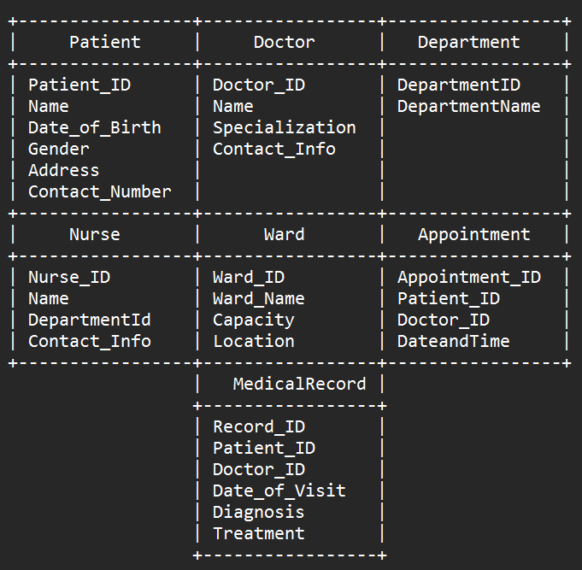
TABLES

Slide 4

1. Retrieve the names and specialties of all doctors.
COMMAND-
SELECT Name, Specialization
FROM Doctor;

Slide 5
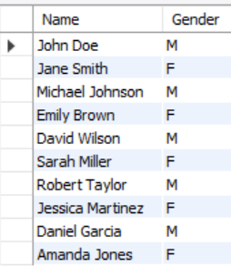
2. Retrieve the names and genders of all patients aged 30 or older.
COMMAND-
SELECT Name, Gender
FROM Patient
WHERE DATEDIFF(CURDATE(), Date_of_Birth) >= 30;

Slide 6

3. Retrieve the names of patients treated by Dr. John Johnson.
COMMAND-
SELECT p.Name
FROM Patient p
INNER JOIN MedicalRecord m
ON p.Patient_ID = m.Patient_ID
INNER JOIN Doctor d
ON m.Doctor_ID = d.Doctor_ID
WHERE d.Name = 'Dr. John Johnson';

Slide 7

4. Retrieve the names of doctors who specialize in Pediatrics, ordered alphabetically by name.
COMMAND-
SELECT Name
FROM Doctor
WHERE Specialization = 'Pediatrics’
ORDER BY Name;

Slide 8
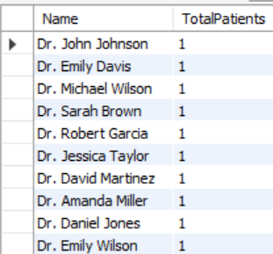
5. Retrieve the total count of patients treated by each doctor.
COMMAND-
SELECT d.Name, COUNT(*) AS TotalPatients
FROM Doctor d
INNER JOIN MedicalRecord m
ON d.Doctor_ID = m.Doctor_ID
GROUP BY d.Name;

Slide 9

6. Retrieve the average age of patients, grouped by gender.
COMMAND-
SELECT Gender, AVG(DATEDIFF(CURDATE(), Date_of_Birth) / 365) AS AvgAge
FROM Patient
GROUP BY Gender;

Slide 10
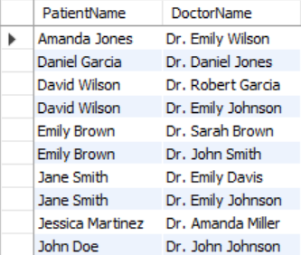
7. Retrieve the names of patients and their corresponding doctors, sorted by patient name.
COMMAND-
SELECT p.Name AS PatientName, d.Name AS DoctorName
FROM Patient p
INNER JOIN MedicalRecord m
ON p.Patient_ID = m.Patient_ID
INNER JOIN Doctor d
ON m.Doctor_ID = d.Doctor_ID
ORDER BY p.Name;

Slide 11

8. Retrieve the names of doctors who have not been assigned any patients.
COMMAND-
SELECT d.Name
FROM Doctor d
LEFT JOIN MedicalRecord m
ON d.Doctor_ID = m.Doctor_ID
WHERE m.Doctor_ID IS NULL;

Slide 12
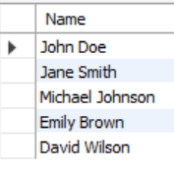
9. Retrieve the names of patients who have been treated by more than one doctor.
COMMAND-
SELECT p.Name
FROM Patient p
INNER JOIN ( SELECT Patient_ID FROM MedicalRecord
GROUP BY Patient_ID
HAVING COUNT(DISTINCT Doctor_ID) > 1 )
AS multiple_doctors ON p.Patient_ID = multiple_doctors.Patient_ID;

Slide 13
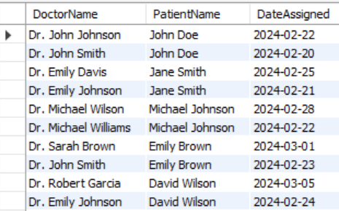
10. Retrieve the names of doctors and patients along with the date they were assigned to each other (assuming there's a "DateAssigned" column in the DoctorPatient table).
COMMAND-
SELECT Doctor.Name AS DoctorName, Patient.Name AS PatientName, DoctorPatient.DateAssigned
FROM DoctorPatient
JOIN Doctor ON DoctorPatient.Doctor_ID = Doctor.Doctor_ID
JOIN Patient ON DoctorPatient.Patient_ID = Patient.Patient_ID;

Slide 14
Conclusion
In this presentation, we explored the entity-relationship (ER) diagram and database schema for a hospital management system. We identified various entities such as patients, doctors, departments, nurses, wards, appointments, and medical records, along with their respective attributes. Additionally, we established relationships between these entities, including primary and foreign key constraints to maintain data integrity.
Furthermore, we executed several SQL queries to retrieve meaningful insights from the database. These queries ranged from fetching doctor specialties to obtaining patient demographics based on age criteria. Through these queries, we demonstrated the practical use of the database in extracting valuable information for hospital management and patient care.
In conclusion, the hospital management system presented here showcases the importance of effective data modeling and database management in healthcare settings. By accurately representing the relationships between different entities and querying the database intelligently, hospitals can streamline their operations, enhance patient care, and improve overall efficiency.

Slide 15


