Slide 1
Temporal Cross Validation

Slide 2
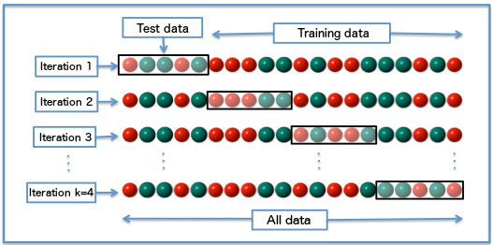
Standard Cross Validation

Slide 3
Temporal Cross Validation
Time
Data
Train Features
Train Label
Test Features
Test Label
Train Features
Train Label
Test Features
Test Label
Train Features
Train Label
Test Features
Test Label

Slide 4
Standard vs Temporal
Generally used for non-temporal data, such as for image classification
Uses comparatively more training data and more folds,
Theoretically reduces variance in error predictions
Labels and features are static properties
Especially important for data with a time component
Mimics the use of our models in the real world
Computationally cheaper because of reusability of folds
Theoretically reduces bias in error predictions on out of sample data
Labels and features are aggregations over timespans

Slide 5
Implementing Temporal Cross Validation
A series of loops with complicated logic …

Slide 6
Implementing Temporal Cross Validation
Split data at a specific timestamp so that:
features only incorporate information before (<) that timestamp
labels include information at or later (>=) than that timestamp

Slide 7
Implementing Temporal Cross Validation
For example:
features: As of January 1, 2012, how many jail bookings did you have in the last four years?
labels: Starting January 1, 2012, do you have a jail booking in the next year?

Slide 8
entity_id | as_of_date | bookings_last_4_yrs | label
1 | 2012-01-01 | 3 | 1
2 | 2012-01-01 | 1 | 0
3 | 2012-01-01 | 1 | 1

Slide 9
entity_id | as_of_date | bookings_last_4_yrs | label
1 | 2012-01-01 | 3 | 1
2 | 2012-01-01 | 1 | 0
3 | 2012-01-01 | 1 | 1
SELECT count(*)
FROM events
WHERE event_type = ‘booking’
AND event_date < ‘2012-01-01’
AND event_date >= (‘2012-01-01 – INTERVAL ‘4 years’)

Slide 10
entity_id | as_of_date | bookings_last_4_yrs | label
1 | 2012-01-01 | 3 | 1
2 | 2012-01-01 | 1 | 0
3 | 2012-01-01 | 1 | 1
WITH positive_labels AS (
SELECT entity_id
FROM events
WHERE event_type = ‘booking’
AND event_date >= ‘2012-01-01’
AND event_date < (‘2012-01-01 + INTERVAL ‘1 year’)
)
SELECT CASE WHEN entity_id IN (positive_labels) THEN 1 ELSE 0 END as label
FROM entities

Slide 11
Finding Train-Test Splits
Split data at a specific timestamp so that test labels do not overlap with training labels.

Slide 12
entity_id | as_of_date | bookings_last_4_yrs | label
1 | 2012-01-01 | 3 | 1
2 | 2012-01-01 | 1 | 0
3 | 2012-01-01 | 1 | 1
train
entity_id | as_of_date | bookings_last_4_yrs | label
1 | 2013-01-01 | 2 | 1
2 | 2013-01-01 | 2 | 1
3 | 2013-01-01 | 0 | 0
test

Slide 16
Train-Test Splits: How Much Time for Modeling?
Start and end times:
feature_start_time: earliest time in any feature aggregation
feature_end_time: upper limit for data in any feature aggregation
label_start_time: earliest time in any label
label_end_time: upper limit for label data

Slide 17
Train-Test Splits: How Much Time for Modeling?
For example:
feature_start_time: January 1, 1970
feature_end_time: January 1, 2016
label_start_time: January 1, 2011
label_end_time: January 1, 2016

Slide 18
Earliest label is a train label
Latest label is a test label

Slide 19
Use the freshest data:
Start from the last split and roll back

Slide 20
WHILE your labels are within the labeling time, keep moving back…

Slide 21
WHILE your labels are within the labeling time, keep moving back…

Slide 22
WHILE your labels are within the labeling time, keep moving back…

Slide 23
TOO FAR! Stop making splits!

Slide 24
Configuring Labels
Labels aggregate data over a fixed time period, beginning at the feature label cut point (as of date), and assign a score.
For example:
Will this property have a housing code violation in the next year?

Slide 25
Configuring Labels
Labels aggregate data over a fixed time period, beginning at the feature label cut point, and assign a score.
For example:
Will this property have a housing code violation in the next year?
How many bookings will this person have in the next six months?

Slide 26
Configuring Labels
The length of time aggregated into the label is the label timespan. It can be configured separately for train and test labels.
train_label_timespan: how much time is aggregated into labels in the training matrix?
test_label_timespan: how much time is aggregated into labels in the test matrix?

Slide 27
entity_id | as_of_date | bookings_last_4_yrs | label
1 | 2012-01-01 | 3 | 1
2 | 2012-01-01 | 1 | 0
3 | 2012-01-01 | 1 | 1
train
entity_id | as_of_date | bookings_last_4_yrs | label
1 | 2012-07-01 | 3 | 1
2 | 2012-07-01 | 1 | 1
3 | 2012-07-01 | 0 | 1
test

Slide 28
How often to retrain the model?
You can retrain models after any arbitrary amount of time, called the model update frequency. For example...
1 year between training feature-label splits

Slide 29
1 year between training feature-label splits

Slide 30
6 months between training feature-label splits

Slide 31
How many rows to put in the matrix?
So far, all of the matrices have one row per entity. We train on one time (July 1, 2012) and test on one time (January 1, 2013).

Slide 32
entity_id | as_of_date | bookings_last_4_yrs | label
1 | 2012-07-01 | 3 | 1
2 | 2012-07-01 | 1 | 0
3 | 2012-07-01 | 1 | 1
train
entity_id | as_of_date | bookings_last_4_yrs | label
1 | 2013-01-01 | 3 | 1
2 | 2013-01-01 | 1 | 1
3 | 2013-01-01 | 0 | 1
test

Slide 33
Temporal “oversampling”
So far, all of the matrices have one row per entity. We train on one time (January 1, 2012) and test on one time (July 1, 2012).
But we can train the same model on multiple dates….

Slide 34
entity_id | as_of_date | bookings_last_4_yrs | label
1 | 2011-07-01 | 3 | 1
1 | 2012-01-01 | 2 | 1
1 | 2012-07-01 | 4 | 1
2 | 2011-07-01 | 0 | 1
2 | 2012-01-01 | 1 | 0
2 | 2012-07-01 | 0 | 0
3 | 2011-07-01 | 1 | 1
3 | 2012-01-01 | 1 | 0
3 | 2012-07-01 | 2 | 1
train

Slide 35
Configuring Temporal Parameters (Timechop)
How many as of dates are in a training matrix depends on 2 parameters:
training_as_of_date_frequency: how much time between dates
max_training_history: how much time between first and last training as of dates (at most)
Max training history of 1 year
Training as of date frequency of 6 months

Slide 36
last_as_of_date = train_test_split_date – train_label_timespan
earliest_possible_as_of_date = last_as_of_date – max_training_history
as_of_dates = []
current_as_of_date = last_as_of_date
WHILE current_as_of_date >= earliest_possible_as_of_date:
as_of_dates.append(current_as_of_date)
current_as_of_date = current_as_of_date - as_of_date_frequency
Max training history of 1 year
Training as of date frequency of 6 months

Slide 37
Configuring Temporal Parameters
The same controls exist for test matrices, allowing you to include multiple test dates for the same model:
test_as_of_date_frequency: how much time between dates
test_duration: how much time between first and last test as of dates
Test duration of 9 months
Test as of date frequency of 3 months

Slide 38
Same loop, but roll forward this time, and don’t forget to always use <
Test duration of 9 months
Test as of date frequency of 3 months

Slide 39
entity_id | as_of_date | bookings_last_4_yrs | label
1 | 2013-01-01 | 3 | 1
1 | 2013-04-01 | 3 | 1
1 | 2013-07-01 | 4 | 1
2 | 2013-01-01 | 0 | 1
2 | 2013-04-01 | 1 | 0
2 | 2013-07-01 | 0 | 0
3 | 2013-01-01 | 1 | 1
3 | 2013-04-01 | 3 | 0
3 | 2013-07-01 | 3 | 1
test

Slide 40
All the Temporal Parameters
temporal_config:
feature_start_time: '1995-01-01' # earliest date included in features
feature_end_time: '2015-01-01' # latest date included in features
label_start_time: '2012-01-01' # earliest date for which labels are avialable
label_end_time: '2015-01-01' # day AFTER last label date (all dates in any model are < this date)
model_update_frequency: ['6month’] # how frequently to retrain models
training_as_of_date_frequencies: ['1day’] # time between as of dates for same entity in train matrix
test_as_of_date_frequencies: ['3month’] # time between as of dates for same entity in test matrix
max_training_histories: ['6month', '3month'] # length of time included in a train matrix
test_durations: ['0day', '1month', '2month'] # length of time included in a test matrix
training_label_timespans: ['1month'] # time period across which outcomes are labeled in train matrices
test_label_timespans: ['7day'] # time period across which outcomes are labeled in test matrices

Slide 41
General Structure
Outer loop: Find train-test split dates within label and feature time
Roll backwards from last possible split to use your freshest data
Inner loops: Find feature-label split dates (as-of-dates) with the matrix duration
Train matrices: roll backward from the latest possible as-of-date
Test matrices: roll forward from the train-test split date

Slide 42
Warnings
ALWAYS USE >= AND <
Test your temporal code: Start with a simple configuration where you can write out the expected results without code, and make sure your code produces the right dates
Test your feature code: Start with a few people and a few features that you made up, calculate the expected matrices by hand and check them against the matrices your code makes

Slide 43
Sources of Temporal Leakage
Obvious:
Train and test labels aggregate data from overlapping times
Labels and features aggregate data from overlapping times
Less obvious:
Cohorts: People not known in the data until later are included in earlier models

Slide 44
Temporal Model Evaluation

Slide 45
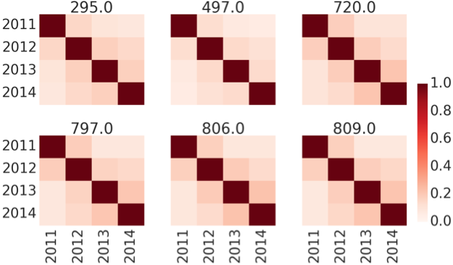

Slide 46
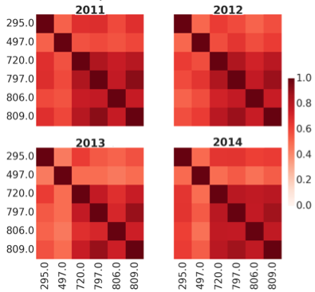

Slide 47
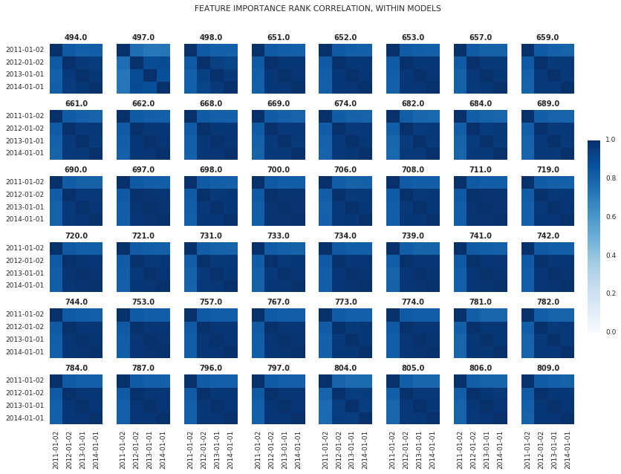

Slide 48
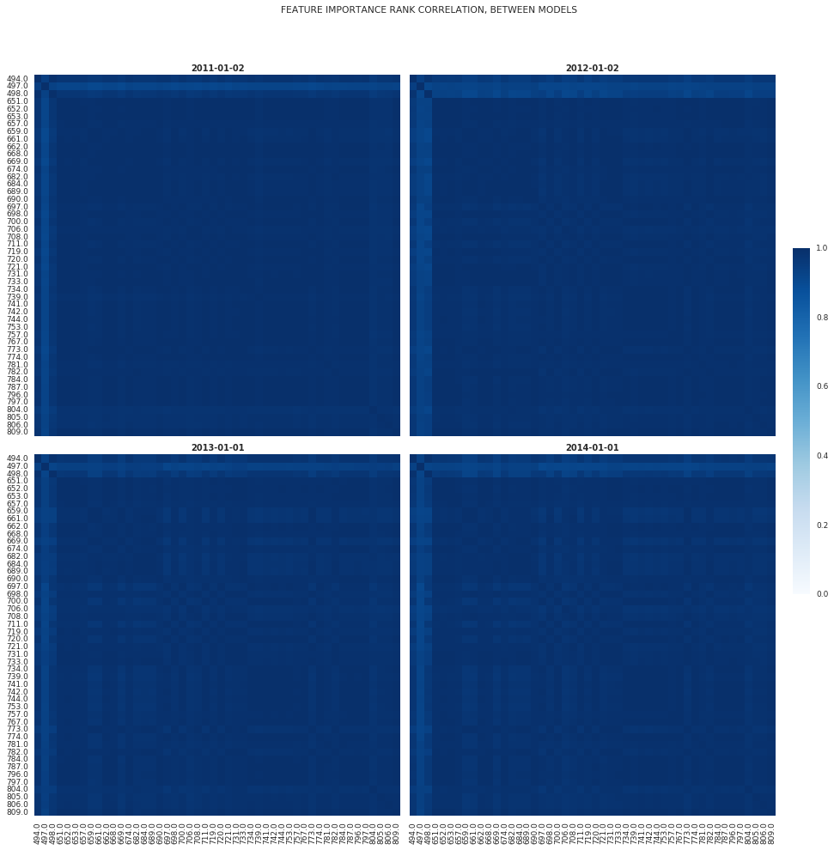

Slide 49
