Slide 1
Hack-a-Sketch!
Akshita Amanda
Pracheta Seetha

Slide 2
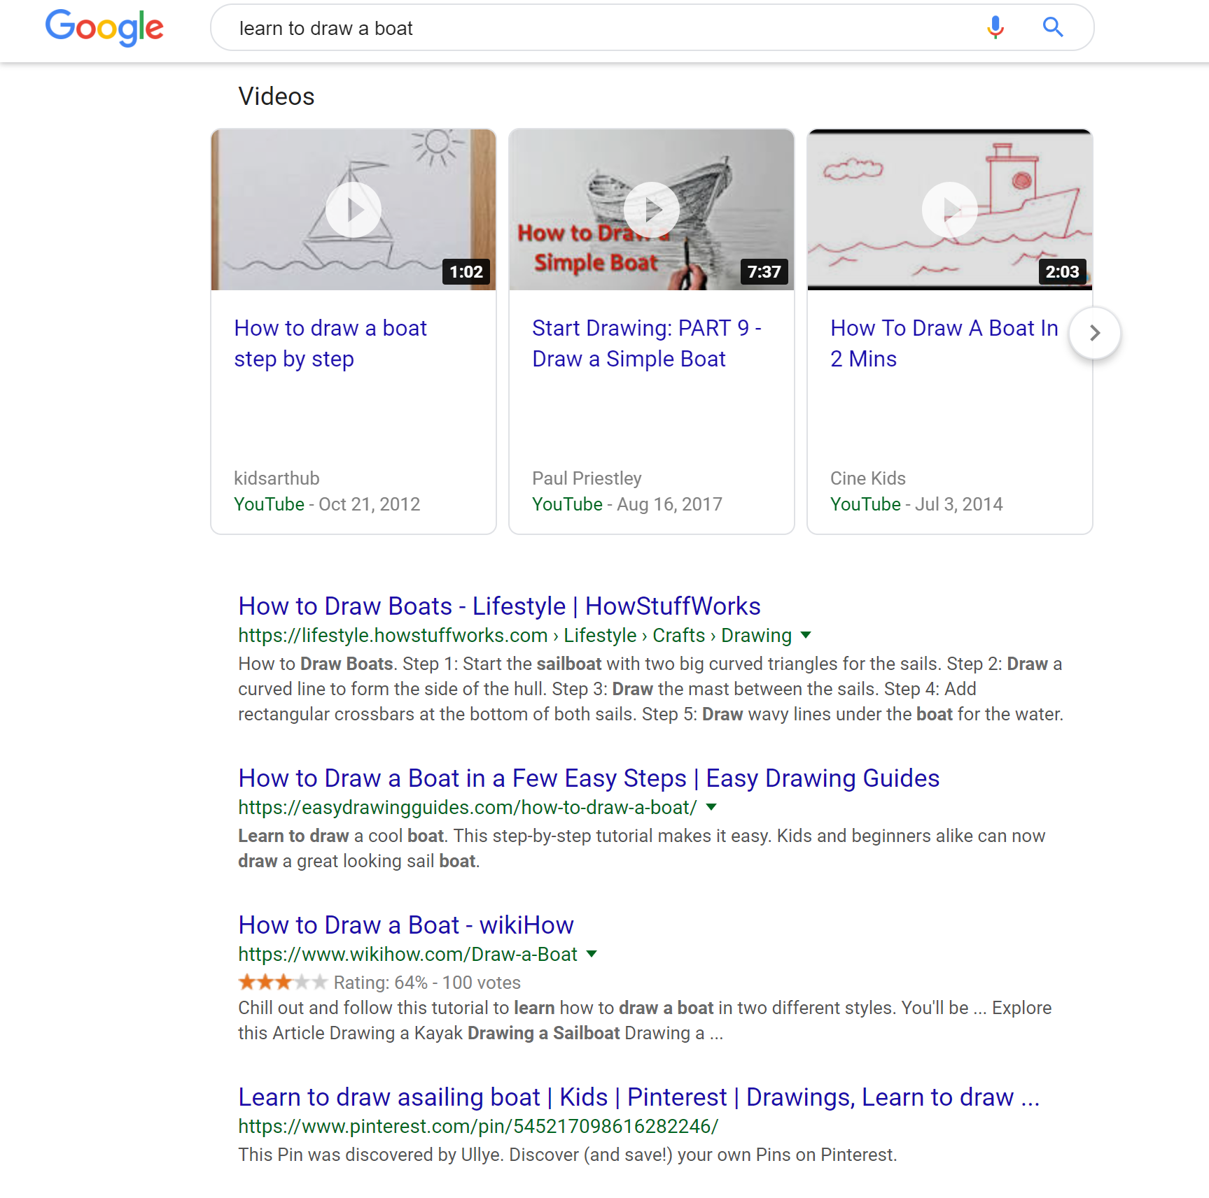

What if you wanted to learn how to draw...
Google can teach me everything!
Reality
I can google how to draw a boat…
Oh look, I have hundreds of options!
*This Photo by Unknown Author is licensed under CC BY-ND

Slide 3
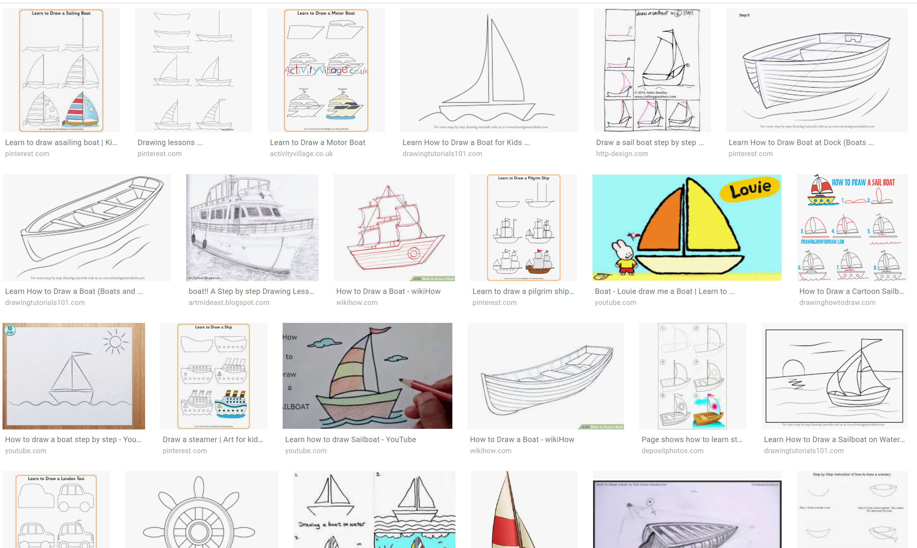

Can there really be too many options?
This Photo by Unknown Author is licensed under CC BY-NC

Slide 4
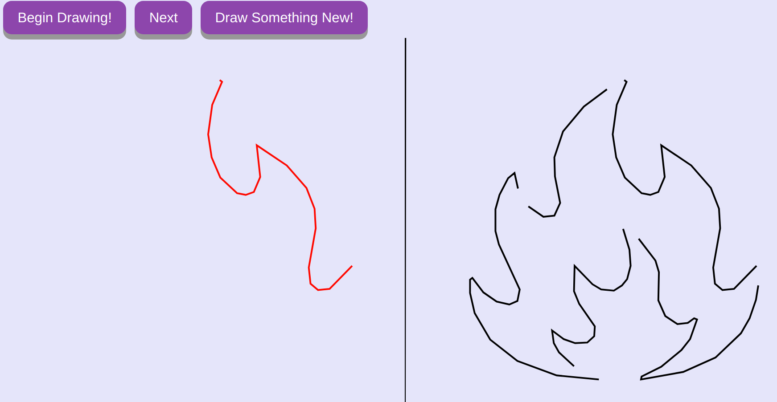
Use Hack-a-Sketch
To draw your picture, simply do the following –
1. Take a picture
2. Upload it to hack-a-sketch.
3. Begin drawing!

