Slide 1

MENTAL HEALTH IN TECH SURVEY
Exploratory Data Analysis & Workplace Insights
What drives tech employees to seek mental health treatment — and how employers can close the gap.
1,259 Respondents
48 Countries
OSMI 2014 Dataset

Slide 2






AGENDA
What We'll Cover
The Dataset
Data Cleaning
Scope, source, and structure of the 2014 OSMI survey
Fixing age outliers, gender free-text, and contextual missing values
Who Responded
What Drives Treatment
Age, gender, and geographic makeup of the sample
Family history, work interference, and workplace policy
The Communication Gap
Recommendations
Anonymity and leave-policy awareness
Actionable steps for tech employers
Mental Health in Tech Survey | EDA & Insights
2

Slide 3
ABOUT THE DATA
A Snapshot of the Tech Workforce
The Open Sourcing Mental Illness (OSMI) 2014 survey asked tech employees worldwide about demographics, workplace policy, and their attitudes toward mental health.
1,259
27
48
50.5%
Survey Responses
Questions Asked
Countries Represented
Sought Treatment
Primary variable of interest:
treatment — whether the respondent has sought treatment for a mental health condition. Nearly every chart in this deck explores what relates to this outcome.
Mental Health in Tech Survey | EDA & Insights
3

Slide 4

DATA PREPARATION
From Raw Survey to Analysis-Ready Data
Age had impossible values
Negative ages and one entry of 99,999,999,999
Filtered to a realistic 18–75 range
Gender had 49 free-text spellings
"M", "male", "Cis Male", "malr"...
Standardized into Male / Female / Other
state was 41% missing
Only meaningful for US respondents
Filled with "Not Applicable" for non-US rows
work_interfere was 21% missing
Only asked of those with a condition
Filled with "Not Applicable" (meaningful NaN)
comments & Timestamp not useful
87% empty free text / submission metadata only
Dropped from the analysis
Mental Health in Tech Survey | EDA & Insights
4

Slide 5
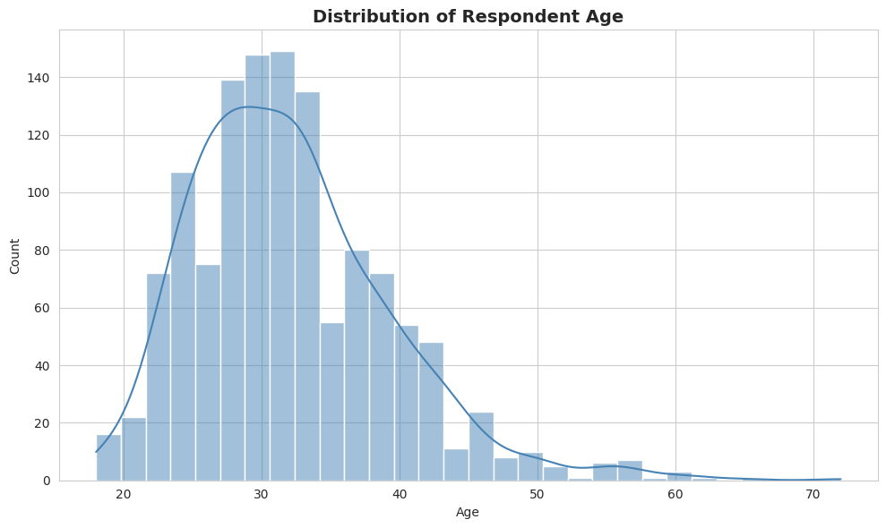
WHO RESPONDED · 01
A Young, Early-Career Workforce
KEY INSIGHT
Respondents are concentrated between ages 23–40, peaking around 28–32.
BUSINESS TAKEAWAY
Mental health programs should be designed for an early-to-mid career audience — not a generic, age-agnostic workforce.
Mental Health in Tech Survey | EDA & Insights
5

Slide 6
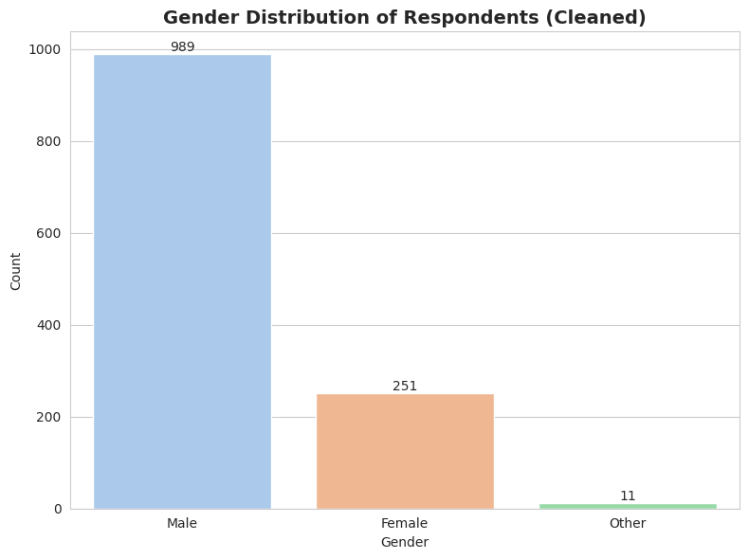
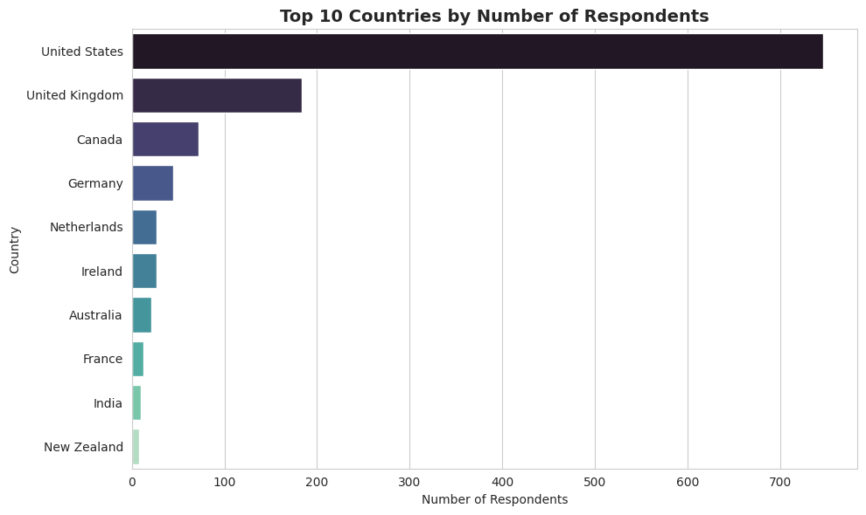
WHO RESPONDED · 02
Gender Skew & Geographic Concentration
79% Male · 20% Female · <1% Other — mirrors tech's gender gap.
US & UK alone account for ~75% of respondents.
Mental Health in Tech Survey | EDA & Insights
6

Slide 7
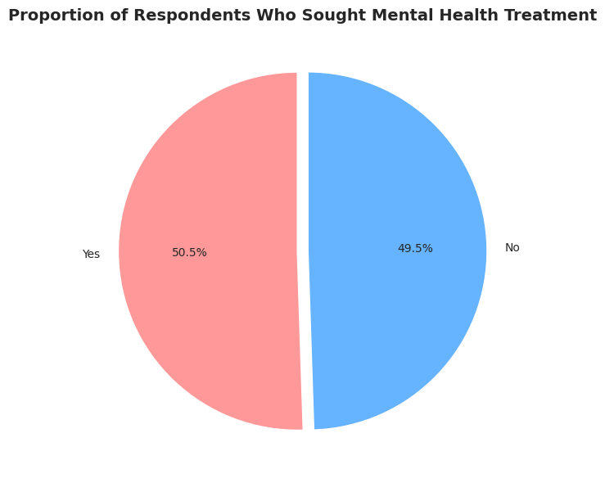
THE CORE QUESTION
Who Seeks Mental Health Treatment?
50.5%
of respondents have sought treatment for a mental health condition
A near-perfect 50/50 split makes treatment a well-balanced outcome — any factor that correlates strongly with it, as explored on the following slides, is a meaningful signal rather than a statistical artifact.
Mental Health in Tech Survey | EDA & Insights
7

Slide 8
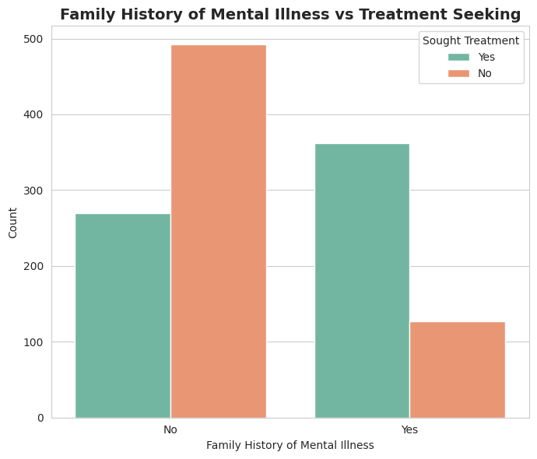
WHAT DRIVES TREATMENT · 01
Family History Is the Strongest Signal
74%
of respondents WITH a family history sought treatment
35%
of respondents WITHOUT a family history sought treatment
Mental Health in Tech Survey | EDA & Insights
8

Slide 9
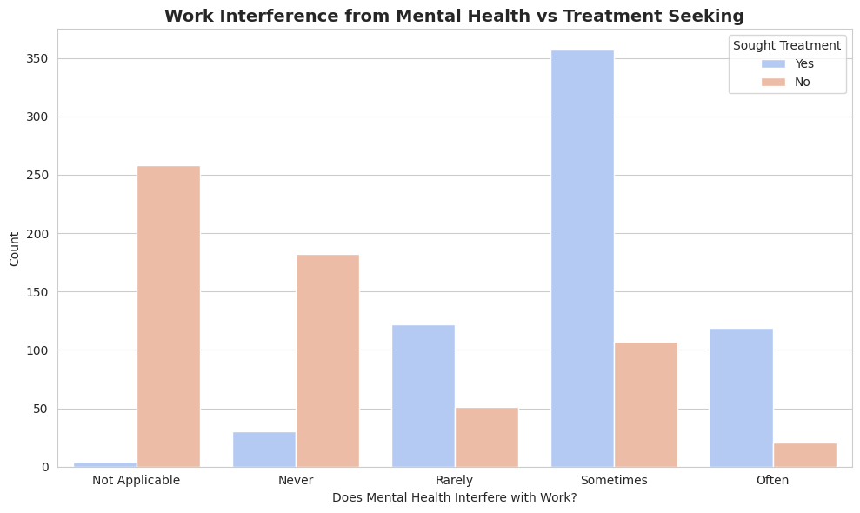
WHAT DRIVES TREATMENT · 02
Treatment-Seeking Tracks Work Interference
Treatment rate by interference level:
Never
14%
Rarely
71%
Sometimes
77%
Often
85%
Mental Health in Tech Survey | EDA & Insights
9

Slide 10
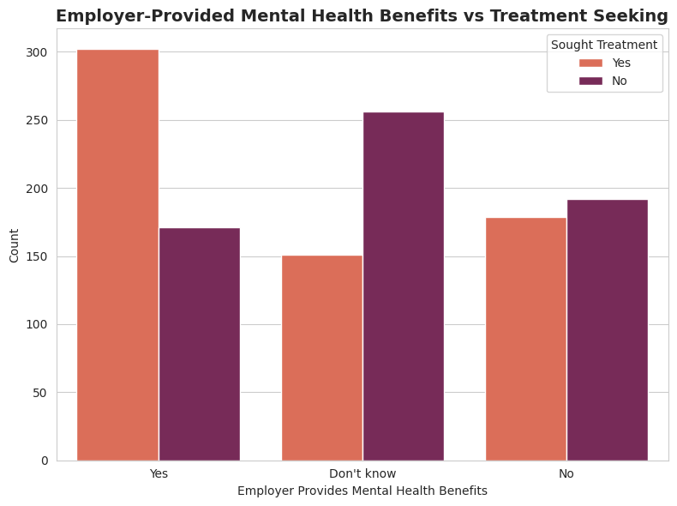
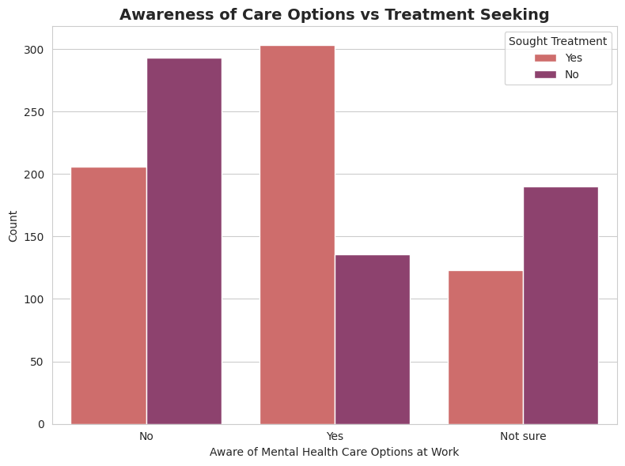
WHAT DRIVES TREATMENT · 03
Communication Matters More Than the Benefit Itself
Treatment rate: 63.8% (benefits offered) vs 37.1% (unsure if offered) — a 26.7-point gap driven by awareness, not just the benefit.
Mental Health in Tech Survey | EDA & Insights
10

Slide 11
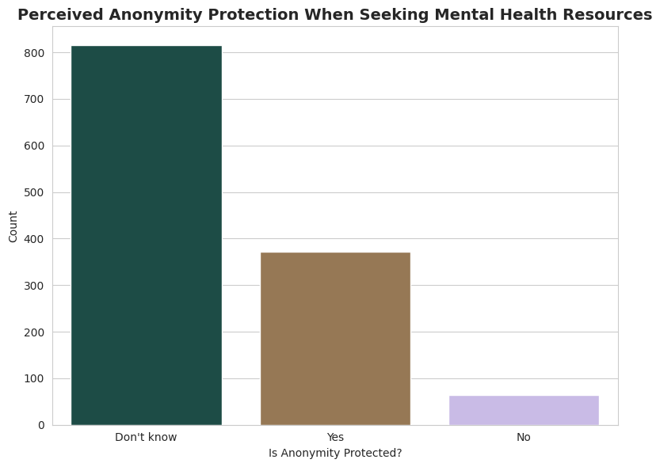
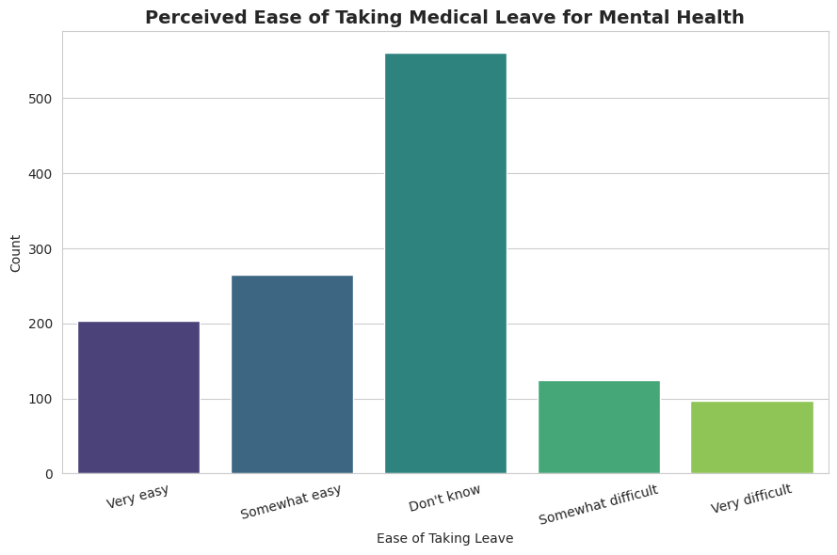
THE COMMUNICATION GAP
Employees Don't Know What's Available to Them
65% don't know if anonymity is protected · 45% don't know how easy mental-health leave would be to take.
Mental Health in Tech Survey | EDA & Insights
11

Slide 12
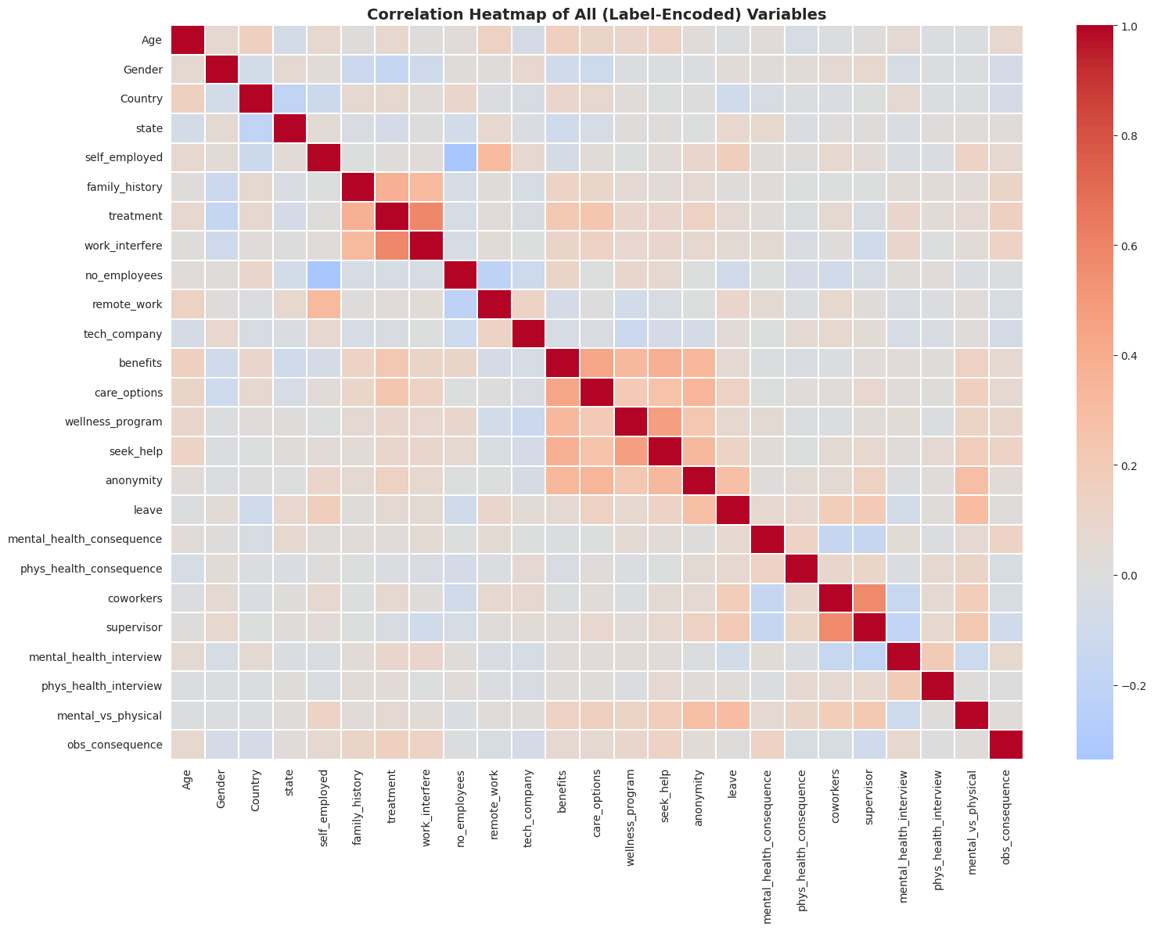
THE FULL PICTURE
How All Variables Relate to One Another
Mental Health in Tech Survey | EDA & Insights
12

Slide 13




KEY TAKEAWAYS
What the Data Tells Us
Personal history matters most
Family history of mental illness is the single strongest predictor of treatment-seeking (74% vs 35%).
Interference is a warning sign
Treatment-seeking rises from 14% to 85% as self-reported work interference increases.
Awareness beats provision
Knowing about benefits and care options lifts treatment rates more than the benefit's mere existence.
Privacy uncertainty holds people back
65% don't know if anonymity is protected; 45% don't know their leave options.
Mental Health in Tech Survey | EDA & Insights
13

Slide 14
RECOMMENDATIONS
What Tech Employers Should Do Next
1
Communicate benefits proactively
Close the awareness gap — don't let "don't know" outnumber "yes."
2
Clarify anonymity protections
Publish a simple, visible policy on confidentiality for care resources.
3
Normalize mental health leave
A clear, no-stigma leave policy removes a major source of uncertainty.
4
Train managers on early signals
Work interference rises before a crisis — equip supervisors to notice and respond.
5
Offer opt-in, confidential outreach
Target higher-risk groups (e.g., family history) without requiring disclosure.
Mental Health in Tech Survey | EDA & Insights
14

Slide 15

Closing the Communication Gap Is the Single Most Actionable Lever
Tech employers already have most of the tools — benefits, care options, leave policy. What's missing is clear, consistent, stigma-free communication about them.
Thank you
Mental Health in Tech Survey | EDA & Insights
15

