Slide 1
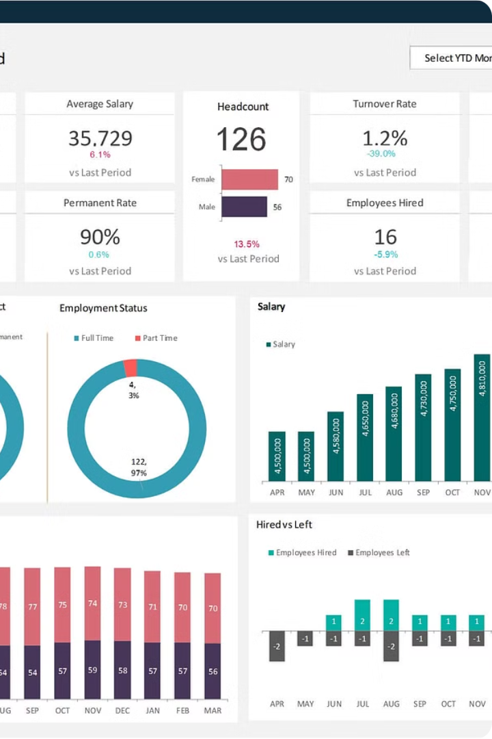


HR Analytics Dashboard
The HR Analytics Dashboard is a powerful tool designed to help HR departments visualize data, gain insights, and make informed decisions. This dashboard provides a comprehensive view of key performance indicators (KPIs) that are crucial for improving employee performance, retention, and overall organizational success.
by Akshita Srivastava

Slide 2
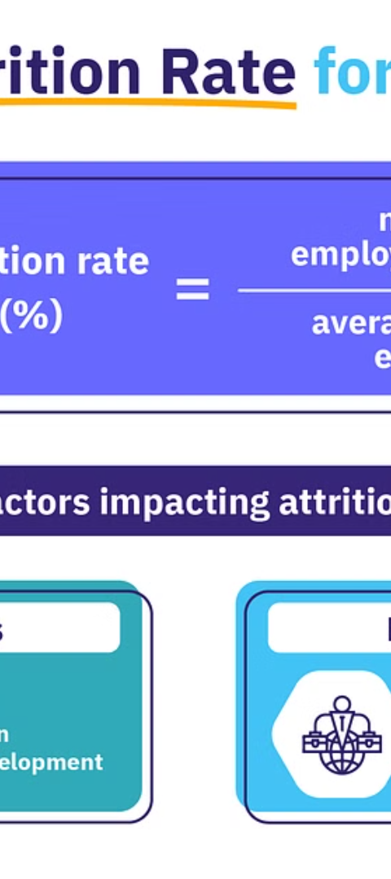
Employee Count and Attrition
Employee Count
Attrition Count
The total number of employees in the organization, providing a clear understanding of the workforce size.
The number of employees who have left the organization, highlighting the need to address retention strategies.
Attrition Rate
The percentage of employees who have left the organization, a critical metric for identifying and addressing turnover issues.

Slide 3
Employee Demographics
Average Age
Average Salary
Average Years of Service
The average age of employees, providing insights into the age distribution and potential workforce planning needs.
The average salary of employees, which can be used to benchmark compensation and identify potential areas for improvement.
The average tenure of employees, indicating the organization's ability to retain talent and foster long-term engagement.

Slide 4
Attrition Insights
1
Education Background
2
Age Group
Employees with educational backgrounds in life sciences have the highest attrition rates, suggesting the need to review retention strategies for this group.
The 26-35 years age group has the most significant attrition rate, highlighting the importance of understanding the unique needs and challenges of this demographic.
3
Salary Range
4
Gender
Higher attrition is observed in employees with salaries less than Rs 5000, indicating the need to review compensation and benefits for this group.
Higher attrition rates are seen among male employees, suggesting the need to investigate potential gender-specific factors contributing to turnover.

Slide 5

Tenure and Attrition
1
1 Year
Many employees tend to leave the organization after one year of service, highlighting the need to focus on onboarding and early-stage engagement strategies.
2
Job Roles
The top three job roles with the highest attrition are Sales Executive, Scientist, and Laboratory Technicians, suggesting the need to review job-specific retention strategies.

Slide 6



Data Preparation
Data Cleaning
Data Processing
Data Quality
Cleaning and processing the dataset, handling missing values, duplicates, and inconsistencies to ensure data integrity and reliability.
Transforming and preparing the data for analysis, ensuring it is in the right format and structure for the dashboard creation.
Ensuring the data is accurate, complete, and consistent, laying the foundation for meaningful insights and informed decision-making.

Slide 7
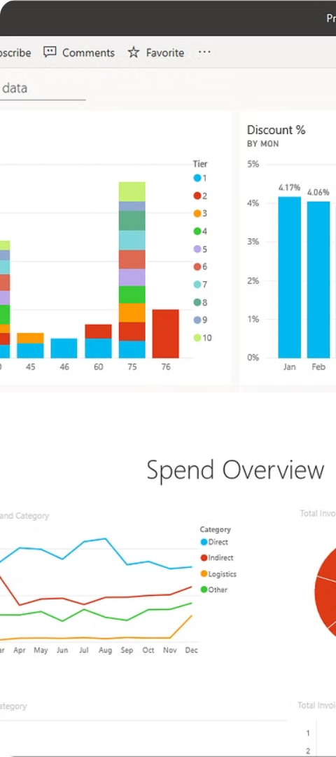



Dashboard Creation
Visualization
Developing an interactive dashboard using Power BI to track the key performance indicators and provide a comprehensive view of the data.
Interactivity
Incorporating filters, slicers, cards, and charts to enable user-driven exploration and facilitate data-driven decision-making.
Insights
Leveraging the information presented in the dashboard to uncover actionable insights and optimize strategies for decreasing attrition and improving employee satisfaction.

Slide 8
Conclusion
Actionable Insights
The HR Analytics Dashboard provides owners and stakeholders with actionable insights into employee performance and preferences, enabling them to make informed decisions and optimize strategies.
Decrease Attrition
By leveraging the information presented in the dashboard, the organization can implement targeted initiatives to decrease employee attrition and improve retention.
Improve Satisfaction
The dashboard also helps the organization identify areas for improvement in employee satisfaction, allowing them to enhance overall workforce engagement and productivity.

