Slide 1

Jhapki
The Brogrammers

Slide 2
Drowsiness Detection

Slide 3
Inspiration

Slide 4
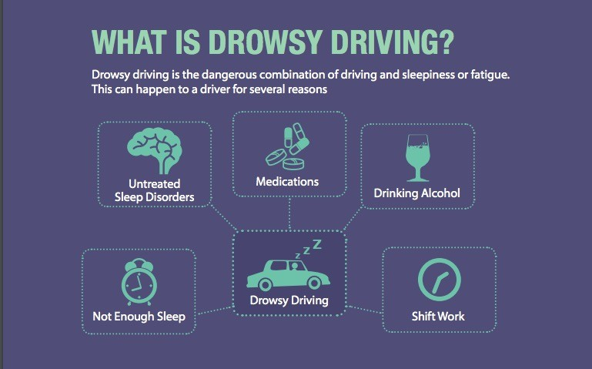
We felt the need for this product in long range driving as it is natural for a driver to feel sleepy during such times but is indeed fatal for him and others as well. Our inspiration stems from a desire to combat this problem at a feasible level
Found around the house!

Slide 5
THEME WE ARE WORKING ON
Social Welfare
Any application that can improve the current situation of a section of society using technology, is, in our opinion, a good application.

Slide 6
What it does?

Slide 7
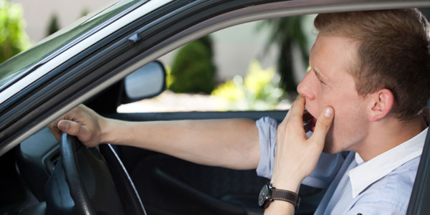
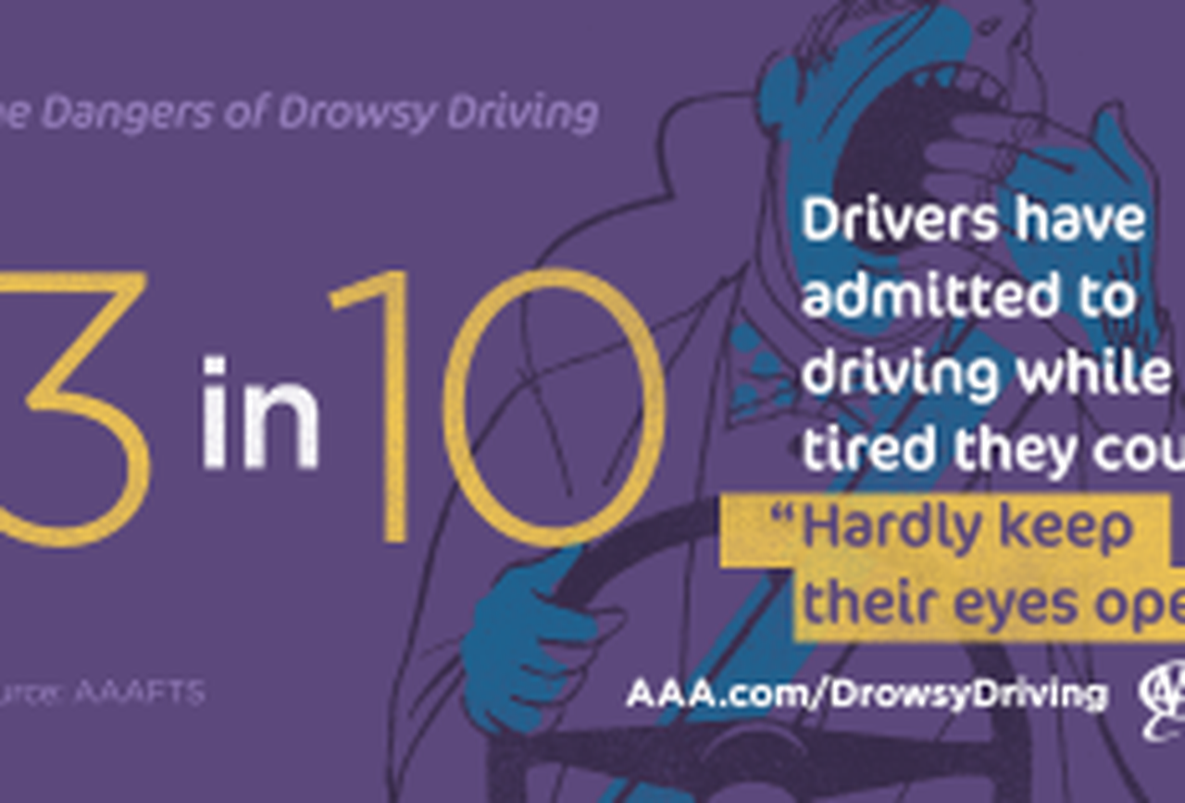
Jhapki helps the driver stay safe by looking out for symptoms of drowsiness. It timely alerts them of this development so that immediate actions can be taken to remedy the situation on the road.

Slide 8
How we built it?

Slide 9
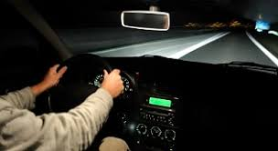
We used computer vision library (cv2) to detect a person's blink. The data about blinks is then used to conclude about the state of the driver. This sets off an alarm in the front end of the application and takes other helpful measures as well.

Slide 10
Working

Slide 11
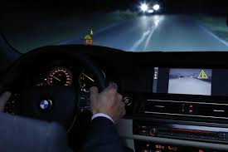
The user launches the app in the background before he starts driving. If Jhapki detects that the user is feeling drowsy, it tries to wake the user up by playing a siron until the user wakes up and turns it off.

Slide 12
Accomplishments that we're proud of !

Slide 13
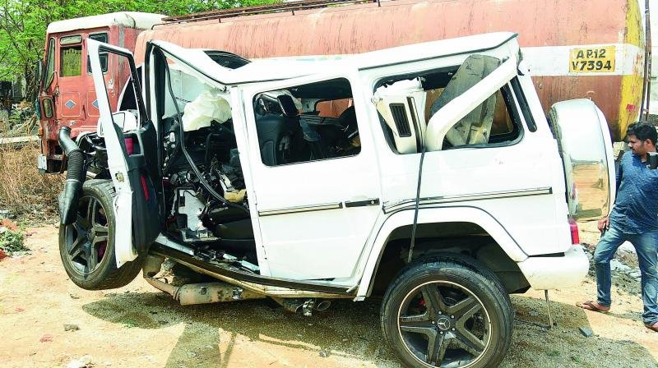
We are proud of the fact that this program can be deployed in real-time computation due to its low-overhead and high accuracy in detecting a person's blnk. Even one life saved is a matter of pride for us.

Slide 14
Future Scope

Slide 15
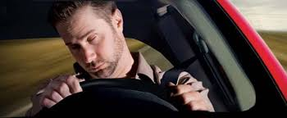
We want to augment our app by adding functionality for SMS alerts to family members containing location of the driver after the alarm isn’t turned off within a certain time limit.
We also want to add support for Android and iOS so that our product can be used for real world scenarios inside phone holders in cars.

Slide 16
What's next for Jhapki ?

Slide 17
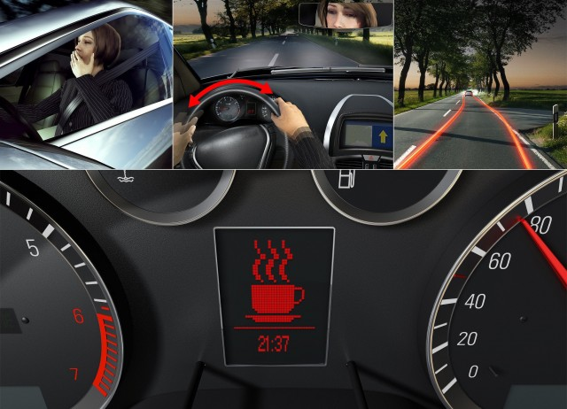
Helping Jhapki reach a mass audience is a dream for us as we can't help but stress the need for this product. Right now, only a handful of very high-end luxury cars like Tesla support this feature. Bringing it to an average driver on the highway would be a moment of pure elation for us.

Slide 18
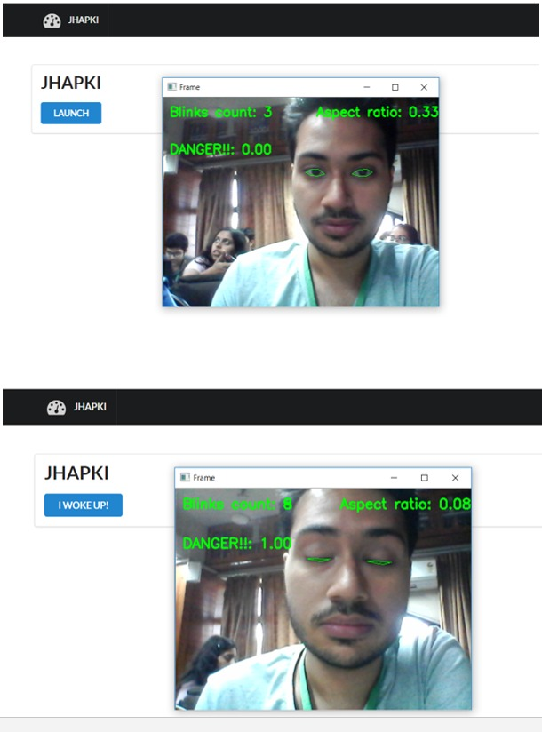

Slide 19
Thank you for your time!
:’)

