Slide 1
Performance of Sensor MAC Schemes and Prediction Model For Bursty Traffic
Akshita MVVS
Naveen Chalicheemala

Slide 2
Summary of the Paper
Addressed the issue of hybrid networks
Proposed a new MAC Scheme – MobIQ ,that works efficiently on a Hybrid networks when compared to other MAC protocols
This scheme allows selective and low delay mobile to static communication link
Provides a Contention Avoidance Algorithm to leverage channel contention and hidden terminal problem

Slide 3
Prediction Model
The prediction model has four phases to it:
Data Collection
Defining the burst
Generating the burst data
Machine learning model

Slide 4
Data Collection
In this phase we take all the packet information from different base stations
The Data Structure – each row represents a packet and each column represents a one feature of the packet.

Slide 5
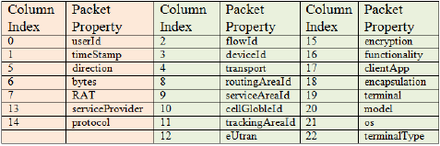
Data Collection
The information consists of 23 different features that define a packet
The model considers, the 7 most important features for defining the packet - userid, timestamp, direction, bytes, rat , service protocol, provider.

Slide 6
Defining the burst
In this phase a new parameter is introduced which gives the maximum inter-packet gap
The new parameter X – this value has to be selected such that the number of bursts changes slowly without effecting the performance of the model.

Slide 7
Defining the burst
Burst Gap
Time
Burst

Slide 8
Generating the burst data
Once all the burst parameters a determined , you get the burst.
The packet information should now be converted to burst information.
One row for each packet
One row for each burst
One column for each packet property
One row for each burst property

Slide 9
Generating the burst data
The packets are first grouped on the basis of userId
For each userId , the bursts are then separated using the parameter.
The burst generation can be done using either multi-core processing or Apache Spark

Slide 10
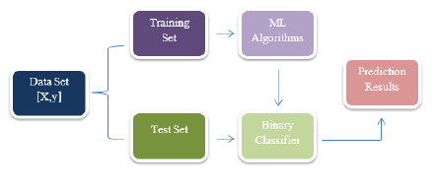
Machine Learning Model
The ML Data Set
The ML Data set is a collection of [X,y] rows, where X is the feature Vector and y is the true label of the packet or burst.

Slide 11
Machine Learning Model
Feature Prediction:
Feature Extraction
Feature Construction
N and n

Slide 12
Machine Learning Model
Adding label to supervised learning:
In this a threshold is set and the feature prediction is done depending on if the packet features are below the threshold or above the threshold
Set Split – The data splitting is done to train the model
Vertical Split
Horizontal Split

Slide 13
Machine Learning Model
Two functions are present in the implementation which is:
Burst Volume Prediction
Burst Duration Time Prediction

Slide 14
Wireless Sensor Mac Protocols
There are two kinds of Wireless Sensor MAC Protocols
Schedule based: LEACH , PEDAMACS,PRIMA
Contention based: SMAC,BMAC,PW-MAC

Slide 15
S-MAC (Sensor MAC)
Main goal of the protocol is to reduce the energy consumption.
Neighbouring nodes auto-synchronize their sleep schedule with each other.
Each node can have multiple schedules
Each node maintains a table that includes the schedules of the neighbours

Slide 16
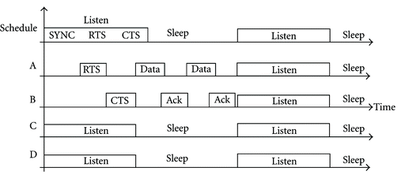
S MAC
Fig 1 . Basic Working of SMAC

Slide 17
S MAC
Advantages
Reduces energy consumption
Adapts easily to the change in topology
No one point of control
Disadvantages
Loose synchronisation has to be maintained for the schedules to work properly
Shifts in clocks causes unsynchronisation
RTS and CTS generate overhead
Idle listening still occurs

Slide 18
LEACH (Low-Energy Adaptive Clustering Hierarchy)
Assumptions made by the protocol
All the nodes are synchronised.
Can control their transmission power
Can reach one base station
LEACH works in rounds

Slide 19
LEACH
In the setup phase – non persistent CSMA is used
Node i selects itself as a ClusterHead
Once the cluster head is elected , it sends the advertisement packet
All the non-elected nodes receive this message and decide which cluster to join
CH creates a TDMA
every node uses only its assigned time slot to send data to the CH and sleeps the rest of the time
CH sends the obtained data to the BS

Slide 20
LEACH
Advantages
Energy saving through sleeping
CH rotation extends the lifetime of the network.
Disadvantages
If the CH dies then the entire cluster becomes inactive
Assumes one hop communication between nodes
Requires tight synchronisation

Slide 21
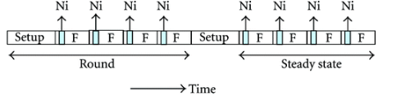
LEACH
Fig 2 Rounds in LEACH protocol

Slide 22
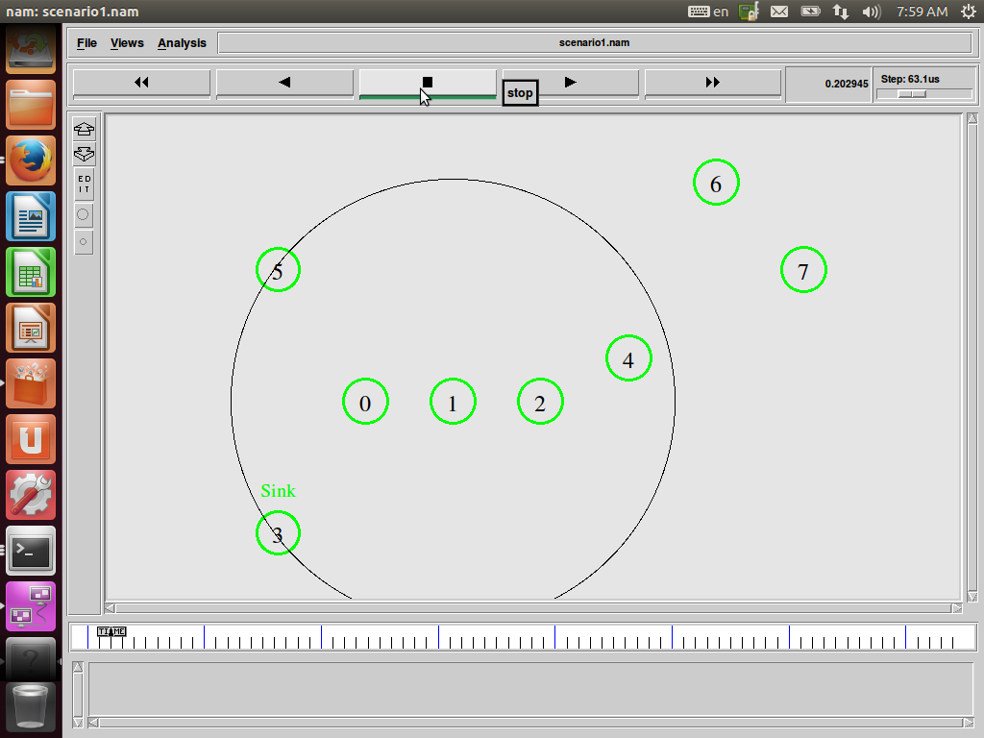
Tools used and Initial Simulation
Tools used
NS2 for network simulation
Gnuplot for plotting data
For the initial setup we have created a WSN with 8 nodes in it

Slide 23
Simulation for SMAC
The simulation has been done for 100 nodes.
set opt(nn) 100
The protocol is then compared to the 802_11 MAC scheme
set opt(mac) Mac/802_11
set opt(mac) Mac/SMAC

Slide 24
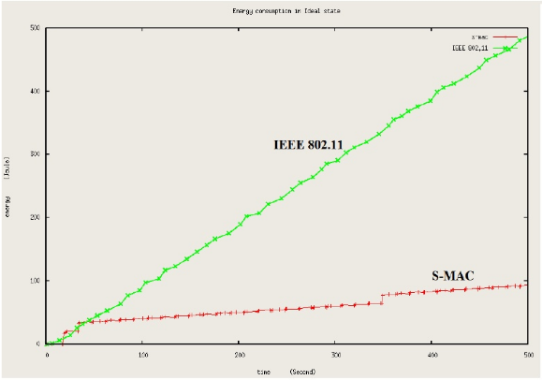
Simulation for SMAC
Measurement of Energy Consumption
Once the tcl script is run, we get a .trace file .
Using the data of the trace file we compare the protocols using gunplot

Slide 25
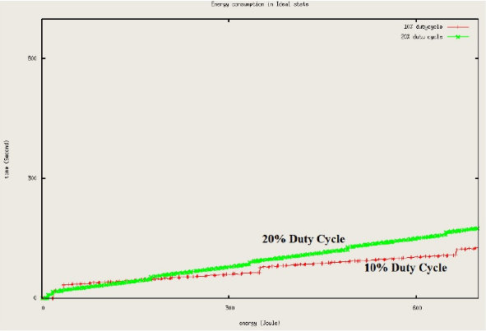
Simulation for SMAC
Energy consumption with delay
We have tested the protocol for two duty cycles
Mac/SMAC set dutyCycle_10 #10%
Mac/SMAC set dutyCycle_20 #20%

Slide 26
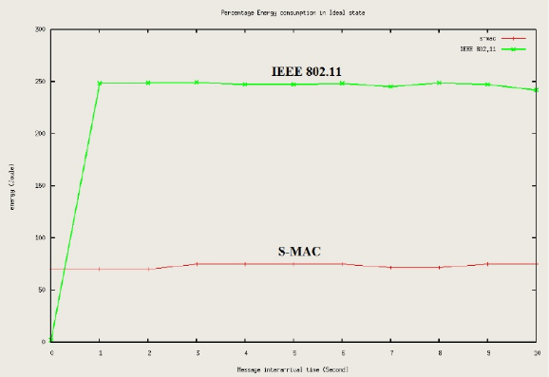
Simulation for SMAC
Energy consumption with traffic variation
High traffic is set by :
$cbr(0)set interval 0.001
Low traffic is set by
$cbr(0) set interval 10.0

Slide 27
Simulation for LEACH
For this we have simulated a network of 100 nodes in it
The sensor nodes start from 0 to 99
The last node is the Base Station (BS).

Slide 28
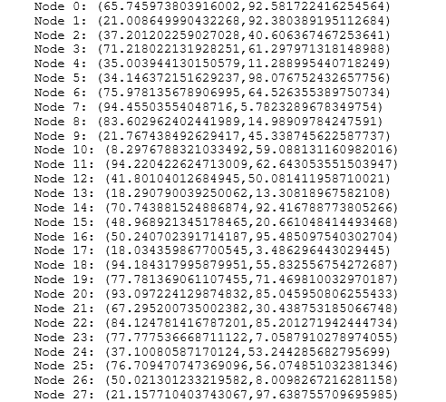
Simulation for LEACH
The nodes are placed randomly in a area of 800 units by 800 units by using a random number generator.
if {$opt(seed) > 0} { puts "Seeding Random number generator with $opt(seed)\n" ns-random $opt(seed)

Slide 29

LEACH Simulation
Once the entire simulation is done we get the total time the network was running

Slide 30
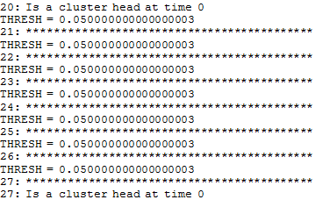
LEACH Simulation
In the first run of the code we get:
The amount of energy consumed by each node – In this case we have given fixed energy to the nodes
The cluster heads in the first round.

Slide 31
Conclusion
SMAC does perform better in terms of energy consumption when compared to the other mac protocol on a WSN.
LEACH – we have run it on a network , we are yet to compare it to another mac protocol
The prediction model- may help in accurately predicting the advent of bursty traffic in a network at a given instance.

Slide 32
THANK YOU

