Slide 1






Project Title
PROJECT NAME
Team : 1 Akshit Jayesh Dhake [Akshit.dhake@mitaoe.ac.in]
2 Harshwardhan Waydande [harshwardhan.waydande@mitaoe.ac.in]
3 Chetan Sapkal [chetan.sapkal@mitaoe.ac.in]
4 Chetan Talele [chetan.talele@mitaoe.ac.in]
Guide: Hrishikesh Mahure
Disclaimer: The content is curated for educational purposes only.
Notes:
Slides: Prepare a short slide deck (10-12 slides) summarizing the project objectives, methodology, and key results.
1

Slide 2
Laundry Service Booking System
OUTLINE
Abstract of the Project
Problem Statement
Proposed Solution
System Architecture
Live Demo of the Project
Embedded Video of Project
Conclusion
Future Scope
Notes:
2

Slide 3
Laundry Service Booking System
Abstract
Connects users with laundry service providers.
Users can browse, compare, and order services.
Providers can list and manage orders.
Simplifies access to laundry services.
Improves operational efficiency for both users and providers.

Slide 4
Laundry Service Booking System
Problem Statement
Users struggle to find and manage laundry services, and providers have difficulty managing orders. A centralized platform is needed to simplify access and streamline order management

Slide 5
Laundry Service Booking System
Proposed Solution
Laundry Service Provider
List services and pricing.
Manage orders with a dashboard.
Track and update orders in real-time.
Optimize operations and resources.
2.Customer
Compare services by price and location.
Order easily via an intuitive interface.
Track orders in real-time.

Slide 6
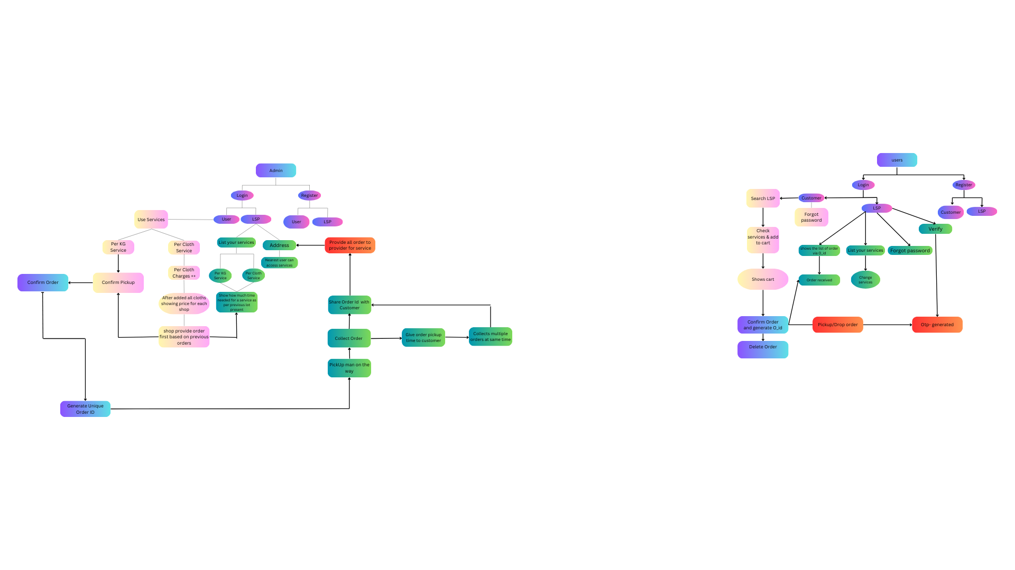
Laundry Service Booking System
System Architecture

Slide 7
Laundry Service Booking System
Live Demo of Project
Project Live
Project video

Slide 8
Laundry Service Booking System
Conclusion
Centralized platform connecting users and service providers.
Simplifies access and streamlines order management.
Enhances user experience and operational workflow.
Promotes efficiency and customer satisfaction.

Slide 9
Laundry Service Booking System
Future Scope
Integration with Payment Gateways: Adding secure online payment options for a seamless transaction experience.
Mobile Application Development: Expanding to mobile platforms for greater accessibility.
Feedback Mechanism: Introducing a review and rating system to enhance service quality and customer satisfaction.

Slide 10
Laundry Service Booking System
References:
[1]. S. V. Katti and M. S. Barot, "Online Laundry Service Application," International Journal of
Scientific Research in Computer Science, Engineering and Information Technology
(IJSRCSEIT), vol. 2, no. 1, pp. 281–286, Jan.–Feb. 2017.
[2]. https://tumbledry.in/
[3]. https://uclean.in/
[4]. https://laundrokart.com/
[5]. https://laundrymate.in/

Slide 11
Laundry Service Booking System
Thank you!
Notes:
thank you very much for joining this PPT, keep learning.
11

