Slide 1

Heart Disease Risk Modelling
Phase 1: six machine-learning classifiers on 303 Cleveland patients, compared under one leakage-safe nested cross-validation
Hardik · Ayush · Akshith · Vansh · Kabir
[Course / institution] · October 2026
Notes:
Hardik opens. One-line framing: an academic machine-learning comparison on a public dataset, not a diagnostic system. Phase 1 covers six classical models; each team member presents the part they built.

Slide 2
Team and roles
Presenter Hardik
Member | Phase 1 work | Explains in the viva
Hardik | Data loading, verification, EDA and notebook, preprocessing / feature engineering | Dataset quality and EDA, feature engineering
Ayush | Bayesian network (structure, conditional probability tables, inference), data splits, metrics, Methods page | Theoretical rigour (probabilistic graphical models)
Akshith | Logistic Regression and SVM, model pipelines, the script that trains and compares all models | Model application (linear and kernel models)
Vansh | Random Forest and Gradient Boosting, hyper-parameter tuning (nested CV), feature importance | Model application (ensembles), tuning
Kabir | Naive Bayes, the web app (adapted to the ML models only) | Model application, demo
Notes:
Each slide shows its presenter in the top-right corner. Order: Hardik (data), Ayush (evaluation design and Bayesian network), Kabir (Naive Bayes), Akshith (Logistic Regression, SVM and the comparison), Vansh (ensembles, tuning and feature importance), Ayush (are the differences real), Kabir (demo).

Slide 3



The question, and the short answer
Presenter Hardik
RESEARCH QUESTION
Yes, they predict well
Can classical machine-learning models predict angiographic heart disease from 13 clinical and test variables, and does the choice of model matter?
ROC AUC 0.89–0.91 and accuracy 81.8%–84.9% on patients the models had not seen.
The choice of model barely matters
Five models cannot be told apart; Gradient Boosting is slightly behind. Every other paired difference includes zero.
Six models, the same folds, the same metrics, 303 patients.
Internal evidence only
One centre, 303 patients, no external validation. Not a clinical tool.
Notes:
Headline first. All six models discriminate well (ROC AUC 0.890 to 0.910). The highest ROC AUC is Bayesian Network and the highest accuracy SVM, but among the top five the differences are much smaller than the uncertainty, so we do not claim a winner.

Slide 4
Dataset: UCI Heart Disease, Cleveland
Presenter Hardik
303
13
45.9%
6
patients
predictors
have disease (139)
rows with a missing value
Loaded from the original UCI archive and checked: 303 rows × 14 columns, no duplicates, no impossible values
Target: disease = 1 if the angiographic diagnosis num is 1–4, else 0
Close to balanced: 164 without, 139 with disease
Missing only in ca (4) and thal (2)
Six predictors come from exercise tests, fluoroscopy and imaging: a diagnostic work-up, not first-contact screening
Notes:
We use processed.cleveland.data (CC BY 4.0); the archive itself warns that the raw cleveland.data file is corrupted. The verification script checks the archive, the column count, value domains and duplicates before anything else runs.

Slide 5
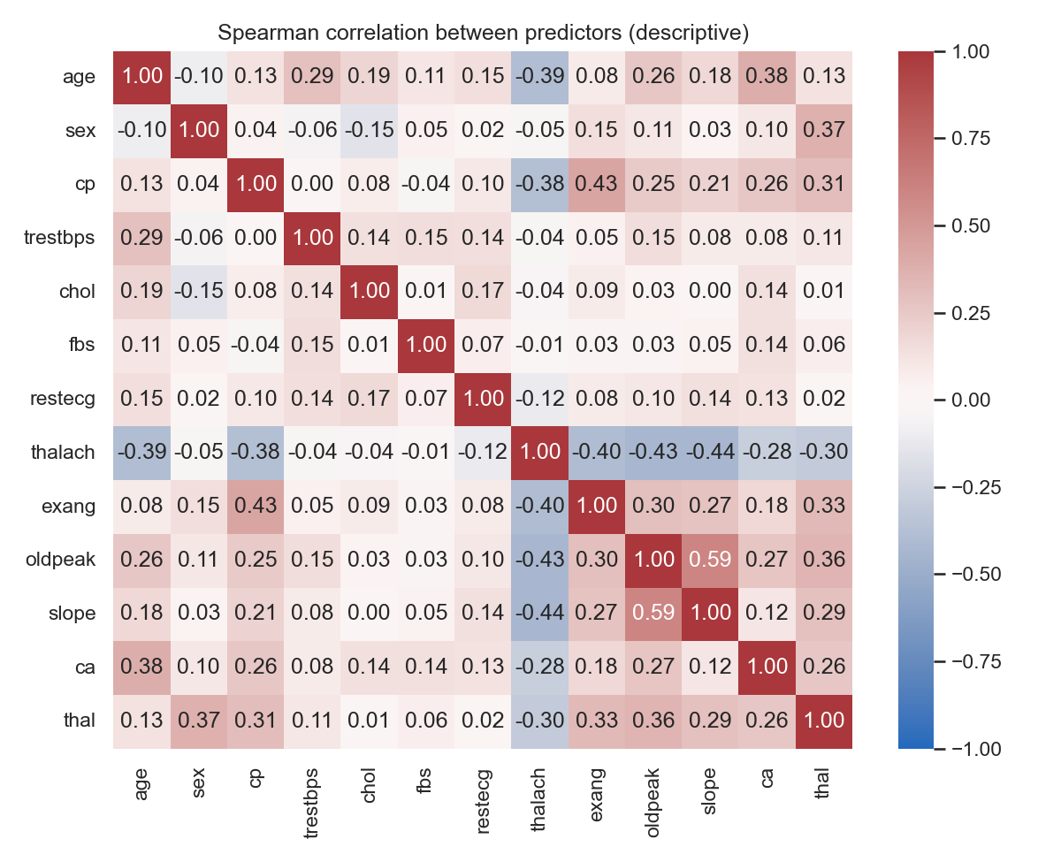
What the exploratory analysis showed
Presenter Hardik
Only one strongly related pair
oldpeak and slope (Spearman 0.595); no feature duplicates another
Sparse categories
restecg = 1 has 4 patients; thal = 6 has 18; ca = 3 has 20
Referral bias is visible
Asymptomatic chest pain has the highest disease rate (0.73): it reflects who was sent for angiography
Notes:
Descriptive only; correlation is not causation. The full EDA notebook is notebooks/01_eda.ipynb.

Slide 6
Feature engineering without leakage
Presenter Hardik
1
2
3
4
5
Raw 303 rows
Guard: the target can never be an input
Fit preprocessing on the training fold only
Train the model
Score the held-out fold
LR, SVM, RF, GB: 20 numeric inputs
Bayesian network, Naive Bayes: 13 discrete inputs
Median / most-frequent imputation
Standardise continuous and ordinal features
One-hot encode cp, restecg, thal
Continuous features cut into training-fold tertiles
Integer codes from the training categories
Missing or unseen values → training mode
Medians, scaling statistics, categories and bin edges are learned from the training fold only and refitted in every fold.
Notes:
Leakage means test information sneaking into training. If we scaled with the mean of all 303 patients, the held-out patients would influence the model. So the whole pipeline is refitted inside each training fold.

Slide 7
Data splits and evaluation metrics
Presenter Ayush
5-fold stratified CV × 5 repeats = 25 folds
Accuracy
share of all patients classified correctly
red = held-out fold (~60 patients), grey = training folds (~240)
Sensitivity (recall)
share of diseased patients detected: TP / (TP + FN)
Specificity
share of healthy patients cleared: TN / (TN + FP)
Precision
share of positive calls that are right: TP / (TP + FP)
Stratified: every fold keeps ~46% disease
The same 25 splits for all six models (seed 42), so comparisons are fair and paired
Each patient is predicted once per repeat by a model that never saw them
F1
balance of precision and recall
ROC AUC
chance a random diseased patient scores above a random healthy one
Brier score
mean squared error of the probability (lower is better)
Notes:
Hard-label metrics use a fixed threshold of 0.5 chosen in advance. Uncertainty: mean ± standard deviation over the 25 folds, plus a patient-level bootstrap (2000 resamples) for 95% intervals.

Slide 8
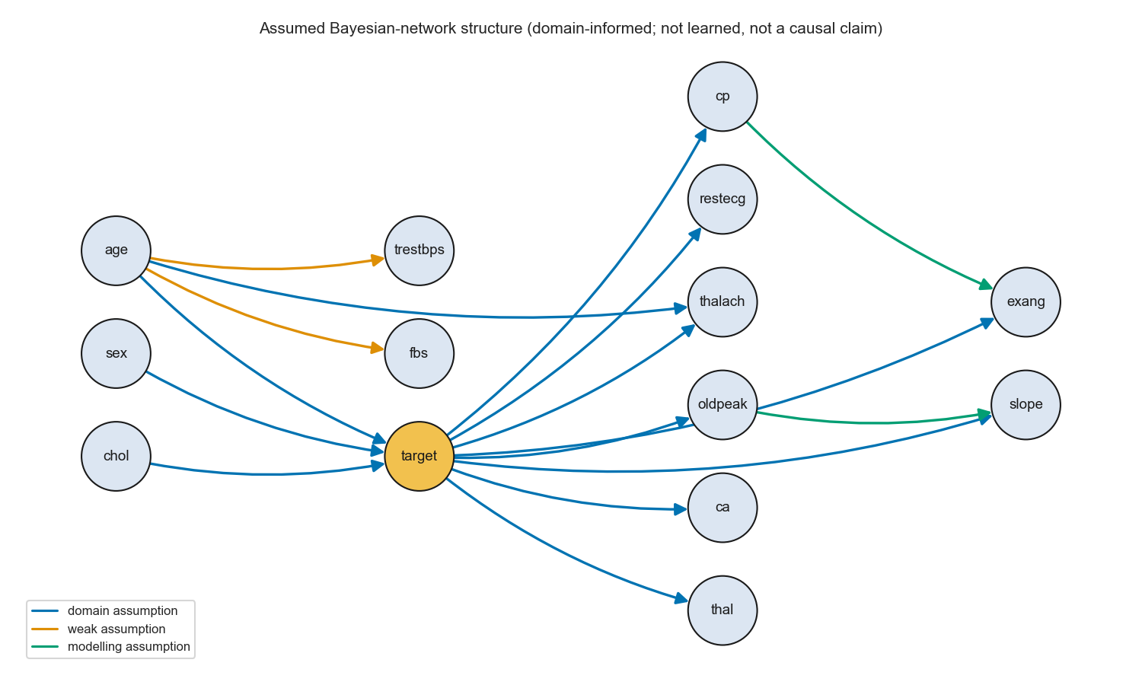
Bayesian network: probability over a graph
Presenter Ayush
A directed acyclic graph: 14 nodes, 16 edges, fixed from domain reasoning (risk factors → disease → findings)
Each node stores a conditional probability table P(node | parents), learned from the training fold
Dirichlet smoothing (pseudo-count) avoids zero probabilities; tuned
Inference: P(disease | 13 findings) by exact variable elimination
An assumption, not a causal claim
Notes:
Joint distribution factorises as the product of P(node | parents). Blue edges are clinical reasoning, orange weak, green added to relax Naive Bayes independence. Most chosen pseudo-count: 10 (25 of 25 folds). Implemented with pgmpy.

Slide 9
Naive Bayes: the simplest Bayesian network
Presenter Kabir
How it works
Why include it
Bayes' rule: P(disease | x) ∝ P(disease) × Π P(xᵢ | disease)
Assumes every predictor is independent of the others once the class is known
Same 13 discrete inputs as the Bayesian network
Laplace smoothing α tuned: α = 10 in 25 of 25 folds
A fast, standard baseline. Comparing it with the Bayesian network shows whether the extra edges help.
Result
ROC AUC 0.905, accuracy 82.8%. The independence assumption is broken (oldpeak/slope, cp/exang), which mainly makes its probabilities too extreme, not its ranking worse.
Notes:
Implemented with scikit-learn's CategoricalNB. Domingos and Pazzani (1997) explain why Naive Bayes ranks well even when independence is violated.

Slide 10


Logistic Regression and SVM
Presenter Akshith
Logistic Regression
Support vector machine
Weighted sum of the 20 inputs → sigmoid → P(disease)
L2 penalty keeps the weights small; strength 1/C tuned over 0.01, 0.1, 1, 10
Most chosen: C = 1 (14/25 folds)
Interpretable: each weight shows a direction of effect
Finds the boundary with the widest margin between classes
RBF kernel lets the boundary curve; C and gamma tuned
Most chosen: C = 1, gamma = 0.01 (23/25 folds)
Platt scaling turns its scores into probabilities
ROC AUC 0.904 accuracy 84.8%
ROC AUC 0.907 accuracy 84.9%
Notes:
Both use the numeric pipeline (imputation, standardisation, one-hot). Standardisation matters for both: the L2 penalty and the RBF distance are scale-dependent. Implemented with scikit-learn.

Slide 11


Random Forest and Gradient Boosting
Presenter Vansh
Random Forest
Gradient Boosting
Many decision trees, each on a bootstrap sample with random feature subsets
Prediction = average of the trees' votes (bagging reduces variance)
Tuned: number of trees and depth
Most chosen: n_estimators = 200, max_depth = 5 (8/25)
Small trees added one at a time; each fixes the errors of the ones before
Learning rate shrinks each step (boosting reduces bias)
Tuned: learning rate, number of trees, depth
Most chosen: learning_rate = 0.05, n_estimators = 100, max_depth = 2 (20/25)
ROC AUC 0.903 accuracy 83.4%
ROC AUC 0.890 accuracy 81.8%
Notes:
Both use the same numeric pipeline as Logistic Regression (trees do not need scaling, but sharing the pipeline keeps the comparison simple). Implemented with scikit-learn.

Slide 12
Hyper-parameter tuning with nested CV
Presenter Vansh
Model | Grid | Chosen most often
Bayesian network | pseudo_count: 0.5, 1, 2, 5, 10 | pseudo_count = 10 (25/25 folds)
Naive Bayes | alpha: 0.5, 1, 2, 5, 10 | alpha = 10 (25/25 folds)
Logistic Regression | C: 0.01, 0.1, 1, 10 | C = 1 (14/25 folds)
SVM | C: 0.1, 1, 10 gamma: scale, 0.01 | C = 1, gamma = 0.01 (23/25 folds)
Random Forest | n_estimators: 200, 500 max_depth: 3, 5, None | n_estimators = 200, max_depth = 5 (8/25 folds)
Gradient Boosting | learning_rate: 0.05, 0.1 n_estimators: 100, 200 max_depth: 2, 3 | learning_rate = 0.05, n_estimators = 100, max_depth = 2 (20/25 folds)
Inside every one of the 25 training folds
1
Split the training fold again into 5 inner folds
2
Try every setting in the grid on the inner folds
3
Keep the setting with the lowest inner log loss
4
Refit it on the whole training fold
5
Only then predict the held-out fold
Notes:
Why nested: if we tuned on the same folds we report on, the score would be optimistic (Varma and Simon 2006; Cawley and Talbot 2010). The outer held-out labels are never used for choosing settings. Grids were declared before the Phase 1 run. The Bayesian network and Naive Bayes chose the largest smoothing value (10) in every fold: more smoothing kept making their over-confident probabilities more cautious. We report this rather than keep widening the grid after seeing results.

Slide 13
Results: the six models are close
Presenter Akshith
Model | Accuracy | Sensitivity | Specificity | F1 | Brier
Bayesian network | 0.829 | 0.793 | 0.861 | 0.810 | 0.121
Naive Bayes | 0.828 | 0.794 | 0.857 | 0.808 | 0.129
Logistic Regression | 0.847 | 0.780 | 0.905 | 0.823 | 0.120
SVM | 0.849 | 0.790 | 0.899 | 0.826 | 0.119
Random Forest | 0.834 | 0.778 | 0.882 | 0.810 | 0.126
Gradient Boosting | 0.818 | 0.772 | 0.857 | 0.795 | 0.131
Mean over 25 outer folds, threshold 0.5. Fold-to-fold SD: accuracy ≈ 0.05, ROC AUC ≈ 0.03–0.04.
Highest ROC AUC: Bayesian network (0.910); highest accuracy: SVM (84.9%); lowest: Gradient Boosting.
Notes:
run_evaluation.py trains and evaluates all six models on the same 25 folds and writes every table and figure. Brier: lower is better; it measures how good the probabilities are, not just the yes/no calls.

Slide 14
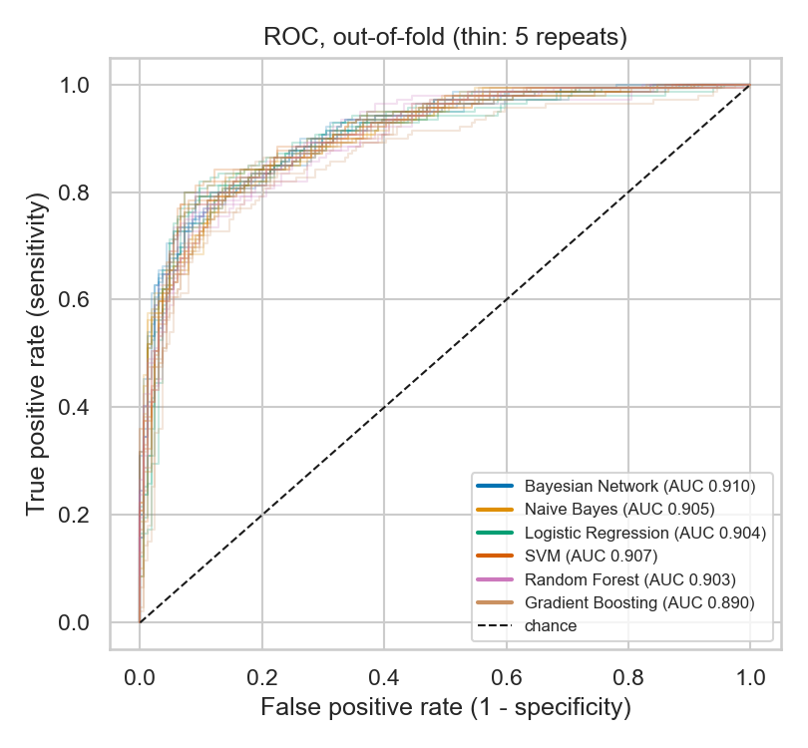
Are the differences real?
Presenter Ayush
12 / 15
12 / 15
paired ROC AUC differences whose 95% interval includes zero
paired accuracy differences whose 95% interval includes zero
How we checked
Resample the 303 patients 2000 times (bootstrap), recompute every model's score, take the difference
If the 95% interval of a difference includes 0, the data cannot tell those two models apart
Every interval that excludes 0 involves Gradient Boosting: it is slightly behind; the other five tie
Each model still misses about 29–32 of the 139 diseased patients per repeat at threshold 0.5
Notes:
Because all models are scored on exactly the same patients, the bootstrap is paired. Intervals that exclude zero: Bayesian Network - Gradient Boosting (ROC AUC +0.020); Logistic Regression - Gradient Boosting (accuracy +0.029); SVM - Gradient Boosting (accuracy +0.030); SVM - Gradient Boosting (ROC AUC +0.017); Random Forest - Gradient Boosting (accuracy +0.016); Random Forest - Gradient Boosting (ROC AUC +0.013). With 30 comparisons, one or two such intervals are expected by chance, so we treat them as weak evidence.

Slide 15
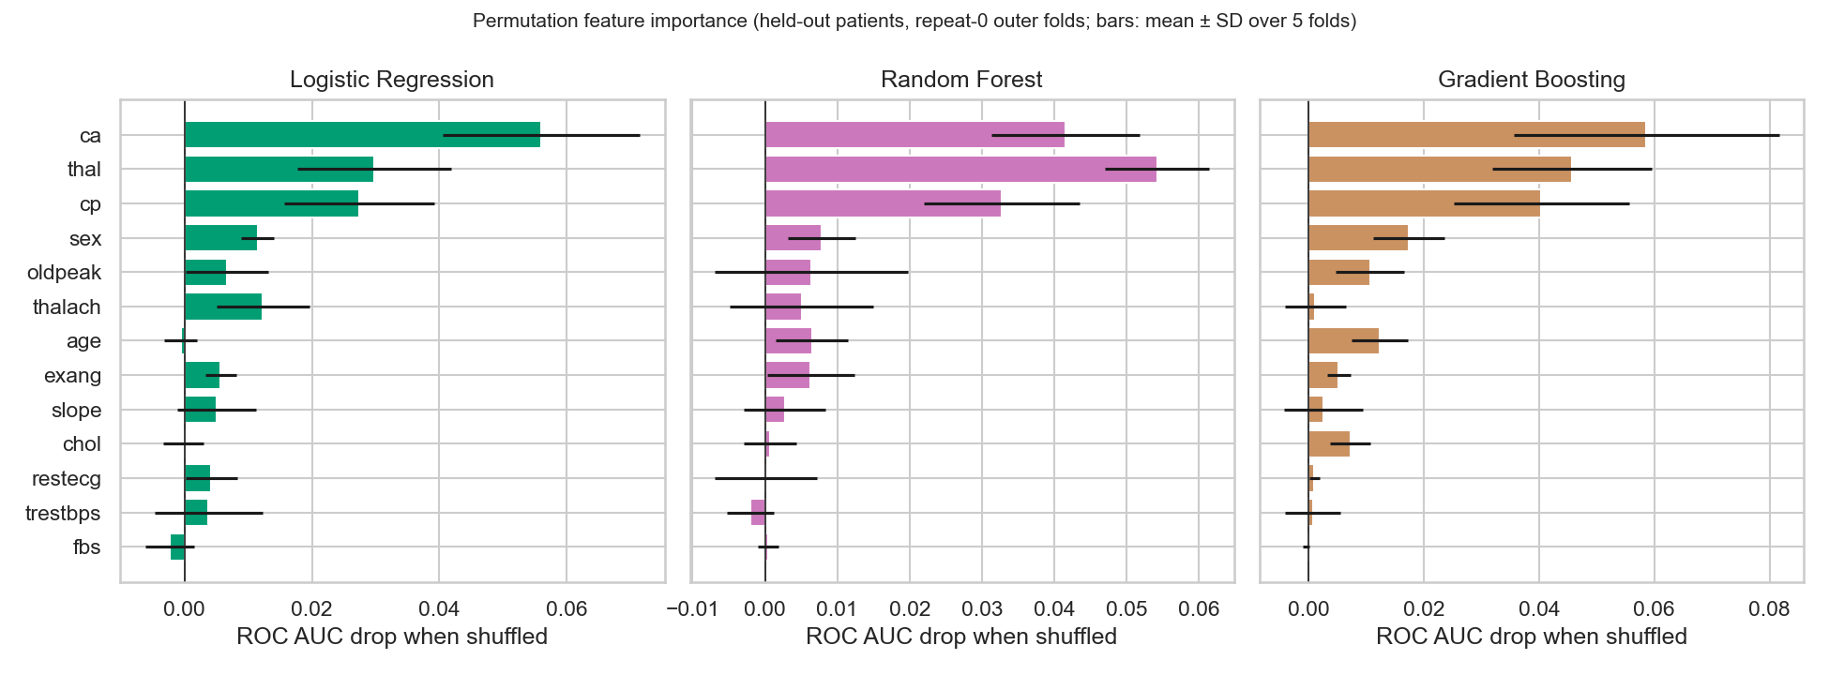
Which features matter
Presenter Vansh
Permutation importance: shuffle one column in the held-out patients and measure how much ROC AUC drops. Bigger drop = the model relies on it more.
All three agree: ca, thal, cp (LR); thal, ca, cp (RF); ca, thal, cp (GB). It describes the models, not causes.
Notes:
Computed on the five repeat-0 outer folds with the hyper-parameters chosen in each fold; 30 shuffles per feature. ca = vessels coloured by fluoroscopy, cp = chest pain type, thal = thallium scan. Correlated features share credit, so a low rank does not mean irrelevant.

Slide 16
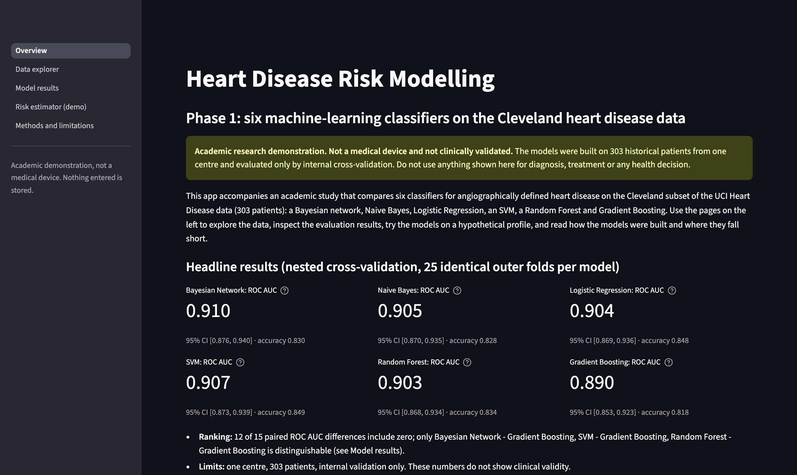
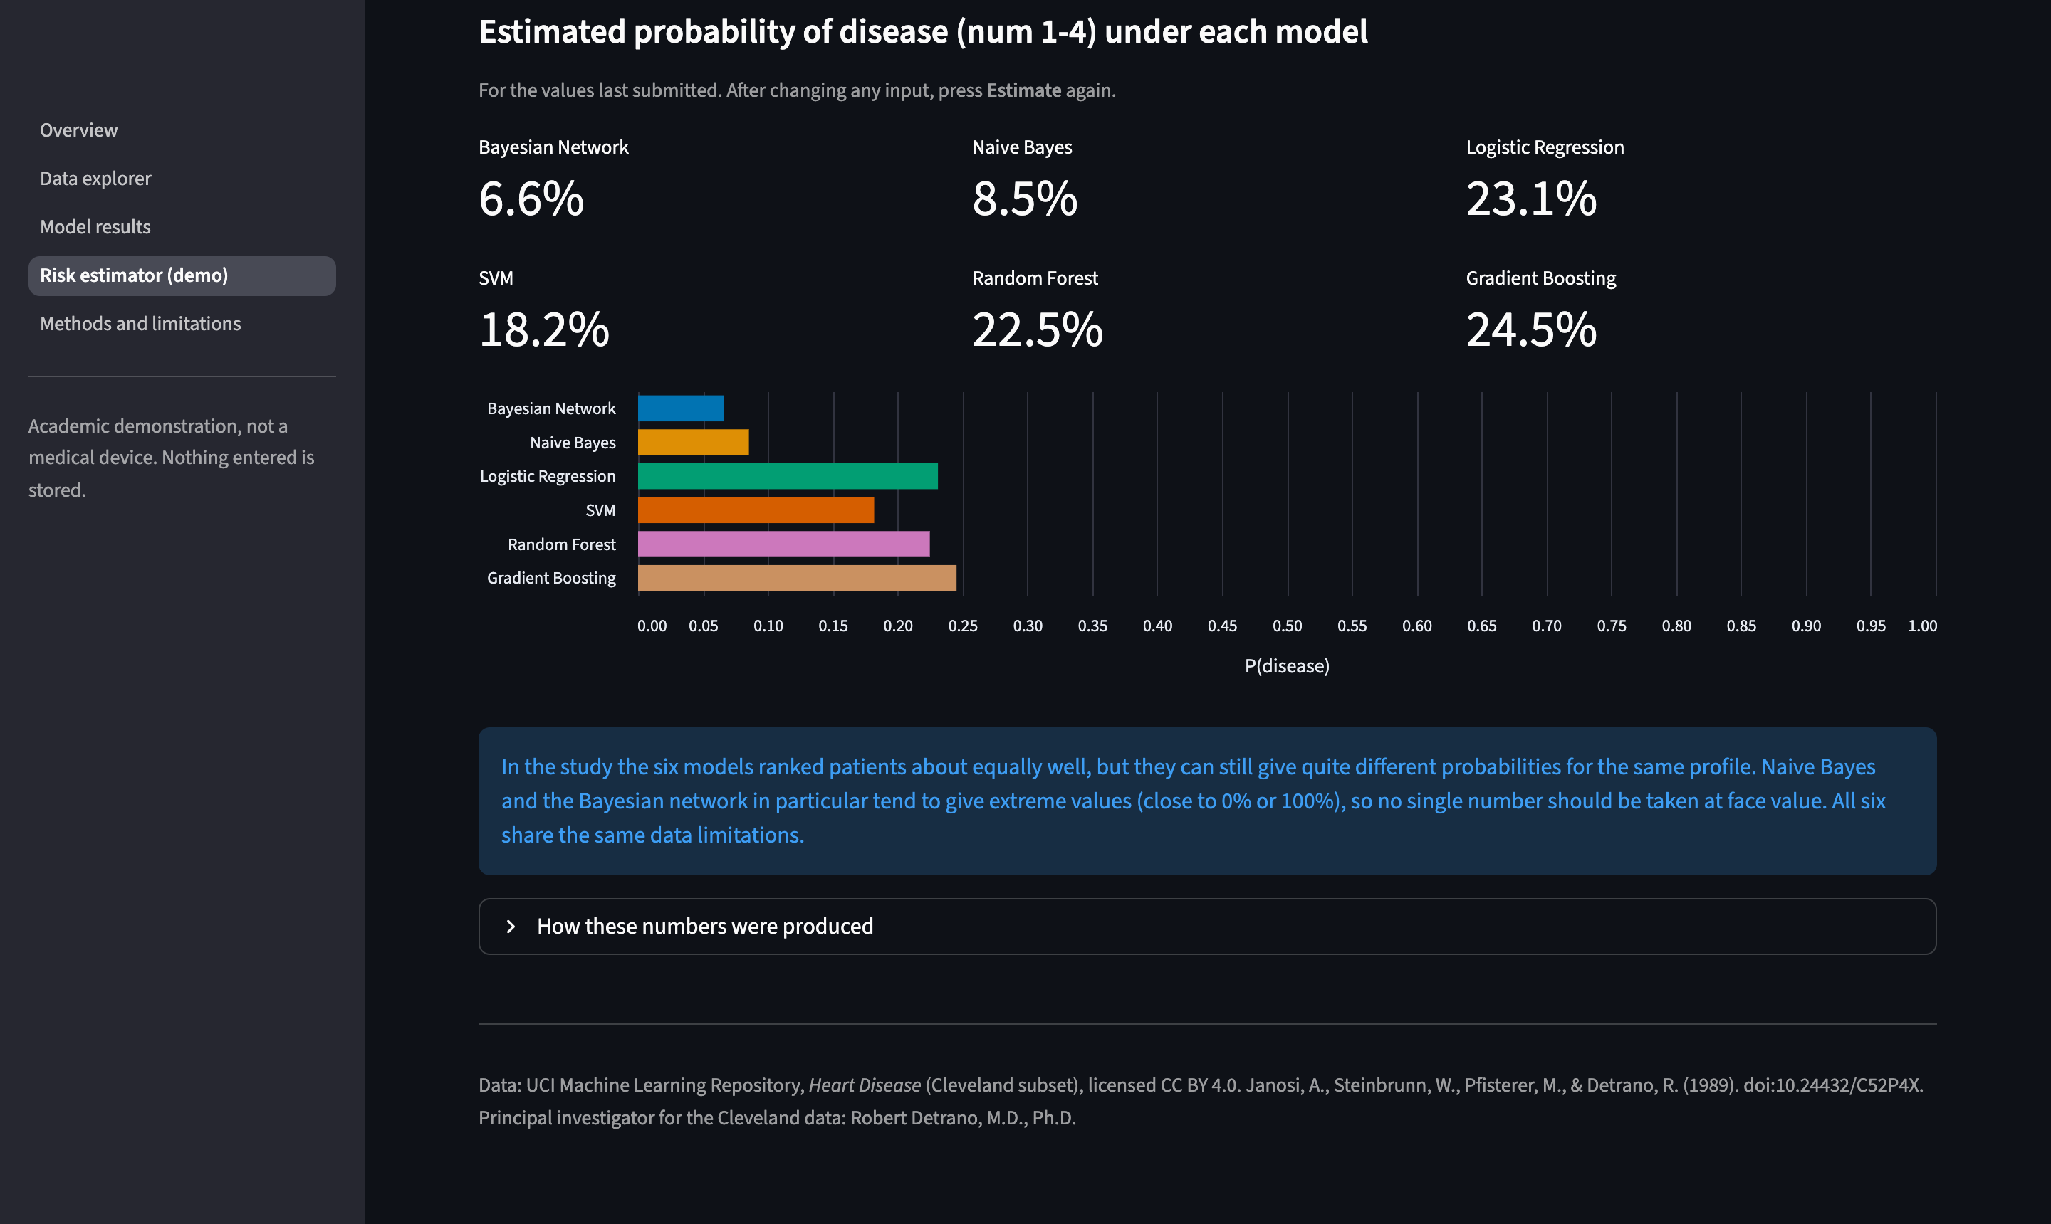
Interactive web app (Streamlit)
Presenter Kabir
Overview: headline results
Risk estimator: all six models side by side
Five pages: Overview · Data explorer · Model results · Risk estimator (demo) · Methods and limitations. Disclaimer on every page, inputs validated, nothing stored, telemetry off.
Notes:
Live demo, about two minutes: .venv/bin/python -m streamlit run app/streamlit_app.py, open localhost:8501. Show Model results, then Risk estimator: press Estimate with the defaults, then change ca to 3 and thal to reversible defect and press Estimate again.

Slide 17
Limitations and future work
Presenter Hardik
Limitations
Next (Phase 2 and beyond)
303 patients, one centre, internal validation only
Referral bias; predictors from specialist tests
Severity levels collapsed into yes / no
Mode imputation for 6 rows
Bayesian network structure assumed, not learned
Add a neural network and compare it on the same folds
External validation on the Hungarian, Swiss and VA files
Learn the Bayesian network structure from data
Multiple imputation for missing values
Subgroup and fairness analysis (206 men vs 97 women)
Notes:
The other three databases in the UCI archive give a natural external test set.

Slide 18
Conclusion
They work
No clear winner
No clinical claim
ROC AUC 0.89–0.91 and accuracy 81.8%–84.9% on unseen patients.
Five models tie within the uncertainty on 303 patients; Gradient Boosting is slightly behind.
A careful, reproducible academic comparison, not a diagnostic tool.
Thank you. Questions?
Notes:
Likely questions: why nested CV (avoid optimistic scores); why stratified folds (keep the class balance); why the Bayesian network needs discrete inputs (conditional probability tables); why standardise for LR and SVM (penalty and kernel are scale-dependent); bagging vs boosting.

