Slide 1
Classification of Arrhythmia
Author: Akshith Goud

Slide 2
Motivation
Saving lives
Between 1.5% and 5% of the general population have some form of arrhythmia
Advancing healthcare
Precision medicine
Innovation in cardiology
Research and development

Slide 3

Objective:
The objective of this project is to design and implement a supervised learning classification model that accurately predicts the occurrence of arrhythmia in individuals. If arrhythmia is detected the model will classify the condition into one of twelve distinct categories, facilitating precise diagnosis and enabling the formulation of appropriate treatment plans

Slide 4
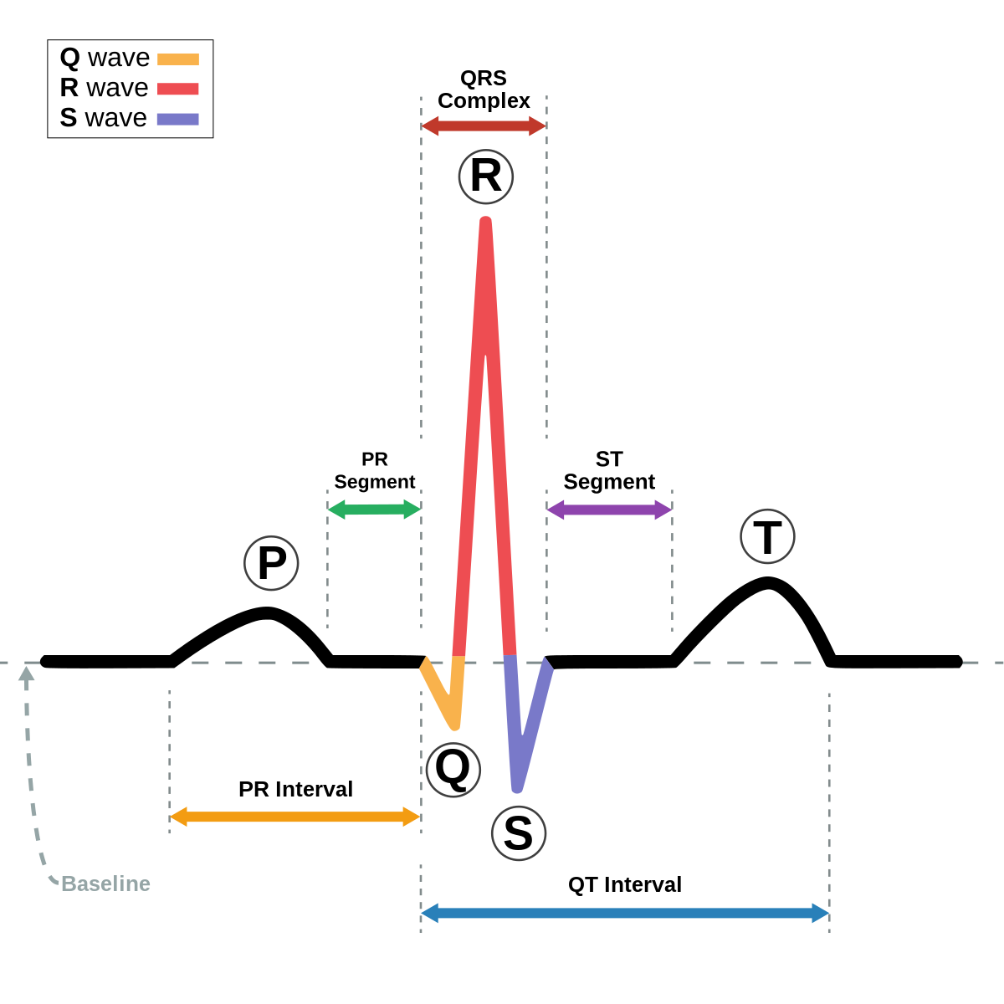
Types of Arrythmias
01. Normal
02. Ischemic changes (Coronary Artery Disease)
03. Old Anterior Myocardial Infarction
04. Old Inferior Myocardial Infarction
05. Sinus tachycardia
06. Sinus bradycardia
07. Ventricular Premature Contraction (PVC)
08. Supraventricular Premature Contraction
09. Left bundle branch block
10. Right bundle branch block
11. 1st degree Atrioventricular block
12. 2nd degree AV block
13. 3rd degree AV block
14. Left ventricle hypertrophy
15. Atrial Fibrillation or Flutter
16. Others

Slide 5
Dataset Description
The dataset used in this project is available on the UCI machine learning repository.
It can be found at: https://archive.ics.uci.edu/ml/datasets/Arrhythmia
It consists of 452 different examples spread over 16 classes. Of the 452 examples, 245 are of "normal" people. We also have 12 different types of arrhythmias.
Among all these types of arrhythmias, the most representative are the "coronary artery disease" and "right bundle branch block".
We have 279 features which include age, sex, weight, height of patients and other related information. We explicitly observe that the number of features is relatively high compared to the number of examples we have available.

Slide 6
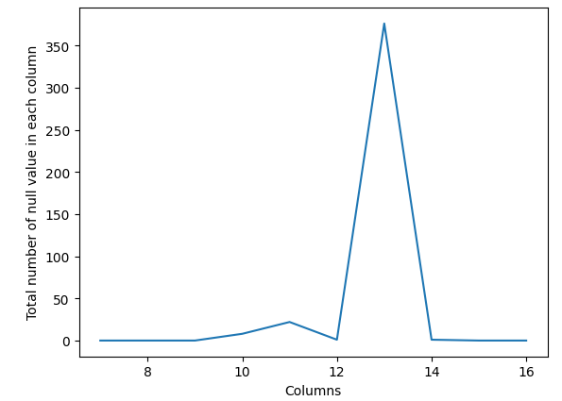
Data preprocessing
Handling Missing Values:
Column 13 contained more than 350 missing values out of total 452 instances, so we will drop column 13. Other attributes have comparatively less null values. So instead of dropping them, we will replace the null value of other attributes with their mean values.

Slide 7
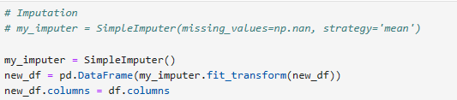
Using the mean strategy for imputation:

Slide 8
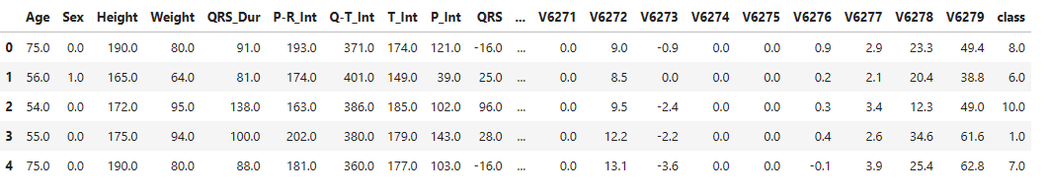
Labelling Attributes to dataset

Slide 9
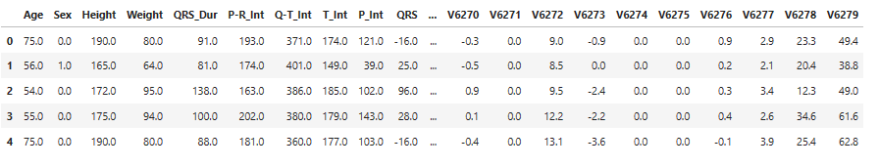
Generating final dataset
As our dataframe is completely cleaned and preprocessed. we will remove the target attribute and store our final dataframe.

Slide 10
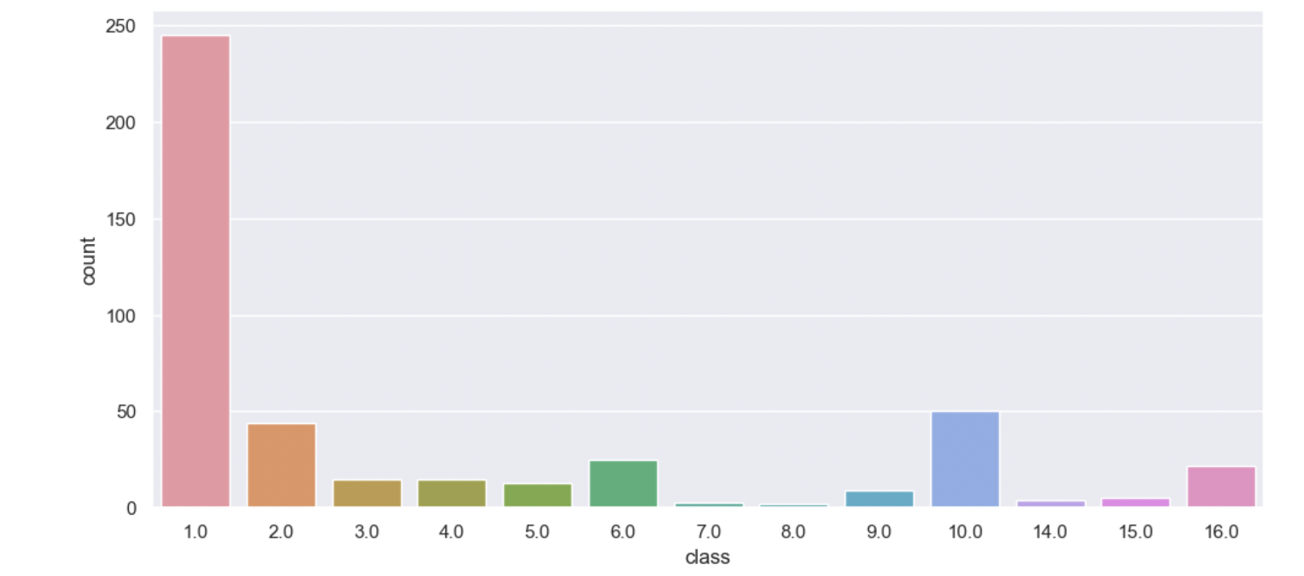
Exploratory Data Analysis (EDA)

Slide 11
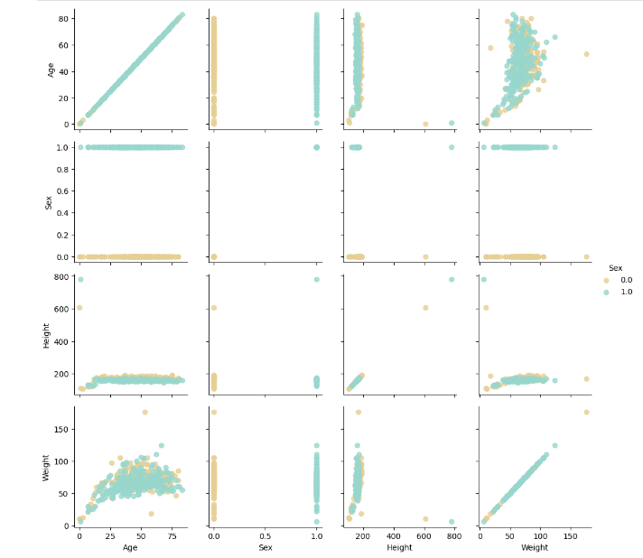
Pairwise Plots
Based on the scatter plots, it appears that there are outliers present in the 'height' and 'weight' attributes.
The tallest person ever lived in the world was 272 cm (1940). His followers were 267 cm (1905) and 263.5 cm (1969). Replacing 780 and 608 with 180.
176 kgs is a possible weight, so we'll keep them in the data frame.

Slide 12
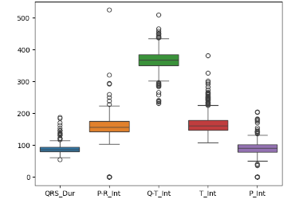
Boxplots
PR interval is the period, measured in milliseconds, that extends from the beginning of the P wave until the beginning of the QRS complex; it is normally between 120 and 200ms in duration.

Slide 13
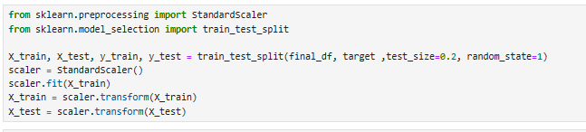
Feature Scaling
In our project, we implement feature scaling using the StandardScaler from sklearn.preprocessing. This method standardizes features by removing the mean and scaling to unit variance.
We will be using 80% of our dataset for training purpose and 20% for testing. .

Slide 14
Evaluation strategy
The most suitable evaluation strategy for these models involves comparing precision and recall. Given the nature of our problem, where misclassifying a healthy individual as having Cardiac Arrhythmia (FN) is unacceptable, the emphasis lies on the precision of our models' predictions.
Therefore, our primary focus will be on sensitivity, which measures the percentage of sick individuals correctly identified as having the condition, rather than specificity, which pertains to the percentage of healthy individuals correctly identified as not having the condition.

Slide 15
Modeling

Slide 16
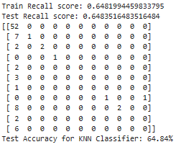
KNN

Slide 17
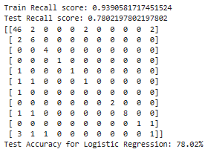
Logistic Regression

Slide 18
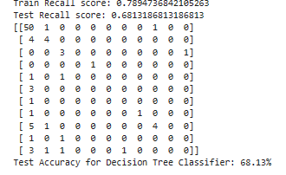
Decision Tree Classifier

Slide 19
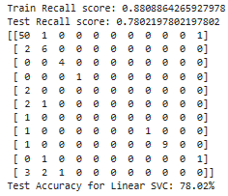
Linear SVM

Slide 20
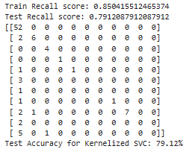
Kernelized SVM

Slide 21
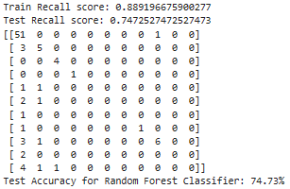
Random Forest Classifier

Slide 22
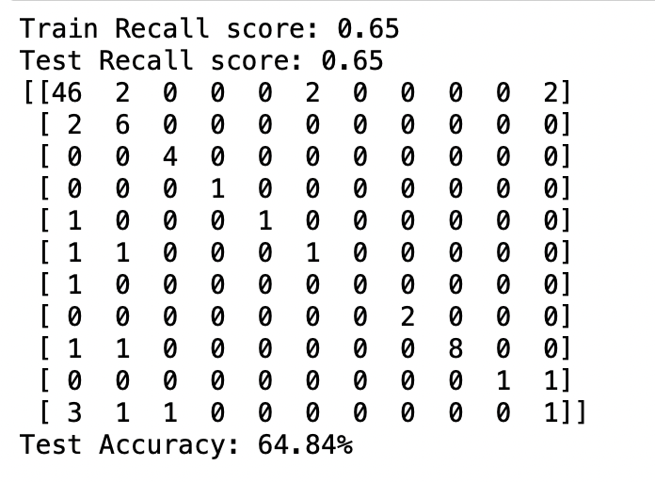
KNN with PCA

Slide 23
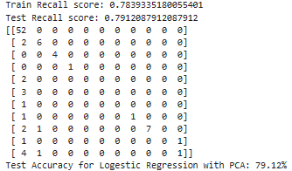
Logistic with PCA

Slide 24
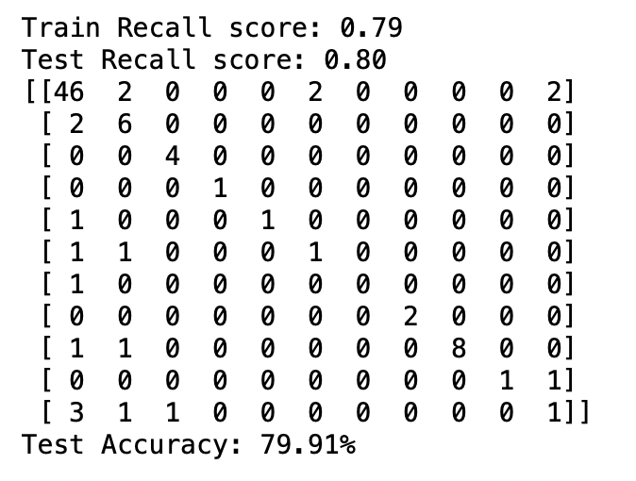
Linear SVM with PCA

Slide 25
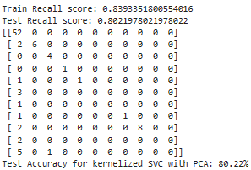
Kernal SVM with PCA

Slide 26
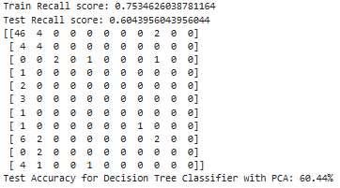
DecisionTree Classifier with PCA

Slide 27
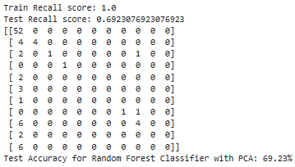
Random Forest Classifier With PCA

Slide 28

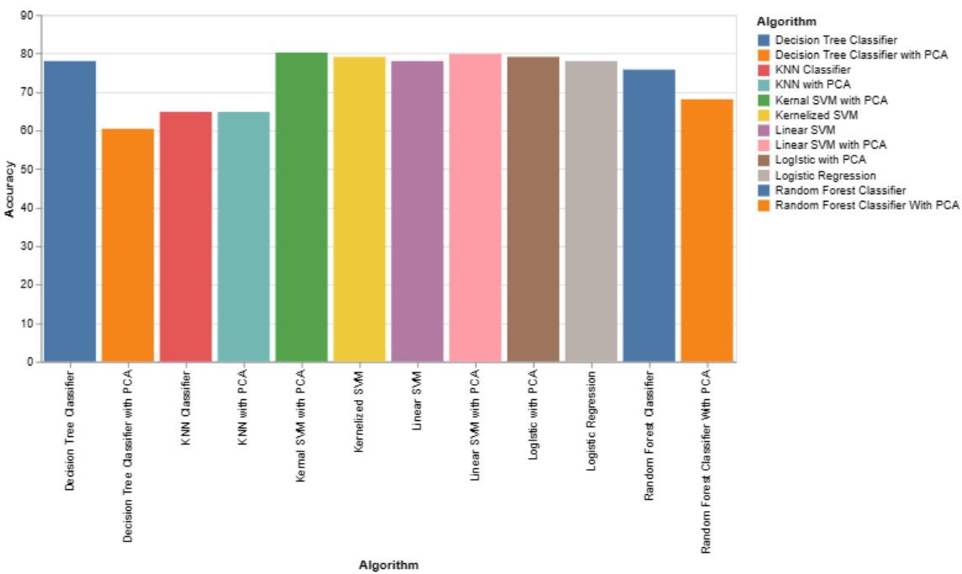
Comparative Analysis of Algorithmic Accuracies

Slide 29
Conclusion
The models started performing better after we applied PCA on the resampled data. The reason behind this is that PCA reduces the complexity of the data. It creates components based on giving importance to variables with large variance, and also the components which it creates are non collinear in nature which means it takes care of collinearity in the large data set. PCA also improves the overall execution time and quality of the models and it is very beneficial when we are working with huge amounts of variables.
The Best model in term of recall score is Kernalized SVM with PCA having accuracy of 80.22%.

Slide 30
Future Work
In this project, a false positive refers to a situation where a person is incorrectly predicted to have arrhythmia despite not having it. However, our primary focus is to minimize false negatives due to the associated health risks of missing an actual case of arrhythmia.
We need to refine our approach to prioritize sensitivity over accuracy in detecting arrhythmia.
We should investigate additional strategies by adjusting the hyperparameters and experimenting with different algorithms to optimize our model’s performance.

Slide 31
References
https://www.ncbi.nlm.nih.gov/books/NBK558923/
https://www.mayoclinic.org/diseases-conditions/coronary-artery-disease/symptoms-causes/syc-20350613
https://my.clevelandclinic.org/health/diseases/21692-right-bundle-branch-block
https://archive.ics.uci.edu/ml/datasets/Arrhythmia

Slide 32

Thank You

