Slide 1
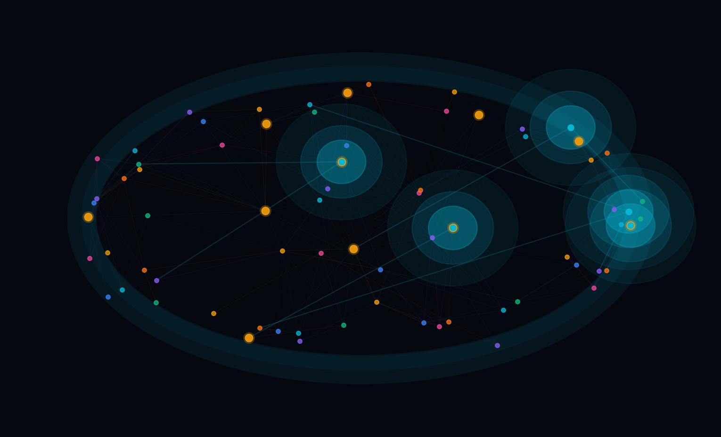
SYNAPSE
Human Connectome Explorer
Full Stack Development Project · MongoDB Integrated
HTML5
CSS3
JavaScript
Canvas API
Node/Express
MongoDB
MongoDB-backed sample connectome · 60 Brain Regions · Interactive Dashboard

Slide 2
WHAT IS SYNAPSE?
Exploring a
Brain Network
◉ 60 Sample Regions
⟿ Generated Connection Network
Each region is modeled as a node with hemisphere, network, MNI-style coordinates, hub score, and activation.
Weighted sample edges are generated from node distance, network grouping, and hub status to create a believable connectome.
⚡ Signal Propagation
✕ Lesion Simulator
Fire a signal from the selected region and watch canvas ripples activate nearby nodes and connections.
Lesion sample regions and see efficiency, clustering, active node count, and matrix display update live.

Slide 3
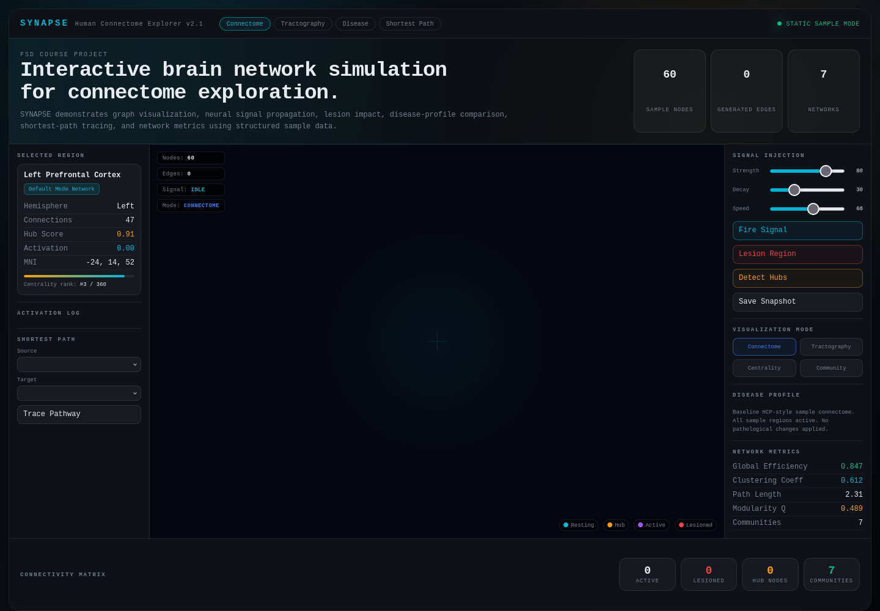
DASHBOARD PREVIEW

Slide 4
INTERACTIVE FEATURES
01
02
03
Click-to-Select Region
Signal Fire + Animate
Lesion Impact Demo
Click any visible node. The left panel loads its name, network, hemisphere, MNI-style coordinates, hub score, connections, and activation.
Tune Strength, Decay, and Speed sliders. Fire a cyan signal ripple from the selected node and watch connected regions activate.
Lesion non-hub sample regions. Network metrics and the connectivity matrix update to show reduced graph health.
04
05
06
Disease Profile Swap
Visualization Modes
Shortest Path Finder
Switch between Healthy, Alzheimer's, Parkinson's, and Schizophrenia sample profiles with different metric values and affected regions.
Switch between Connectome, Tractography, Centrality, and Community views to demonstrate multiple dashboard states.
Pick source and target regions. A sample pathway helper highlights a believable communication route through the network.

Slide 5
TECH STACK
What Technology Does What
HTML5 + CSS3
Frontend
Vanilla JavaScript
Interaction
Semantic dashboard layout and responsive clinical UI with panels, cards, sliders, HUD, matrix footer, and visual states.
Handles app state, UI events, disease switching, signal controls, lesion actions, pathway tracing, and DOM updates.
Canvas API
Visualization
Node.js + Express
Backend
Draws the connectome graph, animated signal ripples, active/lesioned nodes, weighted edges, and connectivity matrix.
Serves the frontend and exposes REST APIs for dashboard bootstrap data, health checks, and simulation snapshots.
MongoDB
Database
Webpack + npm
Tooling
Stores regions, functional networks, disease profiles, sample pathways, and saved simulation snapshots.
Build scripts, dependency management, and optional production bundling/copy workflow.

Slide 6
MONGODB DATA + SIMULATION LOGIC
MONGODB COLLECTIONS
SIMULATION LOGIC
regions
Seeded Graph Generation
60 stored region documents with keys, labels, hemispheres, network IDs, MNI-style coordinates, and hub flags.
Creates stable weighted edges from MongoDB region data using distance, same-network grouping, and hub status.
networks
Signal Propagation
7 functional network documents with names and colors used by the canvas renderer.
Canvas ripple expands from a node and activates nearby nodes plus strong connected edges.
diseaseProfiles
Lesion Impact
Healthy, Alzheimer's, Parkinson's, and Schizophrenia profiles with affected regions and metric values.
Lesioned nodes are marked red, skipped during signal spread, and reduce displayed network metrics.
pathways + snapshots
Pathway Tracing
Preset source-target paths are loaded from MongoDB, and the Save Snapshot button writes simulation state back to MongoDB.
Selected source and target regions produce a highlighted sample route and strength score.

Slide 7
WHY IT STANDS OUT
60
Auto
5
4
Brain Regions
Connections
Mongo Collections
Disease Profiles
Structured sample data
Weighted sample graph
Regions/networks/profiles
Demo scenarios
◎
Uses MongoDB as the project data layer while keeping local fallback data for easy demo recovery.
⚡
Interactive Canvas simulation: signal firing, node activation, lesion states, graph metrics, and matrix display.
▣
Code is organized into frontend modules plus a backend API and MongoDB seed layer.
✦
Run with npm start to serve the app, load dashboard data from MongoDB, and save simulation snapshots.

