Slide 1
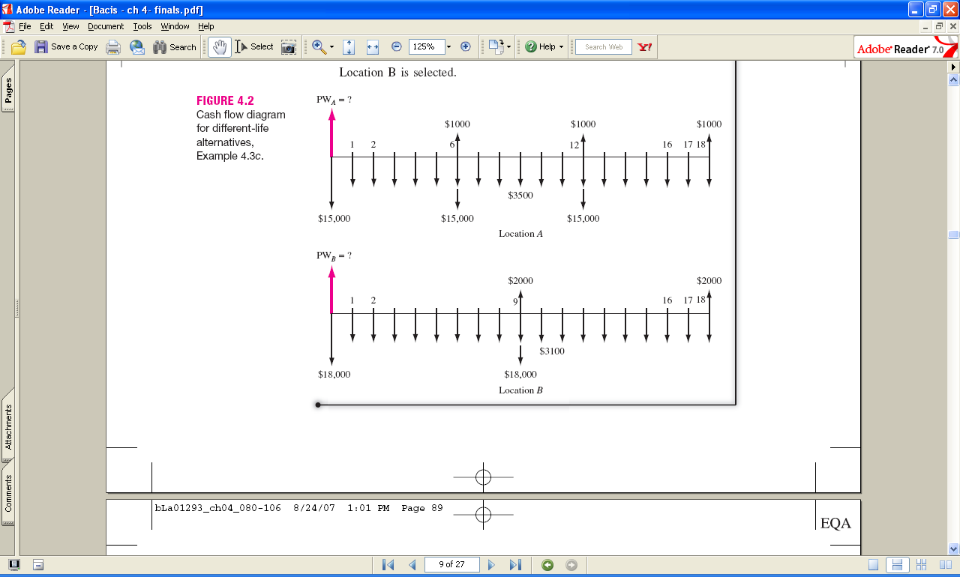
Different-life Analysis - Example
For 18 years at MARR = 15%: PW_{A} = $-45,036
For 18 years at MARR = 15%: PW_{B} = $-41,384
Select location B
Note: Selection changed from 5-year study period

Slide 2
Future Worth Evaluation
FW evaluation of alternatives is especially applicable for LARGE capital investment situations when maximizing the future worth of a corporation is important
e.g., buildings, power generation, acquisitions
Evaluation approach: Determine FW value from cash flows or PW with an n value in F/P factor
equal to study period, or
equal to LCM of alternatives’ lives

Slide 3
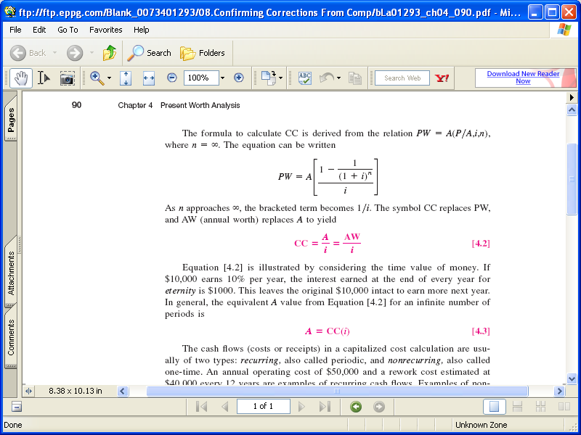
Capitalized Cost (CC)
PW of alternative that will last ‘forever’
Especially applicable to public project evaluation (dams, bridges, irrigation, hospitals, police, etc.)
CC relation is derived using the limit as n → ∞ for the P/A factor
PW = A(P/A,i%,n) =
PW = A[1/i ]

Slide 4
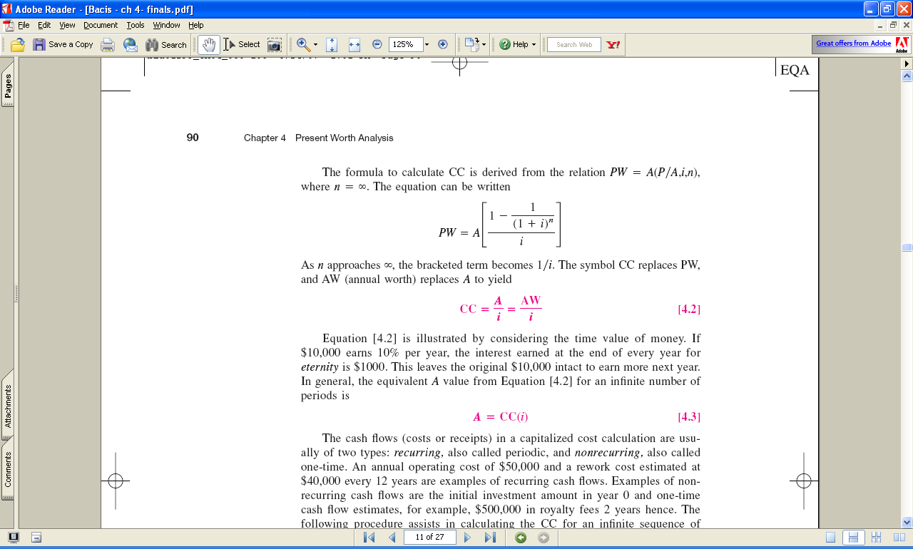
Capitalized Cost
Refer to PW as CC when n is large (can be considered infinite). Then
and AW = CC × i
Example: If $10,000 earns 10% per year, $1,000 is interest earned annually for eternity. Principal remains in tact
Cash flows for CC computations are of two types -- recurring and nonrecurring

Slide 5
Capitalized Cost
Procedure to find CC
Draw diagram for 2 cycles of recurring cash flows and any nonrecurring amounts
Calculate PW (CC) for all nonrecurring amounts
Find AW for 1 cycle of recurring amounts; then add these to all A series applicable for all years 1 to ∞ (or long life)
Find CC for amount above using CC = AW/i
Add all CC values (steps 2 and 4)

Slide 6
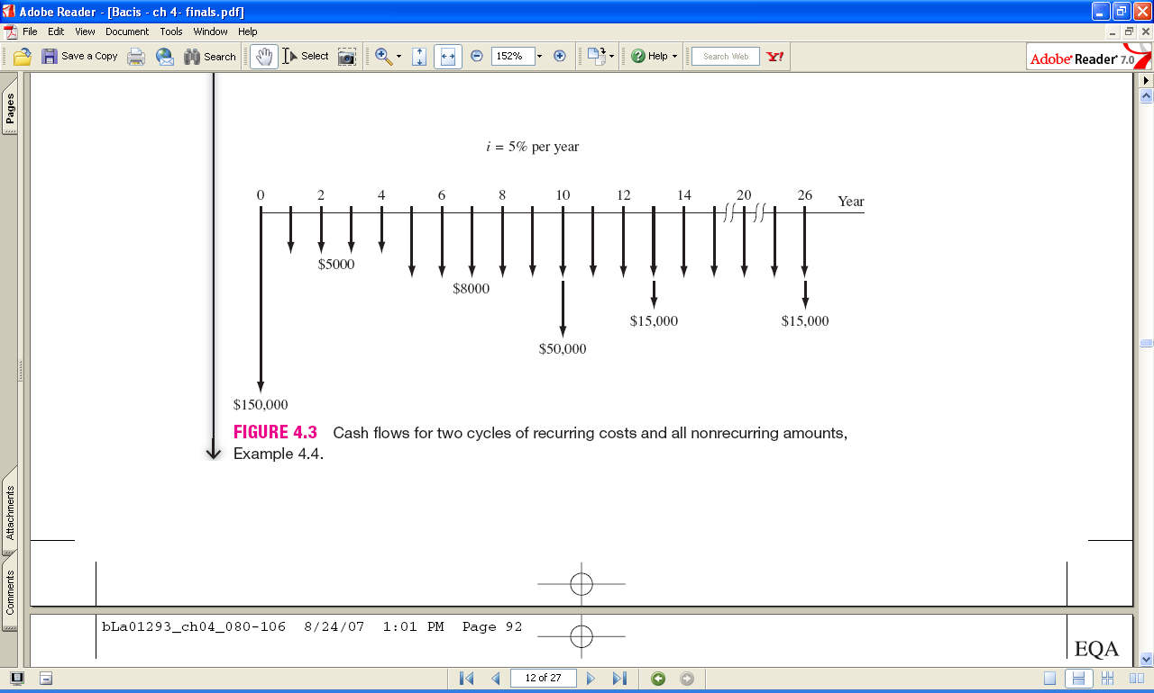
CC Computation - Example
Find CC and A values at i = 5% of long-term public project with cash flows below. Cycle time is 13 years.
Nonrecurring costs: first $150,000; one-time of $50,000 in year 10
Recurring costs: annual maintenance of $5000 (years 1-4) and $8000 thereafter; upgrade costs $15,000 each 13 years
Step 1
(cont →)

Slide 7
CC Computation - Example
CC of nonrecurring costs:
CC₁ = -150,000 – 50,000(P/F,5%,10) = $-180,695
AW of recurring $15,000 upgrade:
AW = -15,000(A/F,5%,13) = $-847 per year
AW of recurring maintenance costs years 1 to ∞:
AW = $-5000 per year forever
CC of extra $3000 maintenance for years 5 to ∞:
CC₂ = -3000(P/F,5%,4)/0.05 = $-49,362
CC for recurring upgrade and maintenance costs:
CC₃ = (-847-5000)/0.05 = $-116,940
Total CC obtained by adding all three CC components
CC_{T} = -180,695 – 49,362 – 116,940 = $-346,997
The AW value is the annual cost forever:
AW = CC × i = -346,997(0.05) = $-17,350

Slide 8
CC Evaluation of Alternatives
For two long-life or infinite-life alternatives:
SELECT ALTERNATIVE WITH LOWER CC OF COSTS
For one infinite life and one finite life:
Determine CC for finite life alternative using
AW of 1 life cycle and relation CC = AW/i
SELECT ALTERNATIVE WITH LOWER CC OF COSTS

Slide 9
CC Evaluation of Alternatives - Example
1 long-term (assumed infinite); 1 finite life
Long-term alternative (LT): $8 million now; $25,000 renewal annual contract
Short-term alternative (ST): $2.75 million now; $120,000 AOC; life is n = 5 years
Select better at MARR = 15% per year
CC_{LT} = -8,000,000 – 25,000/0.15 = $-8.17 million
CC_{ST} = AW/0.15
= [-2,750,000(A/P,15%,5) – 120,000]/0.15
= $-6.27 million
Conclusion: Select ST with lower CC of costs

Slide 10
Annual Worth Analysis

Slide 11
LEARNING OUTCOMES
Advantages of AW
Capital Recovery and AW values
AW analysis
Perpetual life
Life-Cycle Cost analysis

Slide 12

Advantages of AW Analysis
AW calculated for only one life cycle
Assumptions:
Services needed for at least the LCM of lives of alternatives
Selected alternative will be repeated in succeeding life cycles
in same manner as for the first life cycle
All cash flows will be same in every life cycle (i.e., will change
by only inflation or deflation rate)

Slide 13
Alternatives usually have the following
cash flow estimates
Initial investment, P – First cost of an asset
Salvage value, S – Estimated value of asset at end of useful life
Annual amount, A – Cash flows associated with asset, such
as annual operating cost (AOC), etc.
Relationship between AW, PW and FW
AW = PW(A/P,i%,n) = FW(A/F,i%,n)
n is years for equal-service comparison (value of LCM or specified study period)

Slide 14
Calculation of Annual Worth
AW for one life cycle is the same for all life cycles!!
An asset has a first cost of $20,000, an annual operating
cost of $8000 and a salvage value of $5000 after 3 years.
Calculate the AW for one and two life cycles at i = 10%
AW_{one} = - 20,000(A/P,10%,3) – 8000 + 5000(A/F,10%,3)
= $-14,532
AW_{two} = - 20,000(A/P,10%,6) – 8000 – 15,000(P/F,10%,3)(A/P,10%,6)
+ 5000(A/F,10%,6)
= $-14,532

Slide 15
Capital Recovery and AW
Capital recovery (CR) is the equivalent annual amount that an asset, process, or system must earn each year to just recover the first cost and a stated rate of return over its expected life. Salvage value is considered when calculating CR.
CR = -P(A/P,i%,n) + S(A/F,i%,n)
Use previous example:(note: AOC not included in CR )
CR = -20,000(A/P,10%,3) + 5000(A/F,10%,3) = $ – 6532 per year
Now AW = CR + A
AW = – 6532 – 8000 = $ – 14,532

Slide 16
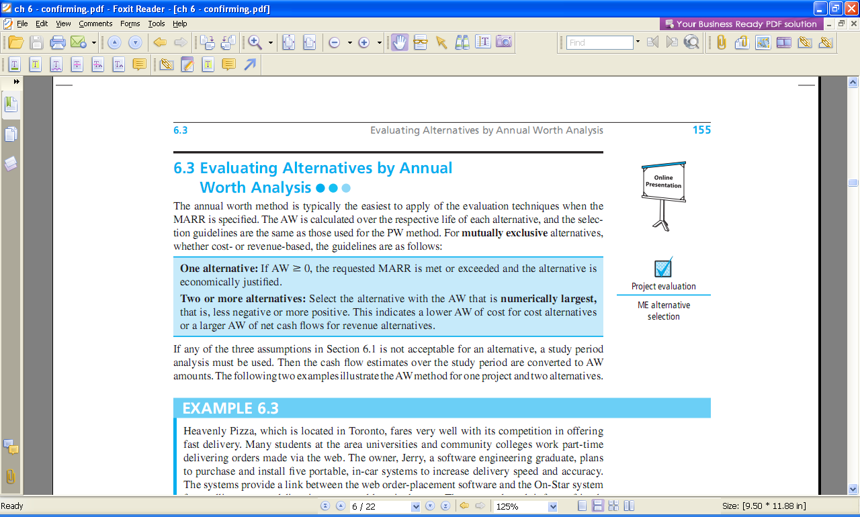
Selection Guidelines for AW Analysis

Slide 17
ME Alternative Evaluation by AW
Not necessary to use LCM for different life alternatives
A company is considering two machines. Machine X has a first cost of $30,000, AOC of $18,000, and S of $7000 after 4 years.
Machine Y will cost $50,000 with an AOC of $16,000 and S of $9000 after 6 years.
Which machine should the company select at an interest rate of 12% per year?
Solution:
AW_{X} = -30,000(A/P,12%,4) –18,000 +7,000(A/F,12%,4)
= $-26,412
AW_{Y} = -50,000(A/P,12%,6) –16,000 + 9,000(A/F,12%,6)
= $-27,052
Select Machine X; it has the numerically larger AW value

Slide 18
AW of Permanent Investment
Use A = Pi for AW of infinite life alternatives
Find AW over one life cycle for finite life alternatives
Compare the alternatives below using AW and i = 10% per year
C D
First Cost, $ -50,000 -250,000
Annual operating cost, $/year -20,000 -9,000
Salvage value, $ 5,000 75,000
Life, years 5 ∞
Solution: Find AW of C over 5 years and AW of D using relation A = Pi
AW_{C} = -50,000(A/P,10%,5) – 20,000 + 5,000(A/F,10%,5)
= $-32,371
AW_{D} = Pi + AOC = -250,000(0.10) – 9,000
= $-34,000
Select alternative C

Slide 19
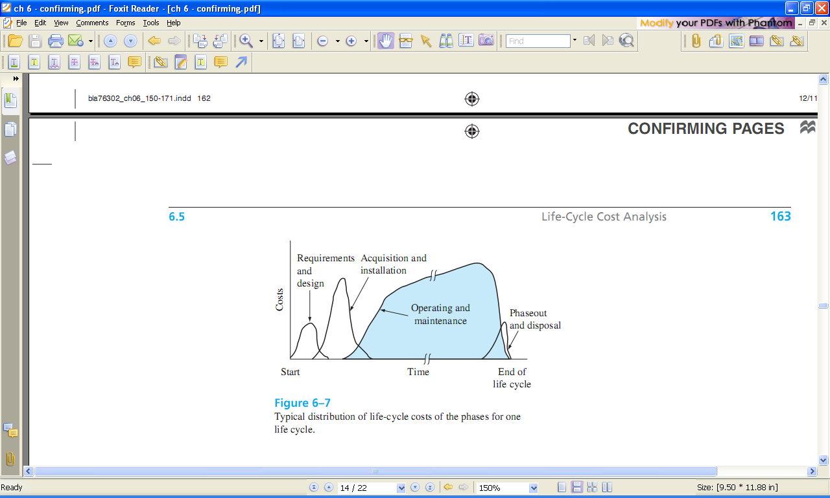
Typical Life-Cycle Cost Distribution by Phase

Slide 20
Life-Cycle Cost Analysis
LCC analysis includes all costs for entire life span,
from concept to disposal
Best when large percentage of costs are M&O
Includes phases of acquisition, operation, & phaseout
Apply the AW method for LCC analysis of 1 or more cost alternatives
Use PW analysis if there are revenues and other benefits considered

Slide 21
Summary of Important Points
AW method converts all cash flows to annual value at MARR
Alternatives can be mutually exclusive, independent,
revenue, or cost
AW comparison is only one life cycle of each alternative
For infinite life alternatives, annualize initial cost as A = P(i)
Life-cycle cost analysis includes all costs over
a project’s life span

