Slide 1
Present Worth Analysis

Slide 2
Present Worth Analysis
PURPOSE
Identify types of alternatives; and compare alternatives using a present worth basis
TOPICS
Formulating alternatives
Single and equal-life alternatives
Different-life alternatives
Capitalized cost alternative evaluation
Independent alternatives

Slide 3
Formulating Alternatives
Types of alternatives
Mutually exclusive (ME) - only one viable project can be accepted. Do-nothing (DN) alternative is selected if none are justified economically
Independent - more than one project can be selected. DN is one of the projects
Do-nothing – maintain status quo/current approach
Types of cash flow estimates for an alternative
Revenue – estimates include costs, revenues and (possibly) savings
Cost – only cost estimates included; revenues assumed equal for all alternatives

Slide 4
Formulating Alternatives
Much of the emphasis in professional engineering practice is on ME, cost alternatives. However, all tools in Eng Econ can be used to evaluate ME and independent alternatives that are revenue- or cost-based. Examples of both are included later.
Notes: P value of cash flows is now called PW, or present worth
P now represents first cost of an alternative

Slide 5
PW of a Single Alternative
Single project analysis
Calculate PW at stated MARR
Criterion: If PW ≥ 0,
project is economically justified
Example: MARR = 10%
First cost, P = $-2500
Annual revenue, R = $2000
Annual cost, AOC = $-900
Salvage value, S = $200
Life, n = 5 years
PW = P +S(P/F,10%,5)
+ (R-AOC)(P/A,10%,5)
= -2500 + 200(P/F,10%,5)
+ (2000-900)(P/A,10%,5)
= $1794
PW > 0; project is
economically justified

Slide 6
Equal-life ME Alternatives
Calculate PW of each alternative at MARR
Equal-service of alternatives is assumed
Selection criterion: Select alternative with most favorable PW value, that is,
numerically largest PW value
PW₁ | PW₂ | Select
$-1,500 | $-500 | 2
-2,500 | 500 | 2
2,500 | 1,500 | 1
Note : Not the absolute value

Slide 7
Equal-life ME Alternatives
Example: Two ME cost alternatives for traffic analysis. Revenues are equal. MARR is 10% per year. Select one. (cont→)
Estimate | Electric-powered | Solar-powered
P, $/unit | -2,500 | -6,000
AOC, $/year | -900 | -50
S, $ | 200 | 100
n, years | 5 | 5

Slide 8
Equal-life ME Alternatives
Determine PW_{E} and PW_{S}; select larger PW
PW_{E} = -2500-900(P/A,10%,5)+200(P/F,10%,5)
= $-5788
PW_{S} = -6000-50(P/A,10%,5)+100(P/F,10%,5)
= $-6127
Conclusion: PW_{E} > PW_{S}; select electric-powered

Slide 9
Different-life Alternatives
PW evaluation always requires equal- service between all alternatives
Two methods available:
Study period (same period for all alternatives)
Least common multiple (LCM) of lives for alternatives
Study period method is recommended
Evaluation approach: Determine each PW at stated MARR; select alternative with numerically largest PW

Slide 10
Different-life Alternatives
Study Period of length n years (periods)
n is same for each alternative
If life > n, use market value estimate in year n for salvage value
If life < n, estimate costs for remaining years
Estimates outside time frame of the study period are ignored

Slide 11
Different-life Alternatives
LCM Method
Assumptions (may be unrealistic at times)
Same service needed for LCM years (e.g., LCM of 5 and 9 is 45 years!)
Alternatives available for multiple life cycles
Estimates are correct over all life cycles (true only if cash flow estimate changes match inflation/deflation rate)
Evaluation approach: obtain LCM, repeat purchase and life cycle for LCM years; calculate PW over LCM; select alternative with most favorable PW

Slide 12
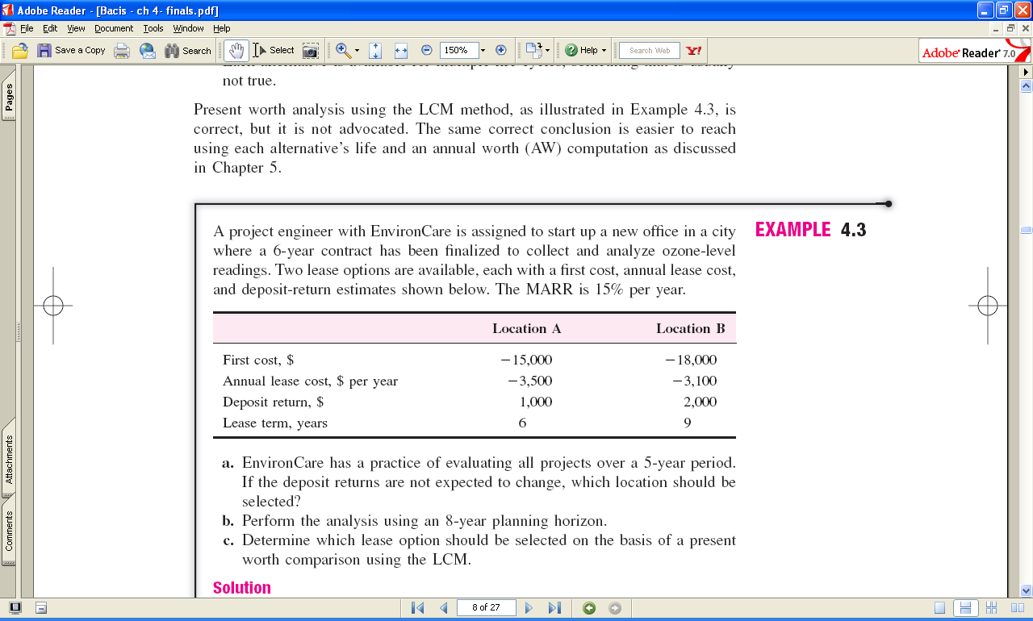
Different-life Analysis - Example
Use PW to select lower-cost alternative:
For 5-year study period
Using LCM of alternatives’ lives
Assume MARR = 15% per year (cont →)

Slide 13
Different-life Analysis - Example
Study period of 5 years
Assume deposit returns are good estimates after 5 years
F = 1,000
PW_{A} = ?
Location A
P = -15,000 A = -3,500
F = 2,000
P = -18,000 A = -3,100
PW_{B} = ?
Location B
For 5 years at i = 15%: PW_{A} = $-26,236 and PW_{B} = $-27,397
Select Location A with lower PW of costs

Slide 14
Different-life Analysis - Example
LCM evaluation
LCM is 18 years
Repurchase A twice (years 6 and 12)
Repurchase B once (year 9)
Assume all cash flow estimates (including first cost end-of-lease ‘deposit return’) are correct for repeated life cycles to total 18 years (cont →)

Slide 15
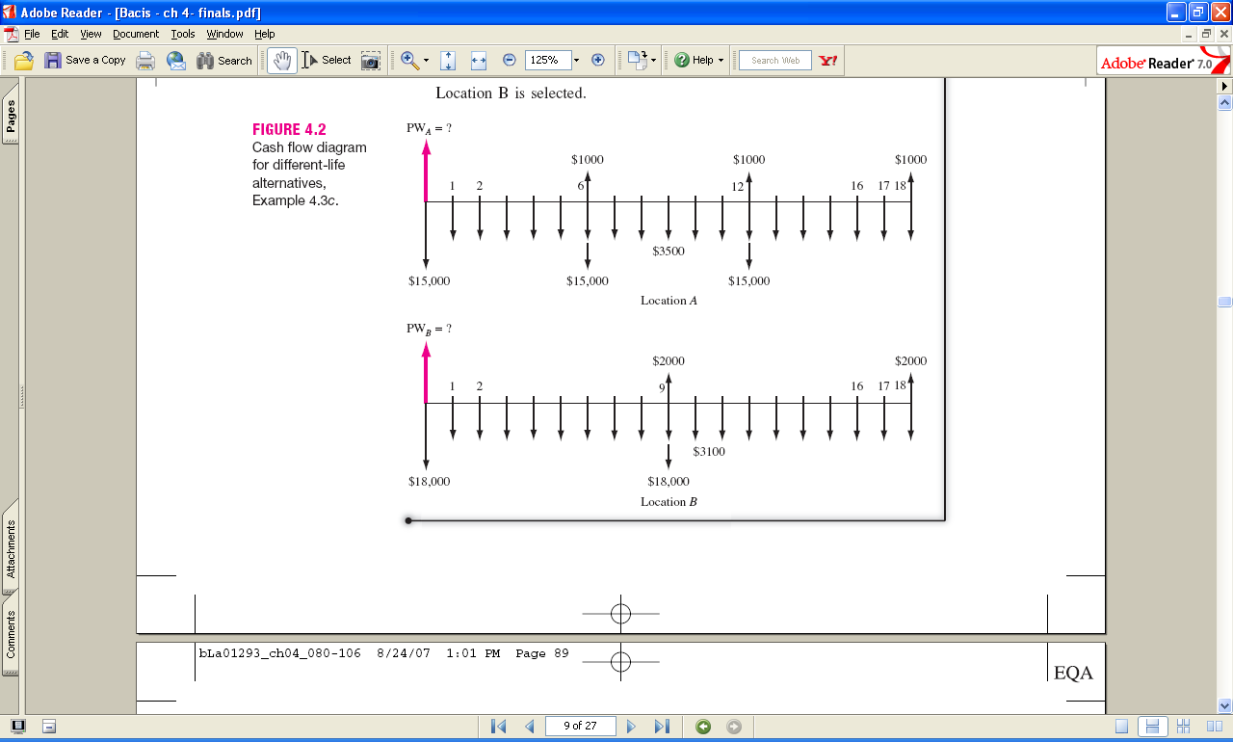
Different-life Analysis - Example
For 18 years at MARR = 15%: PW_{A} = $-45,036
For 18 years at MARR = 15%: PW_{B} = $-41,384
Select location B
Note: Selection changed from 5-year study period

