Slide 1
Rate of Return for Single Project

Slide 2
LEARNING OUTCOMES
Understand meaning of ROR
Calculate ROR for cash flow series
Understand difficulties of ROR
Determine multiple ROR values
Calculate External ROR (EROR)
Calculate r and i for bonds

Slide 3
Interpretation of ROR
Rate paid on unpaid balance of borrowed money such that final payment brings balance to exactly zero
with interest considered
ROR equation can be written in terms of PW, AW, or FW
Use trial and error solution by factor
Numerical value can range from -100% to infinity

Slide 4
ROR Calculation and Project Evaluation
To determine ROR, find the i* value in the relation
PW = 0 or AW = 0 or FW = 0
Alternatively, a relation like the following finds i*
PW_{outflow} = PW_{inflow}
For evaluation, a project is economically viable if
i* ≥ MARR

Slide 5
ROR Calculation Using PW, FW or AW Relation
ROR is the unique i* rate at which a PW, FW, or AW relation equals exactly 0
Example: An investment of $20,000 in new equipment will generate income of $7000 per year for 3 years, at which time the machine can be sold for an estimated $8000. If the company’s MARR is 15% per year, should it buy the machine?
Solution:: The ROR equation, based on a PW relation, is:
0 = -20,000 + 7000(P/A,i*,3) + 8000(P/F,i*,3)
Solve for i* by trial and error: i* = 18.2% per year
Since i* > MARR = 15%, the company should buy the machine

Slide 6
Special Considerations for ROR
May get multiple i* values (discussed later)
i* assumes reinvestment of positive cash flows
earn at i* rate (may be unrealistic)
Incremental analysis necessary for multiple
alternative evaluations (discussed later)

Slide 7
Multiple ROR Values
Multiple i* values may exist when there is more than one sign
change in net cash flow (CF) series.
Such CF series are called non-conventional
Two tests for multiple i* values:
Descarte’s rule of signs: total number of real i* values
is ≤ the number of sign changes in net cash flow series.
Norstrom’s criterion: if the cumulative cash flow starts off negatively and has only one sign change, there is only one positive root .

Slide 8
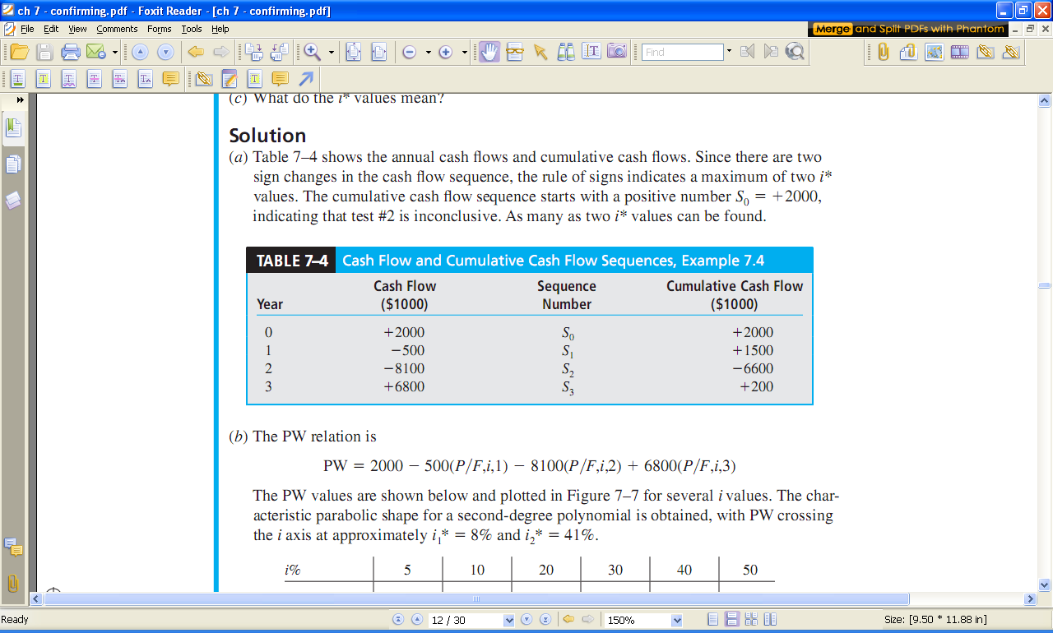
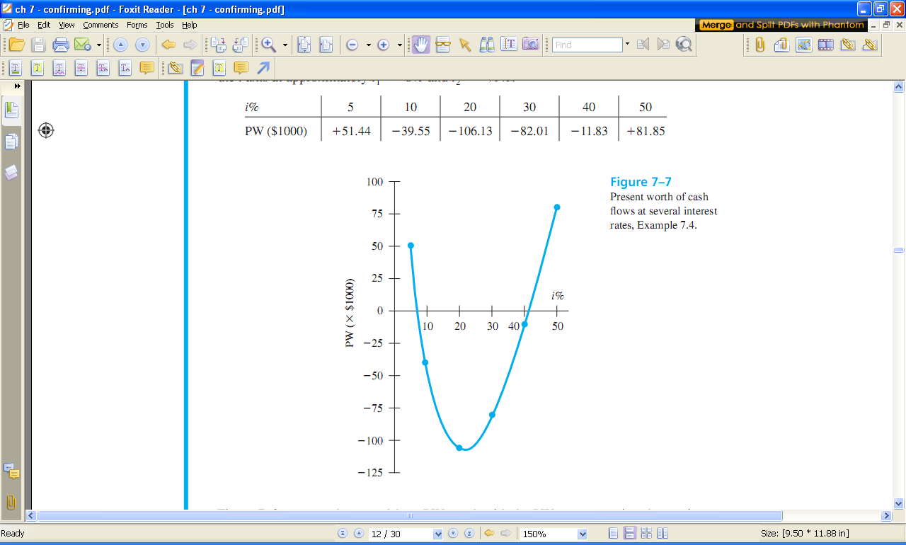
Plot of PW for CF Series with Multiple ROR Values
i* values at ~8% and ~41%

Slide 9
Example: Multiple i* Values
Determine the maximum number of i* values for the cash flow shown below
Year Expense Income
Net cash flow
Cumulative CF
0 -12,000 -
-12,000
-12,000
1 -5,000 + 3,000
-2,000
-14,000
2 -6,000 +9,000
+3,000
-11,000
3 -7,000 +15,000
+8,000
-3,000
4 -8,000 +16,000
+8,000
+5,000
5 -9,000 +8,000
-1,000
+4,000
Solution:
The sign on the net cash flow changes
twice, indicating two possible i* values
The cumulative cash flow begins
negatively with one sign change
Therefore, there is only one i* value ( i* = 8.7%)

Slide 10
Removing Multiple i* Values
Two new interest rates to consider:
Investment rate i_{i} – rate at which extra funds
are invested external to the project
Borrowing rate i_{b} – rate at which funds are
borrowed from an external source to provide
funds to the project
Two approaches to determine External ROR (EROR)
(1) Modified ROR (MIRR)
(2) Return on Invested Capital (ROIC)

Slide 11
Modified ROR Approach (MIRR)
Four step Procedure:
Determine PW in year 0 of all negative CF at i_{b}
Determine FW in year n of all positive CF at i_{i}
Calculate EROR = i’ by FW = PW(F/P,i’,n)
If i’ ≥ MARR, project is economically justified

Slide 12
Example: EROR Using MIRR Method
For the NCF shown below, find the EROR by the MIRR method if
MARR = 9%, i_{b} = 8.5%, and i_{i} = 12%
Year 0 1 2 3
NCF +2000 -500 -8100 +6800
Solution:
PW₀ = -500(P/F,8.5%,1) - 8100(P/F,8.5%,2)
= $-7342
FW₃ = 2000(F/P,12%,3) + 6800
= $9610
PW₀(F/P,i’,3) + FW₃ = 0
-7342(1 + i’)³ + 9610 = 0
i’ = 0.939 (9.39%)
Since i’ > MARR of 9%, project is justified

Slide 13
Return on Invested Capital Approach
Measure of how effectively project uses funds that remain internal to project
ROIC rate, i’’, is determined using net-investment procedure
Three step Procedure
(1) Develop series of FW relations for each year t using:
F_{t} = F_{t-1}(1 + k) + NCF_{t}
where: k = i_{i} if F_{t-1} > 0 and k = i’’ if F_{t-1} < 0
(2) Set future worth relation for last year n equal to 0 (i.e., F_{n}= 0); solve for i’’
(3) If i’’ ≥ MARR, project is justified; otherwise, reject

Slide 14
ROIC Example
For the NCF shown below, find the EROR by the ROIC method if
MARR = 9% and i_{i} = 12%
Year 0 1 2 3
NCF +2000 -500 -8100 +6800
Solution:
Year 0: F₀ = $+2000 F₀ > 0; invest in year 1 at i_{i} = 12%
Year 1: F₁ = 2000(1.12) - 500 = $+1740 F₁ > 0; invest in year 2 at i_{i} = 12%
Year 2: F₂ = 1740(1.12) - 8100 = $-6151 F₂ < 0; use i’’ for year 3
Year 3: F₃ = -6151(1 + i’’) + 6800 Set F₃ = 0 and solve for i’’
-6151(1 + i’’) + 6800 = 0
i’’= 10.55%
Since i’’ > MARR of 9%, project is justified

Slide 15
Important Points to Remember
About the computation of an EROR value
EROR values are dependent upon the
selected investment and/or borrowing rates
Commonly, multiple i* rates, i’ from MIRR and
i’’ from ROIC have different values
About the method used to decide
For a definitive economic decision, set the
MARR value and use the PW or AW method
to determine economic viability of the project

Slide 16
ROR of Bond Investment
Bond is IOU with face value (V), coupon rate (b), no. of payment periods/year (c),
dividend (I), and maturity date (n). Amount paid for the bond is P.
I = Vb/c
General equation for i*: 0 = - P + I(P/A,i*,nxc) + V(P/F,i*,nxc)
A $10,000 bond with 6% interest payable quarterly is purchased for $8000.
If the bond matures in 5 years, what is the ROR (a) per quarter, (b) per year?
Solution:
(a) I = 10,000(0.06)/4 = $150 per quarter
ROR equation is: 0 = -8000 + 150(P/A,i*,20) + 10,000(P/F,i*,20)
By trial and error or spreadsheet: i* = 2.8% per quarter
(b) Nominal i* per year = 2.8(4) = 11.2% per year
Effective i* per year = (1 + 0.028)⁴ – 1 = 11.7% per year
Effective i per year = (1 + 0.028)⁴ – 1 = 11.7% per year

Slide 17
Summary of Important Points
ROR equations can be written in terms of PW, FW, or AW and
usually require trial and error solution
i* assumes reinvestment of positive cash flows at i* rate
More than 1 sign change in NCF may cause multiple i* values
Descarte’s rule of signs and Norstrom’s criterion useful when
multiple i* values are suspected
EROR can be calculated using MIRR or ROIC approach. Assumptions about investment and borrowing rates is required.
General ROR equation for bonds is
0 = - P + I(P/A,i*,nxc) + V(P/F,i*,nxc)

