Slide 1


RISHI MS INSTITUTE OF ENGINEERING AND
TECHNOLOGY FOR WOMEN
DEPARTMENT OF COMPUTER SCIENCE AND ENGINEERING
IIYEAR IISEM ‘CSE-B’
A REAL TIME PROJECT PRESENTATION ON
TYPE2TONE
TEAM NUMBER: 8
Names(Roll numbers):
M.KEERTHI (236P1A0589) O.RAJESHWARI(236P1A05A8)
P.KUSUMA(236P1A05B0) P.AKSHITHA (236P1A05B7)
Under the Guidance:
Dr.K. Ramakrishna PhD
Ass Prof , Dept of CSE

Slide 2
TABLE OF CONTENTs
Abstract
Introduction
Existing System
Proposed System
Literature Survey
System Requirements
System Architecture and Methodology
Output
Conclusion
Future Enhancement
References
Thank You

Slide 3
ABSTRACT
This project aims to develop a functional and efficient text-to-speech (TTS) converter utilizing HTML, CSS, and JavaScript technologies. The TTS converter is designed to enable users to input text and generate audible speech output, bridging the gap between written and spoken communication. The implementation leverages modern web development techniques to create an interactive and user-friendly interface with HTML and CSS, and employs JavaScript to integrate speech synthesis capabilities, a core feature of Web Speech API. This tool has practical applications in enhancing accessibility for visually impaired individuals, language learning, and automated systems requiring vocal interaction.

Slide 4
INTRODUCTION
Enhances accessibility and ease of communication.
Enables auditory interaction with digital content.
Supports visually impaired individuals.
Assists in language learning.
Provides automated voice responses.
Web-based TTS converter using HTML, CSS, and JavaScript.
Uses Web Speech API for speech synthesis.
Intuitive design for user-friendliness.

Slide 5
OBJECTIVE
Here’s the objective presented in points for clarity:
1.Develop a web-based text-to-speech (TTS) converter using HTML, CSS, and JavaScript.
2. Enable seamless conversion of written text into audible speech for improved accessibility.
3. Design a user-friendly interface that promotes intuitive usage.
4. Leverage the Web Speech API for accurate and efficient speech synthesis.

Slide 6
EXISTING SYSTEM
Existing system does not use the smart concept which are is now a days. Often lacks natural rhythm and intonation, sounding robotic. High-quality engines can be expensive in existing system.
Disadvantages Of Existing System
Pronunciation Issues: Can mispronounce words, especially proper nouns.
Context Blindness: May misinterpret meaning based on context.
Voice Limitations: Limited variety and customization options.
Resource Intensive: Some advanced systems require significant processing power.

Slide 7
PROPOSED SYSTEM
Introducing our revolutionary Type2Tone using HTML, CSS and Javascript is designed to address the drawbacks of existing system.
Advantages of proposed system
More Natural Speech: Sounds less robotic, more human-like.
Greater Expressiveness: Conveys emotions and nuances better.
Wider Language/Accent Support: Handles more diverse speech.
Improved Error Handling: Deals better with imperfect text.
Customizable Voices: Offers more control over voice characteristics.

Slide 8
LITERATURE SURVEY
Title: JavaScript Libraries for TTS:
Author: C. Smith
Source: Comparative Study of JavaScript TTS Libraries, 2018.
Summary:
While the Web Speech API is the most direct approach, developers also use libraries that simplify or extend TTS features.
Examples:
ResponsiveVoice.js – a commercial API wrapper for speech synthesis.
meSpeak.js – a JavaScript port of eSpeak TTS engine.
annyang – used in combination with speech recognition and synthesis.

Slide 9
Title: Accessibility and Educational Tools
Author: K. Martinez.
Source: The Role of TTS in Web-Based Education Tools, 2021.
Summary:
Accessibility and Educational Tools TTS systems built with HTML/CSS/JS are commonly used in educational apps and accessibility tools.
Case Study: An online reading assistant using TTS improved reading comprehension for ESL students.
TTS integration into e-learning platforms showed better engagement from users with dyslexia.

Slide 10
SOFTWARE AND HARDWARE REQUIREMENTS
Software Requirements:
Code Editor : Visual Studio Code
Coding Language : HTML, CSS and Javascript
Operating System: Windows 7 (or) above generations
Browser: To see the Output
Hardware Requirements:
RAM: Minimum 4GB
Hard Disk: Minimum 4GB
Processor: Intel Core i3 processor

Slide 11
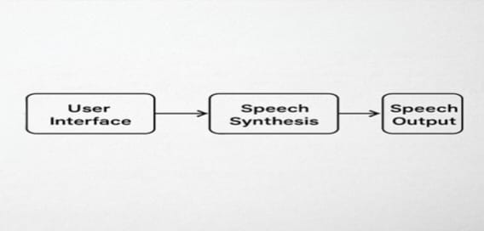
SYSTEM ARCHITECTURE
API

Slide 12
METHODOLOGY
Creating a text to speech converter ensures a systematic framework for handling text input, linguistic analysis, phonetic conversion, and speech synthesis. It guarantees consistency, accuracy, and scalability, enabling the development of a reliable system that converts text into natural-sounding speech.
Modules: Identifying the key functionalities or features our Type2Tone(Text to speech converter) will have. Common modules include:
Home
Explore
Text Entry
Select voice
Listen
Exit

Slide 13
Module Detailing:
1.Home : About the our project.
2.Explore : After clicking the explore button, we will navigate to main page.
3.Text entry : Enter the text in text area.
4.Select voice : Select the required voice.
5.Listen : By clicking the listen button we listen the audio.
6.Exit : Exit after your work.

Slide 14
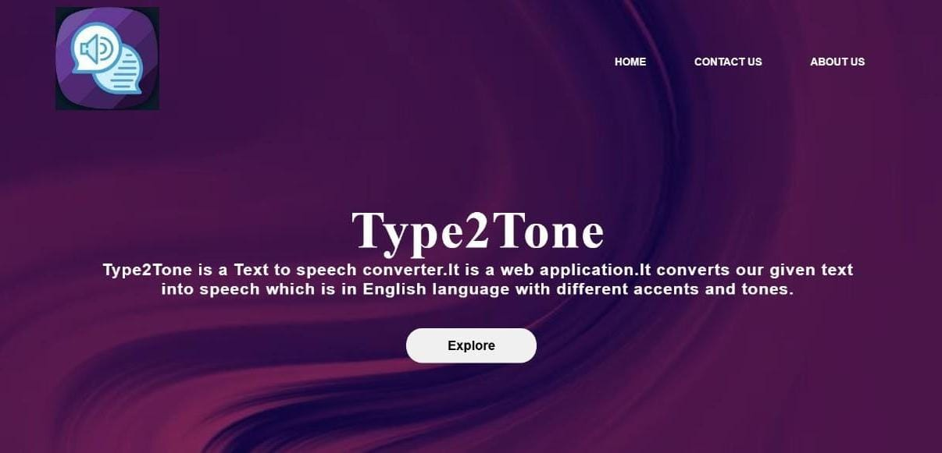
OUTPUT
HOME PAGE

Slide 15
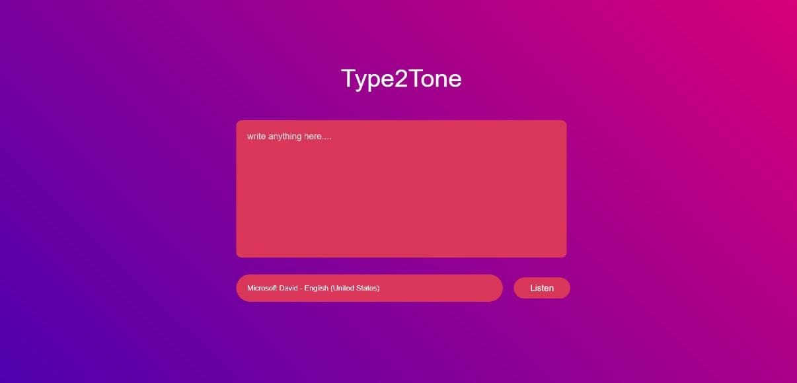
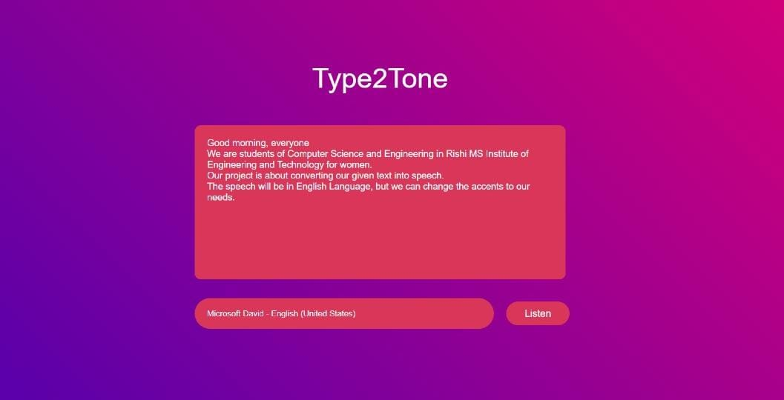
MAIN PAGE

Slide 16
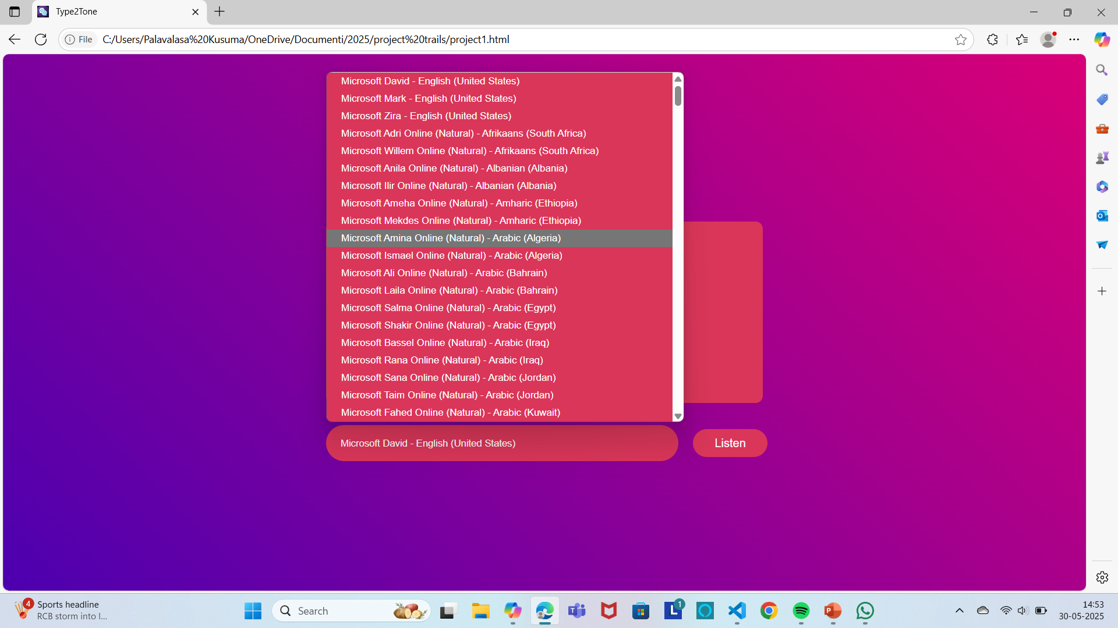
Tone Selection

Slide 17
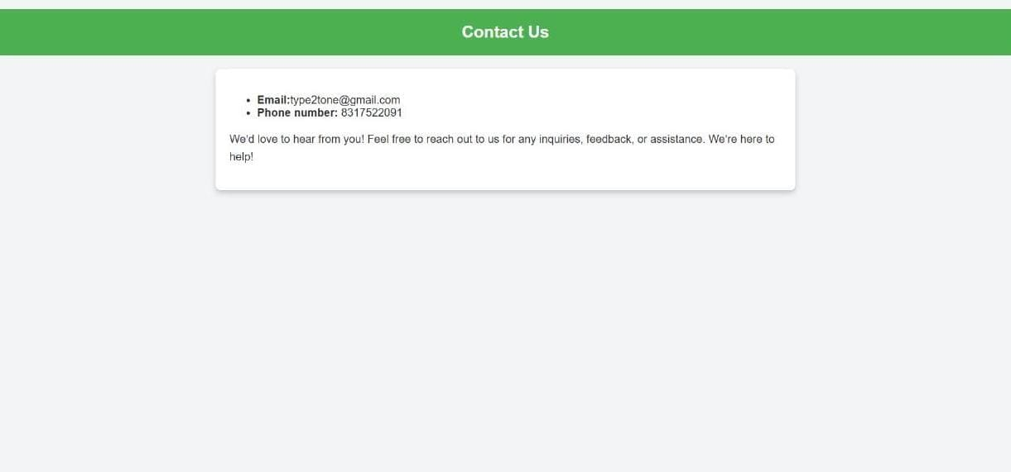
CONTACT PAGE

Slide 18
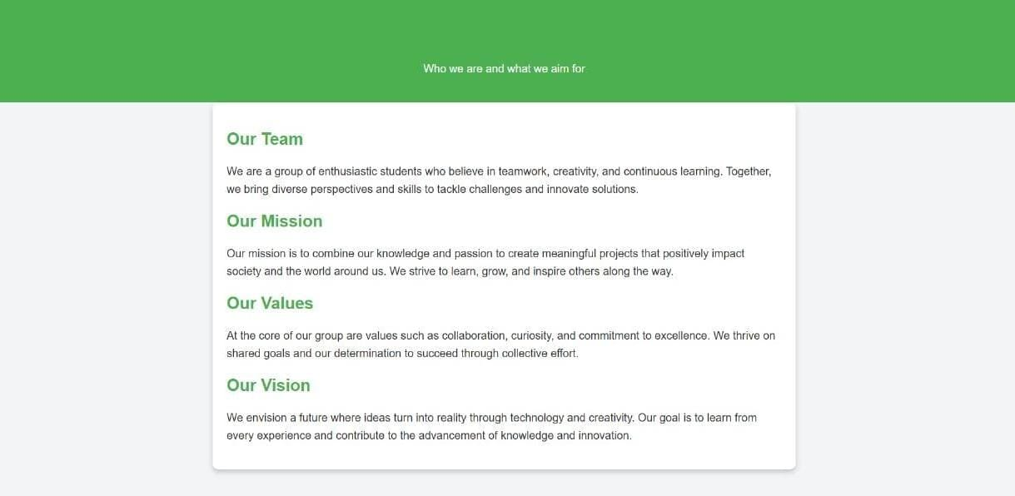
ABOUT US PAGE

Slide 19
CONCLUSION
The Text-to-Speech (TTS) converter is a powerful tool that bridges the gap between written text and audible speech, offering significant value in various applications. It enhances accessibility for visually impaired users, facilitates language learning, and serves a critical role in virtual assistants, customer service bots, and other automated systems. The technology has evolved to produce highly natural and intelligible speech, with customizable features such as voice selection, speech rate, and pitch adjustments. Despite the remarkable advancements, challenges remain, particularly in the areas of pronunciation, emotional tone generation, and handling complex linguistic structures. Future developments, especially with the integration of neural networks and deep learning, promise further improvements in speech naturalness, multilingual capabilities, and contextual understanding. As TTS technology continues to advance, it will increasingly offer more personalized, efficient, and context-aware experiences, making it an indispensable tool in a variety of industries.

Slide 20
FUTURE ENHANCEMENT
Future enhancements for a Text-to-Speech converter could focus on several key aspects. Improving natural speech quality would enhance emotional expression and make voices sound more realistic. Expanding multilingual support by incorporating more languages and dialects would increase accessibility and usability across diverse populations. Personalization features, such as custom voice and pitch settings, would allow users to tailor the output to their preferences. Strengthening accessibility with advanced features for visually impaired users would make the technology more inclusive. Optimizing real-time processing could minimize delays, making the converter more suitable for conversational applications.

Slide 21
REFERENCES
1. Web Speech API Documentation (MDN Web Docs)
This is the official reference for the SpeechSynthesis and SpeechSynthesisUtterance objects you are using. - Link: [https://developer.mozilla.org/en-US/docs/Web/API/Web_Speech_API](https://developer.mozilla.org/enUS/docs/Web/API/Web_Speech_API)
2. W3C Web Speech API Specification
The technical specification for browser support and how speech synthesis is structured. - Link: [https://wicg.github.io/speech-api/](https://wicg.github.io/speech-api/)
3. Google Text-to-Speech (for Android)
If you want to reference mobile TTS, Google's TTS system is widely used. - Link: [https://developers.google.com/assistant/sdk/reference/rpc/google.cloud.texttospeech.v1](https://developers.google.com/assistant/sdk/reference/rpc/google.cloud.texttospeech.v1)
4. Github Projects
Example repositories of TTS implementations using JavaScript and other languages. - Example: [https://github.com/mdn/web-speech-api](https://github.com/mdn/web-speech-api)

Slide 22
THANK YOU

