Slide 1


Pharmaceutical Inventory Analysis

Slide 2
Contents
Business Objective
Business Constraints
Project Architecture - Data Flow Diagram
Data Collection
Exploratory Data Analysis (SQL & Python)
Data Preprocessing
AutoEDA
Data Visualization
Notes:
Change

Slide 3
Business Problem
Lack of strategic raw material procurement leads to overpaying and surplus unutilized stock in the inventory.

Slide 4
Project Overview and Scope
Project Title : Pharmaceutical Inventory Analysis.
Business Problem : Lack of strategic raw material procurement leads to overpaying and surplus unutilized stock in the inventory.
Business Objective : Minimize inventory cost.
Business Constraint : Maximize current stock utilization.
Business Success Criteria : Reduced underutilized stock levels in the inventory by at least 20%.
Economic Success Criteria : Reduced costs associated with storing and managing excess raw materials by at least 25%.

Slide 5
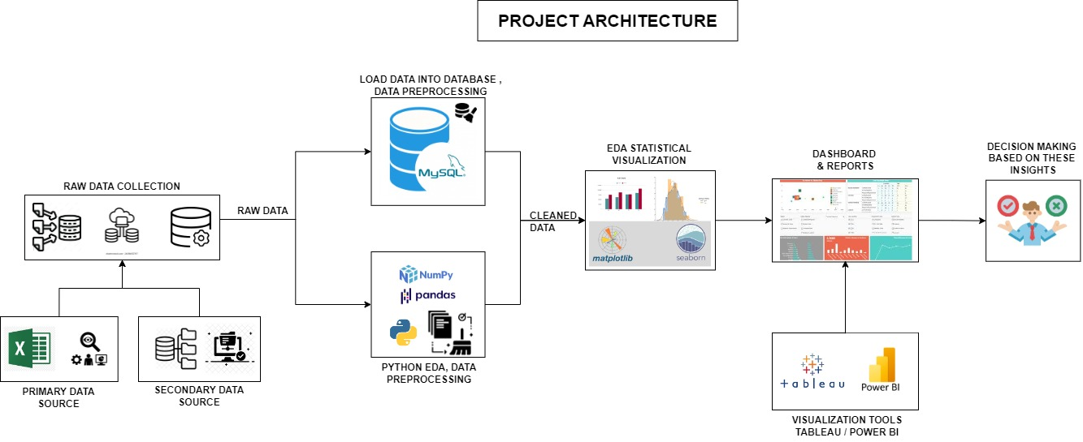
Project Architecture

Slide 6
Data Dictionary
Data Dictionary
S.No. | Column Name | Data Type | DataType(continous/discrete) | Nominal/Ordinal/Interval/Ratio | Structured/Unstructured
1 | Material | int | Discrete data | Nominal data | Structured data
2 | Material Description | string | Discrete data | Nominal data | Unstructured data
3 | Plant | int | Discrete data | Nominal data | Structured data
4 | Storage Location | string | Discrete data | Nominal data | Structured data
5 | Movement Type | int | Discrete data | Nominal data | Structured data
6 | Material Document | int | Discrete data | Nominal data | Structured data
7 | Material Doc.Item | int | Discrete data | Ordinal data | Structured data
8 | Posting Date | date | Discrete data | Interval data | Structured data
9 | Qty in Un. of Entry | float | Continuos data | Ratio data | Structured data
10 | Unit of Entry | string | Discrete data | Nominal data | Structured data
11 | Batch | int | Discrete data | Nominal data | Structured data
12 | Order | int | Discrete data | Nominal data | Structured data
13 | Reference | string | Discrete data | Nominal data | Unstructured data
14 | Movement Type Text | string | Discrete data | Nominal data | Unstructured data
15 | Counter | int | Discrete data | Ratio data | Structured data
16 | Routing number for operations | int | Discrete data | Nominal data | Structured data
17 | Document Date | date | Discrete data | Interval data | Structured data
18 | Qty in OPUn | float | Continuos data | Ratio data | Structured data
19 | Order Price Unit | string | Discrete data | Nominal data | Structured data
20 | Order Unit | string | Discrete data | Nominal data | Structured data
21 | Qty in order unit | float | Continuos data | Ratio data | Structured data
22 | Company Code | int | Discrete data | Nominal data | Structured data
23 | Entry Date | date | Discrete data | Interval data | Structured data
24 | Time of Entry | time | Continuos data | Interval data | Structured data
25 | Amount in LC | float | Continuos data | Ratio data | Structured data
26 | Purchase Order | int | Discrete data | Nominal data | Structured data
27 | Item | int | Discrete data | Ordinal data | Structured data
28 | Ext. Amount in Local Currency | float | Continuos data | Ratio data | Structured data
29 | Sales Value | float | Continuos data | Ratio data | Structured data
30 | Reason for Movement | int | Discrete data | Nominal data | Structured data
31 | Sales Order Schedule | int | Discrete data | Nominal data | Structured data
32 | Sales Order Item | int | Discrete data | Ordinal data | Structured data
33 | Cost Center | int | Discrete data | Nominal data | Structured data
34 | Movement indicator | string | Discrete data | Nominal data | Structured data
35 | Consumption | string | Continuos data | Ratio data | Structured data
36 | Receipt Indicator | string | Discrete data | Nominal data | Structured data
37 | Supplier | int | Discrete data | Nominal data | Structured data
38 | Sales order item | int | Discrete data | Nominal data | Structured data
39 | Base Unit of Measure | string | Discrete data | Nominal data | Structured data
40 | Quantity | float | Continuos data | Ratio data | Structured data
41 | Material Doc. Year | date | Discrete data | Nominal data | Structured data
42 | Reservation | int | Discrete data | Nominal data | Structured data
43 | Item No.Stock Transfer Reserv. | int | Discrete data | Ordinal data | Structured data
44 | Debit/Credit ind | string | Discrete data | Nominal data | Structured data
45 | User name | string | Discrete data | Nominal data | Structured data
46 | Trans./Event Type | string | Discrete data | Nominal data | Structured data
47 | Sales Value inc. VAT | float | Continuos data | Ratio data | Structured data
48 | Currency | string | Discrete data | Nominal data | Structured data
49 | Item automatically created | string | Discrete data | Nominal data | Structured data
50 | Original Line Item | int | Discrete data | Nominal data | Structured data
51 | Product Code | int | Discrete data | Nominal data | Structured data
52 | Product Description | string | Discrete data | Nominal data | Unstructured data
53 | Material Type | string | Discrete data | Nominal data | Structured data
54 | Vendor Code | int | Discrete data | Nominal data | Structured data

Slide 7
Business Moments
Python EDA (Before Imputation)
 |  | 1st Moment |  |  | 2nd Moment |  |  |  |  | 3rd Moment | 4th Moment
S.No. | Column Name | Mean | Median | Mode | Variance | Std Deviation | Max | Min | Range | Skewness | Kurtosis
1 | Material | 31023006.14 | 31026971 | 31033204 | 9031075430.68 | 95031.97 | 31082100 | 30000009 | 1082091 | -9.97 | 104.54
2 | Plant | 8126.88 | 8110 | 8110 | 2927.20 | 54.11 | 8340 | 8110 | 230 | 3.09 | 7.79
3 | Movement Type | 176.01 | 201 | 201 | 5126.04 | 71.59 | 641 | 101 | 540 | 0.52 | -0.57
4 | Material Document | 4941452826.59 | 4901743953 | 4901510945 | 2354956594965020.00 | 48527895.02 | 5000508668.00 | 4900888037.00 | 99620631.00 | 0.39 | -1.85
5 | Material Doc.Item | 5.94 | 2 | 1 | 342.74 | 18.52 | 488 | 1 | 487 | 11.18 | 180.59
6 | Batch | 8117232581.83 | 8114220068 | 8114210874 | 693541919497623.00 | 26335184.07 | 8323230001 | 8113170016 | 210059985 | 7.66 | 56.79
7 | Order | 382914327.22 | 400000048 | 400000048 | 93627931414644900.00 | 305986815.76 | 8817000153 | 100000231 | 8716999922.00 | 26.09 | 717.05
8 | Company Code | 1000.00 | 1000 | 1000 | 0 | 0 | 1000 | 1000 | 0 | 0 | 0
9 | Purchase Order | 4421517531.14 | 4400064373 | 4700003173 | 6271199783968330.00 | 79190907.21 | 5100001751 | 4300002406 | 799999345 | 3.29 | 9.67
10 | Item | 20.26 | 0 | 0 | 3201.37 | 56.58 | 1150 | 0 | 1150 | 7.17 | 80.59

Slide 8
Business Moments
Python EDA (Before Imputation)
 |  | 1st Moment |  |  | 2nd Moment |  |  |  |  | 3rd Moment | 4th Moment
S.No. | Column Name | Mean | Median | Mode | Variance | Std Deviation | Max | Min | Range | Skewness | Kurtosis
11 | Ext. Amount in Local Currency | 0 | 0 | 0 | 0.00 | 0 | 0 | 0 | 0 | 0 | 0
12 | Sales Value | 0 | 0 | 0 | 0.00 | 0 | 0 | 0 | 0 | 0 | 0
13 | Reason for Movement | 0 | 0 | 0 | 0.01 | 0.01 | 2 | 0 | 2 | 199.74 | 41864.09
14 | Sales Order Schedule | 0 | 0 | 0 | 0.00 | 0 | 0 | 0 | 0 | 0 | 0
15 | Sales Order Item | 0 | 0 | 0 | 0.00 | 0 | 0 | 0 | 0 | 0 | 0
16 | Cost Center | 81198716.84 | 81101504 | 81101506 | 181275974187.41 | 425765.17 | 90012101 | 81101101 | 8911000 | 4.79 | 29.17
17 | Supplier | 54279.59 | 54540 | 50115 | 6456506.36 | 2540.97 | 60126 | 50001 | 10125 | -0.15 | -1.05
18 | Sales order item | 0 | 0 | 0 | 0.00 | 0 | 0 | 0 | 0 | 0 | 0
19 | Reservation | 11467.12 | 0 | 0 | 1277550832.44 | 35742.85 | 138992 | 0 | 138992 | 2.84 | 6.12
20 | Item No.Stock Transfer Reserv. | 0.37 | 0 | 0 | 5.88 | 2.43 | 244 | 0 | 244 | 40.66 | 3392.88
21 | Original Line Item | 0 | 0 | 0 | 0 | 0 | 0 | 0 | 0 | 0 | 0
22 | Product Code | 53000765.00 | 53000765 | 53000765 | 0 | 0 | 53000765 | 53000765 | 0 | 0 | 0
23 | Vendor Code | 54301.34 | 54605 | 50115 | 6430299.01 | 2535.81 | 60023 | 50001 | 10022 | -0.18 | 10022

Slide 9
Exploratory Data Analysis [EDA]
Statistical Insights
Business Insights
The Material column exhibits high variability with a large range, slight negative skewness, and sharp peaks indicated by high kurtosis. Mean, median, and mode are closely aligned, suggesting a nearly normal distribution.
The Plant column shows minimal variability with low dispersion, a small range, and a slightly right-skewed distribution. Central tendency measures are almost identical.
Movement Type has moderate variability, a balanced distribution, and a small positive skew. Slightly broad peak indicated by low kurtosis.
Material Document displays extremely high variability with a large range. The distribution is nearly symmetrical with a flat peak and low kurtosis.
This column has significant variability, a highly skewed positive distribution, and extreme kurtosis due to rare outliers.
Batch data shows high variability, a wide range, and a moderately positive skew. High kurtosis indicates heavy tails and extreme values.
Order has extreme variability with a very large range, high positive skewness, and heavy-tailed distribution due to high kurtosis.
Purchase Order shows high variability with a large range, moderate positive skewness, and slightly peaked distribution as indicated by kurtosis.
The Item column exhibits moderate variability with a positive skew and high kurtosis, indicating the presence of rare extreme values.
High variability suggests diverse materials in inventory; slight left skew indicates a few high-frequency materials.
Minimal variability and small range suggest standardized operations across plants, simplifying logistics.
Consistent material flow with occasional spikes reflects predictable operational processes.
High transaction volume with balanced documentation; no significant outliers.
Rare transactions with very high item counts indicate exceptional orders requiring focus.
Diverse batch sizes reflect varying production/procurement cycles; positive skew shows smaller batch dominance.
High diversity in order sizes; most are small, but large orders may drive revenue.
Wide purchase volume range highlights supplier variability; a few large orders need strategic oversight.
Inventory inconsistencies or demand spikes visible; rare high item counts need better planning.
Diverse spending patterns; moderate costs dominate, with some departments incurring higher expenses.
Notes:
EDA is used for seeing what the data can tell us before the modeling task.
Change

Slide 10
Exploratory Data Analysis [EDA]
Statistical Insights
Business Insights
Cost Center data has moderate variability, a wide range, a moderately positive skew, and high kurtosis with some outliers.
Supplier has minimal variability, a small range, slight negative skewness, and flat distribution as reflected in low kurtosis.
Reservation shows moderate variability with a large range, positive skewness, and a slightly peaked distribution due to moderate kurtosis.
This column has small values with significant skewness and extreme kurtosis due to rare outliers, despite minimal variance.
The Product Code column is perfectly consistent, with no variability, skewness, or kurtosis as all values are identical.
Vendor Code exhibits moderate variability with a small range, slight negative skewness, and a relatively flat distribution.
Stable supplier base with minimal variability; most suppliers show consistent activity.
Occasional large reservations for projects; small reservations dominate.
Rare high-volume transfers require monitoring; most values are minimal.
Uniform data indicates a single product or standardized coding, simplifying tracking.
Stable vendor activity; slight negative skew highlights some below-average performers.
Notes:
EDA is used for seeing what the data can tell us before the modeling task.
Change

Slide 11
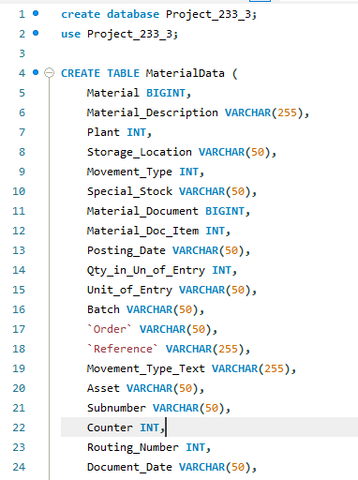
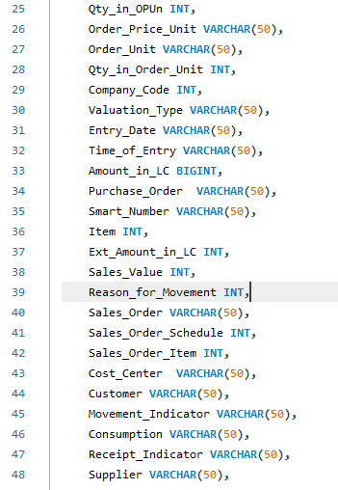
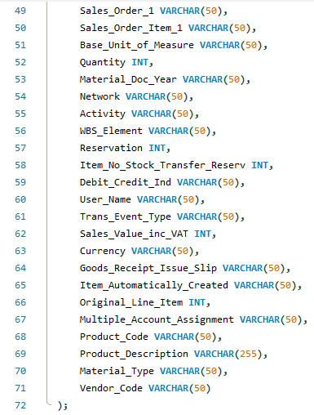
Data Preprocessing
Notes:
Keep observations

Slide 12
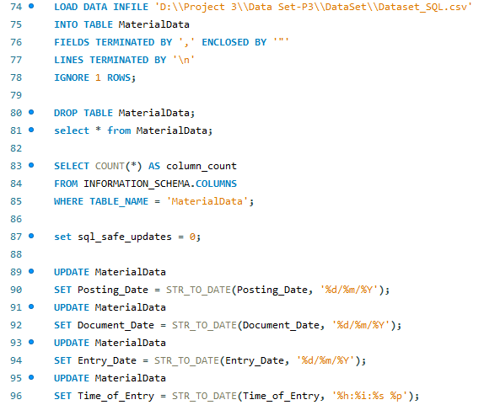
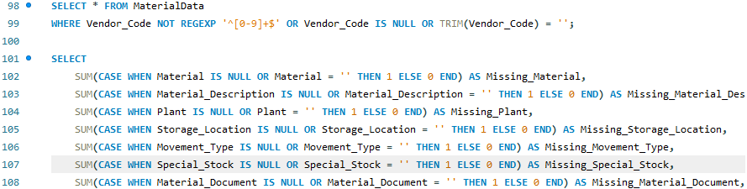
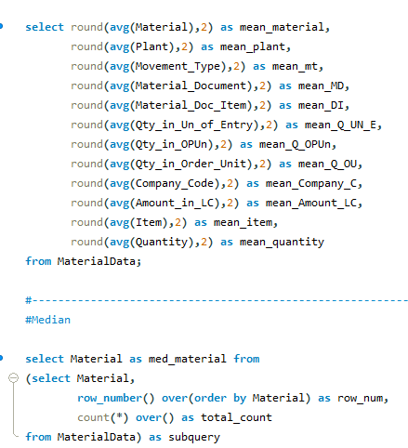
Data Preprocessing
Notes:
Keep observations

Slide 13
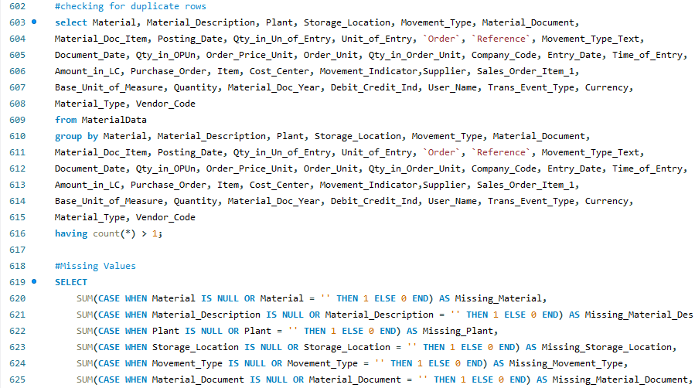
Data Preprocessing
1. Import Datasets:
Create a table named MaterialData.
The Solar Table contains 61567 rows and 67 columns.
2. Business Moments Calculation:
Calculated the business moments (mean, median, mode, variance, skewness, etc.) for each individual table.
Also calculated the business moments for the merged Solar Table.
Compared the values between the individual tables and the merged table.
3. Handling Null and Duplicate Values:
Checked the MaterialData Table for null values and duplicate rows.
Identified duplicate rows in the Table. Removed these duplicate rows.
4. Outlier Detection and Treatment:
Used the Interquartile Range (IQR) method to identify outliers in all columns.
Replaced the outliers by setting them to the upper limit (for values above the upper bound) or the lower limit (for values below the lower bound) as per the IQR method.
Notes:
Keep observations

Slide 14

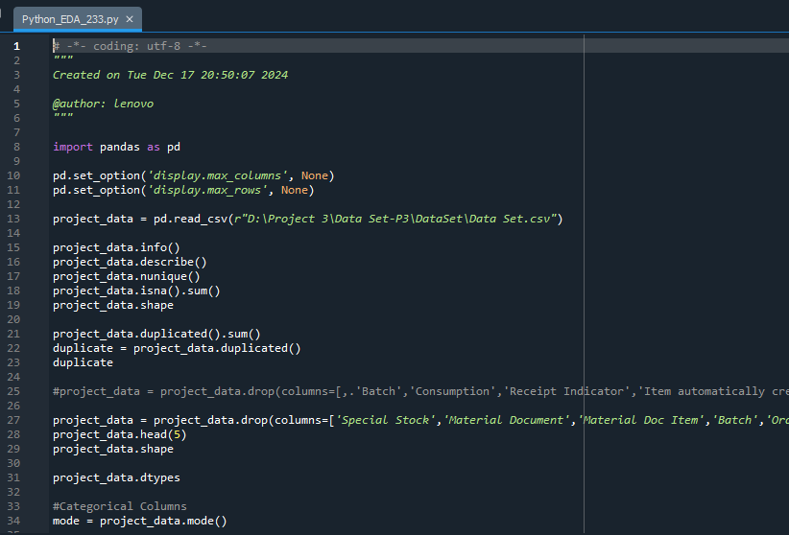
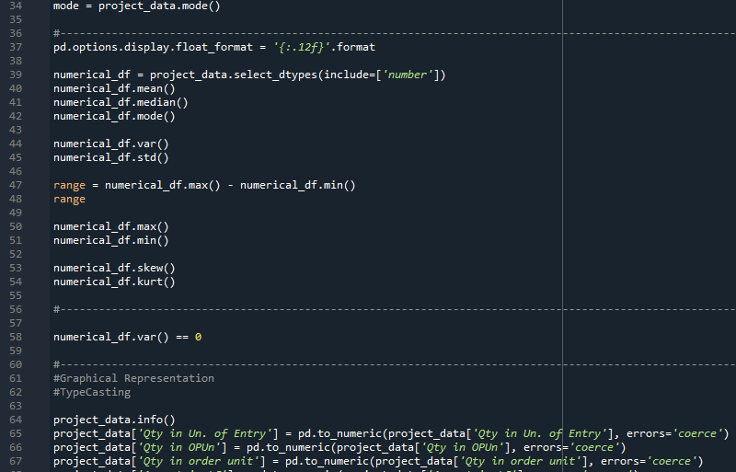
Data Preprocessing
Notes:
Add graphical

Slide 15
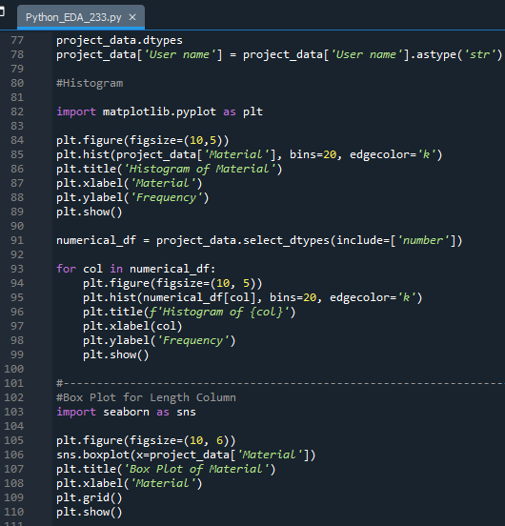
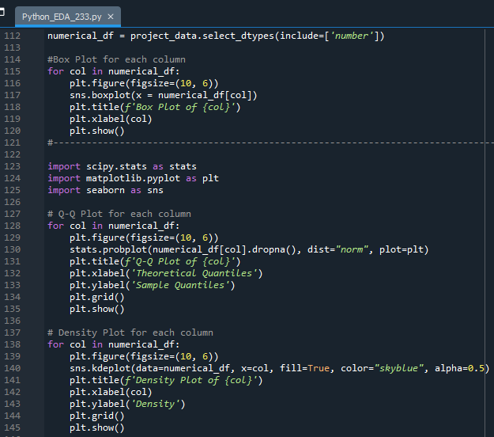
Data Preprocessing
Notes:
Add graphical

Slide 16
Data Preprocessing
1. Data Importing and Preprocessing
MaterialData dataset are imported from CSV files.
For both datasets, column names are provided manually during the import process.
The Date column in datasets is converted to a datetime format for easier time-based analysis.
2. Exploratory Data Analysis (EDA)
Data types of each column are checked using dtypes.
General information about the dataset (like row count, column count, etc.) is displayed using info().
Descriptive statistics of the dataset (mean, median, mode, etc.) are calculated using describe().
The uniqueness and null values of the dataset are checked using nunique() and isna().sum().
4. Business Moments Calculations
First Business Moments (mean, median, mode) are calculated using mean(), median(), and mode().
Second Business Moments (variance, standard deviation, range) are calculated using var(), std(), max() - min().
Third and Fourth Business Moments (skewness and kurtosis) are calculated using skew() and kurt().
5. Handling Duplicates
The number of duplicate rows is checked using duplicated().
Duplicate rows are removed, and the dataset is saved.
6. Handling Missing Values
Missing values are counted using isna().sum().
The Missing values columns are dropped as part of data preparation for further analysis.
7. Data Visualization
Bar plots for numeric columns, such as Material, are plotted using matplotlib.
Histograms for numeric columns are created to show the distribution of data.
Box plots are plotted for each numeric column to visualize outliers.
Line plots are created to visualize time-series data for various columns.
Scatter plot is generated between Date and Material.
8. Correlation Analysis
A correlation matrix is calculated for numeric columns using corr().
Notes:
Add graphical

Slide 17
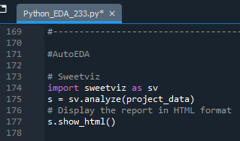
Data Preprocessing
A heatmap of the correlation matrix is plotted using seaborn to visualize relationships between columns.
9. Outlier Detection
Outliers are detected using the Interquartile Range (IQR) method.
For each numeric column, the lower and upper bounds are calculated, and any value outside these bounds is flagged as an outlier.
10. Outlier Treatment using Winsorization
Outliers in numeric columns are replaced using Winsorization with the IQR method from the feature_engine library.
11. Data Scaling
Data is scaled using RobustScaler from sklearn to reduce the impact of outliers on the scaled data.
The scaled dataset is saved in dataset_robust, and descriptive statistics for the scaled data are shown.
AutoEDA Libraries
Sweetviz is used to automatically generate an HTML report for exploratory data analysis.
Autoviz is used to generate visualizations automatically from the dataset.
Dtale is used to open an interactive session for visualizing and exploring the dataset.
Notes:
Add graphical

Slide 18
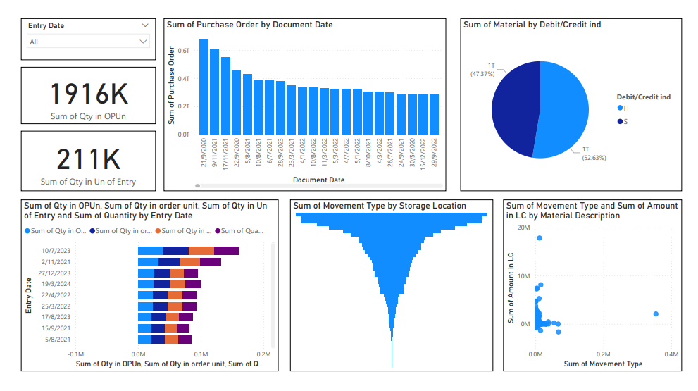
Data Visualization(Power BI Dashboard)
Notes:
Add graphical

Slide 19


