Slide 1
USB 6501
Submitted BY
Mohana Priya G
Akshitha K V

Slide 2
Implementing USB 6501 in LabVIEW STEPS
Launch the DAQ Assistant
Open LabVIEW and create New VI.
Right click on block diagram and select Express -> Input -> DAQ Assist.
2. Create the Task
In this example, we will configure a simple Digital output .
Select Generate signals and then select digital output.
Select the physical channel(Port 0.0) for which you are creating this task.
3. Generate LabVIEW Code
Right click on block diagram and select Vertical Toggle switch and Round LED.
Connect Vertical Toggle switch, Round LED and DAQ Assist .

Slide 3
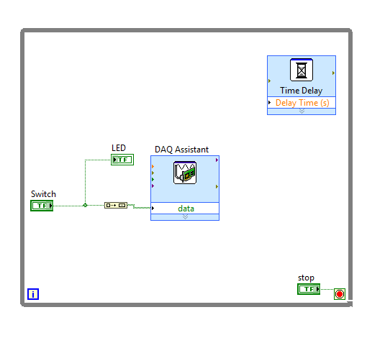
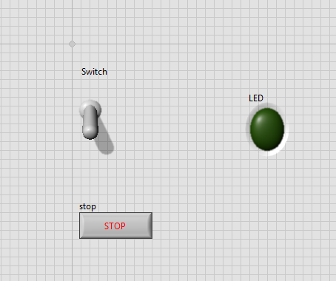
Implementing USB 6501 in LabVIEW
Block Diagram
Front Panel

Slide 4
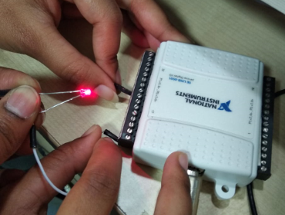
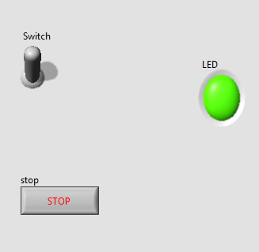
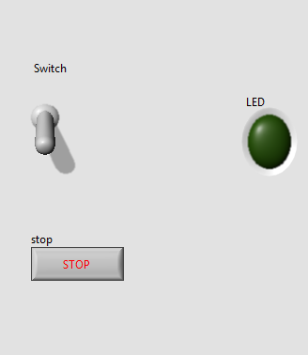
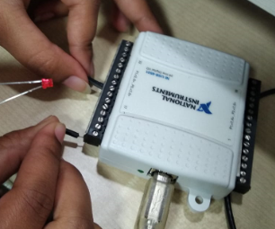
Implementing USB 6501 in LabVIEW 4. Run VI.

Slide 5
Overview Digital Output mode is used to generate output to digital ports/lines. The user requires to select the DAQmx Channel and click on the button corresponding to the port/lines, which will give a high output and LED goes high.
STEPS
Open a blank VI in LabVIEW.
Connect USB-6501 through USB port.
Right click on block diagram select daqmx create channel, daqmx read, daqmx write, daqmx start and daqmx stop.
Specify the channel to set as outputs and inputs using their respective controls in the Channel Settings panel.
Specify output level (high or low) using the Output Array control.
Click the Run button to begin outputting values and reading inputs.
The inputs will display in the Input Array indicator.
Change the outputs as desired.
Click the Stop button to end the program.

Slide 6
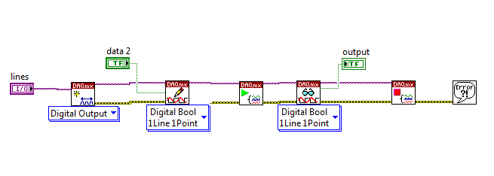
BLOCK DIAGRAM

Slide 7
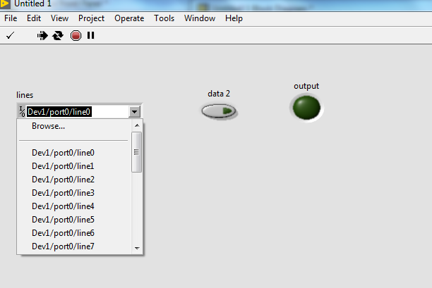
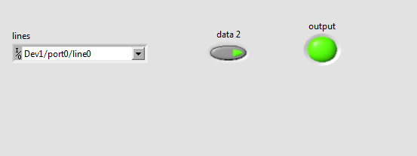
FRONT PANEL

Slide 8
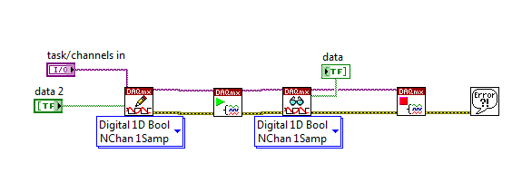
This example automates the digital input and output (DIO) channels; users can select which channels should be inputs or outputs and specify output values.
BLOCK DIAGRAM

Slide 9
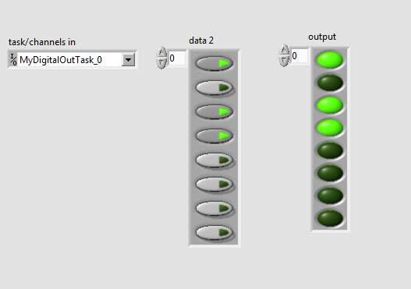
FRONT PANEL

Slide 10
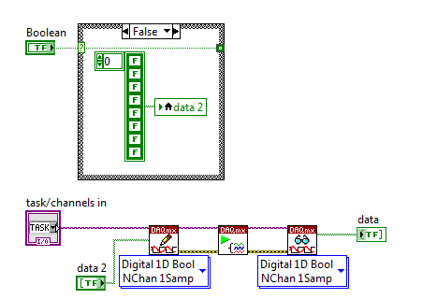
This VI allows for the user to toggle the output of 8 lines of the port between HIGH, LOW.
BLOCK DIAGRAM

Slide 11
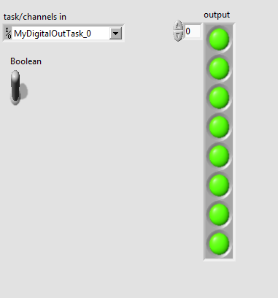
FRONT PANEL

Slide 12
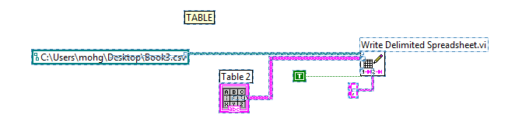
This example shows how to use the Write to Spreadsheet VI to write data to a Comma Separated Value (CSV) spreadsheet file which can be read in Microsoft Excel. STEPS 1.Right click on block diagram and select Write delimited spreadsheet 2.Specify file path where you would like to store the file. 3.Data in the TABLE are written to the CSV file. 4.Run VI.
BLOCK DIAGRAM

Slide 13
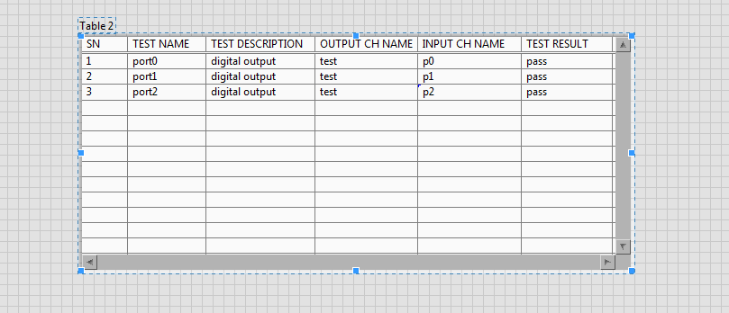
FRONT PANEL

Slide 14
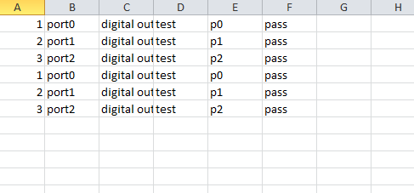
Microsoft Excel File

Slide 15
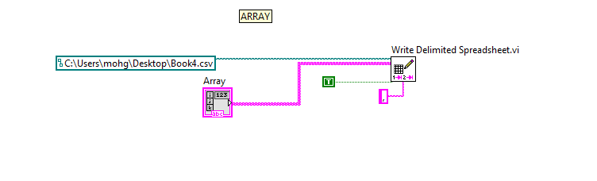
Using Array STEPS 1.Right click on block diagram and select Write delimited spreadsheet 2.Specify file path where you would like to store the file. 3.Data in the ARRAY are written to the CSV file. 4.Run VI.
BLOCK DIAGRAM

Slide 16
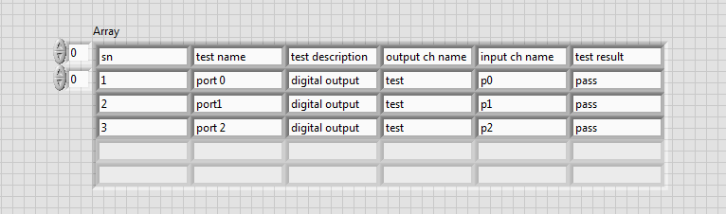
FRONT PANEL

Slide 17
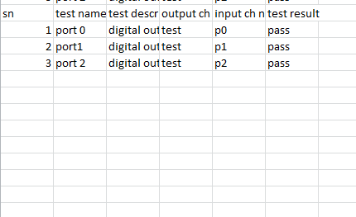
Microsoft Excel File

Slide 18
Overview
This example automates the digital input and output (DIO) channels; users
can select which channels should be inputs or outputs, specify output
Values , display Date and current Time and display the serial number, channel
name, Description, Status and Remarks.
STEPS
Open blank VI in Labview.
Connect USB-6501 through USB port.
Select the task\channel
Specify output level (high or low) using the Output Array control.
Run VI.
The inputs will display in the Input Array indicator.
Change the outputs as desired.
Click the Stop button to end the program.

Slide 19
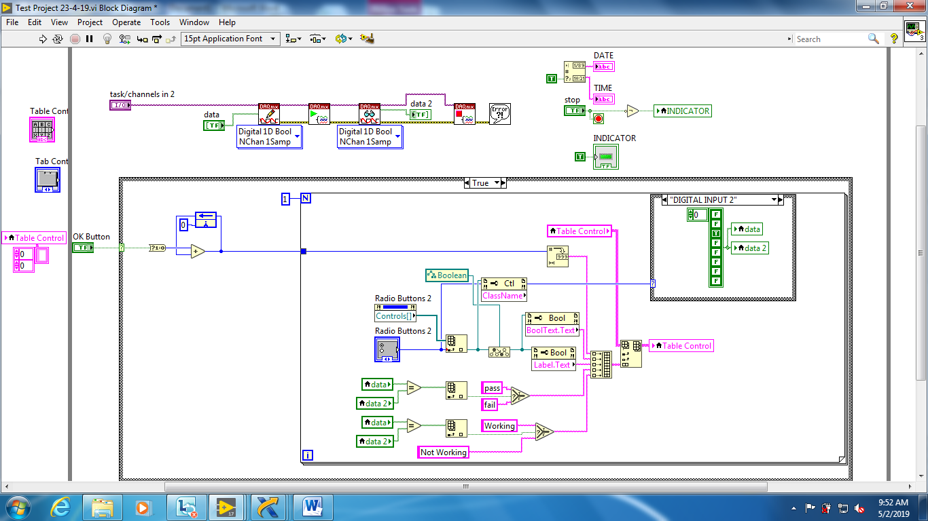
BLOCK DIAGRAM

Slide 20
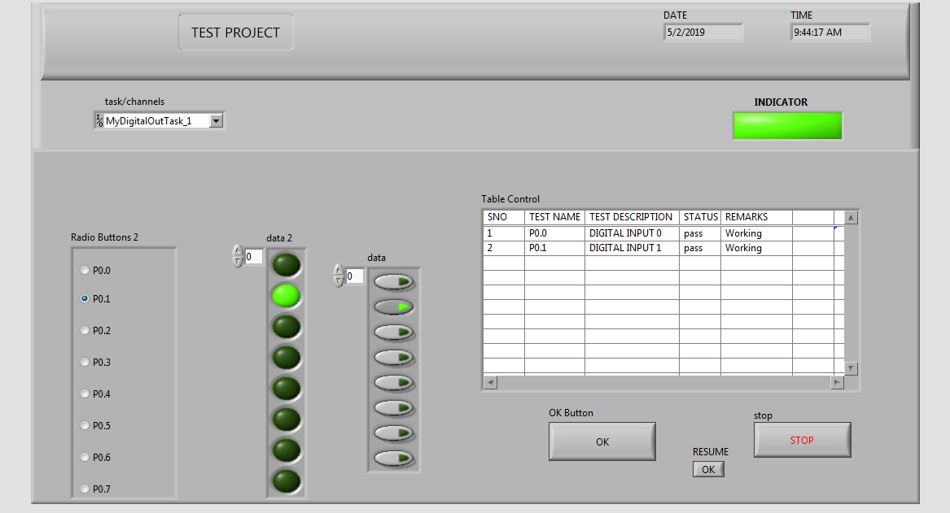
FRONT PANEL

Slide 21
THANK YOU

