Slide 1
RS232

Slide 2
What is RS232?
The RS-232(X) is a serial communication protocol, commonly used for transferring and receiving the serial data between two devices.
It supports both synchronous and asynchronous data transmissions.
The RS-232 cable works at different baud rates like 9600 bits/s, 2400bits/s, 4800bits/s etc.
The RS-232 cable has two terminal devices namely Data Terminal Equipment and Data communication Equipment. Both devices will send and receives the signals.
The data terminal equipment is a computer terminal and data communication Equipment is modems, or controllers etc.
The maximum length of RS-232 cable is 50ft.

Slide 3
Why we use RS232?
RS232 is commonly used for serial communication.
SERIAL COMMUNICATION
Serial communication data transmission occurs bit by bit at a time. serial communication is fast for long distances and high frequencies.

Slide 4
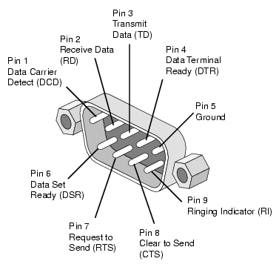
RS232 Pin Description DB9 CONNECTOR

Slide 5
PIN DESCRIPTION
Pin | SIG. | Signal Name | DTE (PC)
1 | DCD | Data Carrier Detect | in
2 | RXD | Receive Data | in
3 | TXD | Transmit Data | out
4 | DTR | Data Terminal Ready | out
5 | GND | Signal Ground | -
6 | DSR | Data Set Ready | in
7 | RTS | Request to Send | out
8 | CTS | Clear to Send | in
9 | RI | Ring Indicator | in

Slide 6
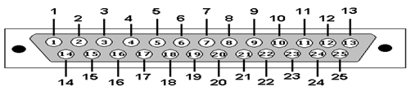
DB25-CONNECTOR

Slide 7
PIN DESCRIPTION
Pin | SIG. | Signal Name
1 | GND | Shield Ground
2 | TXD | Transmit Data
3 | RXD | Receive Data
4 | RTS | Request to Send
5 | CTS | Clear to Send
6 | DSR | Data Set Ready
7 | GRD | System Ground
8 | CD | Carrier Detect
9 | -- | RESERVED

Slide 8
PIN DESCRIPTION
Pin | SIG. | Signal Name
10 | --- | RESERVED
11 | STF | Select Transmit Channel
12 | S.CD | Secondary Carrier Detect
13 | S.CTS | Secondary Clear to Send
14 | S.TXT | Secondary Transmit Data
15 | TCP | Transmission Signal Element Timing
16 | S.RXD | Secondary Receive Data
17 | RCK | Receiver Signal Element Timing
18 | LL | Local Loop Control

Slide 9
PIN DESCRIPTION
Pin | SIG. | Signal Name
19 | S.RTS | Secondary Request to Send
20 | DTR | Data Terminal Ready
21 | RL | Remote Loop Control
22 | RI | Ring Indicator
23 | DSR | Data Signal Rate Selector
24 | XCK | Transmit Signal Element Timing
25 | TI | Test Indicator

Slide 10
What is MAX232?
Max 232 device is used to communicate with the DTE and DCE devices through RS-232 cable.
The Max 232 IC can be used as an intermediate connection between Microcontroller and a Computer.

Slide 11
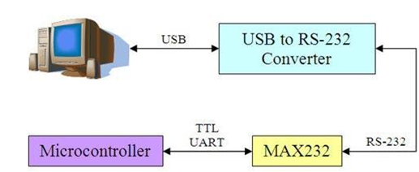
Interfacing RS232 to Microcontrollers using Max 232

Slide 12
Interfacing RS232 to Microcontrollers using Max 232
Max 232 as a intermediate between the Microcontroller and the RS 232 connected to the Computer, one of the transmitter input pins receive TTL input from the Microcontroller and the capacitor arrangement obtains the +/-10V signal which is applied to the corresponding transmitter output pin, given to the RS232 port.
The receiver input pin receives 232 standard input from the RS232 port and accordingly the corresponding receiver output pin gives the TTL standard output to the Microcontroller.

Slide 13
Implementing RS232 in Labview
Labview provide build in VISA SERIAL PORT for serial communication.
VISA (Virtual instrumentation software architecture)
VISA is a standard I/O API for instrumentation programming.
VISA can control GPIB, serial, USB, Ethernet, PXI, or VXI instruments.
WRITE VISA PORT is used for writing data.
READ VISA PORT is used for reading data.
VISA PROPERTY NODE is used for counting how much byte is coming at read serial port pin.

Slide 14
Implementing RS232 in Labview
STEPS
Right click on block diagram and select Visa configuration port.
Right click on block diagram and select read visa port, write visa port and close visa.
Connect Visa configuration port to write visa port.
Right click on Block diagram and select visa property node and connect to read visa port.
Connect read visa port to close visa.
Run VI.

Slide 15
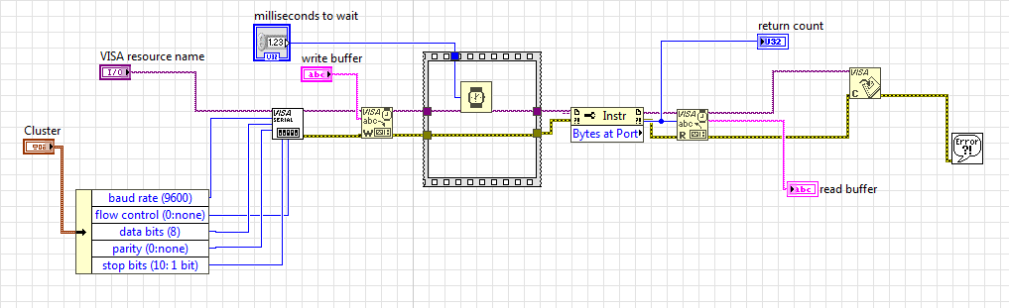
Implementing RS232 in Labview

Slide 16
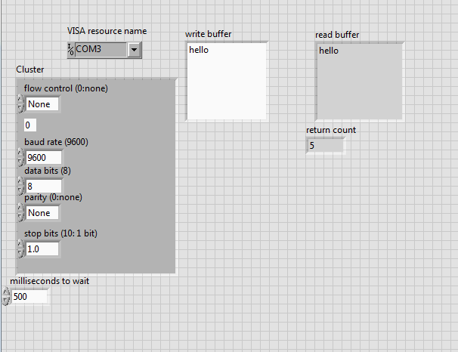
Implementing RS232 in Labview

Slide 17
THANK YOU

