Slide 1
RS422
Submitted By
Mohanapriya G
Akshitha K V

Slide 2
What is RS422?
This RS422 interface is used to transmit data at higher speed and for larger distance compare to RS232.
This is possible due to differential mode of transmission. It uses twisted pair cable for transmission. Hence noise is reduced to great extent.
This serial interface can transmit data at 10Mbps rate for distances upto 50 feet and at 100 Kbps data rate for distances upto 4000 feet.
RS422 interface one device acting as master can control upto 10 slave devices.
RS422 uses both differential transmitters and receivers which means that it is much more resilient to common mode interference, a key issue with long lines.

Slide 3
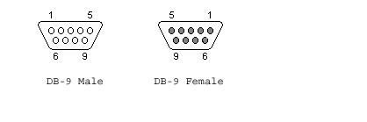
RS422 Pin Diagram DB9
This interface is similar to RS485 interface. The RS422 interface is used for multi drop configuration and supports up to 10 devices at a time.
It is used in balanced differential mode. It supports data rate from 100 kbps to about 10 Mbps.

Slide 4
Rs422 Pin Description
Pin | Signal | Description
1 | GND | Shield
2 | RTS+ | Request To Send +
3 | RTS- | Request To Send -
4 | TXD+ | Transmit Data +
5 | TXD- | Transmit Data -
6 | CTS+ | Clear To Send +
7 | CTS- | Clear To Send -
8 | RXD+ | Received Data +
9 | RXD- | Received Data

Slide 5
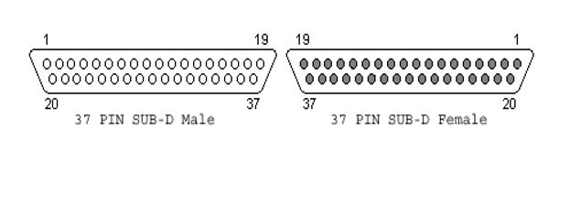
37 Pin connector (DB-37)
The male sockets are used on the DTE(Data Terminal Equipment ) or PC side.
The female sockets are on the DCE (Data Communication Equipment ) or Modem Side.

Slide 6
RS422 Pin Description
Pin | Name | Description
1 | GND | Shield Ground
2 | SRI | Signal Rate Indicator
3 | n/c | Spare
4 | SD | Send Data
5 | ST | Send Timing
6 | RD | Receive Data
7 | RTS | Request To Send
8 | RR | Receiver Ready
9 | CTS | Clear To Send
10 | LL | Local Loopback
11 | DM | Data Mode
12 | TR | Terminal Ready

Slide 7
RS422 Pin Description
Pin | Name | Description
13 | RR | Receiver Ready
14 | RL | Remote Loopback
15 | IC | Incoming Call
16 | SF/SR | Select Frequency/Select Rate
17 | TT | Terminal Timing
18 | TM | Test Mode
19 | GND | Ground
20 | RC | Receive Twister-Pair Common
21 | GND | Spare Twister-Pair Return
22 | /SD | Send Data TPR
23 | GND | Send Timing TPR
24 | /RD | Receive Data TPR

Slide 8
RS422 Pin Description
Pin | Name | Description
25 | /RS | Request To Send TPR
26 | /RT | Receive Timing TPR
27 | /CS | Clear To Send TPR
28 | IS | Terminal In Service
29 | /DM | Data Mode TPR
30 | /TR | Terminal Ready TPR
31 | /RR | Receiver TPR
32 | SS | Select Standby
33 | SQ | Signal Quality
34 | NS | New Signal
35 | /TT | Terminal Timing TPR
36 | SB | Standby Indicator
37 | SC | Send Twister Pair Common

Slide 9
Difference Between RS235,RS422 & RS485
Specification | RS232 | RS422 | RS485
 | RS232 is a single ended serial interface which allows one transmitter and one receiver to be connected together for transfer of data. | This RS422 interface is used to transmit data at higher speed and for larger distance compare to RS232. | This 485 interface is upgraded version of its predecessor RS422. It expands capabilities of RS422 and hence one device can control upto 32 devices. It is similar to RS422 interface.
Cabling technique | single ended | single ended multidrop configuration | Multidrop
Communication mode | Full duplex | Full and half duplex | half duplex and full duplex
No. of devices | 1 transmit and 1 receive | 1 transmitter, 10 receivers | 32 transmitters, 32 receivers
Maximum distance | 50feet at 19.2 Kbps rate | 4000 feet (at 100 Kbps rate) | 4000 feet(at 100 Kbps)
Maximum data rate | 1Mbps upto 50 feet distance | 10 Mbps(at 50 feet) | 10 Mbps(upto 50 feet)
Signaling | unbalanced | Balanced | Balanced

Slide 10
THANK YOU

