Slide 1
RS485
Submitted By
AKSHITHA K V
MOHANAPRIYA G

Slide 2
What is RS485?
RS-485 is a binary serial communications between devices.
The protocol is an updated version of the original serial protocol known as RS232.
A RS-485 compliant network is a multi-point communications network.
The RS-485 standard specifies up to 32 drivers and 32 receivers on a single, two-wire bus.
RS-485 signals are transmitted over twisted-pair cabling, the connections are less sensitive for noise. It can span relatively large distances (up to 4000 feet).
RS-485 is a serial communications standard that provides asynchronous communication capabilities, such as hardware flow control, software flow control, and parity check.

Slide 3
Why we use RS485?
RS485 is commonly used for serial communication.
While the RS-232 standard allowed for the connection of two devices through a serial link, RS-485 allows for serial connections among more than two devices on a networked system.
An important advantage of RS485 is that you can put several RS485 devices on the same bus

Slide 4
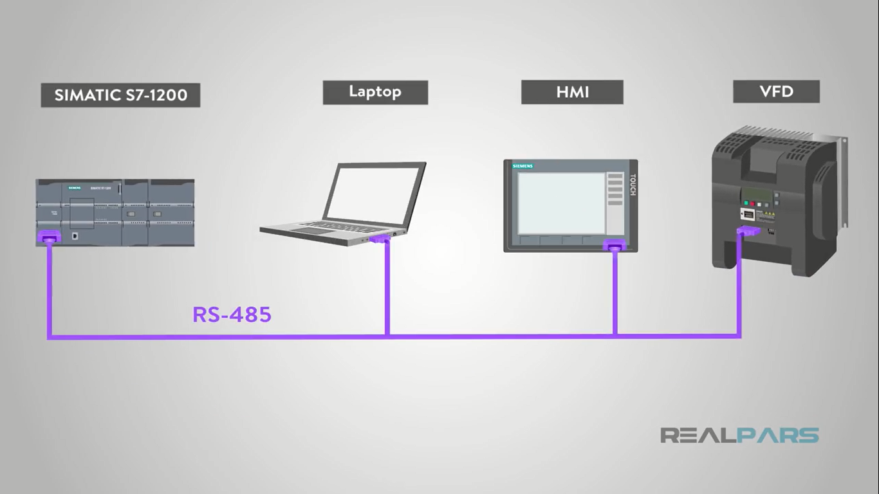
What made it such an advancement over RS232 was that it could transmit not only a single device to device transmission, but also a communicate bus to connect multiple device at once.

Slide 5
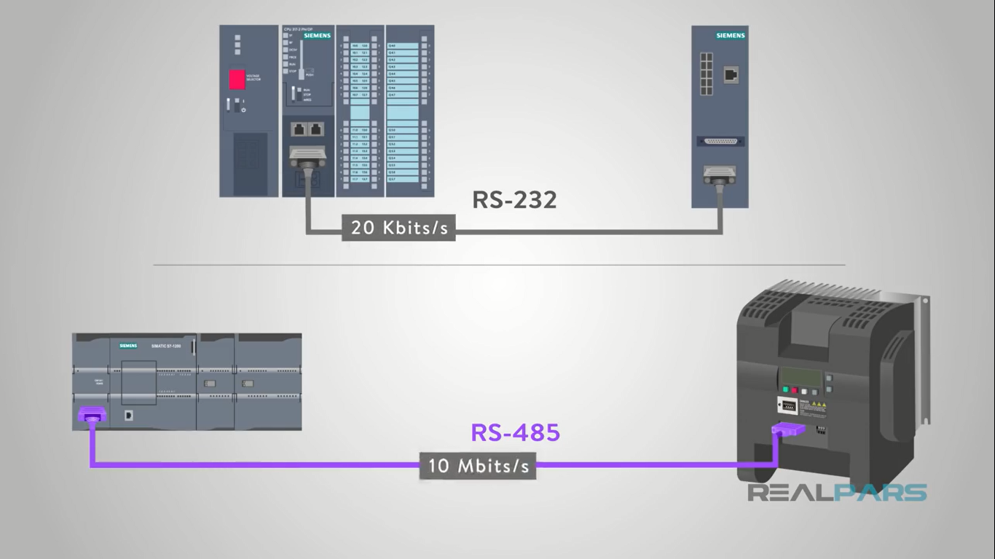
The configuration and specification of RS485 make it faster and extend the range of data transmission.

Slide 6
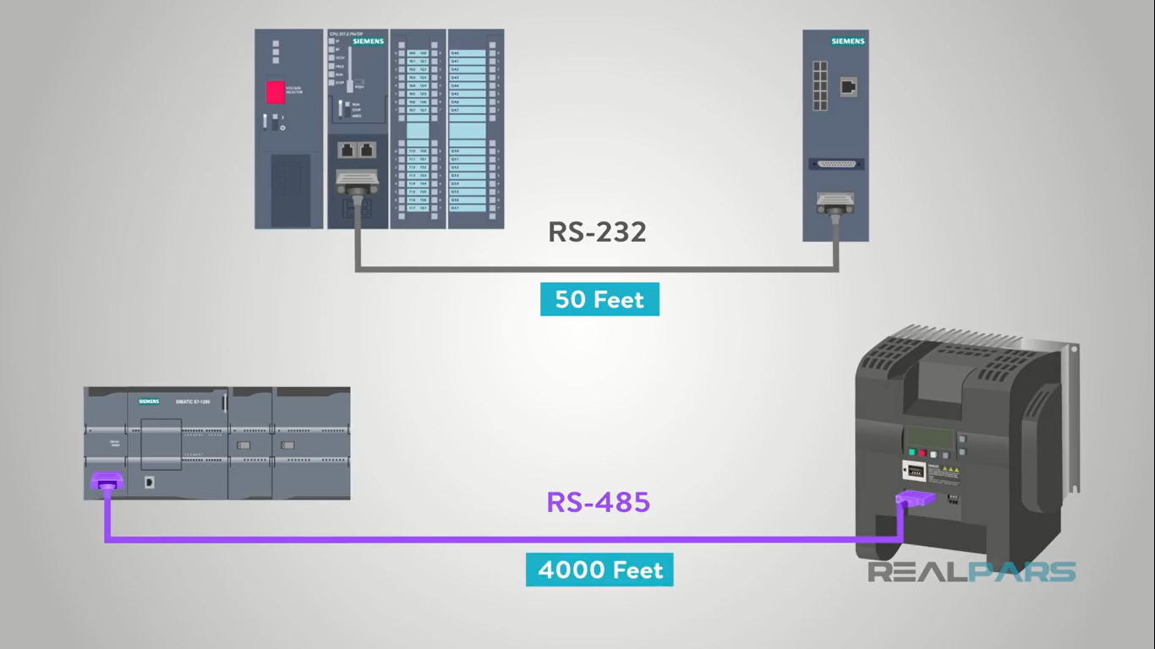
You aren’t limited to fifty feet of cable like with RS232 .The maximum cable length for RS485 is typically listed as 1200 meters or about 4000 feet

Slide 7
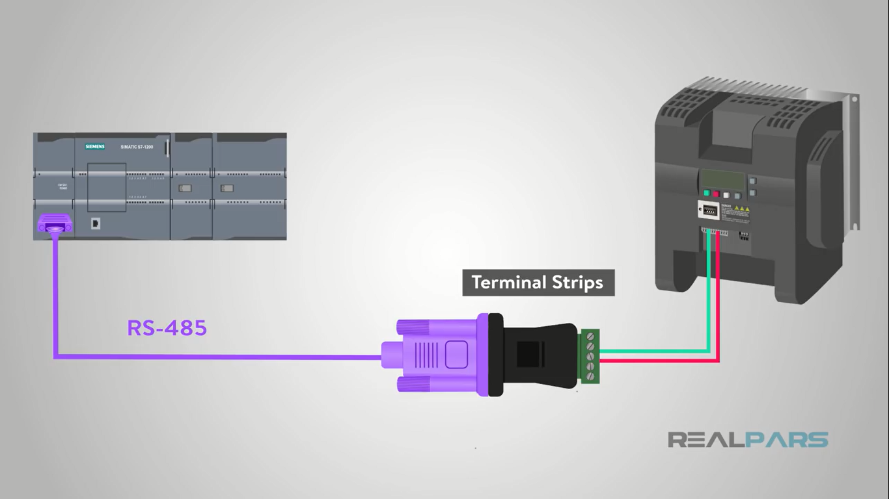
In some application, terminals strips were used in place of a connector. This helped RS485 become a widely used and very versatile from of serial communication.

Slide 8
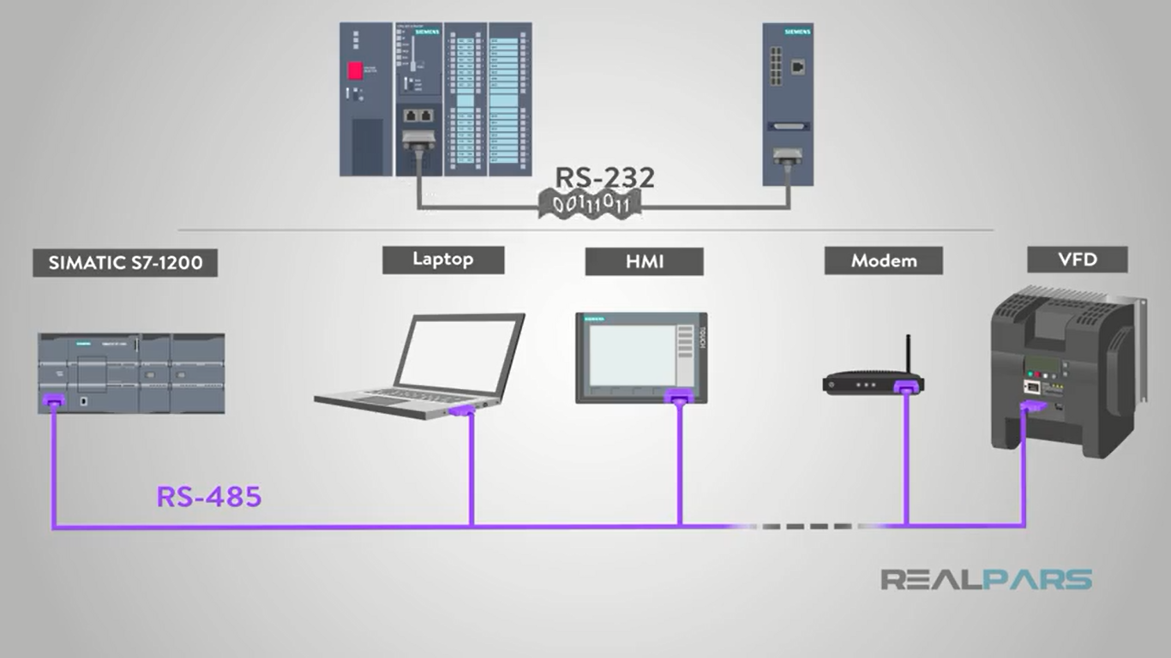
Another plus for RS485 is that it is less susceptible to noise issues. Electric noise can cause all kinds of problem for electronics. RS232 reference ground to decipher the data it was transmitting. This allowed for electrical noise to cause interference.
RS485 avoid this issue which also allows for shielding of cables to prevent noise.

Slide 9
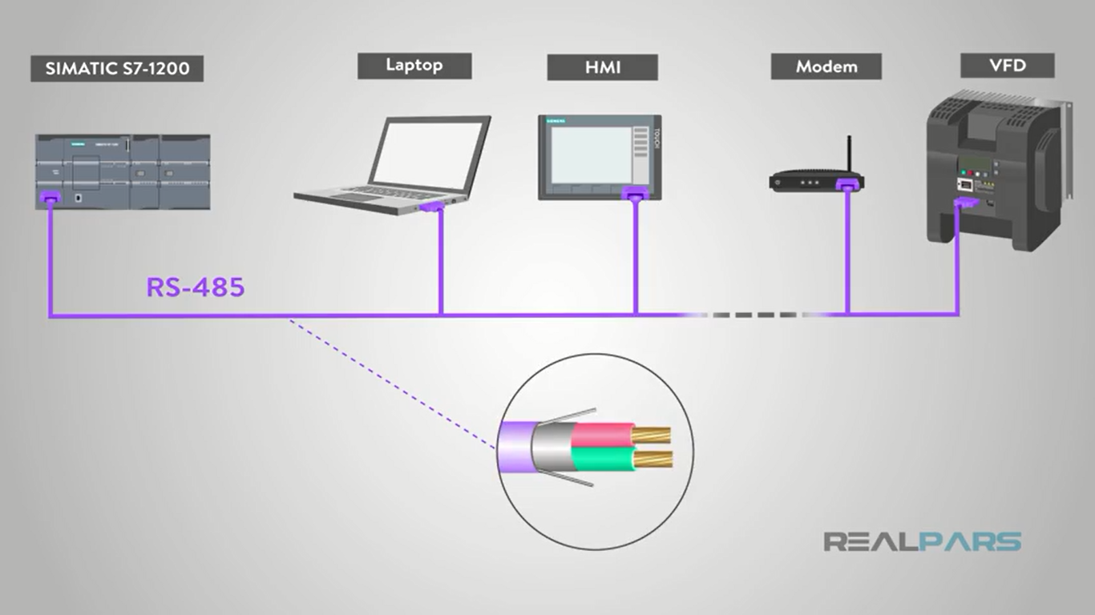

Slide 10
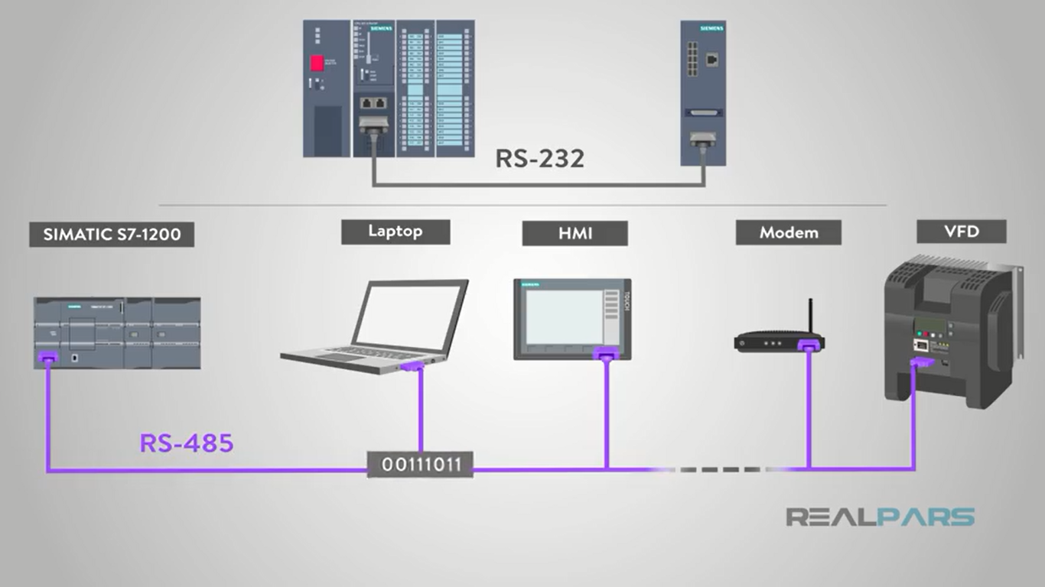

Slide 11
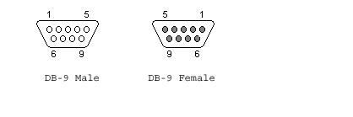
RS485 Pin Description DB9 CONNECTOR
The male sockets are used on the DTE (Data Terminal Equipment ) or PC side.
The female sockets are on the DCE (Data Communication Equipment ) or Modem Side.

Slide 12
PIN DESCRIPTION
Pin | SIG. | Signal Name
1 | GRD | Common Ground
2 | CTS+ | Clear To Send +
3 | RTS+ | Ready To Send +
4 | RXD+ | Received Data +
5 | RXD- | Received Data -
6 | CTS- | Clear To Send -
7 | RTS- | Request To Send -
8 | TXD+ | Transmitted Data +
9 | TXD- | Transmitted Data -

Slide 13
DIFFERENCE BETWEEN RS232 AND RS485
Specifications | RS232 | RS485
Mode of Operation | Single ended | Differential
No. of drivers and receivers | 1 driver, 1 receiver | 32 drivers, 32 receivers
Max. cable length | 50 ft | 4000 ft
Data rate | 20kb/s | 10Mb/s
Driver output voltage | +/-25V | -7V to +12V
Signal level(Loaded min) | +/-5V to +/-15V | +/-1.5 V
Signal level (Unloaded Max) | +/-25V | +/-6V
Driver load impedance | 3k to 7k | 54
Receiver input V range | +/-15V | -7 to +12V
Receiver input sensitivity | +/-3V | +/-200mV
Receiver input resistance | 3k to 7k | More than 12k

Slide 14
RS-485 network
RS-485 provides Half-Duplex, Multidrop communications over a single twisted pair cable.
The standard specifies up to 32 drivers and 32 receivers can share a multidrop network
Terminator resistors avoid reflected signal.
A RS-485 network can be constructed as either a balanced two-wire system or a four-wire system.

Slide 15
RS-485 network
If a RS-485 network is constructed as a two-wire system, all of the nodes have equal ranking.
A RS-485 network constructed as a four-wire system has one node designated as the master, and the remaining nodes are designated as slaves.
Communication in such a system is only between master and slaves and not between slaves.
RS232 many devices simply use text (ASCII) protocols, with RS485 most devices use the MODBUS protocol.

Slide 16
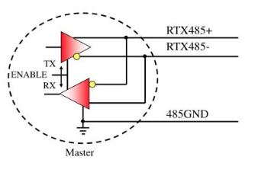
RS485 HALF DUPLEX
Datalogic uses Half-Duplex configurations for Data Collecting and Master/Slave layouts.

Slide 17
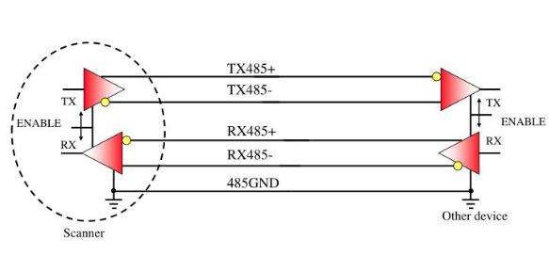
RS485 FULL DUPLEX
Potentially RS-485 interface can also use 4-wires to communicate in multidrop mode

Slide 18
Implementing RS485 in LabVIEW
LabVIEW provide build in VISA SERIAL PORT for serial communication.
VISA (Virtual instrumentation software architecture)
VISA is a standard I/O API for instrumentation programming.
VISA can control GPIB, serial, USB, Ethernet, PXI, or VXI instruments.
WRITE VISA PORT is used for writing data.
READ VISA PORT is used for reading data.
VISA PROPERTY NODE is used for counting how much byte is coming at read serial port pin.

Slide 19
Implementing RS485 in LabVIEW
STEPS
Right click on block diagram and select Visa configuration port.
Right click on block diagram and select read visa port, write visa port and close visa.
Connect Visa configuration port to visa property node.
Connect visa property node to write visa port.
Connect write visa port to read visa port.
Connect read visa port to close visa port.
Run VI.

Slide 20
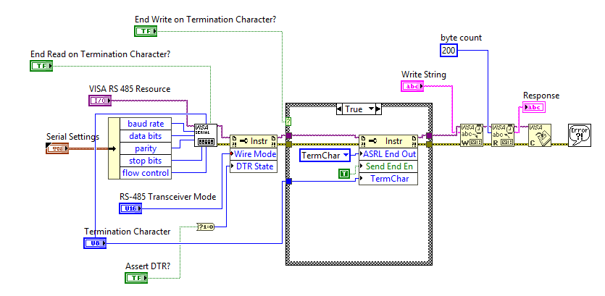
Implementing RS485 in LabVIEW

Slide 21
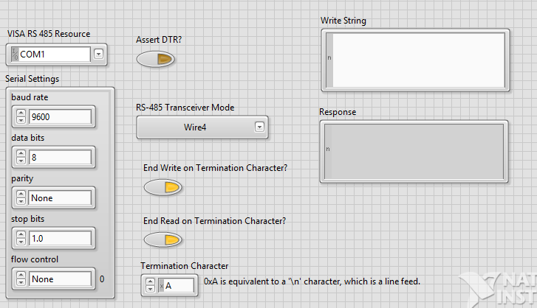
Implementing RS485 in LabVIEW

Slide 22
THANK YOU

