Slide 1
Virtual cursor
Using hand gestures…….
…..Python 3.7.8

Slide 2
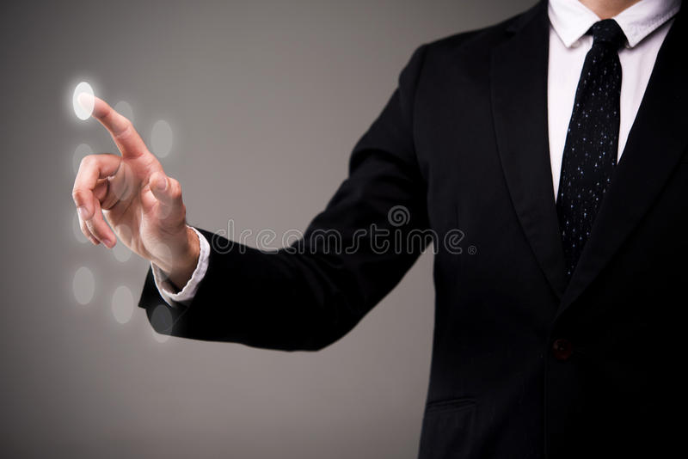
AI Virtual cursor

Slide 3

.

Slide 4
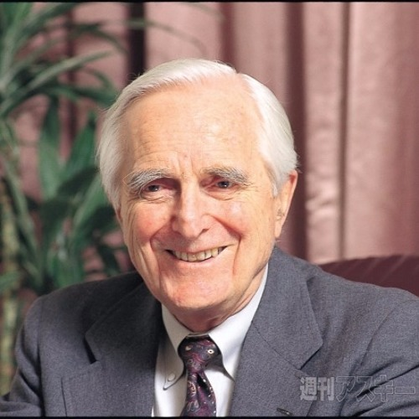
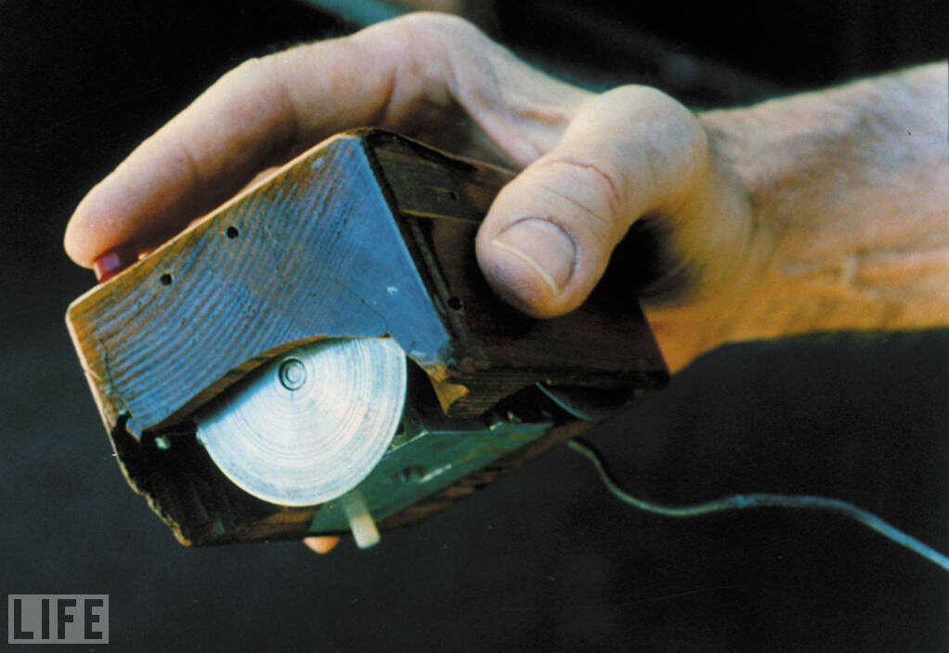

First invention of mouse

Slide 5
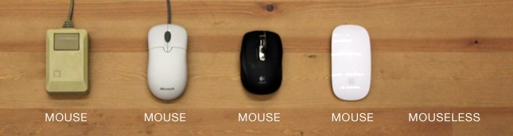
Types of mouse

Slide 6
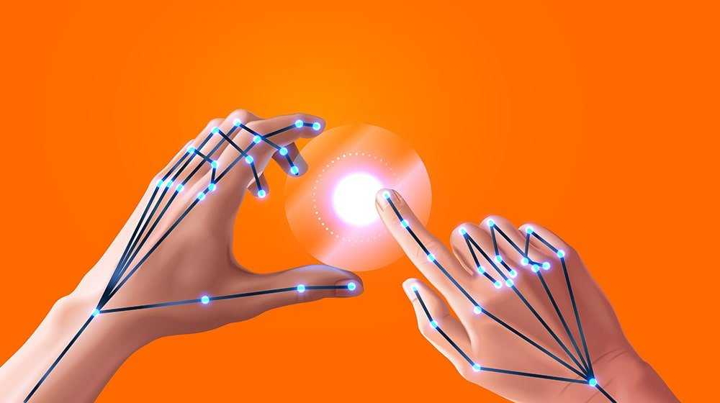
Virtual cursor

Slide 7
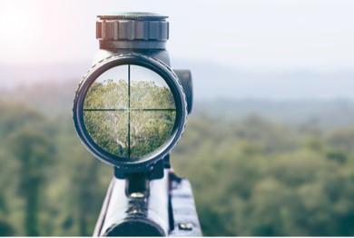

Objectives
.

Slide 8


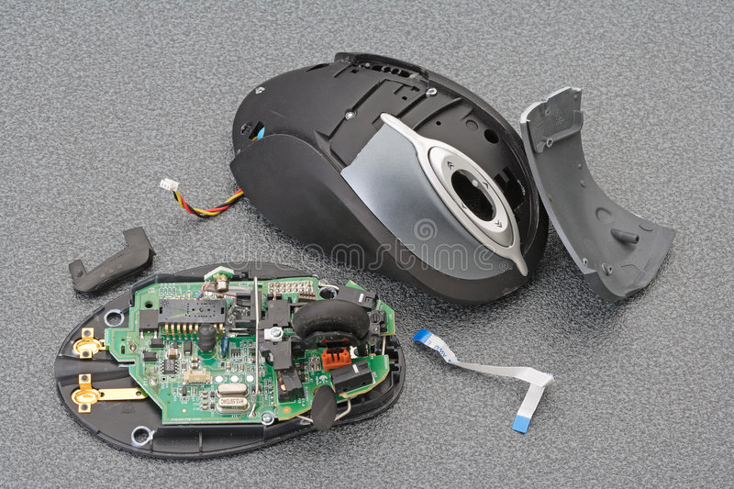
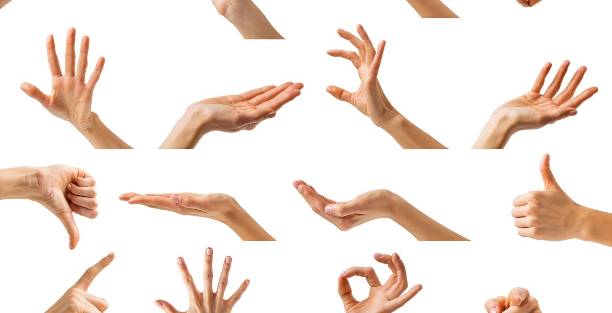
.

Slide 9

.
.

Slide 10
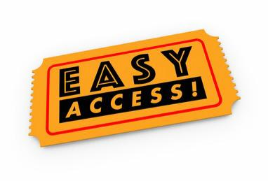

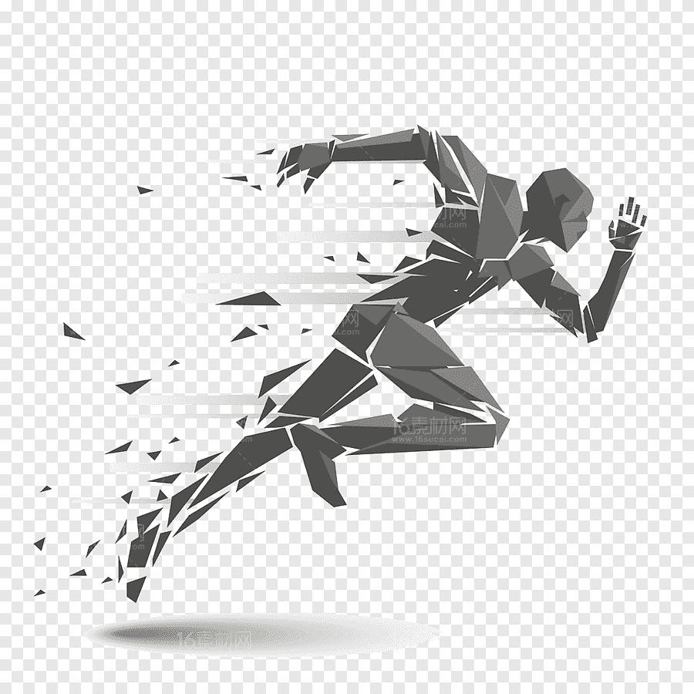
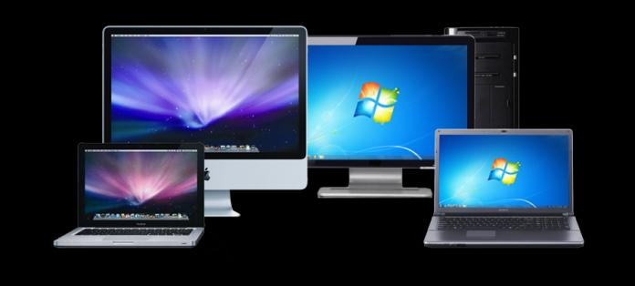

.

Slide 11

.

Slide 12
PROJECT ANALYSIS:
.

Slide 13
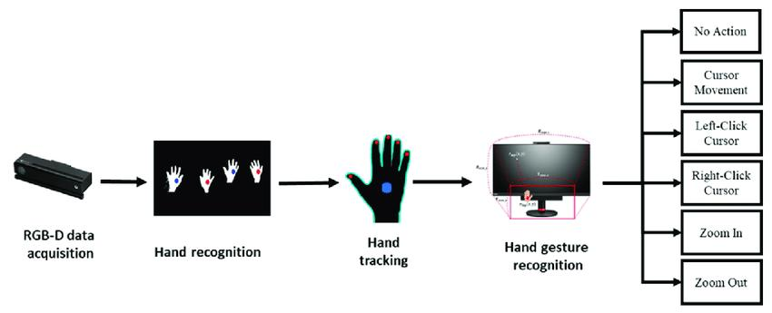
Existing Method:
.
Drawbacks:
-> It requires “RGB” color detection device..
-> To perform operations it requires color on Hand…

Slide 14
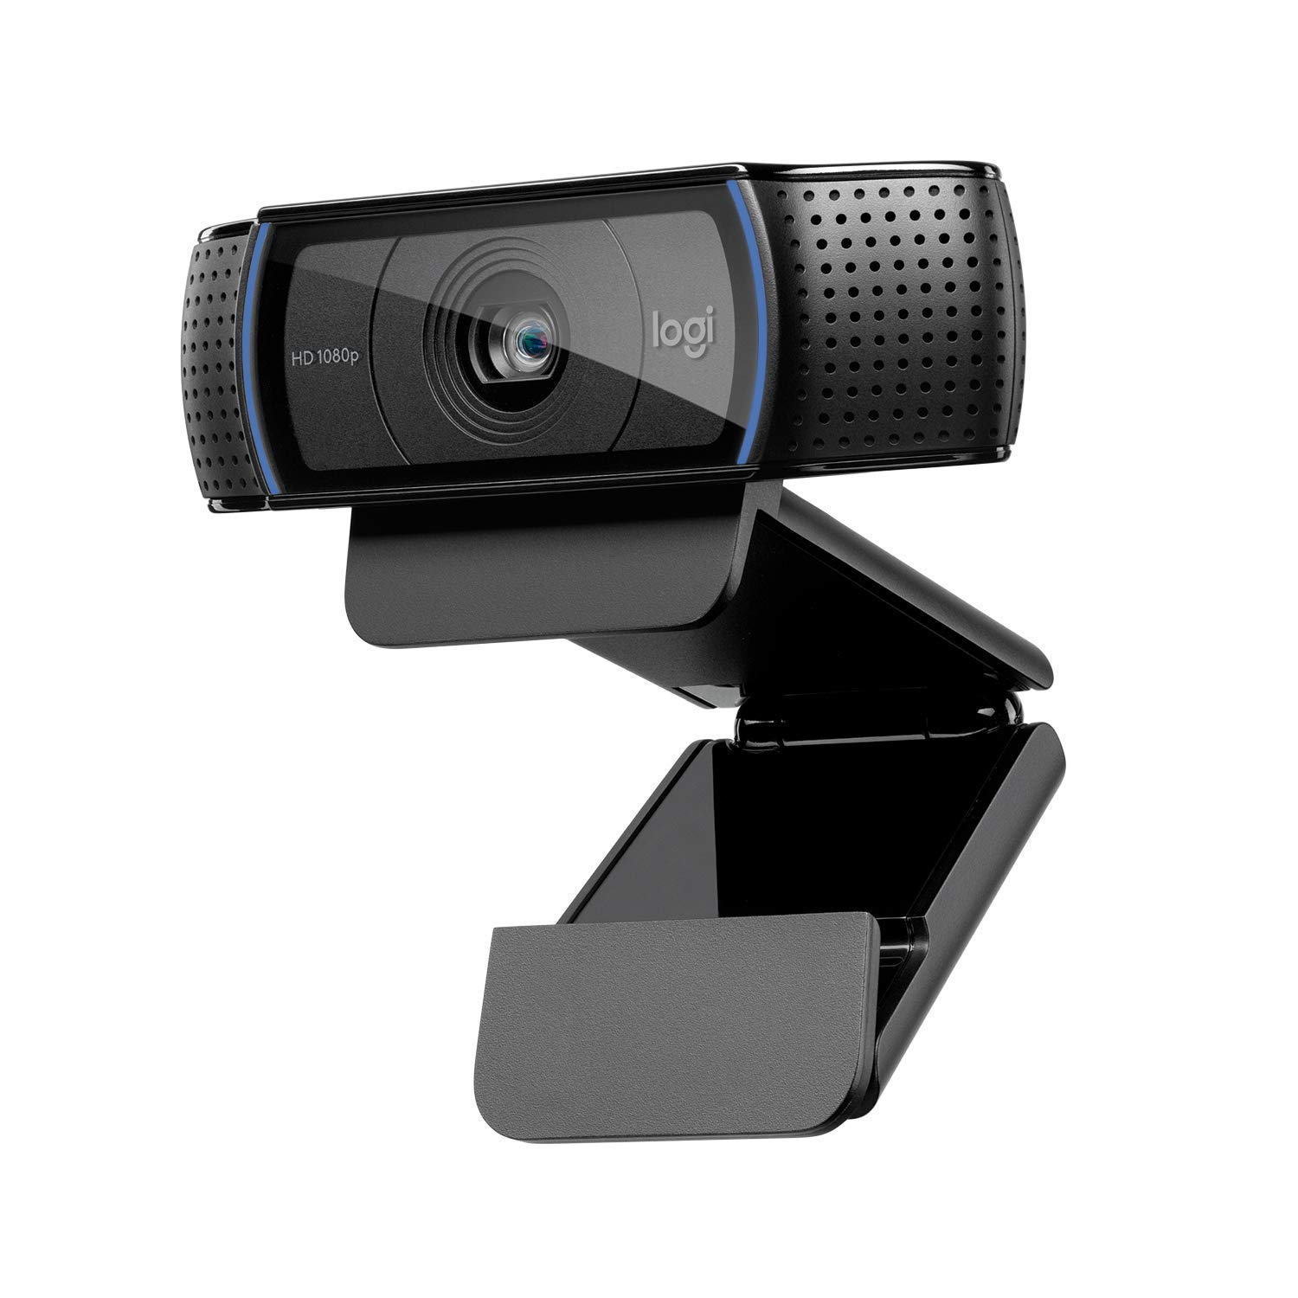
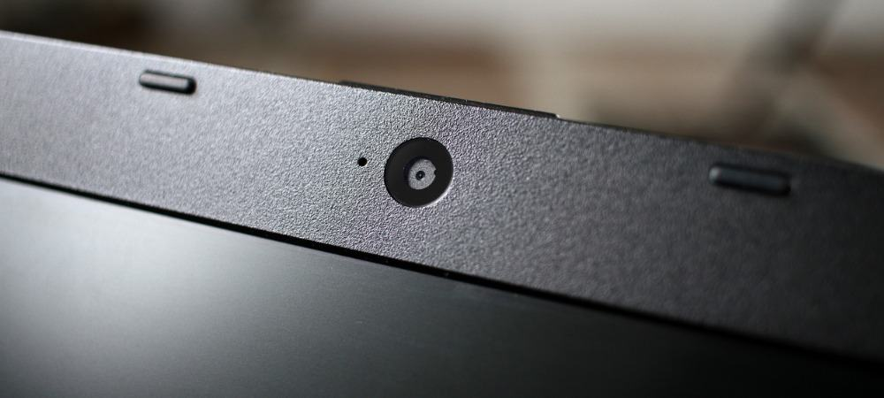
To Capture:

Slide 15
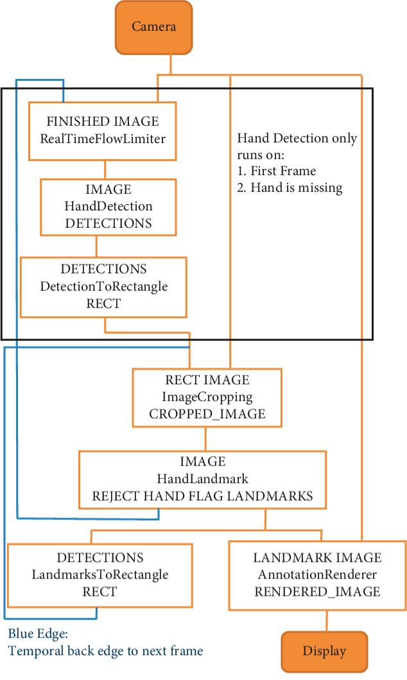
FLOWCHART
.

Slide 16
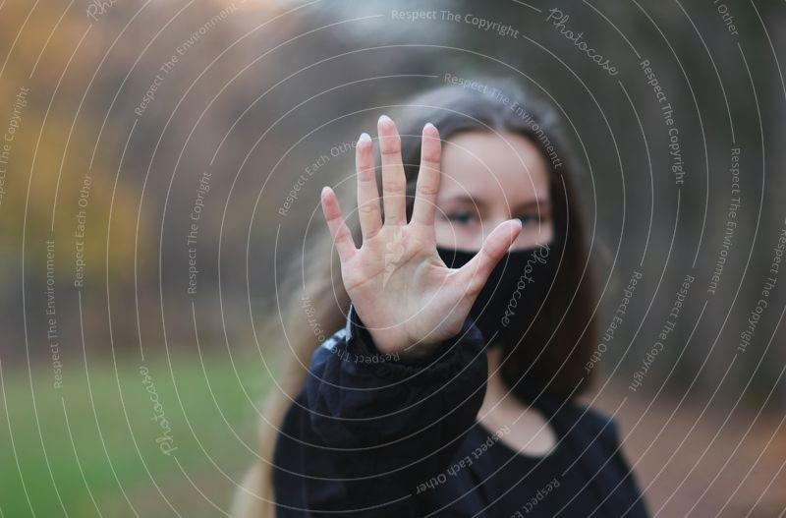

Slide 17
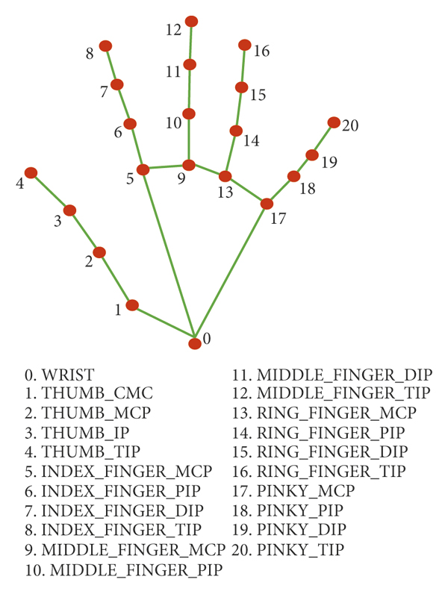
Hand virtual View

Slide 18
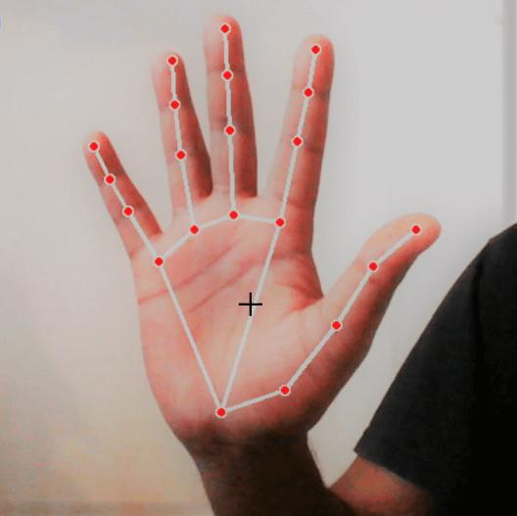

Slide 19
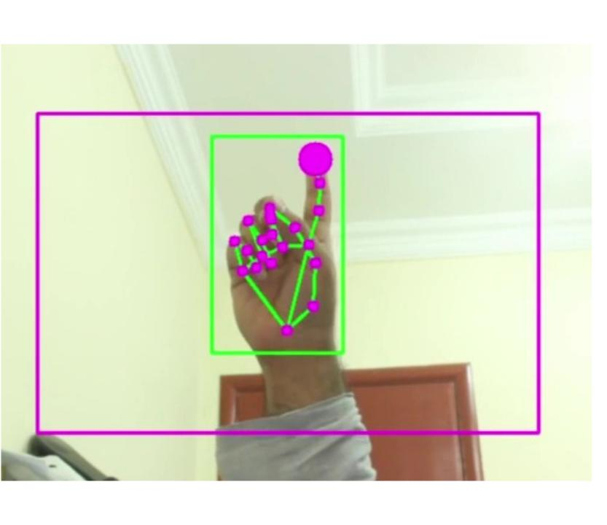
Gesture used to move the cursor

Slide 20
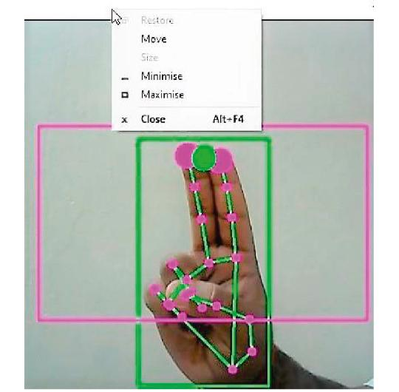
Clicking operation

Slide 21
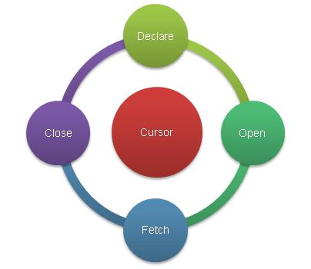
Project life cycle
Find
Fetch
Process
Executing

Slide 22
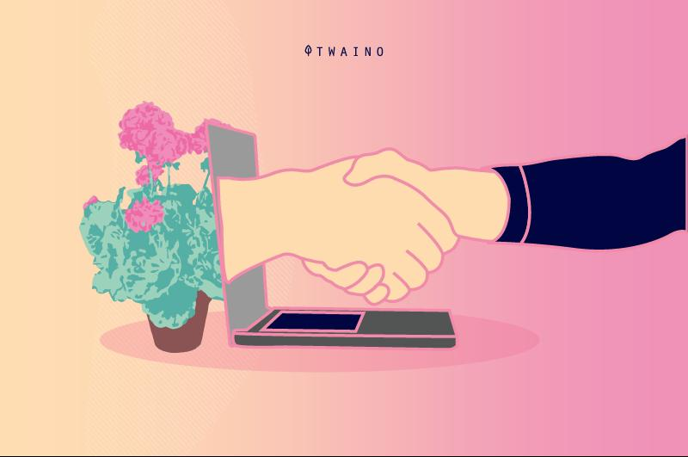

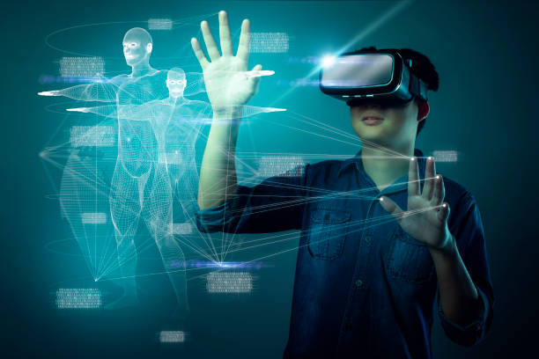
Advantages
User friendly
Easy to operate
Interacting with computer
No use of mouse
Creating virtual environment
Communicating with hand gesture
Mouse to virtual mouse

Slide 23
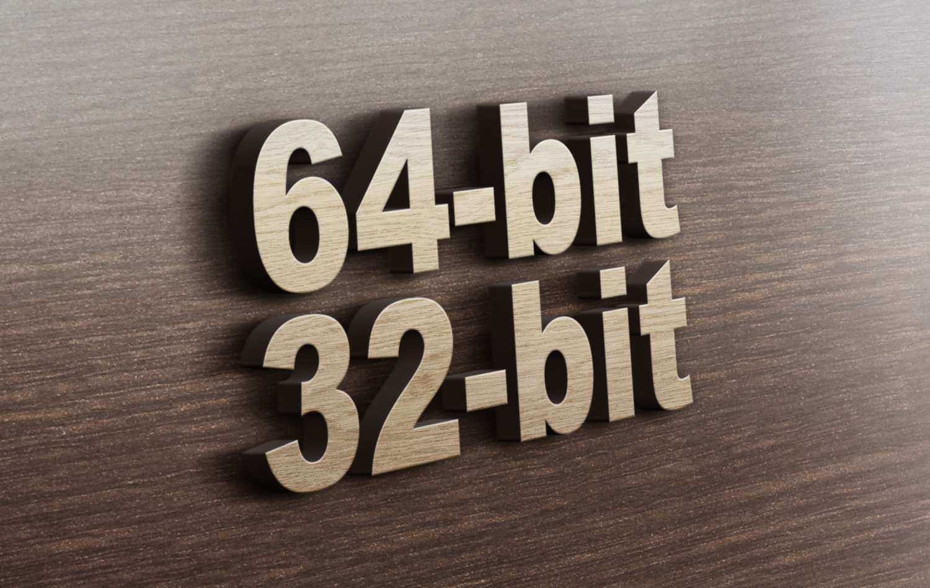
Runs in any system

Slide 24
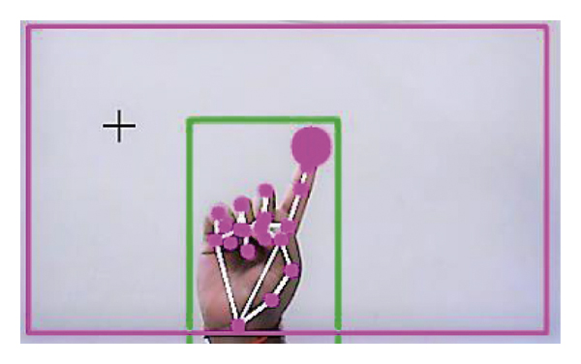
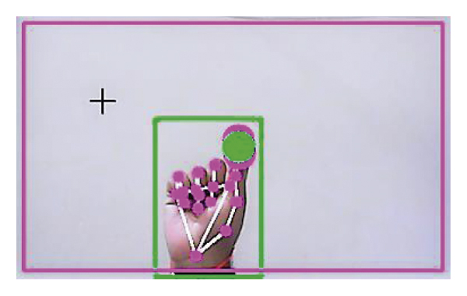
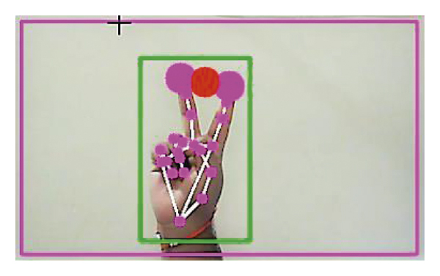
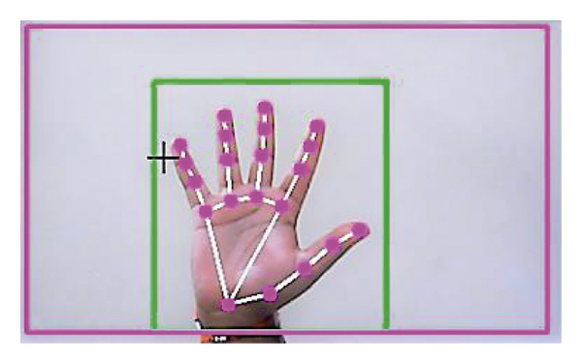
Snapshots
.

Slide 25
Conclusion:
The main objective of the AI mouse system is to control the cursor functions by using the hand gestures instead of using a physical mouse .

Slide 26
Presented by:
K. Charu Srithan.
D. vishnu vardhan.
A. Nivas Goud.
P. Durga Prasad.
L. Aravind Reddy
M. Pranava.
B. Sinduja.

Slide 27
Thank you…..
Any queries ?

