Slide 1
Inheritance
In Java

Slide 2
Inheritance
It is possible to acquire all the members of a class and use them in another class by relating the objects of the two classes.
Interview question:
What is inheritance?
Deriving new classes from existing classes such that the new classes acquire all the features of existing classes is called Inheritance

Slide 3
Let us take an example to understand the concept.
class Teacher{ //instance variables int id; String name; public int getId() { return id; } public void setId(int id) { this.id = id; } public String getName() { return name; } public void setName(String name) { this.name = name; } | public String getAddress() { return address; } public void setAddress(String address) { this.address = address; } public float getSal() { return sal; } public void setSal(float sal) { this.sal = sal; } String address; float sal; }

Slide 4
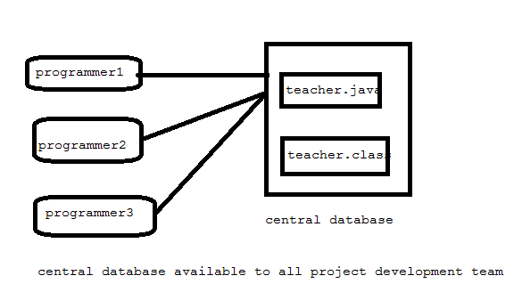
Save the above program Teacher.java and compile it and Teacher.class is generated.
These files are copied into the central database that is available to all the programmers in the project development team.
And other programmers also know this files are available.

Slide 5
Now another programmer wants to develop Student class but he is not considering the Teacher.class.
public class Student { int id; String name; String address; int marks; public int getId() { return id; } public void setId(int id) { this.id = id; } public String getName() { return name; } | public void setName(String name) { this.name = name; } public String getAddress() { return address; } public void setAddress(String address) { this.address = address; } public int getMarks() { return marks; } public void setMarks(int marks) { this.marks = marks; } }

Slide 6
package com.inheritance.in; class Student { int id; String name; String address; int marks; public int getId() { return id; } public void setId(int id) { this.id = id; } public String getName() { return name; } public void setName(String name) { this.name = name; } public String getAddress() { return address; } public void setAddress(String address) { this.address = address; } public int getMarks() { return marks; } | public void setMarks(int marks) { this.marks = marks; } } public class Use1 { public static void main(String[] args) { // TODO Auto-generated method stub Student s = new Student(); s.setId(1001); s.setName("Ravi chandra"); s.setAddress("Jalluru village"); s.setMarks(800); // retrive data System.out.println("Id "+s.getId()); System.out.println("Name "+s.getName() ); System.out.println("Address "+s.getAddress() ); System.out.println("Marks "+s.getMarks() ); } }

Slide 7
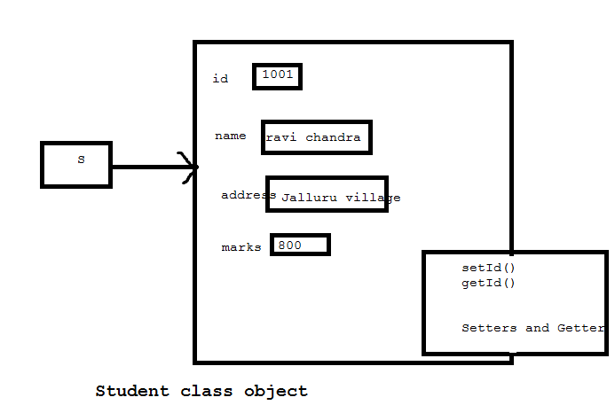
In this program an object to student class is created by JVM, as shown below.

Slide 8
Just compare the teacher class and student class. You can find the similarities in the both the classes.
While developing the student class, if a programmer decides to reuse the Teacher class code, then developing the student class would be easier.
Lets us write the student class once again.
For this purpose we use the keyword “extends”
The above statement means all the members of Teacher class are available to Student class.

Slide 9
Class sub class extends superclass
When Student s = new Student();
When an object to student class is created, it contains the copy of the Teacher class within it.
This means there is a relation between teacher class and student class.
*** Remember we don’t create Teacher class object, but still a copy of it is available to student class object.

Slide 10
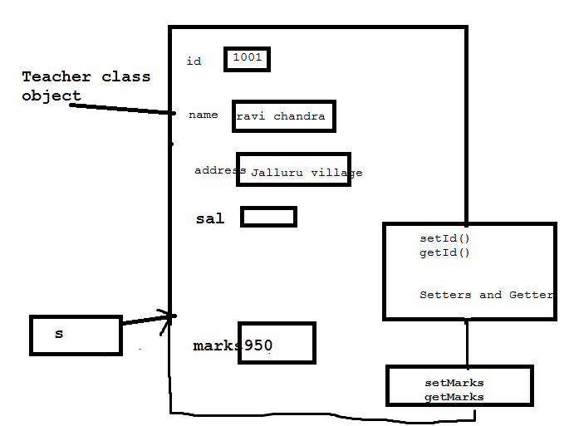
Student class object contains a copy of Teacher class

Slide 11
Interview questions
Why super class members are available to sub class?
Because the subclass object contains a copy of super class object.
What is the advantage of Inheritance?
In Inheritance, a programmer reuses the super class code with out rewriting it, in creation of subclass. So developing the classes becomes very easy. So programmer productivity increases.

Slide 12
Inhertitance
class One{
Int s=10;
void Simple(){
System.out.println("Super class method: i="+i);
}
}
class Two extends One
{
int i=20;
void show(){
System.out.println("Sub class method: i="+i);
}
}
public class Super1 {
public static void main(String[] args) {
// TODO Auto-generated method stub
Two t = new Two();
t.show();
t.simple();
}
}

Slide 13
The keyword ‘super’
If we create a object to super class, we can access only the super class member, but not the sub class members.
But if we create sub class object, all the members of both super class and sub class is available.
This is the reason we always create an object to sub-class.
Some times the super class members and sub class member may have same names, In that case by default, sub class members are accessible.

Slide 14
Members of super class and sub class are same.
package com.inheritance.in;
class One{
int i=10;
void show(){
System.out.println("Super class method: i="+i);
}
}
class Two extends One
{
int i=20;
void show(){
System.out.println("Sub class method: i="+i);
}
}
public class Super1 {
public static void main(String[] args) {
// TODO Auto-generated method stub
Two t = new Two();
t.show();
}
}

Slide 15
In that case, how to access the super class members from sub class is question.
For this purpose ‘super’ keyword has been came into picture.
‘super’ refers to super class members from a sub class.
super.variable;
super.methods();
super()– can be used to refer to super class constructor
we no need to call the default constructor of the super class, as it is by default available to sub class,
Parameterized constructor
super(values)

Slide 16
Using super keyword
package com.inheritance.in;
class One{
int i=10;
void show(){
System.out.println("Super class method: i="+i);
}
}
class Two extends One
{
int i=20;
void show(){
System.out.println("Sub class method :i" +i);
// using super we are calling the super class method.
super.show();
//we can access super class variable.
System.out.println("super class variable: i="+super.i);
}
}
public class Super1 {
public static void main(String[] args) {
// TODO Auto-generated method stub
Two t = new Two();
t.show();
}
}

Slide 17
Super class constructor is available to sub class constructor.
package com.inheritance.in;
class One1{
One1(){
System.out.println("One");
}
}
class Two1 extends One1{
Two1()
{
System.out.println("Two");
}
}
public class Super2 {
public static void main(String[] args) {
// TODO Auto-generated method stub
Two1 t = new Two1();
}
}

Slide 18
Parameterized constructor (Always super class constructor should be first statement in sub class constructor)
package com.inheritance.in;
class One1{
// super class variable
int i;
// super class parameter construcor
One1(int i){
this.i=i;
}
}
class Two1 extends One1{
// sub class instance variable
int i;
Two1(int a, int b)
{ super(a);// calling super class construcor ad pass a;
i=b;// initialize sub class variable
}
// sub class method
void show()
{
System.out.println("Sub class i= "+i);
System.out.println("Super class i= "+super.i);
}
}
public class Super2 {
public static void main(String[] args) {
// TODO Auto-generated method stub
Two1 t = new Two1(11,22);
t.show();
}
}

Slide 19
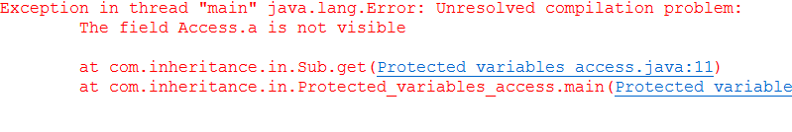
Private variables are not accessible in sub class
package com.inheritance.in;
class Access{
private int a;
protected int b;
}
class Sub extends Access{
public void get(){
System.out.println(a);
System.out.println(b);
}
}
public class Protected_variables_access {
public static void main(String[] args) {
// TODO Auto-generated method stub
Sub s = new Sub();
s.get();
}
}

Slide 20
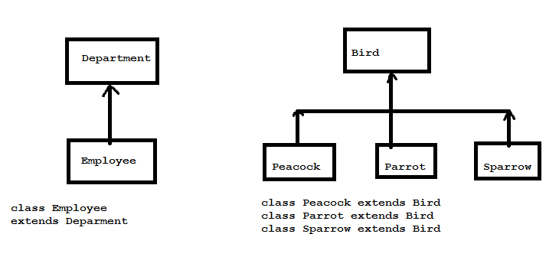
Types of Inheritance
Single Inheritance: producing sub classes from a single super class is called single inheritance.
In this, a single super class will be there. There can be one or more sub classes.

Slide 21
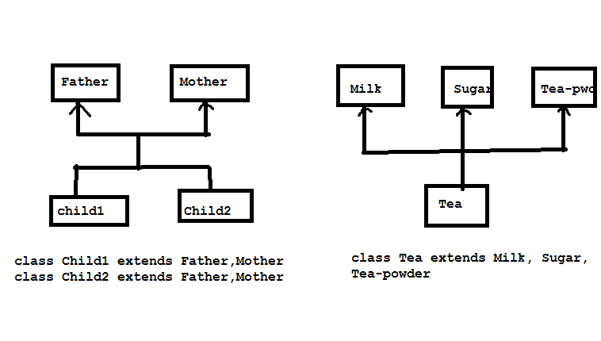
Multiple Inheritance
Producing subclass from multiple super classes is called Multiple inheritance.
There will be more than one super class and there can be one or more sub class.

Slide 22
Only Single Inheritance is available in java. There is no multiple inheritance in java.
The following are the reasons:
Multiple Inheritance leads to confusion for the programmer.
Ex Class A has got a member x
Class B has got a member x.
when another class C extend both the classes, then there is a confusion regarding which copy of x is available in C.

Slide 23
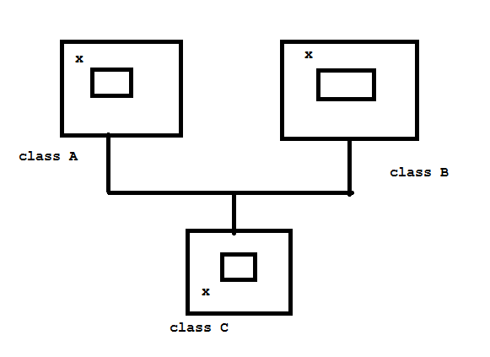
Which copy of x is in class c?

Slide 24
Multiple inheritance is available in C++ but not in java.
Fortunately Java people have provided interface concepts, expecting the programmers to achieve multiple inheritance by using multiple interfaces.
class Myclass implements interface1,interface2…
In this case, all the members of inteface1 and interface2 are accessible in Myclass. This is the way we can achieve multiple inheritance in a indirect way.
But this is lacking in real flexibility offered by multiple inheritance.
In case of interface, none of the methods will have method body. So programmers should provide the body for all the methods in the implementation class.
So multiple inheritance by using interface is not so useful.

Slide 25
The programmer feels achieving multiple inheritance by classes is more useful.
Indirect way is :
Class B extends A
Class C extends B
In first statement, copy of A is available in B, In the second statement copy of A plus B available to C.
But class C extends A,B--- invalid.

Slide 26
Interview questions
Why multiple inheritance is not available in java?
It leads to confusion for a java program.
The programmer can achieve multiple inheritance by using interfaces.
The programmer can achieve multiple inheritance by repeatedly using single inheritance.
How many types of inheritance are there?
There are two types single and Multiple. All other types are mere combinations of these two.
Java supports only single inheritance.

