Slide 1
Interfaces
In Java

Slide 2
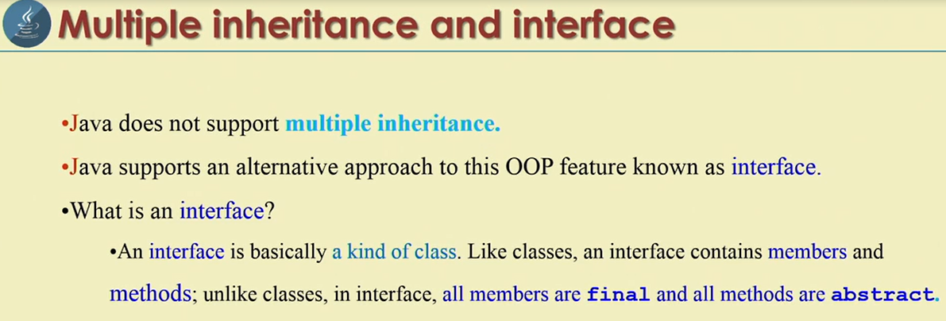
Interface

Slide 3
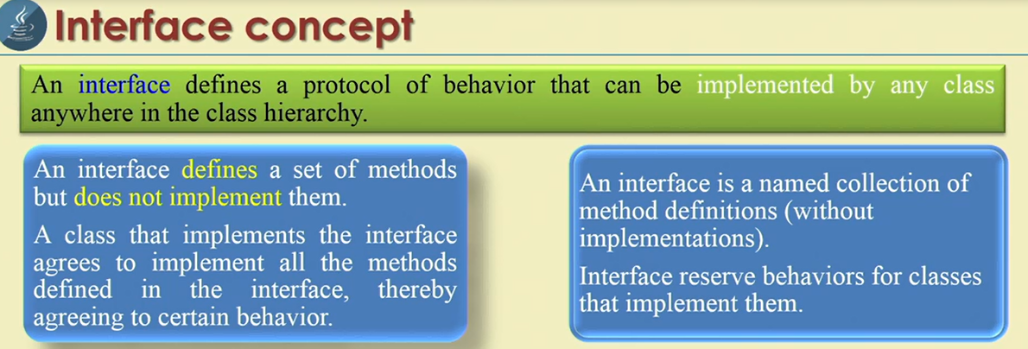
Methods declared in an interface are always public and abstract, then the java compiler will not complain if you omit both the keywords.
Static methods cannot be declared in the interfaces,-these methods never abstract and do not express behavior on objects

Slide 4
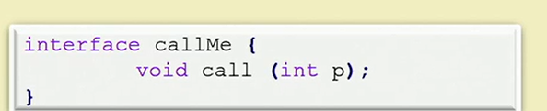
Basic concept of inheritance
Using keyword ‘interface’.
Interface syntactically similar to classes, but they lack instance variables and their methods are defined with out body.
Ex:

Slide 5
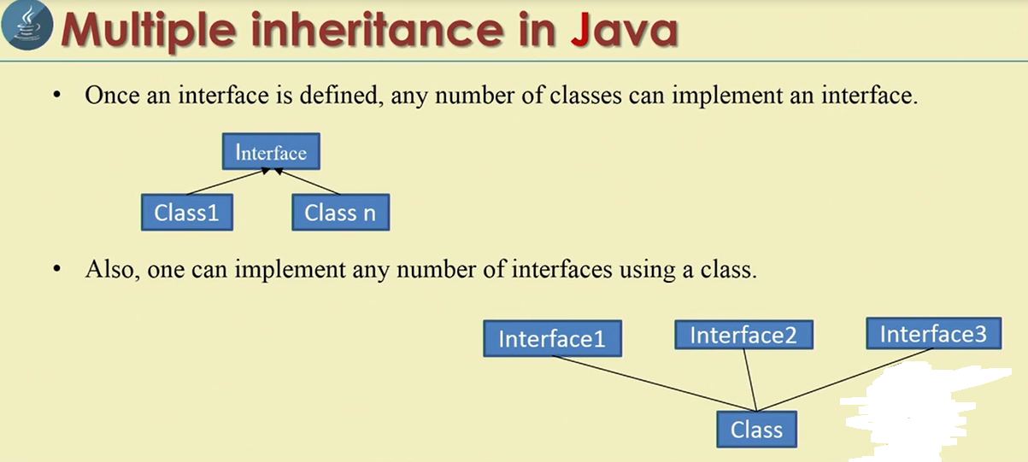

Slide 6
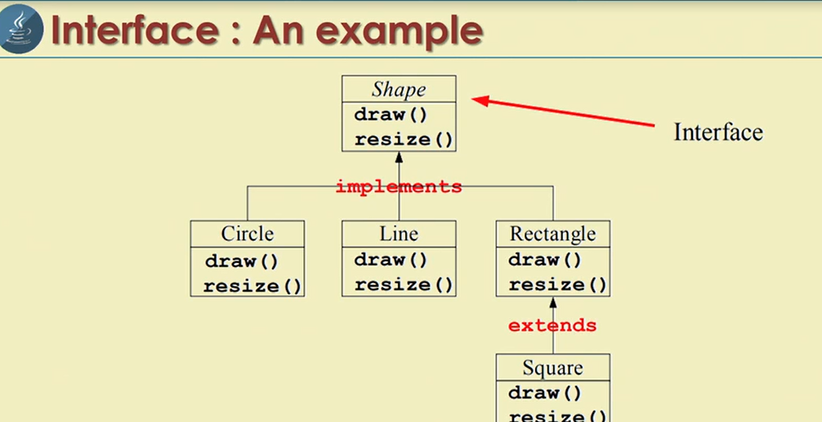

Slide 7
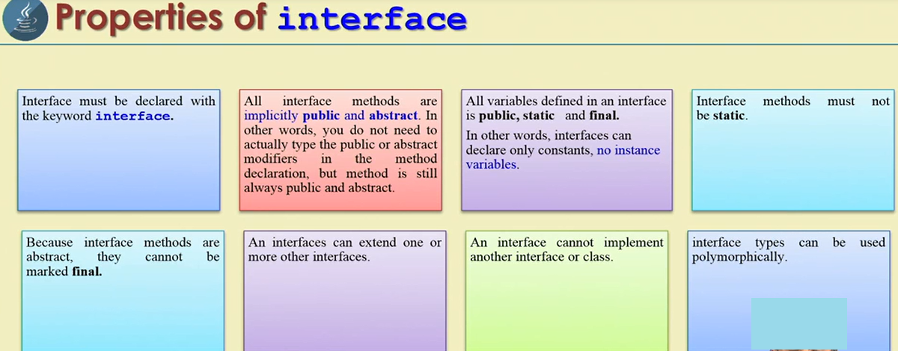

Slide 8
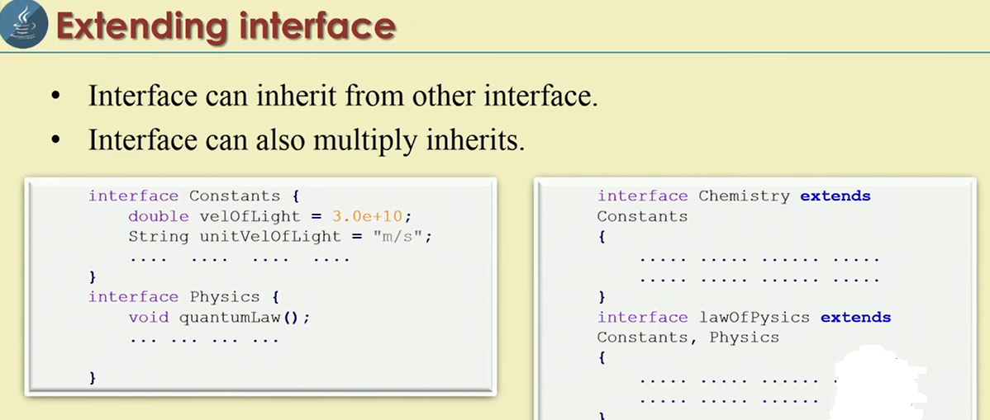

Slide 9
Interface examples program
package com.interfaceex.in;
interface RollNoDetails
{
void rollNo();
}
interface PersonDetails extends RollNoDetails {
void name();
}
public class Student implements PersonDetails {
public static void main(String[] args) {
// TODO Auto-generated method stub
RollNoDetails ref;
Student s = new Student();
ref=s;
System.out.print("Name: ");
s.name();
System.out.print("Roll No: ");
s.rollNo();
}
@Override
public void rollNo() {
// TODO Auto-generated method stub
System.out.println(153456);
}
@Override
public void name() {
// TODO Auto-generated method stub
System.out.println("Ravichandra");
}
}

Slide 10
Another interface extends multiple interfaces
package com.interfaceex.in;
interface RollNoDetails
{
void rollNo();
}
interface Address
{
void address();
}
interface PersonDetails extends RollNoDetails, Address{
void name();
}
public class Student implements PersonDetails {
public static void main(String[] args) {
// TODO Auto-generated method stub
RollNoDetails ref;
Student s = new Student();
ref=s;
System.out.print("Name: ");
s.name();
System.out.print("Roll No: ");
s.rollNo();
System.out.print("Adress: ");
s.address();
}
@Override
public void rollNo() {
// TODO Auto-generated method stub
System.out.println(123456);
}
@Override
public void name() {
// TODO Auto-generated method stub
System.out.println("Ravichandra");
}
@Override
public void address() {
// TODO Auto-generated method stub
System.out.println("Jalluru");
}
}

Slide 11
Multiple Inheritance
package com.interfaceex.in;
interface Father
{
float HT=6.2f;// public static final
void height();// public abstract
}
interface Mother
{
float HT=5.8f;// public static final
void height();// public abstract
}
// child
public class MultiInterface implements Father, Mother{
public static void main(String[] args) {
// TODO Auto-generated method stub
MultiInterface m = new MultiInterface();
m.height();
}
@Override
public void height() {
// TODO Auto-generated method stub
float ht=(Father.HT+Mother.HT)/2;
System.out.println("child height :" + ht);
}
}

Slide 12
Advantage of interface
Let us see how the interface is advantageous in software development.
A programmer asked to write a java program to connect to database and retrieve a data from database, process the data and display the results.
Class Myclass
{void connect();--- code connect to oracle DB
void disconnect(); }
This has the limitation. It can connect only Oracle data base.
Suppose if client is using any other database and this code doesn’t work. Then how to design a code in such a way that is used to connect any database in the world.

Slide 13
One way to write several classes., each to connect to a particular data base.
This takes a lot of time and effort.
Once we release our software into market if the version of data base is changes and again we need to rewrite our code.
Interface helps in solve this problem.
interface MyInter
{void connect();
void disconnect();}
Important Interview Questions
Interface methods are public since they should be available to third party vendors to provide implementation. They are abstract because the implementation is left for third party vendors.
Oracle company will implementation that is Driver class.

Slide 14
There are two more concerns :
Why third party vendors implementation
Profitable and purchases every one.
Second concern:
How the third party vendor knows which method to implement?
The third party vendor know from the API document(Application Programmable Interface).

Slide 15
Program through command line
package com.interfaceex.in;
interface MyInter
{
void connect();
void disconnect();
}
class OracleDB implements MyInter
{
public void connect()
{
System.out.println("Connecting to Oracle database");
}
public void disconnect()
{
System.out.println("Disconnecting from Oracle database");
}
}
class SybaseDB implements MyInter
{
public void connect()
{
System.out.println("Connecting to Sybase database");
}
public void disconnect()
{
System.out.println("Disconnecting from Sybase database");
}
}
public class InterfaceDemo {
public static void main(String args[]) throws Exception {
// Accept the implementation classname from command line arguments
// and store in object c.
Class c= Class.forName(args[0]);
// create an object to the class whose name is in c.
// let the reference variable of interface point to it.
MyInter mi = (MyInter)c.newInstance();
// call methods of the object using mi.
mi.connect();
mi.disconnect();
}
}

Slide 16
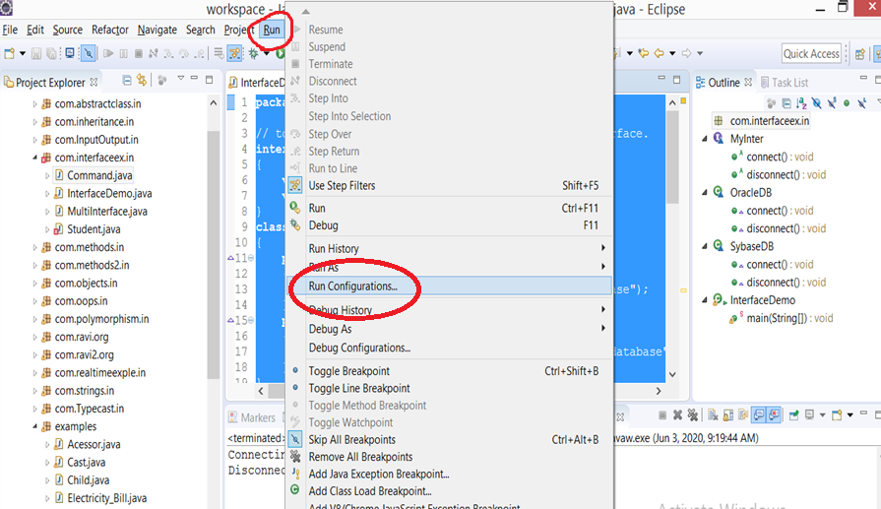
How to use command line arguments

Slide 17
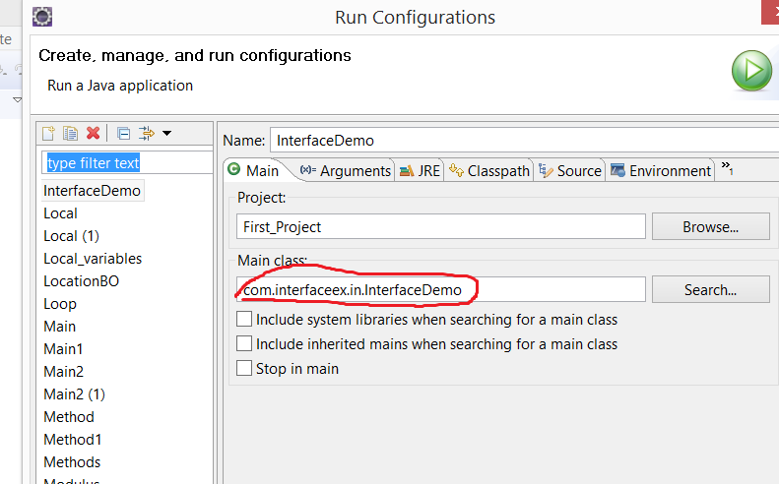

Slide 18
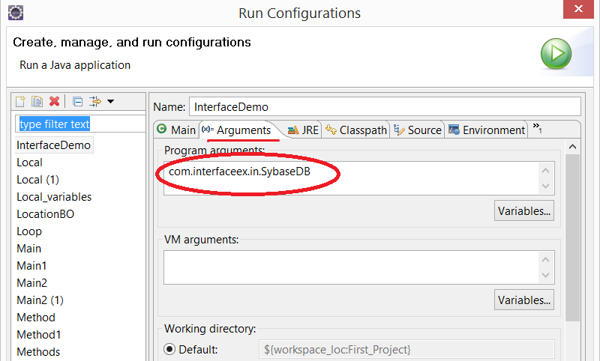

Slide 19
Summarize points on interface
An interface is a specification of method prototypes. This means only method names are written in the interface with out bodies,
An interface will have 0 or more abstract methods which are public and abstract by default.
An interface can have variables which are public static and final by default. This means all variables are constants.
None of the methods in interface can be private, protected or static.
We cannot create an object to interface, but we can create a reference of interface type.
All the methods of an interface should be implemented in its implementation classes. If any method is not implemented, then that implementation class should be declared as ‘abstract’.
Interface can refer to the objects of implementation classes.
When an interface is written, any third party vendor can provide implementation classes to it.
An interface can extend another interface.
An interface cannot implement another interface.
It is possible to write a class with in a interface.
Interface forces the implementation classes to implements all of its methods compulsory. Java compiler checks whether all the methods are implemented in implementation classes or not.

Slide 20
There is a responsibility for the programmer to provide the sub classes whenever he writes an abstract class.
This means same development team should provide the sub classes for abstract class.
But if interface is written, any third party vendor will take the responsibility of providing the implementation class.
This means, the programmer prefers to write an interface when he wants to leave the implementation part to the third party vendor.

Slide 21
In case of interface, every time a method is called, JVM should search for the method in the implementation classes which are elsewhere in the system and then execute the method. This take more time.
But when an abstract class is written, since common methods are defined within the abstract class and the sub classes are generally in the same place along with the software, JVM will not have that much overhead to execute a method. Hence interfaces are slow compared to abstract class.

Slide 22
Difference between interface and abstract class
Abstract class | Interface
An abstract class is written when there are some common features shared by all the objects | An interface is written when all the features are implemented differently in different objects
When an abstract class is written, it is the duty of the programmer to provide sub classes to it. | An interface is written when the programmer want to leave the implementation to the third party vendors
An abstract class contains some abstract methods and concrete methods. | An interface contains only abstract methods
An abstract class contains instance variables | An interface cannot contains instance variables it contains only constants.
All the abstract methods of the abstract class should be implemented in its sub classes | All the abstract methods of the interface should be implemented in its implementation classes
Used to declared by using the ‘abstract’ keyword. | Used to declared by using the ‘interface’ keyword.

