Slide 1
Methods-2
In java

Slide 2
Passing primitive data types to methods
Primitive data types represents single entity or single value.
Ex char,byte,short,int,float etc.
They are passed to methods by value.
Means when we pass primitive data types to methods, a copy of those will be passed to methods.
Therefore, any changes made to them inside the method will not affect them outside the method.

Slide 3
Pass by value or call by value
package com.methods2.in;
class Check
{
void swap(int num1, int num2)
{
int temp;
temp= num1;
num1= num2;
num2=temp;
}
}
public class PassByValue {
public static void main(String[] args) {
// TODO Auto-generated method stub
// primitive data types
int num1=10,num2=20;
Check c = new Check();
// display before swap;
System.out.println(num1 + "\t"+num2);
//calling swap.
c.swap(num1, num2);
// display after swap
System.out.println(num1 + "\t"+num2);
c.swap(num1, num2);
//
}
}

Slide 4
Passing objects to methods
We can also pass class objects to methods and return objects from the methods.
Empolyee myMethod(Employee obj)
{ statements;
return obj; }
Even objects are also passed to methods by value . This means we send object to a method, bit by bit copy will be sent to the method.
Any modification to the object inside the method will not affect the original copy outside the method.

Slide 5
Pass object to method
package com.methods2.in;
class Employee{
// instance variable
int id;
//
Employee(int id)
{
this.id=id;
}
}
class Check1{
// to interchange Employee class objects
void swap(Employee e1, Employee e2)
{
Employee temp;// take a temporary reference
temp = e1;
e1=e2;
e2=temp;
}
}
public class PassObjects {
public static void main(String[] args) {
// TODO Auto-generated method stub
Employee e1 = new Employee(10);
Employee e2 = new Employee(20);
//create Check class object
Check1 ch = new Check1();
// display before calling swap method
System.out.println(e1.id + "\t"+e2.id);
//calling swap and pass Employee class objects.
ch.swap(e1, e2);
// After swapping
System.out.println(e1.id + "\t"+e2.id);
}
}

Slide 6
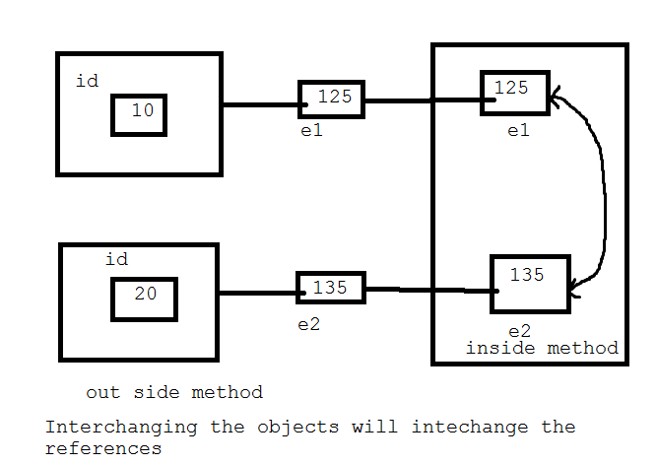
Passing objects to methods

Slide 7
Interview questions
How are objects passed to methods in java?
Primitive data types, objects, even object reference- everything is passed to methods using pass by value or call by value. This means their bit by bit copy is passed to the methods.
So how to interchange the id values of Employee class objects by using swap method?
Only possible solution is to use one object and take two variables id1 and id2, and interchange values in objects.

Slide 8
Using single object
package com.methods2.in;
class Employee1{
// instance variable
int id1,id2;
//
Employee1(int id1, int id2)
{
this.id1=id1;
this.id2=id2;
}
}
class Check2{
// to interchange Employee class objects
void swap(Employee1 e1)
{
int temp;// take a temporary reference
temp = e1.id1;
e1.id1=e1.id2;
e1.id2=temp;
}
}
public class PassObject_by_One {
public static void main(String[] args) {
// TODO Auto-generated method stub
Employee1 e1 = new Employee1(10,20);
Check2 ch = new Check2();
// display before calling swap method
System.out.println(e1.id1 + "\t"+e1.id2);
//calling swap and pass Employee class objects.
ch.swap(e1);
// After swapping
System.out.println(e1.id1 + "\t"+e1.id2);
}
}

Slide 9
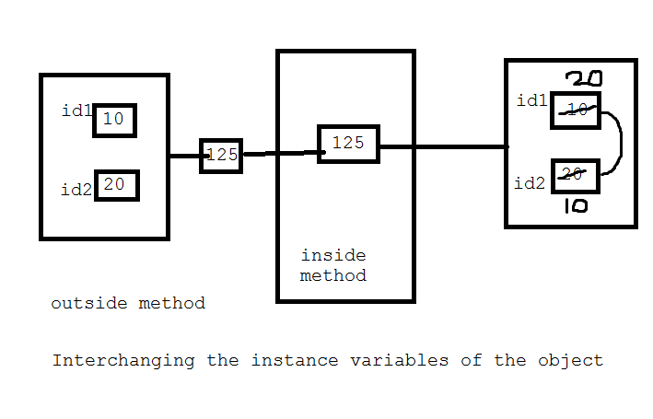
Using single object

Slide 10
For private variables using single object using set and get methods
package com.methods2.in;
class Employee1{
// instance variable
private int id1,id2;
public int getId1() {
return id1;
}
public void setId1(int id1) {
this.id1 = id1;
}
public int getId2() {
return id2;
}
public void setId2(int id2) {
this.id2 = id2;
}
//
//Employee1(int id1, int id2)
//{
//this.id1=id1;
//this.id2=id2;
//}
void swap(Employee1 e1)
{
int temp;// take a temporary reference
temp = e1.id1;
e1.id1=e1.id2;
e1.id2=temp;
}
}
public class PassObject_by_One {
public static void main(String[] args) {
// TODO Auto-generated method stub
Employee1 e1 = new Employee1();
e1.setId1(10);
e1.setId2(20);
//Check2 ch = new Check2();
// display before calling swap method
System.out.println(e1.getId1() + "\t"+e1.getId2());
//calling swap and pass Employee class objects.
e1.swap(e1);
// After swapping
System.out.println(e1.getId1() + "\t"+e1.getId2());
}
}

Slide 11
Factory Methods
Factory Methods are static methods only.
But intention is to create object depending on the user choice.
Precisely, a factory methods is a method that returns an object to the class, to which to belongs.
Ex. getNumberInstance() is a factory method.
Why? Because it ibelongs NumberFormat class and returns an object to NumberFormat class.

Slide 12
At the time of creating objects, if user has several types of options to be passed to the object, then several overloaded constructors should be written in the class.
For ex:
There are 10 different types of values to be passed, then 10 constructors are needed to accept those 10 types of options.
This can be eliminated by using factory methods.

Slide 13
Interview questions
What are factory methods?
A factory method is a method that creates and return object to the class to which it belongs.
A single method replaces several constructors in the class by accepting different options from the user, while object is created.

Slide 14
Program to area of circle
package com.methods2.in;
import java.util.*;
public class Area_circle {
public static void main(String[] args) {
// TODO Auto-generated method stub
final double PI=(double)22/7;
double r = 15.5; // radius
double area = PI*r*r;
System.out.println("Area :"+area);
System.out.printf("%7.2f", area);
}
}

Slide 15
Using NumberFormat class
package com.methods2.in;
import java.text.*;
public class Area_Circle_Factory {
public static void main(String[] args) {
// TODO Auto-generated method stub
final double PI=(double)22/7;
double r = 15.5; // radius
double area = PI*r*r;
System.out.println("Area :"+area);
// create Number Format class object
NumberFormat obj = NumberFormat.getNumberInstance();
obj.setMaximumFractionDigits(2);
obj.setMinimumIntegerDigits(7);
// Apply the format to are value.
String str = obj.format(area);
// display formatted area value
System.out.println("Formatted area ="+str);
}
}

Slide 16
Also observe using the getNumberInstance() method to create an object using default method.
There is another way of using getNumberInstance() method as :
getNumberInstance(Locale constant);
Here parameters represents a constant that represents the name of the country. Locale.CANADA, Locale.INDIA, Locale.UK etc.
For Ex: to format a number according to the numerical format of United States:
NumberFormat obj = NumberFormat.getNumberInstance(Locale.US)

Slide 17
IN the place of getNumberInstance() method, if constructor are provided in the NumberFormat class, they should be created.. Several. It looks awkward and is avoided by using the factory method.
We can consider factory methods as alternative way to create objects, other than new operators.
https://docs.oracle.com/javase/8/docs/api/java/text/NumberFormat.html

Slide 18
Interview question
In how many ways to create an object in java?
There are 4 ways
1)Using new operator:
Employee obj= new Employee();
Here, we are creating Employee class object ‘obj’ using new operator
2)Using factory methods:
NumberFormat obj = NumberFormat.getNumberInstance();
Here we are creating NumberFormat object using the factory method.

Slide 19
3)Using newInstance() method, here two steps required:
a)First store the class name “Employee” as a String into an object. For this purpose, Factory method forName() of the class “Class” will be useful
Class c = Class.forName(“Employee”);
We should note that there is a class with the “Class” in java.lang package.
b) Next create another object to the class whose name is in the object c. For this purpose, we need newInstance() method of the ‘Class’ as:
Employee obj = (Employee)c.newInstance();
4)By cloning an already available object, we can create another object. Creating exact copy of an existing object is called “cloning”.
Employee obj1 = new Employee();
Employee obj2 = (Employee)obj1.clone();
Earlier we created obj2 by cloning the Employee object.clone() method of Object class is used to clone an object.
We should note that there is a class by name “Object” in java.lang pacakage

Slide 20
Creating our own factory methods
Any factory method is created as method belonging to an interface or abstract class.
Hence that method is implemented in the sub classes.
We will create a factory method for getFees() for the Engineering class.
showFees() is a abstract method.

Slide 21
Own Factory Method
package com.methods2.in;
import java.util.*;
// an interface with an abstract method
interface Fees
{
double showFees();// this method does not have body
}
//implementation class
class CSE implements Fees
{
public double showFees()
{
return 60000.00;
}
}
class ECE implements Fees{
public double showFees()
{
return 55000.00;
}
}
// creating factory method
class CourseFees
{
public static Fees getFees(String course)
{
if(course.equalsIgnoreCase("CSE"))
return new CSE();
else if(course.equalsIgnoreCase("ECE"))
return new ECE();
else
return null;
}
}
//using the Factory method
public class FactoryMethod_Fees {
public static void main(String[] args) {
// TODO Auto-generated method stub
Scanner sc = new Scanner(System.in);
System.out.println("Enter the course name");
String course = sc.next();
Fees f =CourseFees.getFees((course));
System.out.println("The Fees is Rs "+f.showFees());
}
}

Slide 22
Methods with variable Arguments
Suppose , we write a method in the form of
int sum(int a , int b)
int sum(int a, int b, int c)
Instead of writing we can call single method
int sum(x[])
The above method can accept a group of integer values and find sum, but the restriction while using the method is we need to pass array and we cannot pass individual values.
Sum(2,3)-- error

Slide 23
There is a solution for this problem. We can write a method which can accept arbitrary number of arguments. For this purpose
int sum(int …x)
Please observe three dots between the data type and variable.
It represent it can take any number of arguments.
This type is called “Method with variable arguments” or simply ‘Method with varargs’.
We can pass individual elements or array also.

Slide 24
Following rules should be observer
We should write the method name followed by simple braces. In braces we can specify the data type and then three dots and then variable
int sum(int …x)
We can also specify other arguments along with varagrs.
int sum(int a, int b, int …x)
Here a and b are ordinary arguments.
We can use only one variable argument in method.
Internally , varargs treated as a one dimensional array.
For ex: if we pass individual elements to sum() method, thw varargs ‘x’ will become an array and stores them all.
Suppose if we pass an array to this method, then all the elements of the array are copied into ‘x’ array.

Slide 25
Varargs
package com.methods2.in;
public class Varargs {
static int max(int ...x)
{
// take first number in array
int max=x[0];
int i;
// compare the biggest number with others.
for(i=1;i<x.length;i++)
{
if(max<x[i])
max=x[i];
}
return max;
}
public static void main(String[] args) {
// TODO Auto-generated method stub
int arr1[]={20,30,40,50,7};
int result=max(arr1);
System.out.println("Maximum " +result);
int arr2[]={20,80,40,7};
result=max(arr2);
System.out.println("Maximum " +result);
result= max(2,3,8);
System.out.println("Maximum " +result);
}
}

