Slide 1
Methods
In java

Slide 2
Methods
A method represents a group of statements that performs a task.
Here task represents a calculation or processing of data or generating reports.
A method has two parts
Method header or method prototype
Method body

Slide 3
Method Header or Method prototype:
It contains method name, method parameters and return type.
return data type methodname(parameter1,…)
double sqrt(double num)
Ex: double result = obj.sqrt(25.6);
Void sum()
EX: obj.sum();

Slide 4
Employee calculateTax(Employee obj)
This method is intended to calculate the income tax of an employee. It accepts Employee object which contains salary of an employee. By taking the salary, it calculates the tax and stores it again in Employee object which is returned.
Empolyee e3 = e1.calculateTax(Employee e2);
Method body contains the statements.
A method can never return more than one value
return x,y; ---not valid
return x; return y--- not valid.

Slide 5
With out parameter and with out return type.
package com.methods.in;
class Sample
{
private double num1,num2;
Sample(double x, double y)
{
num1=x;
num2=y;
}
void sum()
{
double res= num1+num2;
System.out.println("Sum="+res);
}
}
public class Methods {
public static void main(String[] args) {
// TODO Auto-generated method stub
Sample s = new Sample(10,22.5);
s.sum();
}
}

Slide 6
With out parameter and with return type.
import java.util.Scanner;
class Sample
{
private double num1,num2;
Sample(double x, double y)
{
num1=x;
num2=y;
}
double sum()
{
double res= num1+num2;
return res;
}
}
public class Demo {
public static void main(String[] args) {
// TODO Auto-generated method stub
Sample s = new Sample(10,22.5);
double x=s.sum();
System.out.println(x);
}
}

Slide 7
With out parameter and with return type. (with out local variable)
import java.util.Scanner;
class Sample
{
private double num1,num2;
Sample(double x, double y)
{
num1=x;
num2=y;
}
double sum()
{
return (num1+num2);
}
}
public class Demo {
public static void main(String[] args) {
// TODO Auto-generated method stub
Sample s = new Sample(10,22.5);
double x=s.sum();
System.out.println(x);
}
}

Slide 8
Interview questions
What are instance methods?
Instance methods are the methods which act on the instance variables of the class. To call the instance methods, we should use the form objectname.method().

Slide 9
Static Methods
package com.methods.in;
import java.lang.*;
class Sample1{
//method to calculate sum of num1 and num2
double sum(double num1, double num2)
{
double res= num1+num2;
return res;
}
}
public class Method1 {
public static void main(String[] args) {
// TODO Auto-generated method stub
Sample1 s = new Sample1();
// call the method by passing the two arguments and store the result in x.
double x = s.sum(10, 22.5);
System.out.println("Sum="+x);
}
}

Slide 10
Please observe the above program.
sum() method is not acting on any instance variables. In fact there is no instance variables.
When there is no instance variables and no need to create a object to call this methods.
Such methods we can keep static and called static methods.
Interview questions:
What are the static methods?
Static methods are the methods which do not act upon the instance variables of a class.
Static methods are declared as “static”
Classname.method();

Slide 11
Static method with out instance variables
package com.methods.in;
class Sample2{
//method to calculate sum of num1 and num2
static double sum(double num1, double num2)
{
double res= num1+num2;
return res;
}
}
public class Static_Method {
public static void main(String[] args) {
// TODO Auto-generated method stub
Sample2 s = new Sample2();
// call the method by passing the two arguments and store the result in x.
double x = Sample2.sum(10, 22.5);
System.out.println("Sum="+x);
}
}

Slide 12
Static methods
Static methods is a method does not act on instance variables of a class.
A static method declared by using static keyword.
Static methods are called by using Classname.method();
The reason why static methods cannot act on instance variables is: JVM first executes the static methods and then only it creates the objects.
Since objects are not available at the time of calling the static methods, the instance variables are also not available.

Slide 13
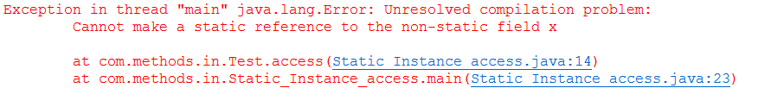
Trying to access instance variable in static method.
package com.methods.in;
class Test
{
// instance variable
int x;
Test(int x)
{
this.x=x;
}//static method to access instance variable.
static void access()
{
System.out.println("x = " +x);
}
}
public class Static_Instance_access {
public static void main(String[] args) {
// TODO Auto-generated method stub
Test obj = new Test(55);
Test.access();
}
}
Error:

Slide 14
Solved the problem by using static variables.
package com.methods.in;
class Test1{
static int x =55;
static void access()
{
System.out.println("X= "+x);
}
}
public class Static_Instance_Solve {
public static void main(String[] args) {
// TODO Auto-generated method stub
Test1.access();
}
}
Note: Static variable is also known as Class Variable.
Static method is called Class Method.

Slide 15
Interview questions
What is the difference between instance variables and static variables(class variables)?
A instance variable is a variable whose separate copy is available to each object.
A class(static) variable is a variable whose single copy is shared by all objects.
Instance variables are created in the objects on heap memory.
Class variables are stored on method area.

Slide 16
Instance variables with separate copy.
package com.methods.in;
class Test2{
int x=10;
void display()
{
System.out.println(x);
}
}
public class InstanceDemo {
public static void main(String[] args) {
// TODO Auto-generated method stub
Test2 obj1, obj2;
obj1= new Test2();
obj2= new Test2();
// increment x;
++obj1.x;
System.out.println("x in obj1");
obj1.display();
System.out.println("x in obj2");
obj2.display();
}
}

Slide 17
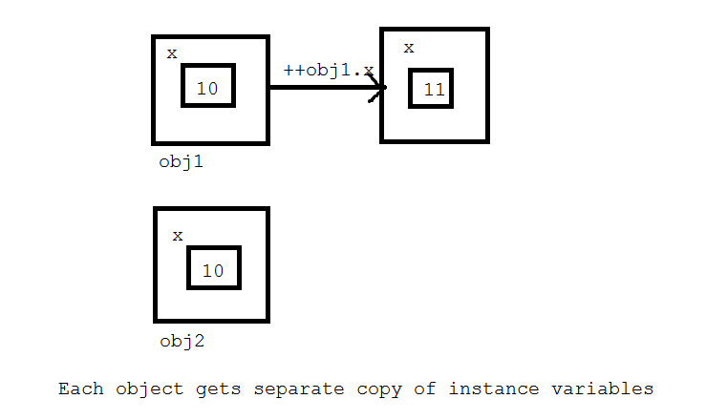
Diagrammatic representation

Slide 18
Static program
package com.methods.in;
class Test3
{
static int x=10;
static void display()
{
System.out.println(x);
}
}
public class StaticDemo {
public static void main(String[] args) {
// TODO Auto-generated method stub
Test3 obj1, obj2;
obj1= new Test3();
obj2= new Test3();
// increment x;
++obj1.x;
System.out.println("x in obj1");
obj1.display();
System.out.println("x in obj2");
obj2.display();
}
}

Slide 19
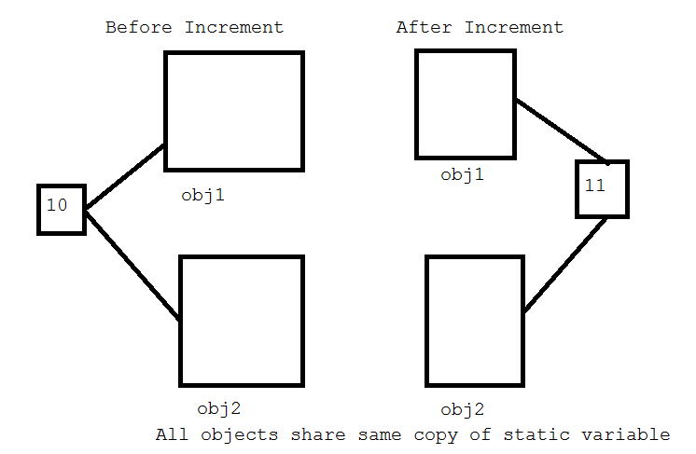
Static variables

Slide 20
Interview questions
Why instance variables are not available to static methods?
After executing static methods. JVM creates the objects. So the instance variables of all objects are not available to static methods.
The execution sequence of JVM creates the process where JVM executes first of all any static blocks in the java program.
Then it executes static methods(remember main()) and then it creates any objects needed by the program.
Finally it executes the instance methods.

Slide 21
Static Block
package com.methods.in;
public class Static_Block {
static
{
System.out.println("Static Block");
}
public static void main(String[] args) {
// TODO Auto-generated method stub
System.out.println("Static Method");
}
}

Slide 22
Java program with out main method
public class First {
static
{
System.out.println("Static Block");
System.exit(0);
}
public static void main(String[] args) {
// TODO Auto-generated method stub
System.out.println("Static Main method");
}
}
System.exit(0) -----------it terminates the program .

Slide 23
Local variables
A local variable is a variable that is declared locally inside a method or a constructor.
It is available in that method or constructor only.
Local variable cannot be accessed outside the method or a constructor.
It is mandatory to initialize the local variable.
We cannot use static keyword for local variable.

Slide 24
Local variable not allowed to use static
package com.methods.in;
public class Local_variables {
public static void main(String[] args) {
// TODO Auto-generated method stub
static int x=10;
System.out.println(x);
}
}

Slide 25

Local variable initialization
package com.methods.in;
public class Local_variables {
public static void main(String[] args) {
// TODO Auto-generated method stub
int x;
System.out.println(x);
}
}

Slide 26
Local variable cannot be accessed outside of method or constructor
package com.methods.in;
class Sample1
{
private int x;
void modify(int a)
{
x=a;
}
void access()
{
System.out.println(x);
System.out.println(a);
}
}
public class Local {
public static void main(String args[])
{
Sample1 s = new Sample1();
s.modify(10);
s.access();
}
}

Slide 27
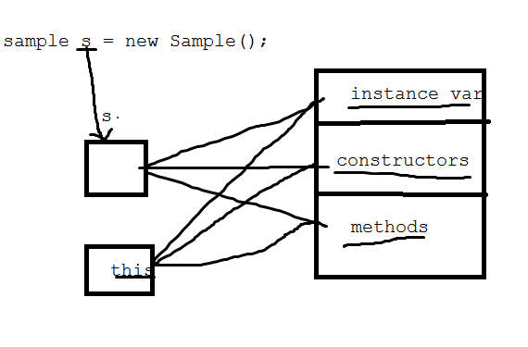
The keyword ‘this’
this keyword that refers the object of class where it is used.
In other words this is refers to the object of the present class.
Generally we write instance variables

Slide 28
this – refers to all the members of present class
package examples;
class Sample1
{
private int x;
Sample1()
{
this(55); // call present class parameter constructor and send 55
this.access();// call present class method
}// parameterized constructor
Sample1(int x)
{
this.x=x;// refer present class instance variable.
}
void access()
{
System.out.println(" x ="+x);
}
}
public class This {
public static void main(String[] args) {
// TODO Auto-generated method stub
Sample1 s = new Sample1();
}
}

Slide 29
Using this keyword
package com.methods.in;
class Sample4
{
private int x;
Sample4()
{
this(55); //call present class parameter constructor
this.access();
}
Sample4(int x)
{
this.x=x;
}
void access()
{
System.out.println("X= "+x);
}
}
public class This {
public static void main(String[] args) {
// TODO Auto-generated method stub
Sample4 s= new Sample4();
}
}

Slide 30
Static variables can by accessed by instance methods
package com.methods.in;
class Test8
{
static int x=10;
void access()
{
System.out.println(x);
}
}
public class Static_Instance {
public static void main(String[] args) {
// TODO Auto-generated method stub
Test8 t= new Test8();
t.access();
}
}

Slide 31
Instance Methods
Instance methods are the methods acts on instance variables.
The specialty of instance methods is they can access instance variables.
Also access static variables.
Two types:
Accessor method- simply to read or access
Mutator method- access and modify also.

Slide 32
Accessor and mutator
package com.methods.in;
class Person
{
//instance variables
String name;
/**
* @return the name
*/
public String getName() {
return name;
}
/**
* @param name the name to set
*/
public void setName(String name) {
this.name = name;
}
/**
* @return the age
*/
public int getAge() {
return age;
}
/**
* @param age the age to set
*/
public void setAge(int age) {
this.age = age;
}
int age;
}
public class Accessor {
public static void main(String[] args) {
// TODO Auto-generated method stub
Person p = new Person();
//store data
p.setAge(22);
p.setName("Raju");
//access data
System.out.println("Name="+p.getName());
System.out.println("Name="+p.getAge());
}
}

Slide 33
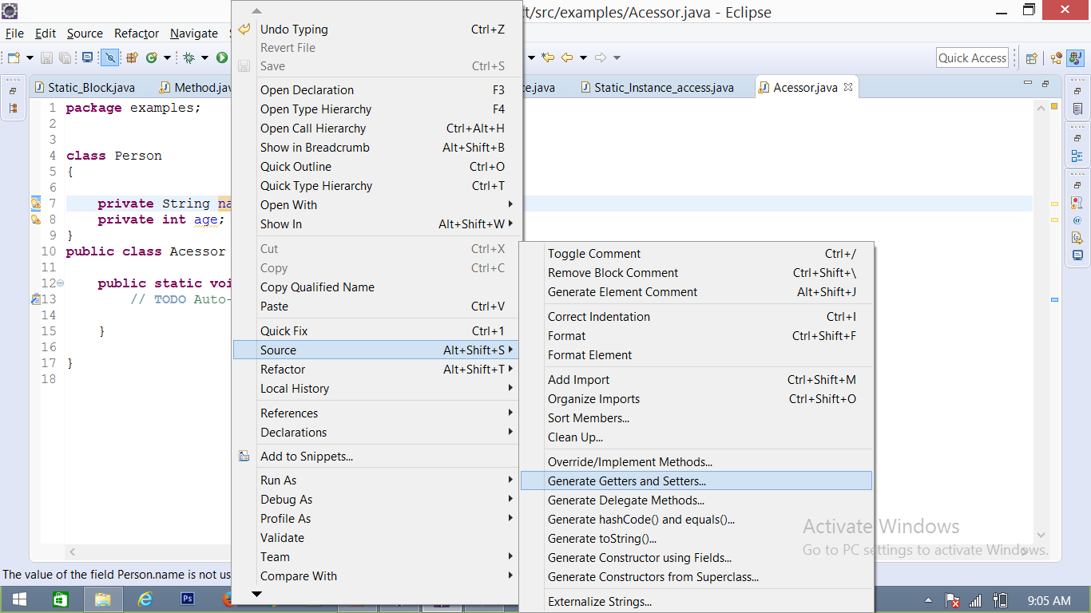
Screen shot

