Slide 1
Core Java
All about Networks

Slide 2
Network
Why C, C++ not opted for a network.
Why Java is a suited for a network, especially Internet.
Network : Interconnection of Computers.
A network may contain two or more computers connected with or with out cable.

Slide 3
Why network is needed
Primary purpose is : resource sharing
Resources like data,memory,software,hardware,CPU etc with other computers on the network.
In network one computer may request the other computer for some service.

Slide 4
Client/Server Architecture
Client(Many): Computer requests for some service
Server: which provide services to client.
Client
Server
request
response

Slide 5
Requirements for Setting up a network
Hardware: Computer systems, Network interface cards(NIC), cables, modems, hubs, satellites etc.
Software: Any software, which supports networking features like UNIX, Linux, Windows NT etc. so data can be sent or received.
Protocol: defined as standard procedure for regulating data transmission between computers.
It specifies a way to identify the destination and source computers.
Ex: TCP/IP.

Slide 6
What comprises the Internet.
Global network of all the networks.
All the systems are which are across the globe connected.
History of Internet.
In 1969, DoD(Department of Defense) in a US military, got connected 4 computers with a cable and UNIX was installed on them.
First network on earth ARPANET(Advance Research Project Agency Network).

Slide 7
Internet
Later, NSFNET(National Science Foundation) encouraged individual users to get connected into the network.
Using a simple cable they can connect.
Problem: Purchasing the cable and Installation.
Solution: alternative , already available cables
By that time telephone network are widely available.

Slide 8
How internet works
The computer which is connected to ISP(Internet Service Provider) is called client.
ISP computer is server.
Application Server– any kind of applications
Ex: students attendance,
Web server- maintains websites, purely related to internet.
Web browser software uses to access websites.
HTTP: Hyper text transfer Protocol.-to display

Slide 9
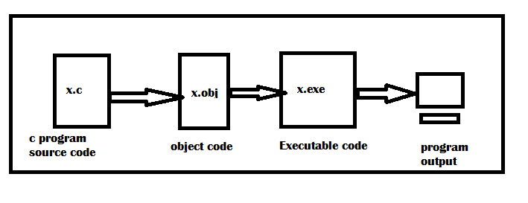
Software Development for Internet
Execution of C Program
Disadvantage: platform dependent

Slide 10
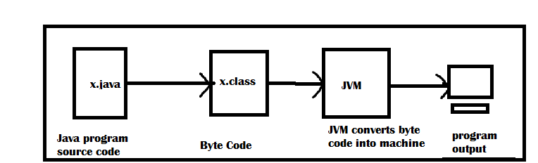
Platform Independent
Execution of a Java Program

Slide 11
Major security problems for data on Internet
Eavesdropping: Means reading other’s data illegally on internet.
Solution: Encryption and Decryption
Tampering: Not only reading other’s data but also modifying it is called tampering.
Solution: Encryption and Decryption
Impersonation: A person disguising himself as another person on internet is called impersonation.
Solution : Digital Signature.
Virus : Virus represents a program that cause harm to data, software, hardware of computer system.
Virus cannot spread with ,txt files. In java we create a .class files similar to .txt files. JVM will stop execution if any other form of code is there in .class files.

Slide 12
Interview Questions
What is the advantage of a network?
The main advantage of a network is that it makes resources sharing possible among connected system, thus helping in better utilization of resources.
Which is the mostly used protocol on internet?
HTTP(Hyper Text Transfer Protocol ) is the most widely used protocol on internet. The text on internet is sent or receive from one machine to another machine using protocol only.

Slide 13
Interview questions
What is the difference between an executable file and .class file?
.exe files contains machine language instructions for the microprocessor and is system dependent,
.class file contains byte code instructions for the JVM and is system Independent.
Why Java is suitable for Internet?
Java is suitable for internet because of two main reasons
1)It is system Independent and hence its programs can run on any type of computer system available on internet.
2)It eliminates lot of security problem for data on internet.

