Slide 1
Strings
In Java

Slide 2
Most of the data that transmits on Internet is in the form of group of characters.
Such group of character are called Strings.
In C/C++, a string represents a array of characters, where the last character will be ‘\0’ and it indicates the end of string.
But this is not valid in java.
In java a string is an object of String class.
It is not a character array.
In java we got character arrays also but strings are given a different treatment because of extensive use on internet.

Slide 3
Even though, String is class, it is used often in the form of data type as:
String s= “Java”;
s is a variable of data type String.
Interview questions:
Is String a class or data type?
String is a class in java.lang package.But in Java, all classes are also considered as data types. So we can take String as a data type also.
Can we call a class as a data type?
Yes, a class is also called ‘user-defined’ data type. This is because a user can create a class.

Slide 4
Creating Strings
There are 3 ways to create Strings in java.
We can create a string just by assigning a group of characters to String type variable.
String s; // declaring variable of string type
s=“Hello”;assign.
String s=“Hello”;
In this case, JVM creates an object and stores the string : “Hello” in that object. This object is referenced by a variable s. Remember creating an object means allocating memory for storing data.

Slide 5
we can create an object to String class by allocating memory using new operator. This is just like creating an object to any class
String s= new String(“Hello”);
Here we are doing two things. First we are creating a object using new operator. Then we are storing the string “Hello” into the object.
The third way of creating strings is by converting the character arrays into strings.
Let us take a character type array as:
Char arr[]= {‘c’,’h’,’a’,’i’,’r’,’s’};
Now create a String object, by passing the array name to it as:
String s = new String(arr);

Slide 6
Now the String object ‘s’ containing the string “chairs”.
This means all the characters of the array are copied into the string. If we don’t want all the character then we can mention which characters we need:
String s= new String(arr, 2,3)
air will be copied. As count starts from 0, the 2th character is a, three characters.

Slide 7
String Class Methods
String concat(String str): Concatenates the specified string “str” at the end of the string.
we can use ‘+’ operator to also for string concatenation.
int length(): It returns the length of a String.
char charAt(int i): It returns the character at the specified index.
int compareTo(String string): This method compares the two strings based on the Unicode value of each character in the strings.
int compareToIgnoreCase(String string): Same as CompareTo method however it ignores the case during comparison.

Slide 8
boolean equals(String s): Compares the string with the specified string and returns true if both matches else false.
boolean equalsIgnoreCase(String string): It works same as equals method but it doesn’t consider the case while comparing strings. It does a case insensitive comparison.
boolean startsWith(String prefix): It tests whether the string is having specified prefix, if yes then it returns true else false.
boolean endsWith(String suffix): Checks whether the string ends with the specified suffix.

Slide 9
int indexOf(String str): This method returns the index of first occurrence of specified substring str.
int lastindexOf(String str): Returns the index of last occurrence of string str.
String replace(char oldChar, char newChar): It returns the new updated string after changing all the occurrences of oldChar with the newChar.

Slide 10
String into a character array.
void getChars(int srcBegin, int srcEnd, char[] dest, int destBegin): It copies the characters of src array to the dest array. Only the specified range is being copied(srcBegin to srcEnd) to the dest subarray(starting fromdestBegin).
https://beginnersbook.com/2013/12/java-strings/
https://www.programiz.com/java-programming/string

Slide 11
String Comparisons
The relational operators like >,<,>= etc cannot be used.
We should use compareTo and equals methods.
package com.strings.in;
public class Strcompare {
public static void main(String[] args) {
// TODO Auto-generated method stub
String s1="Hello";
String s2= new String("Hello");
if(s1==s2)
System.out.println("Both are same");
else
System.out.println("Not same");
}
}

Slide 12
When an object is created by JVM, it returns the memory address of the object as hexadecimal number which is called object reference.
When a new object is created, a new reference is allotted to it.
It means every object will have a unique reference.
Interview question
What is object reference?
Object reference is unique hexadecimal number representing the memory address of the object. It is useful to access the member of the object.

Slide 13
Inspite of the fact both the strings s1 and s2 are same, we are getting wrong out put in program.
String s1=“Hello”, Jvm creates object on heap and allocates memory address.
String s2=new String(“Hello”);
JVM creates another object and hence allocates another reference.

Slide 14
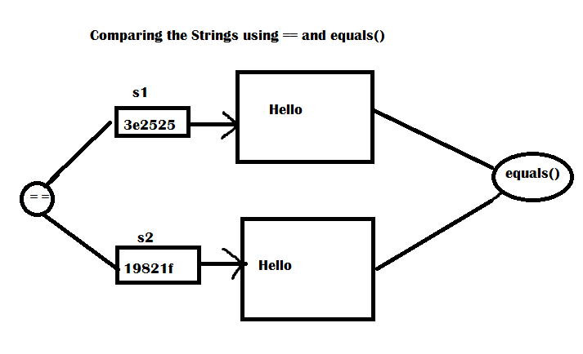

Slide 15
Interview question:
What is the difference between == and equals while comparing strings? Which one is reliable?
== operator compares the references of the string objects. It does not compare the contents of the string. equals() method compares the content. While comparing the strings, equals method should be used as it provides the correct results.

Slide 16
Slight changes with program
package com.strings.in;
public class Strcompare1 {
public static void main(String[] args) {
// TODO Auto-generated method stub
String s1="Hello";
String s2="Hello";
if(s1==s2)
System.out.println("Both are same");
else
System.out.println("Not same");
}

Slide 17
Observations of the program
Please notice how the strings are created as well as the output of the program
String s1=“Hello”;
JVM creates a String Object and stores “Hello” in it.
Observer we are not using any new operator to create the string.
we are using the assignment operator(=).
After creating the String object, JVM uses a separate block of memory which is called string constant pool and stores the object there.

Slide 18
When the next statement,
String s2=“Hello” is executed by the JVM, It searches in the String constant pool to know whether the object with same content is already available or not.
Since the same object is already available there(s1) then, JVM does not create another object.
Simply creates another reference variable(s2) to the same object and copies the reference number of s1 into s2.
So s1 and s2 are having the same reference number it is giving “Both are same”.

Slide 19
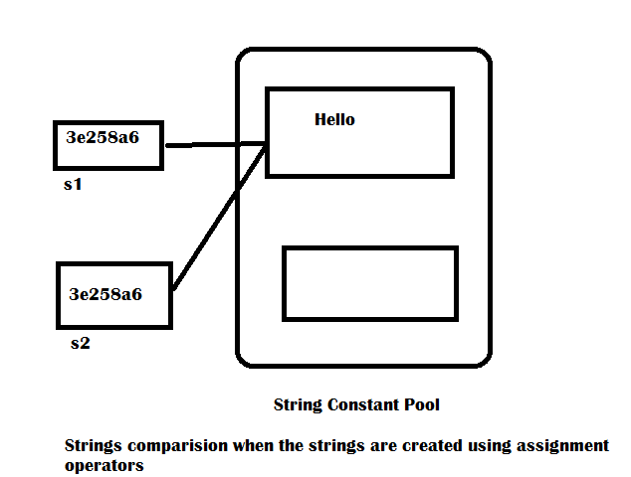

Slide 20
Interview questions.
What is a string constant pool?
String constant pool is a separate block of memory where string objects are held by JVM. If a String object is created directly, using assignment operator as String s1=“hello”, then it is stored in string constant pool.

Slide 21
Interview questions
Explain the difference between the following two statements:
String s=“Hello”
String s= new String(“Hello”);
In the first statement, assignment operator is used to assign the string literal to the string variables s. in this case, JVM first of all check whether the same object is already available in the string constant pool. If it is available , then it creates another reference to it. If same object not available, then it creates another object with content “Hello” and stores into the string constant pool.
In the second statements, new operator is used to create the string object. In this case, JVM always creates a new object without looking in the string constant pool

Slide 22
Immutability of Strings
We can divide objects broadly as mutable and immutable objects.
Mutable objects are those objects whose contents can be modified.
Immutable objects are those objects, once created we cannot be modified.
And String class objects are immutable.

Slide 23
Program to test the immutability of strings
package com.strings.in;
public class Immutable {
public static void main(String[] args) {
// TODO Auto-generated method stub
String s1="data";
String s2="base";
// join s1 and s2 and store in s1
s1=s1+s2;
System.out.println(s1);
}
}

Slide 24
Please observe the statements:
The output of the program is “database”
It seems that s1 is modified string s1 content is modified.
Earlier s1 got “data” and s2 is “base” and after s1+s2, they are joined and the total string is database.
It is assigned to s1 again.
If s1 is mutable, it gets the new string database. This is what we can see in the output.
But we learned strings are immutable.

Slide 25
But why the output of the program is like that?
In this JVM creates two objects, s1 and s2 separately.
When s1+s2 is done, JVM creates a new object and stores the string database in that object.
But it does not modify the content of string s1.
After creating the new object, the reference s1 is adjusted to refer to that new object.

Slide 26
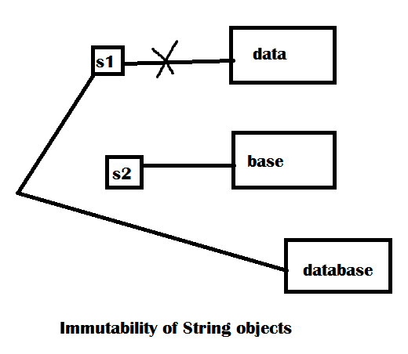
Content of string s1 is not modified so this is the reason strings are called immutable.
The old object that contains data has lost its reference. It is unreferenced object.

Slide 27
Garbage collector will collect and remove it from memory.
Different applications can share the contents of string class objects. This is the reasons why strings objects are made immutable.
To maintain immutable nature all the methods in the String class cannot modify any thing.
So string class is made final and the methods in the class are not over ridden..
The concept of final and method overriding will seen in coming classes

