Slide 1
Threads
In Java

Slide 2
Threads
A thread represents a separate path of execution statements. IN java program, if we write a group of statements, then executed by JVM one by one.
This is called Thread. Because JVM uses a thread to execute these statements.
Means every program, there is always a thread running internally.
** which thread always runs in a java program by default?
Main Thread.

Slide 3
Thread:
1) Thread is nothing but separate path of sequential execution.
2) The independent execution technical name is called thread.
3) Whenever different parts of the program executed simultaneously that each and every part is called thread.
4) The thread is light weight process because whenever we are creating thread it is not occupying the separate memory it uses the same memory. Whenever the memory is shared means it is not consuming more memory.
5) Executing more than one thread a time is called multithreading.

Slide 4
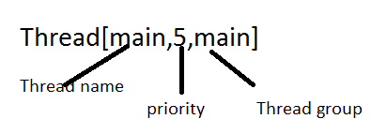
To find current Thread
package com.multiThreading.edu;
public class Current_Thread {
public static void main(String[] args) {
// TODO Auto-generated method stub
System.out.println("Let us find the current Thread");
Thread thread = Thread.currentThread();
System.out.println("Current Thread= "+thread);
System.out.println("Its name = " +thread.getName());
}
}
Let us find the current Thread
Current Thread= Thread[main,5,main]
Its name = main

Slide 5
A thread represents execution of statements. The way the statements executed of two types
Single Tasking
Multi Tasking
Single Tasking:
2) The earlier days the computer’s memory is occupied only one program after completion of one program it is possible to execute another program is called uni programming.
3) Whenever one program execution is completed then only second program execution will be started such type of execution is called co operative execution, this execution we are having lot of disadvantages.
a. Most of the times memory will be wasted.
b. CPU utilization will be reduced because only program allow executing at a time.
c. The program queue is developed on the basis co operative execution

Slide 6
MultiTasking
To overcome above problem a new programming style will be introduced is called multiprogramming.
1) Multiprogramming means executing the more than one program at a time.
2) All these programs are controlled by the CPU scheduler.
3) CPU scheduler will allocate a particular time period for each and every program.
4) Executing several programs simultaneously is called multiprogramming.
5) In multiprogramming a program can be entered in different states.
a. Ready state.
b. Running state.
c. Waiting state.
6) Multiprogramming mainly focuses on the number of programs.
Advantages of multiprogramming:-
1. CPU utilization will be increased.
2. Execution speed will be increased and response time will be decreased.
3. CPU resources are not wasted.

Slide 7
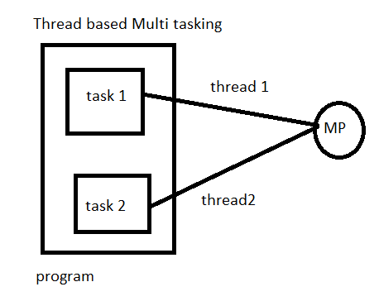
MultiTasking of two types
Process based multi-tasking– several programs are executed at a time, by microprocessor.
Thread based multi-Tasking.
Several parts of same program are executed at a time, by the processor.

Slide 8
Difference between
Process Based Applications 1. It is the one in which there exist single flow of control. 2. All C, C++ applications comes under it. 3. Context switch is more (context switch is the concept of operating system and it says switching the control from one address page to another address page). 4. For each and every sub-program there exist separate address pages. 5. These are treated as heavy weight components. 6. In this we can achieve only sequential execution and they are not recommending for developing internet applications. | Thread Based Applications 1. It is the one in which there exist multiple flow of controls. 2. All JAVA, DOT NET applications comes under it. 3. Context switch is very less. 4. Irrespective of ‘n’ number of subprograms there exist single address page. 5. These are treated as light weight components. 6. In thread based applications we can achieve both sequential and concurrent execution and they are always recommended for developing interact applications.

Slide 9
Why thread are called light-weight?
Because they utilize minimum resources of the system, means they take less memory and less processor time.
Uses of Threads:
Thread are mainly used in server-side programs to serve the needs of multiple clients on a network or internet,
On internet, a server machine has to cater the needs of thousands of clients at a time.
Thread are also used to create games and animation.

Slide 10
Creating a thread and running it.
In order to create a thread in JAVA we have two ways. They are by using java.lang.Thread
class and by using java.lang.Runnable interface.
In multi threading we get only one exception known as java.lang.InterruptedException.
Using java.lang.Thread:
Creating a flow of control in JAVA is nothing but creating an object of java.lang.Thread class.
An object of Thread class can be created in three ways. They are:
i) Directly Thread t=new Thread ();
ii) Using factory method Thread t1=Thread.currentThread ();
iii) Using sub-class of Thread class
class C1 extends Thread
{
……………………;
……………………;
};
C1 o1=new C1 ();
Thread t1=new C1 ();
Here, C1 is the sub-class of Thread class.

Slide 11
Thread class using to create
package com.examples.edu;
class MyThread extends Thread
{
// this code only it get executed
public void run()
{
for(int i=0;i<1000000;i++)
{
System.err.println(i);
}
}
}
public class ThreadDemp {
public static void main(String[] args) {
// TODO Auto-generated method stub
// Need to create an object to my Thread class
MyThread thread = new MyThread();
// Thread class object and attach to our MyThread class.
Thread t= new Thread(thread);
// will execute the code in run.
t.start();
}
}

Slide 12
Terminating the thread
package com.examples.edu;
import java.io.IOException;
class MyThread extends Thread
{
// this code only it get executed
boolean stop= false;
public void run()
{
for(int i=0;i<1000000;i++)
{
System.out.println(i);
if(stop)
return; // come out of run
}
}
}
public class ThreadDemp {
public static void main(String[] args)throws IOException {
// TODO Auto-generated method stub
// Need to create an object to my Thread class
MyThread thread = new MyThread();
// Thread class object and attach to our MyThread class.
Thread t= new Thread(thread);
// will execute the code in run.
t.start();
System.in.read();
thread.stop=true;
}
}

Slide 13
Thread API:
public static final int MAX_PRIORITY (10);
public static final int MIN_PRIORITY (1);
public static final int NORM_PRIORITY (5);
The above data members are used for setting the priority to threads are created. By default,
whenever a thread is created whose default priority NORM_PRIORITY.
Constructors:
i) Thread (): With this Constructor we can create an object of the Thread class whose default
thread name is Thread-0.
For example:
Thread t=new Thread ();
System.out.println (t.getName ());// Thread-0
ii) Thread (String): This Constructor is used for creating a thread and we can give the user specified
thread name.
For example:
Thread t=new Thread (“JAVA”);
t.setName (“JAVA”);
t.setPriority (Thread.MAX_PRIORITY);
iii) Thread (Runnable): This Constructor is used for converting Runnable object into Thread object
for entering into run method of Runnable interface by making use of start method of Thread
class without giving thread name.
iv) Thread (Runnable, String): This Constructor is similar to above Constructor but we give thread
name through this Constructor.
Instance methods:
public final void setName (String)

Slide 14
Important questions
What is the difference between ‘extends and implements Runnable? Which one is advantageous?
Both are functionally same. But when we write extends Thread, there is no scope to extend another class.(No multiple inheritance supported)
Class Myclass extends Thread, Another class //invalid.
Runnable, still there is scope to extend another class.
So Runnable interface definitely advantageous.

Slide 15
Single Tasking using a Thread
A thread can be employed to execute one task at a time. Suppose there are 3 tasks to be executed.
We can create a thread and pass the 3 task one by one to the thread.
For this purpose, we can write all these tasks separately in separate methods. Task 1,2,3. these methods should be called from run() method, one by one.
Remember executes only the code which is inside the run() method. It can never execute other methods unless they are called from run().
*** which method is executed by the thread by default?
public void run() method.

Slide 16
Single Tasking using a Thread
package com.multiThreading.edu;
class MyThread1 extends Thread{
public void run() {
// executes the task one by one
task1();
task2();
task3();
}
void task3() {
// TODO Auto-generated method stub
System.out.println("This is Task 3");
}
void task2() {
// TODO Auto-generated method stub
System.out.println("This is Task 2");
}
void task1() {
// TODO Auto-generated method stub
System.out.println("This is Task 1");
}
}
public class Single_Tasking {
public static void main(String[] args) {
// create an object.
MyThread1 thread = new MyThread1();
Thread t= new Thread(thread);
t.start();
}
}

Slide 17
Mutli Tasking using thread.
In multitasking, several tasks are executed at a time.
For this purpose, we need more than one thread.
For example, to perform 2 tasks, we can take 2 threads and attach them to the 2 tasks.
Then those tasks are simultaneously executed by the two threads. Using more than one thread is called “Multi Threading”.

Slide 18
Multi Tasking using Threads
package com.multiThreading.edu;
class MyThread2 implements Runnable
{
String str;
public MyThread2(String str) {
this.str=str;
}
@Override
public void run() {
// TODO Auto-generated method stub
for(int i =1;i<=10;i++){
System.out.println(str+" : "+i);
try{
Thread.sleep(1000);// stop execution for 2000 milliseconds
}catch (InterruptedException ie) {
ie.printStackTrace();
}
}
}
}
public class MutliTasking_Theatre {
public static void main(String[] args) {
// create two objects to represents two tasks.
MyThread2 thread2 = new MyThread2("Cut the ticket");
MyThread2 thread3 = new MyThread2("show the seat");
// create two threads and attach the objects
Thread t1= new Thread(thread2);
Thread t2= new Thread(thread3);
t1.start();
t2.start();
}
}

Slide 19
In the above example, first we are taking a string variable str in MyThread class.
Then we are passing two strings- cut the ticket and show the seat into variable form from Theater class.
When t1.start() executed, it starts execution on run method code showing cut the ticket and just behind it, t2.start() will make thread t2 also execute on run method almost simultaneously, so it will display Show the seat.

Slide 20
Multiple Thread Acting on Single Object
In the theatre example, we have used 2 threads on the 2 objects of MyThread class. It is also possible to use 2 or more threads on a single object.
But in this case, sometimes we get unreliable results.
First why two threads should share the same object(means same run() method).
We write an object to represent one task. If there is a different task, we can take another object.
When two people(thread) perform same task, then they need same object to be executed each time.
Take the case of railway reservation.

Slide 21
package com.multiThreading.edu;
class Reserve implements Runnable
{
//available berth are 1;
int available=1;
int wanted;
public Reserve(int i) {
// TODO Auto-generated constructor stub
wanted=i;
}
@Override
public synchronized void run() {
//synchronized (this) {
// display available berths.
System.out.println("available berths are" +available);
if(available>=wanted)
{
//get the name of passenger
String name= Thread.currentThread().getName();
//allot berth to him
System.out.println(wanted +" Berths reserverd for"+name);
try{
Thread.sleep(1500);// wait for printing the ticket.
available= available- wanted;
}catch (InterruptedException ie) {
ie.printStackTrace();
// TODO: handle exception
}
}
else {
System.out.println("Sorry, No berths available");
}
//
}
}
//}
public class MThread_on_Single_Object {
public static void main(String[] args) {
// TODO Auto-generated method stub
// passing the wanted berths
Reserve reserve= new Reserve(1);
Thread t1= new Thread(reserve);
Thread t2= new Thread(reserve);
t1.setName("First Person");
t2.setName("Second Person");
t1.start();
t2.start();
}
}

Slide 22
Please observe the output. It has allotted the same berth to both the passengers.
When t1 enters the run method, it sees available number of berths as 1 and hence it displays the message: Available Berths:1
Just behind the first thread, the second thread t2 also enters the same run() method and sees that there is 1 berth remaining. Hence it will also display the same message.
1 Berths reserved for First Person
1 Berths reserved for Second Person
Then the first thread enters try{} block inside run method, where it will sleep for 1.5 sec time. In this time it will print the ticket.
Thread t1 wakes up first, then updates the available number of berths as:
Available=available- wanted;
Now available berth is 0. but by the time second thread already allotted the same berth to the Second Person.
Since both the threads are acting on the same object simultaneously, the results is unreliable.
How to solve this problem.

Slide 23
Synchronization.
***What is Thread Synchronization?
When a thread is already acting on an object, preventing any other thread from acting in same object is called “Thread Synchronization” or Thread Safe. The objects on which the thread are synchronized is called “Synchronized objects”.
It is recommended when multiple threads are used on the same object.

Slide 24
Synchronized object is like a locked object, locked on thread, It is like a room with only one door.
A person has enter the room and locked. Second person has to wait till the first person comes out.
In this way, a thread also locks the object after entering it.
Then next thread cannot enter it till the first thread comes out. This means the object is locked mutually on threads, so this object is called “Mutex”(mutually exclusive lock)

Slide 25
How to synchronize the objects
Using synchronized block: we can embed a group of statements of object(Inside run() method) with in a synchronized block.
synchronized(object)
{ statements;}
Another way.
synchronized void display()
{statements;}
what is the difference between synchronized block and synchronized keyword?
Synchronized block is useful to synchronize a block of statements.
Synchronized keyword is useful to synchronize an entire method.

Slide 26
Thread class methods:
static Thread currentThread()
Returns a reference to the currently executing thread object.
getName()Returns this thread's name.
getPriority()Returns this thread's priority.
isAlive()Tests if this thread is alive
setName(String name)
Changes the name of this thread to be equal to the argument name.
Void setPriority(int newPriority)
Changes the priority of this thread.
sleep(long millis)Causes the currently executing thread to sleep (temporarily cease execution) for the specified number of milliseconds, subject to the precision and accuracy of system timers and schedulers.
start()Causes this thread to begin execution; the Java Virtual Machine calls the run method of this thread.
Thread.MAX_PRIORITY =10);
(Thread.MIN_PRIORITY=1);
(Thread.NORM_PRIORITY=5)

Slide 27
DeadLock
Deadlock in java is a part of multithreading. Deadlock can occur in a situation when a thread is waiting for an object lock, that is acquired by another thread and second thread is waiting for an object lock that is acquired by first thread. Since, both threads are waiting for each other to release the lock, the condition is called deadlock.

Slide 28
Dead Lock
package com.examples.edu;
class BookTicket extends Thread
{
Object train,comp;
public BookTicket(Object train, Object comp) {
this.comp=comp;
this.train=train;
}
public void run()
{
synchronized (train) {
System.out.println("BookTicket locked in train");
try{
Thread.sleep(150);
}catch (InterruptedException e) {}
System.out.println("BookTicket now waiting to lock on comaprtment");;
synchronized (comp) {
System.out.println("BookTicket locked on compartment");
}
}
}
}

Slide 29
class CancelTicket extends Thread
{
Object train,comp;
public CancelTicket(Object train, Object comp) {
this.comp=comp;
this.train=train;
}
public void run()
{
synchronized (comp) {
System.out.println("CancelTicket locked in Compartment");
try{
Thread.sleep(150);
}catch (InterruptedException e) {}
System.out.println("CancelTicket now waiting to lock on Train");;
synchronized (train) {
System.out.println("CancelTicket locked on Train");
}
}
}
}
public class DeadLock {
public static void main(String[] args) {
// TODO Auto-generated method stub
Object train= new Object();
Object compartment= new Object();
BookTicket bo= new BookTicket(train, compartment);
CancelTicket ct= new CancelTicket(train, compartment);
Thread t1= new Thread(bo);
Thread t2= new Thread(ct);
t1.start();
t2.start();
}
}

Slide 30
Deadlock Solution Example Let's change the order of the lock and run of the same program to see if both the threads still wait for each other −
class BookTicket extends Thread{
Object train, comp;
public BookTicket(Object train, Object comp)
{
this.comp=comp;
this.train=train;
}
public void run()
{
synchronized (train) {
System.out.println("BookTicket locked in train");
try{
Thread.sleep(1500);
}catch (InterruptedException e) {
e.printStackTrace();
}
System.out.println("BookTicket now waiting to lock on Compartment ");
synchronized (comp) {
System.out.println("BookTicket locked on Compartment");
}
}
}
}
class CancelTicket extends Thread{
Object train, comp;
public CancelTicket(Object train, Object comp)
{
this.comp=comp;
this.train=train;
}
public void run()
{
synchronized (train) {
System.out.println("CancelTicket locked in compartment");
try{
Thread.sleep(1500);
}catch (InterruptedException e) {
e.printStackTrace();
}
System.out.println("CancelTicket now waiting to lock on Train ");
synchronized (comp) {
System.out.println("CancelTicket locked on Train");
}
}
}
}

Slide 31
Thread Communication
package com.examples.edu;
class Producer extends Thread
{
StringBuffer sb;
boolean dataprodover=false;
Producer()
{
sb = new StringBuffer();// allot memory
}
public void run()
{
//go and append the data(number) to string buffer
for(int i =1;i<10;i++)
{
try{
sb.append(i + ":");
Thread.sleep(100);
System.out.println("appending");
}catch (Exception e) {
// TODO: handle exception
e.printStackTrace();
}

Slide 32
}
dataprodover=true;
}
}
class Consumer extends Thread
{
//create producer reference to refer Producer object from consumer class.
Producer prod;
public Consumer(Producer prod) {
this.prod= prod;
}
public void run()
{
//if production is not over, sleep for 10 ms and check again.
// here there is a time delay of several millisec to receive data.
try{
while (!prod.dataprodover) {
Thread.sleep(10);
}
}catch (Exception e) {
// TODO: handle exception
e.printStackTrace();
}// the content of string buffer when production is over.
System.out.println(prod.sb);
}
}
public class Thread_Communication {
public static void main(String[] args) {
// TODO Auto-generated method stub
Producer producer = new Producer();
Consumer consumer = new Consumer(producer);
//Runnable target;
Thread t1 = new Thread(producer);
Thread t2= new Thread(consumer);
t2.start();// consumer thread wait.
t1.start();//producer thread
}
}

Slide 33
To improve the efficiency.
3 methods. Java.lang.Object
Obj.notify(); This method releases an object and sends a notification to a waiting thread that the object is available.
notifyAll()Wakes up all threads that are waiting on this object's monitor
wait()Causes the current thread to wait until another thread invokes the notify() method or the notifyAll() method for this object.

Slide 34
To improve the efficiency using notify, notifyAll and wait.
package com.examples.edu;
class Producer extends Thread
{
StringBuffer sb;
//boolean dataprodover=false;
Producer()
{
sb = new StringBuffer();// allot memory
}
public void run()
{
//go and append the data(number) to string buffer
synchronized (sb) {
for(int i =1;i<10;i++)
{
try{
sb.append(i + ":");
Thread.sleep(10);
System.out.println("appending");
}catch (Exception e) {
// TODO: handle exception
e.printStackTrace();
}

Slide 35
}sb.notify();
//dataprodover=true;
}
}
}
class Consumer extends Thread
{
//create producer reference to refer Producer object from consumer class.
Producer prod;
public Consumer(Producer prod) {
this.prod= prod;
}
public void run()
{
//if production is not over, sleep for 10 ms and check again.
// here there is a time delay of several millisec to receive data.
synchronized (prod.sb) {
try{
prod.sb.wait();
//while (!prod.dataprodover) {
//Thread.sleep(10);
//}
}catch (Exception e) {
// TODO: handle exception
e.printStackTrace();
}// the content of string buffer when production is over.
System.out.println(prod.sb);
}
}
}
public class Thread_Communication {
public static void main(String[] args) {
// TODO Auto-generated method stub
Producer producer = new Producer();
Consumer consumer = new Consumer(producer);
//Runnable target;
Thread t1 = new Thread(producer);
Thread t2= new Thread(consumer);
t2.start();// consumer thread wait.
t1.start();//producer thread
}
}

Slide 36
Difference between sleep() and wait() method
Both the sleep() and wait() methods are used to suspend a thread execution for a specified time. When sleep() is executed inside a synchronized block, the object is still under lock.
When wait() is executed, it breaks the synchronized block, so the object lock is removed and it is available.
Generally sleep() is used for making a thread to wait for some time. But wait() is used in connection with notify(), notifyAll() methods in thread communication.

Slide 37
Thread Group
A thread group represents several threads as a single group. The main advantage of taking several threads as a group is that by using a single method we can able to control all the threads in the group.
ThreadGroup tg = new ThreadGroup(“groupname”);
Here tg is the thread group object.
To add the thread to this group:
Thread t1= new Thread(tg,targetobj,”threadname”);
To add another thread group(tg1) to tg
ThreadGroup tg1= new ThreadGroup(tg,”groupname”);

Slide 38
tg.activeCount():This method returns an estimate of the number of active threads in the thread group and its subgroups.
tg.getParent(): This method returns the parent of the thread group.
t.getThreadGroup(); to know the parent thread group of a thread.
To change the maximum priority of a thread group tg.
tg.setMaxPriority(): Normally, Max priority is 10. but this method can set it as any other number betweeb 1 to 10.

Slide 39
package com.multiThreading.edu;
class Reservation extends Thread{
public void run()
{
System.out.println("I am in reservation thread");
}
}
class Cancellation extends Thread{
public void run()
{
System.out.println("I am in Cancellation thread");
}
}
public class ThreadGroup1 {
public static void main(String[] args) throws Exception
{
// TODO Auto-generated method stub
Reservation res = new Reservation();
Cancellation can= new Cancellation();
// create a Thread Group
ThreadGroup tg= new ThreadGroup("First Group");
// create two threads and add them to First Group.
Thread t1= new Thread(tg, res,"First Thread");
Thread t2= new Thread(tg, res,"Second Thread");
// create another thread group g1 as a child to tg.
ThreadGroup tg1= new ThreadGroup(tg, "Second Group" );
// create two threads and add them to second Group.
Thread t3= new Thread(tg, can,"Third Thread");
Thread t4= new Thread(tg, can,"Fourth Thread");
// find the parent group of tg1
System.out.println("Parent of tg1="+tg1.getParent());
//set Maximum priority:
tg1.setMaxPriority(7);
//know the thread group of t1 and t3;
System.out.println("Thread Group of t1"+t1.getThreadGroup());
System.out.println("Thread Group of t3"+t3.getThreadGroup());
//start the threads:
t1.start();
t2.start();
t3.start();
t4.start();
// find how many threads are actively running
System.out.println("No of active thread in tg :"+tg.activeCount());
}
}

Slide 40
Daemon Thread
Daemon thread in java is a service provider thread that provides services to the user thread. Its life depend on the mercy of user threads i.e. when all the user threads dies, JVM terminates this thread automatically.
There are many java daemon threads running automatically e.g. gc, finalizer etc.
It provides services to user threads for background supporting tasks. It has no role in life than to serve user threads.
Its life depends on user threads.
It is a low priority thread.
To make a thread t as daemon thread, we can user setDaemon() method as t.setDaemon(true)
To know if a thread is daemon or not
Boolean x= t.isDaemon();

Slide 41
Application of thread
package com.multiThreading.edu;
import java.awt.*;
public class Banner extends Frame implements Runnable{
String str="Core java Online";
Banner() {
setLayout(null);// dont set layout
setBackground(Color.cyan);
setForeground(Color.RED);
}
public void paint(Graphics g)
{
String name;
Font font = new Font("Courier", Font.BOLD, 40);
g.setFont(font);
g.drawString(str, 10, 100);
}
public void run()
{
for(;;){// move banner contiously
repaint();// refresh the frame contents
try{
Thread.sleep(400);
}
catch (Exception e) {
// TODO: handle exception
}
char ch=str.charAt(0);
str=str.substring(1, str.length());
str=str+ch;
}
}
public static void main(String[] args) {
// TODO Auto-generated method stub
Banner banner = new Banner();
banner.setSize(400, 400);
banner.setTitle("My Banner");
banner.setVisible(true);
// create a thread and run it.
Thread thread = new Thread(banner);
thread.start();
}
}

Slide 42

States of Thread

Slide 43
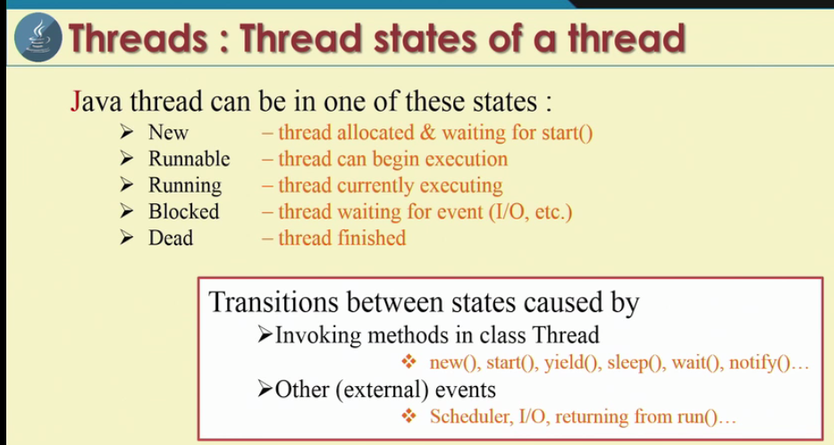

Slide 44
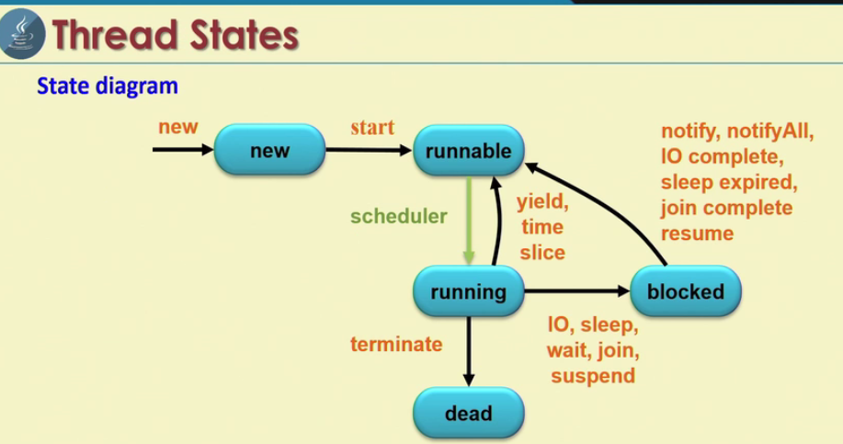

Slide 45
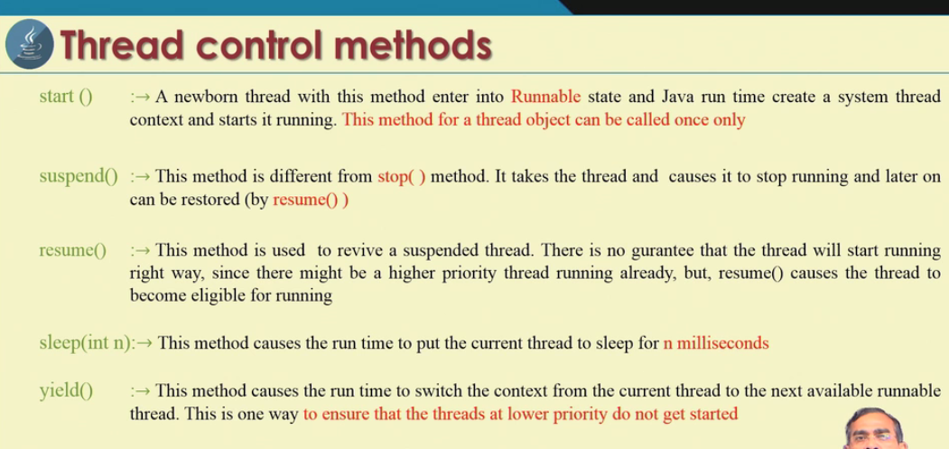

Slide 46
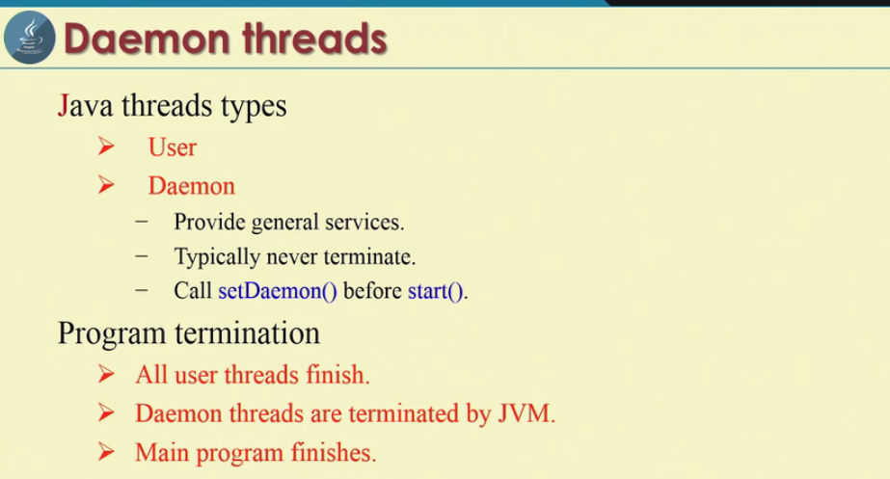

Slide 47
