Slide 1
Restaurant Menu Allergen Checker using RAG
IBM SkillsBuild | Edunet Foundation | AICTE

Slide 2
Problem Statement
People with food allergies struggle to identify safe dishes because restaurant
ingredient information is incomplete.Need an AI assistant that analyzes menus
and warns users about allergens.

Slide 3
Proposed Solution
• Upload or paste restaurant menu
• Enter allergies
• RAG retrieves ingredients from knowledge base
• AI checks allergen matches
• Generates safety report and recommendations

Slide 4
Technology Used
• Python
• Streamlit
• RAG
• Local Knowledge Base (dishes.txt, allergens.txt)
• Matplotlib
• GitHub
• IBM watsonx / Granite (planned integration)

Slide 5
System Architecture
User → Streamlit UI → RAG Retrieval →
Ingredient & Allergen Knowledge Base → AI Analysis → Dashboard & Report

Slide 6
Rag Flow
1. Upload Menu
2. Retrieve Ingredients
3. Retrieve Allergens
4. Compare
5. Generate Safe/Risky Results

Slide 7
Features
• Upload Menu
• Paste Menu
• Allergy Detection
• Dashboard
• AI Chat
• Download Report

Slide 8
Orchestrate Components
Chat Input
Knowledge Retrieval
AI Analysis
Chat Output
File Upload

Slide 9
Role of Agentic AI
Coordinates retrieval, reasoning and personalized recommendations based
on menu and allergy profile.

Slide 10
Novelty
• RAG-based retrieval
• Personalized allergy analysis
• Downloadable report
• AI Q&A

Slide 11
Future Scope
• IBM Granite integration
• OCR menu scan
• Voice assistant
• QR menu analysis
• Restaurant APIs

Slide 12
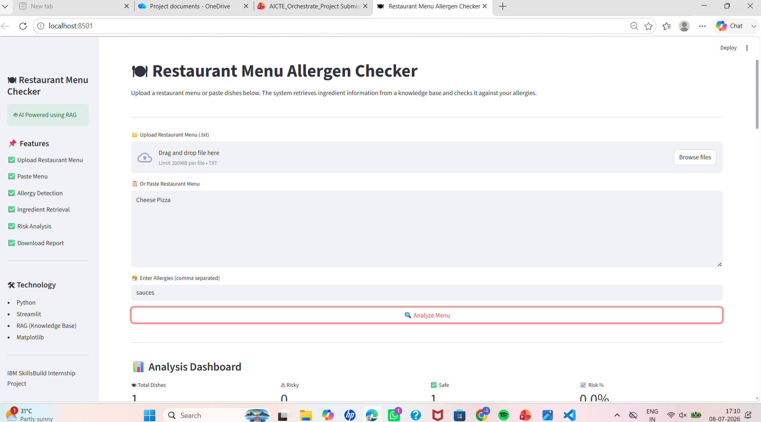
Screenshots

Slide 13
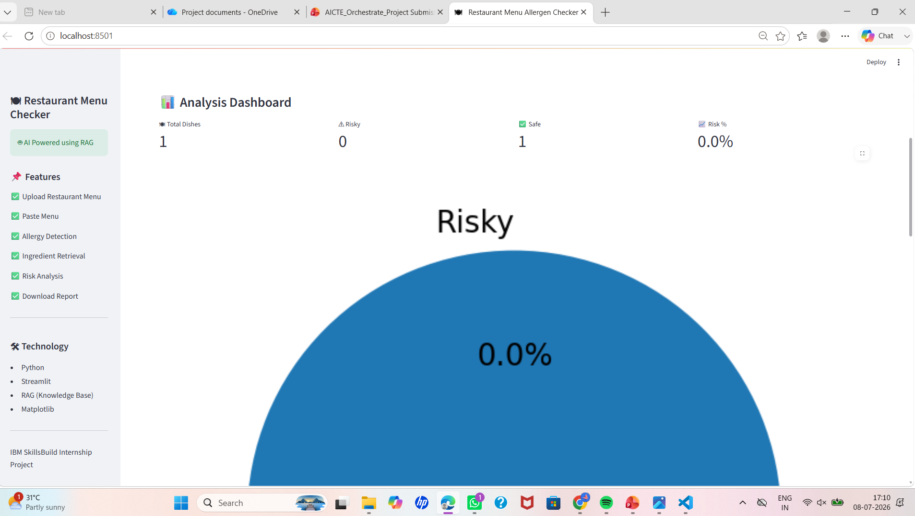
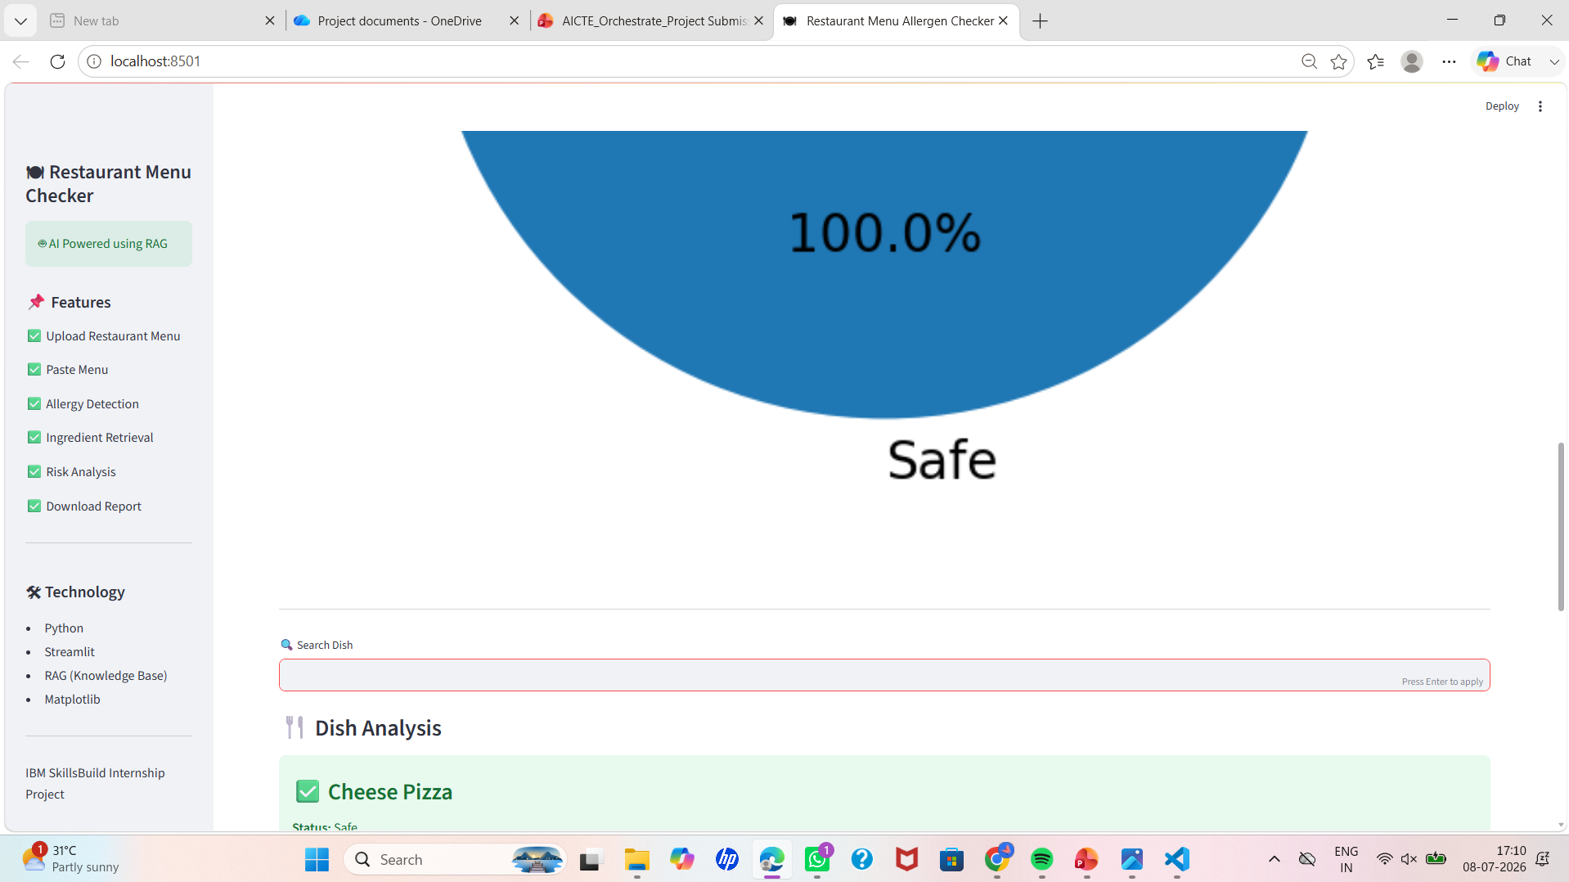

Slide 14
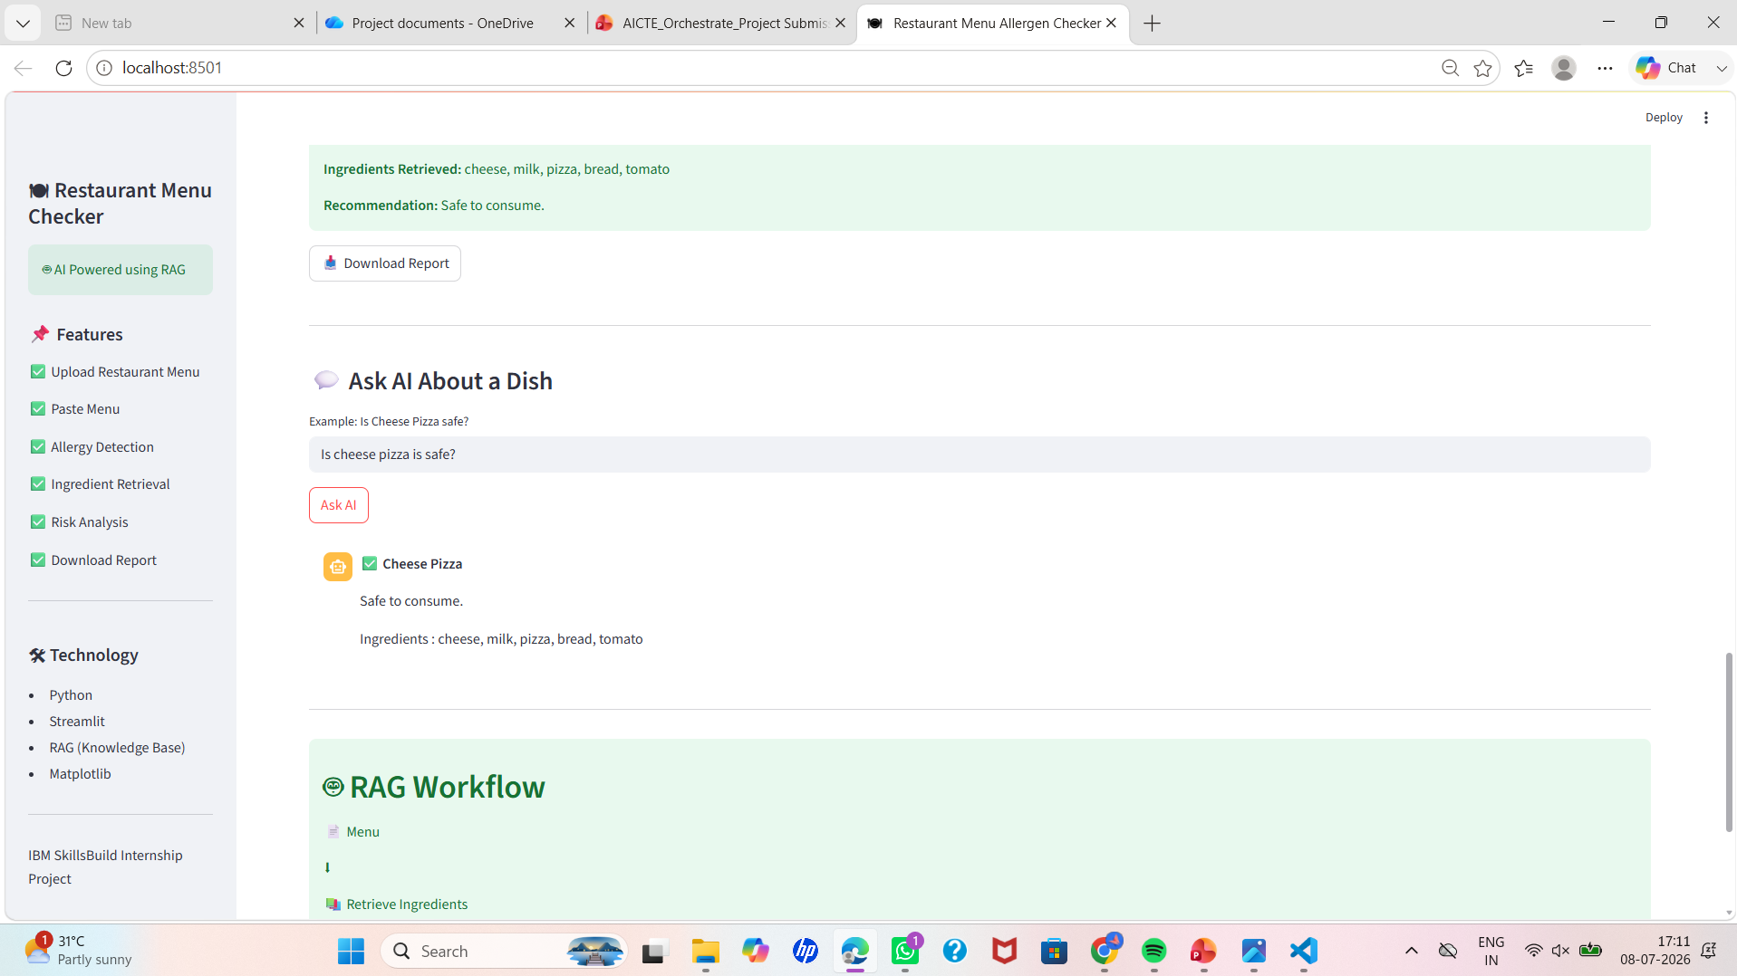

Slide 15
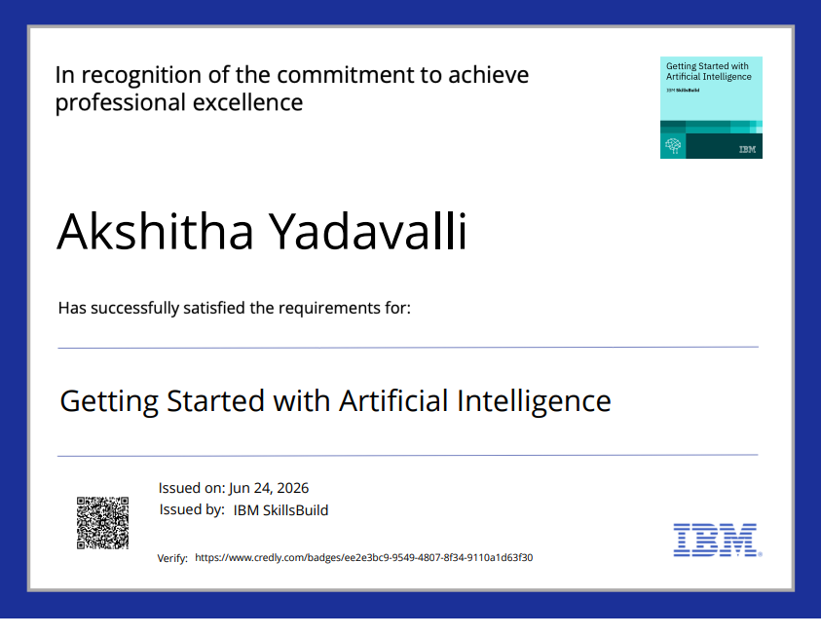
Certificates

Slide 16
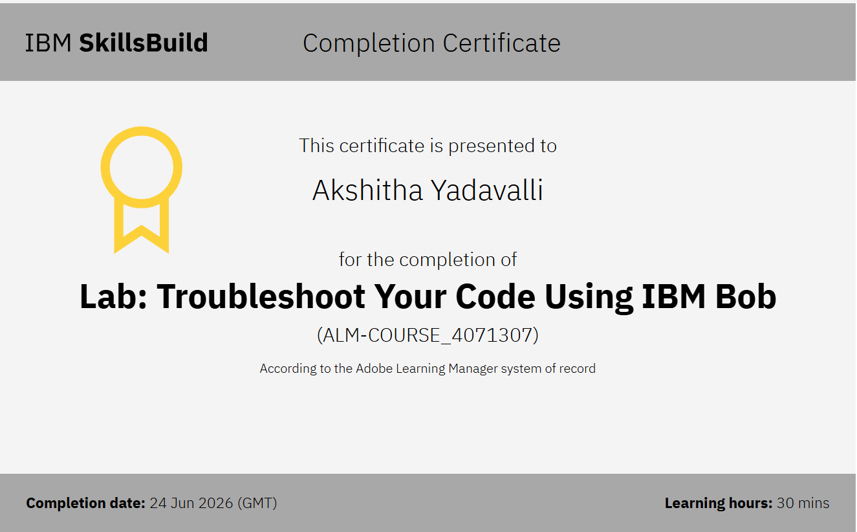

Slide 17
Thank You

