Slide 1
MINI PROJECT
PASSWORD GENERATOR
PROJECT BY
SHYAMALA AKSHITHA

Slide 2
TABLE CONTENTS
ABSTRACT
MODULES DESCRPTION
OUTPUT

Slide 3
ABSTRACT
The hackers will crack the passwords easily. By using many algorithms and mechanisms.
So, that now a days people are using the strong passwords.
This project about generating the passwords.

Slide 4
MODULES DESCRPTION:
RANDOM :
Random class is part of java.util package.
We are often required to generate random numbers while developing applications in Java or any other programming language.
Java provides multiple ways to generate random numbers through different built-in methods and classes like java.util.Random

Slide 5
METHODS :
charAt : The Java String charAt(int index) method returns the character at the specified index in a string.
StringBuilder : StringBuilder in Java is a class used to create a mutable.
toString: The method is used to get a String object representing the value of the Number Object.
EXCEPTIONS :
IllegalArgumentException :It derives from RuntimeException , which is the base class for all unchecked exceptions in Java. Because IllegalArgumentException is an unchecked exception, the Java compiler doesn't force you to catch it.
NegativeArraySizeException :The NegativeArraySizeException is a runtime exception in Java that occurs when an application attempts to create an array with a negative size.

Slide 6
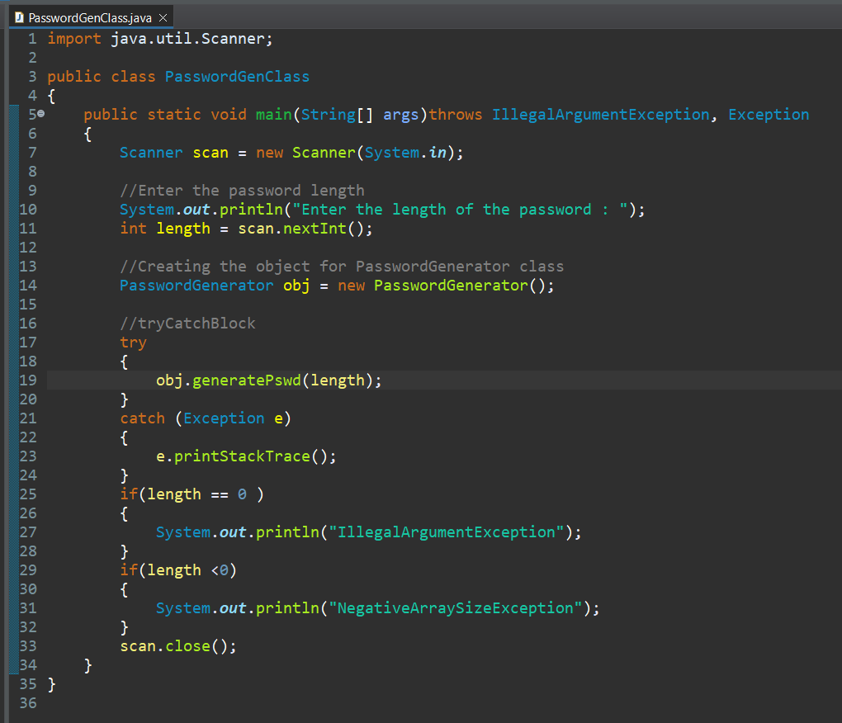
CODE
Main Class name :
“PasswordGenClass.java”

Slide 7
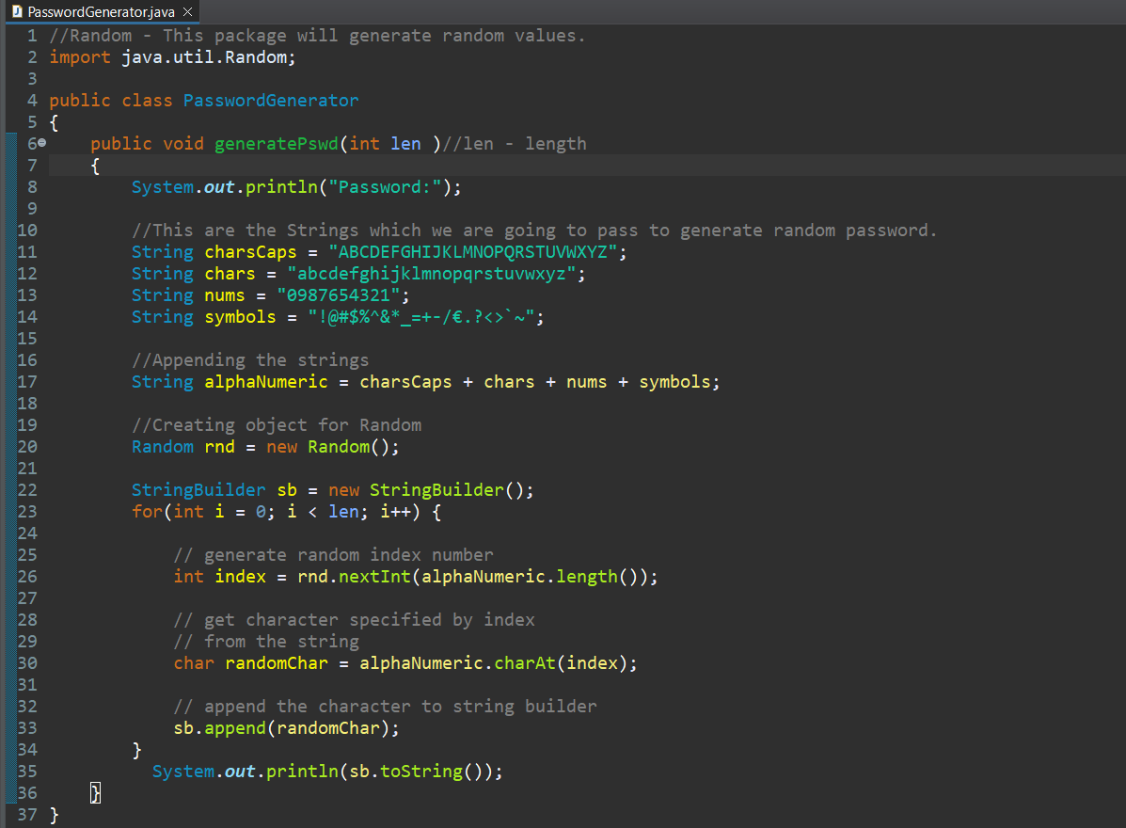
Class name :
“PasswordGenerator.java”
This is using this “StringBuilder”.
From 22 line upto 35 lines –First type snippet.

Slide 8
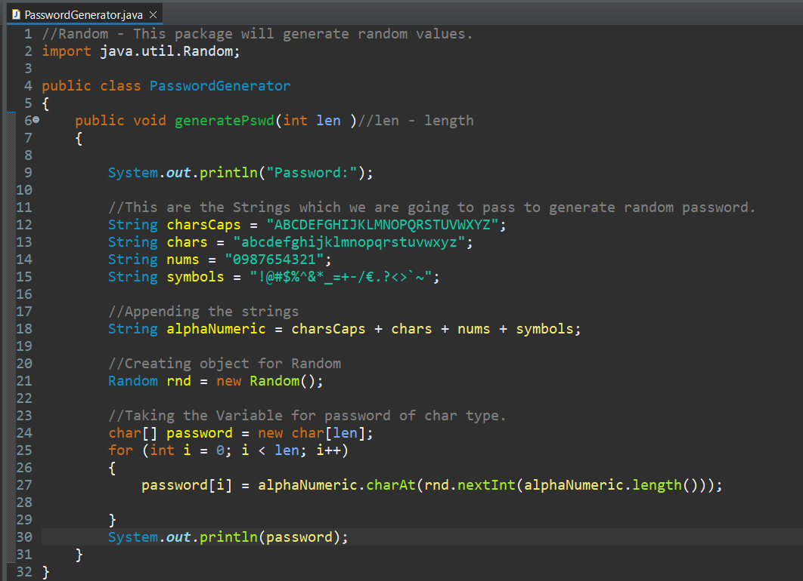
In this from 23 line to 30 line.
This another type of snippet.

Slide 9
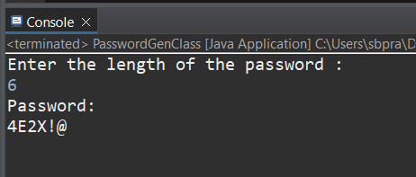
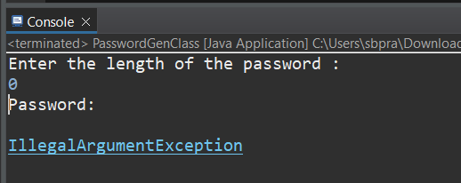
OUTPUT

Slide 10
THANK YOU!

