Slide 1

JavaScript Project Presentation
Project Title: [Personal To-Do List Manager]
Course: JavaScript / Web Development Project
Student Name & Roll No: [Akshitha N & 24BIT005]
Department: Information Technology
Mentor / Guide: [Name & Designation]

Slide 2
Introduction
A smart and colorful web-based To-Do List web app.
Helps users add, edit, delete, and track tasks easily.
Encourages productivity through features like voice commands and streak tracking.
Built using HTML, CSS, and JavaScript.

Slide 3
Problem Statement
People often forget or skip daily tasks due to poor planning.
Manual lists are boring and not interactive.
Hard to track progress or priorities using paper or static apps.
Our app solves this with smart reminders, streaks, and AI tools.

Slide 4
Tools & Technologies Used
Languages: HTML, CSS, JavaScript
Storage: LocalStorage (browser-based)
Editor: Visual Studio Code
Browser: Google Chrome ,Edge

Slide 5
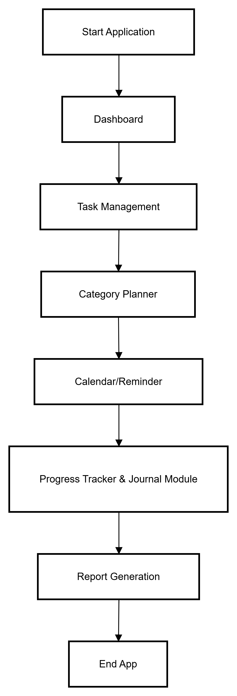

System Design

Slide 6
Module Description
1. Dashboard / Home: Shows total, completed, and pending tasks with quotes.
2. Task Management: Add, edit, delete, and filter tasks with priorities.
3. Category / Planner: Organize tasks under custom categories.
4. Reminder & Calendar: Alerts for due dates and deadlines.
5. Notes / Progress Tracker: Write notes and view progress visually.

Slide 7
Core Logic & Algorithm
User adds a new task (input through text ).
JavaScript validates the task and saves it to LocalStorage.
Task is displayed instantly on the dashboard using DOM updates.
User can edit, delete, or mark as complete — changes update in real-time.
Progress and streaks are calculated based on completed tasks.

Slide 8
Implementation
HTML builds the structure of pages (dashboard, tasks, reports).
CSS adds colorful, light/dark mode designs.
JavaScript handles all task logic, events, and reminders.
LocalStorage keeps user data even after page refresh.

Slide 9
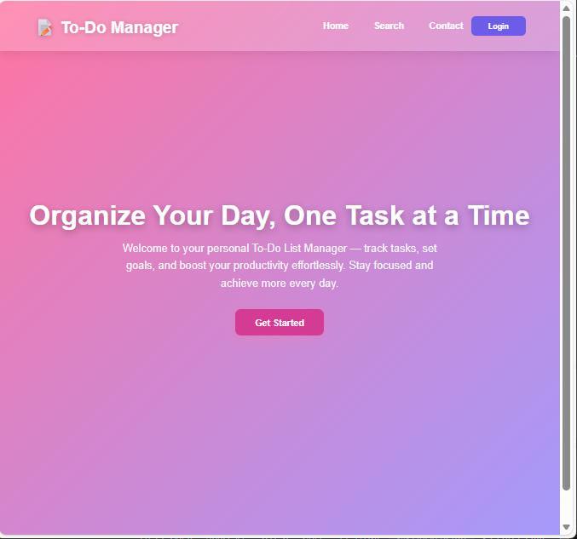
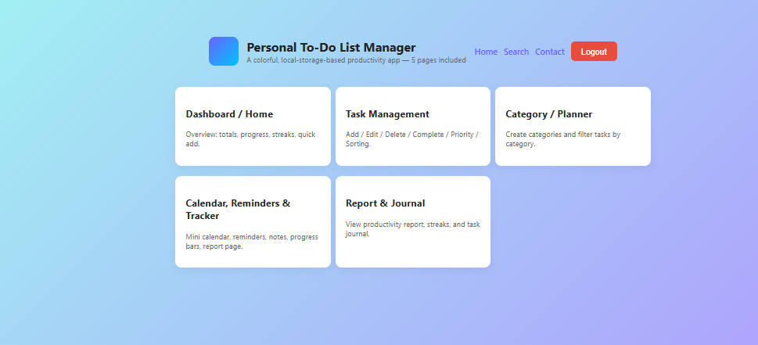
Output Screens

Slide 10
Conclusion & Future Scope
Conclusion: The app helps users stay organized and complete tasks efficiently while maintaining consistency through streak tracking and motivation.
Future Scope:
• Add cloud or database storage for permanent saving.
• Build mobile app version
•Add group task sharing and AI planner suggestions.

Slide 11
References / Acknowledgement
References:
Mozilla Developer Network (MDN)
W3Schools – JavaScript & Web Docs
Stack Overflow – Problem Solutions
Online JavaScript Tutorials
Acknowledgment:
Faculty and mentors for their constant support.
Team members for contribution and coordination.
Online communities for guidance and ideas.

Slide 12
Thank You
Questions & Discussion
[“Don’t just manage your tasks — design your day.”]

