Slide 1
Sales Analysis Dashboard
Data Analytics Internship Task-2

Slide 2
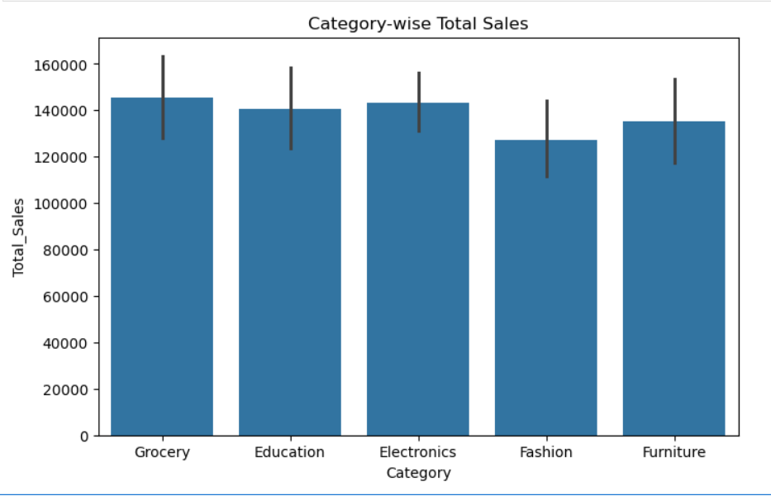
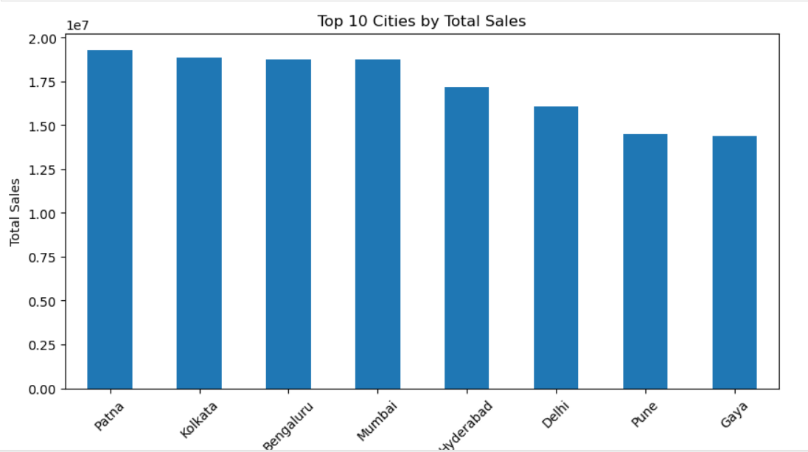
Static Business Dashboard
Total Revenue
139,399,439.65
Total Orders
992
Average Order Value
139,399.44
Top Category
Electronics
Top City
Patna
Total Revenue: 139.39 Million Total Orders: 992
Electronics is the highest-selling category.
Patna generated the highest revenue.
Fashion has the lowest sales among all categories.

